Slide 1


Instructions for the
Recipe Manager
INTERNATIONAL AGENCY FOR RESEARCH ON CANCER LYON - FRANCE
e-SMP

Slide 2

Introduction
Mixed recipes
Ingredients
Specific rules to enter recipes
Use of Recipe Manager – Databases menu
Use of Recipe Manager – Recipe list menu
Recipe Manager
IARC, Lyon - France

Slide 3

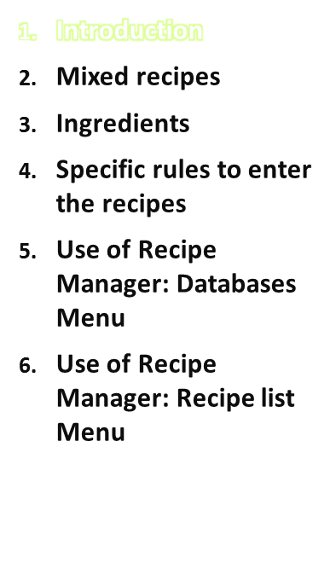
Objective:
To train on how to enter standard “mixed” recipes into the country’s parameters database using the Recipe Manager application
EPIC-Soft training:
IARC, Lyon - France

Slide 4


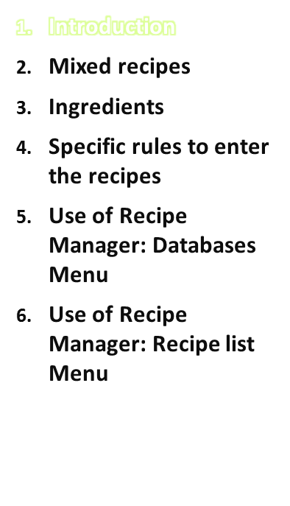
Two main pathways in GloboDiet
  Food pathway
  Recipe pathway
The same sequence of events during the interview (search, description, quantification, probe)
Selected Quick List Item
Food Pathway
Mixed Recipe
Pathway
Automatic search
Found in the food list ?
Found in the recipe list ?
Recipe Manager
IARC, Lyon - France

Slide 5
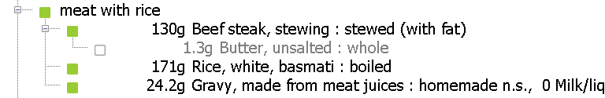
Food pathway - Composed recipes
Definition: its different ingredients can be identified and quantified separately after preparation (e.g. meat balls in sauce, rice with sauce, couscous dish, mixed salad) or just before mixing (e.g. coffee with milk).
This implies that proportions can easily vary between subjects (meat eaters vs. rice eaters) and quantification methods are used for each ‘ingredient’.
Recipe manager
IARC, Lyon - France

Slide 6
Food pathway - Composed recipes
A composed recipe should be used even when some ingredients such as fat, sauce or sweetener cannot be quantified. Standard percentages (PCTFSS) are in GloboDiet, and the possibility to have standard portions (e.g. for cheese or tuna) to be used to compose a mixed salad
→ to be planned when preparing local data (FDSTD)
Composed recipes are created during the interview. All the ingredients of the recipe are described and quantified separately, as were consumed by the subject.
Recipe Manager
IARC, Lyon - France

Slide 7
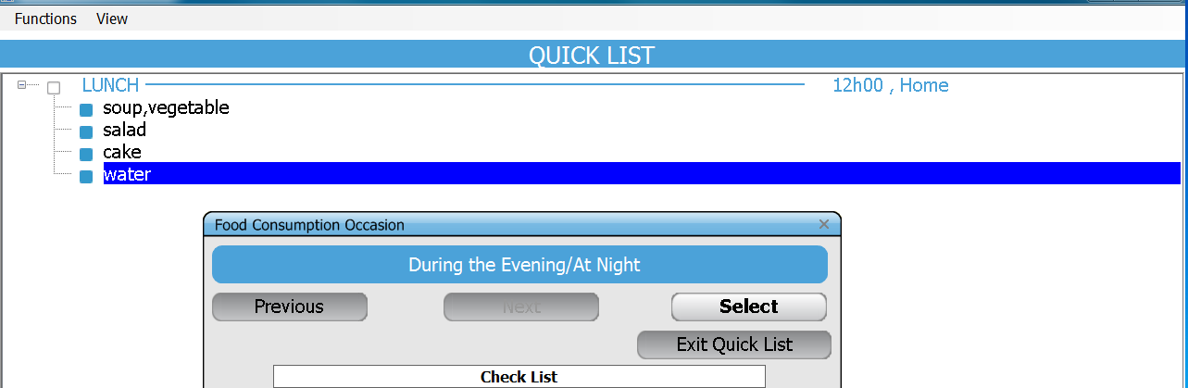
Practice #1
Open your food version
Choose “new interview”
Choose an interviewer from the list
Enter the interviewee information, the recalled day information
In the quick list:
Recipe manager
IARC, Lyon - France

Slide 8
Practice #1 (cont’d)
Exit from Quick list – no dietary supplement
Choose a vegetable soup from your food list, describe it and quantify it
Create a salad with lettuce, tomato, cucumber and salad dressing. The subject can quantify all ingredients but the dressing
Choose a cake from your food list, describe it and quantify it
Choose tap water from your food list, describe it and quantify it
Recipe manager
IARC, Lyon - France

Slide 9
Practice #1 (cont’d)
→discover your version:
Choose a food: see how to select (several options), describe (guided) and to quantify (several choices)
Create a composed recipe:
      Select each ingredient (here from the food list only, but it can be a recipe)
      Describe each ingredient
      Quantify each ingredient using photos/help photos/hhm/?
Use the association table (method “?”)
Recipe manager
IARC, Lyon - France

Slide 10
Recipe pathway - Mixed recipes
Recipes where, after preparation, the different ingredients cannot be identified and quantified separately
The ingredient proportions are stable whatever the serving size
A unique quantification method is used for quantification.
It is not possible to enter only a single ingredient in a mixed recipe (or a cooked food = ‘food’ + ‘salt/fat’).
They are entered as standard recipes with the RECIPE MANAGER and handled at the country level prior to the commencement of the interviews.
Recipe Manager
Notes:
May need to clarify “proportions are stable” – meaning that they are not modifiable by the subject at consumption since all ingredients set or mixed in
May need to modify “ingredients cannot be identified and quantified separately”…as this is not the case for known recipes. Should say that “ingredients as consumed cannot be quantified separately” since they are already mixed in. The recipe is quantified as a unit – i.e. unique/singe quantification method is used by the subject to say how much was consumed

Slide 11
Recipe pathway - Mixed recipes
There are several types of mixed recipes:
  OPEN: may be homemade or not.
  If homemade, may be known or not.
  OPEN WITH BRAND
  CLOSED: may be homemade or not
  CLOSED WITH BRAND
  STRICTLY COMMERCIAL WITH BRAND
  Substitute, Add, Delete
  Substitute
-
There are two types of ingredients of mixed recipes:
FIXED: cannot be replaced or re-described during the interview.
SUBSTITUTABLE: can be replaced or re-described during the interview
→ the recipe is more flexible
Recipe Manager
IARC, Lyon - France

Slide 12
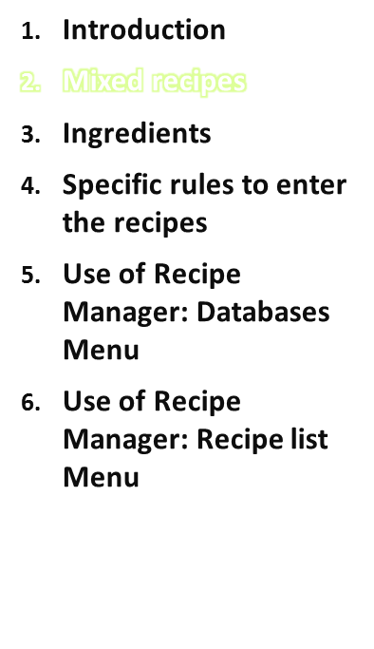
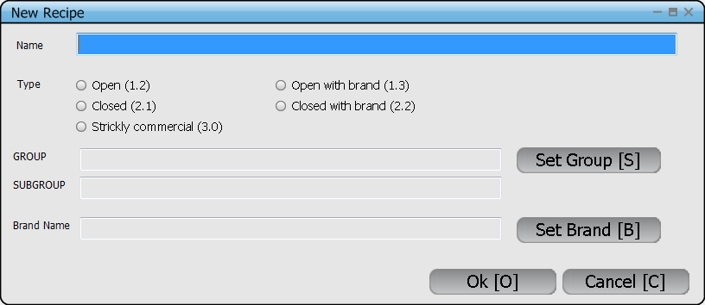
Before entering a recipe into the Recipe Manager, you need to define
1- its Name
2- its Type
3- its Classification
4- its Brand name, if applicable
Recipe Manager
IARC, Lyon - France

Slide 13
Mixed recipes
1- Name
For the search, think of the alphabetical order, like for foods.
To shorten the list, think of the possibility of substitutions of ingredients, if the proportions of ingredients are stable.
NB: it is possible to enter several standard variations of a recipe depending on regions. E.g. Local recipe (North)
For example:
- Pizza, tomato and cheese
- Pizza, tomato, ham, mushrooms, cheese…
- Stew, meat (substitute beef, by pork, veal…)
- Stew, fish
Recipe Manager
IARC, Lyon - France

Slide 14
Mixed recipes
2- its Classification
Based on the main ingredient usually
All sweet recipes are in group 08; sub-groups allow further classification based on the main ingredient
Recipe groups (# sub-groups)
01 Based on meat and meat products (6) 06 Mixed beverages (0)
02 Based on fish and crustaceans/molluscs (3) 07 Soups (6)
03 Based on egg (0) 08 Sweet recipes (5)
04 Based on cereal and cereal products (6) 09 Sauces (0)
05 Based on vegetables (incl. potatoes) (5) 10 Other (0)
Recipe Manager
IARC, Lyon - France
Notes:
Should we mention that also salads are a separate recipe subgroups in group 05 (Based on vegetables)?

Slide 15
Mixed recipes
3- its Type
Based on information on the expected variation of ingredients within the study population
If the variation is found to be great, the recipe should be treated as an OPEN recipe. Additions, deletions and substitutions of ingredients are possible during the interview.
Recipes which are usually homemade and which in turn vary from one family to another
If no variations are expected, a recipe should be treated as a CLOSED recipe or as a strictly commercial recipe.
  For CLOSED recipes, substitutions of ingredients are possible – useful to specify the type of fat, of milk, of meat, of vegetable…
  For STRICTLY COMMERCIAL recipes, no check of ingredients will be proposed during the interview (expected to be unknown).
Recipe Manager
IARC, Lyon - France

Slide 16
Mixed recipes
4- its Brand name
For OPEN, CLOSED and STRICTLY COMMERCIAL recipes, a specific brand can be linked to the recipe.
Note that during the interview, if the recipe is described as commercial, the name of the brand name of the recipe eaten by the subject is asked (and maybe different from that entered in the Recipe Manager)
Recipe Manager
IARC, Lyon - France

Slide 17
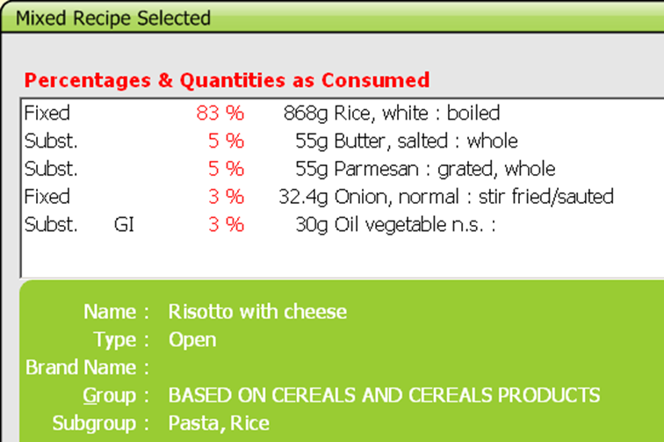
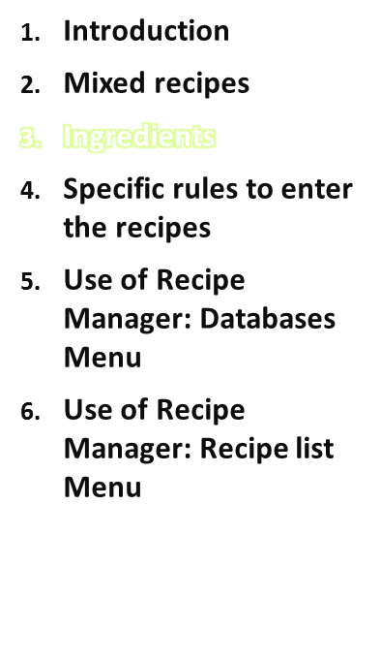
Fixed ingredients - cannot be replaced or re-described during the interview.
Substitutable ingredients - can be replaced or re-described during the interview → the recipe is more flexible
Recipe Manager
IARC, Lyon - France

Slide 18

Ingredients
SUBSTITUTABLE→ allow individual specification during the interview
Ingredients which are likely to be replaced within the same food group/subgroup so that the recipe becomes more flexible (for example meat cut, fish, vegetable).
Generic ingredients (GI), i.e. food items appearing with ‘n.s.’ in the food list
All sauces, fats and dairy creams (oil n.s.)
All ingredients with at least one ‘undefined’ descriptor (descriptor 00) as they need to be re-described with the interviewee
Ingredients with facets 12 Brandname, 13 Skin consumed, 14 Visible fat consumed, 15 Type of milk/liquid used or 16 Type of fat used as their descriptors are changed frequently by subjects.
Recipe manager
IARC, Lyon - France

Slide 19
Ingredients
Some restrictions apply to substitutions.
1.) The quantity of substitutable ingredients cannot be changed.
2.) Substitution rules are decided for each study by the coordinator.
(File SUBSTIT handled by IARC). The substitution is limited to either the food group level, or the sub-group level, or the sub-sub-group level. For foods in some specific groups/subgroups no substitution is allowed at all.
Examples:
- Milk (0501) may be substituted by items of groups 1300 Unclassified non alcoholic beverages, 1304 Waters, 1602 Bouillons, 0502 Milk substitutes, 0507 Creams
- Butter (1002) may be substituted by any fat (group 10 + 0507 Creams)
- Any vegetable (group 02) by any vegetable, any fruit (group 04) by any fruit
Recipe manager
IARC, Lyon - France

Slide 20
Ingredients
Fixed → not checked during the interview. Which means that not only the food item cannot be changed, but also its description (including the cooking method, fat content…)
If there is no replacement foreseen, such as e.g. spices
If the ingredient has low nutritional impact , e.g. stock cubes
If the descriptors of an ingredient are not likely to vary, e.g. egg
Often, if ingredient appears in the name of the recipe (standard recipe with low variation)
All the ingredients in STRICTLY COMMERCIAL RECIPES
NB: Some ingredients are automatically set to ‘fixed’ by the RECIPE MANAGER because of their description which has a direct link with quantification (for example, powdered ↔ liquid)
Recipe manager
IARC, Lyon - France

Slide 21
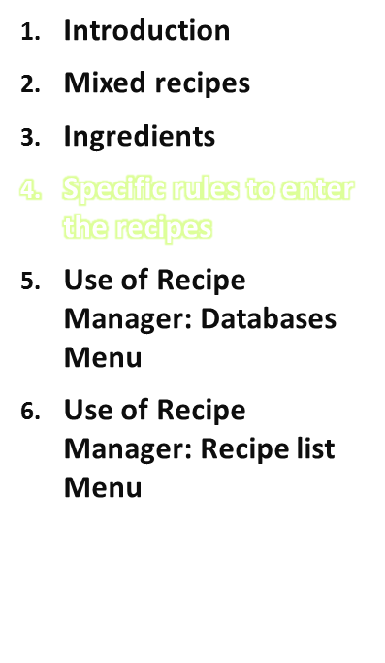
→Follow the GloboDiet methodology
Recipes can be entered for any number of persons/portions – use ‘recipe book-type’ recipes. It is preferable to enter a recipe for more than one person in order to quantify more accurately ingredients of very small quantities.
The actual portion of the recipe consumed by the subject is recorded during the interview.
Added ingredients (if allowed) will be quantified on the consumed-portion basis and included into this portion (for example a piece of Pizza A + 3 black olives and a slice of bacon – same final portion weight).
Recipe Manager
IARC, Lyon - France

Slide 22
Choice of the ingredients
Fat (used for cooking) should be entered as a single ingredient per recipe. Exceptions are deep fried foods, for which the fat absorbed during deep-frying should not be listed as an ingredient as it will be handled/calculated automatically by the RECIPE MANAGER.
As specific as possible, for example if most of the milk is UHT half-skimmed milk from cow, it is wise to describe it this way but set it as substitutable. Generic ingredients are entered only if these ingredients may vary considerably or if they are often unknown. They should be substitutable.
Any liquid (including water, broth/stock, milk, etc.) used to cook (and rehydrate) dried food items such as pasta, rice, legumes or mushrooms should not be counted twice: the GloboDiet raw-to-cooked coefficient of these items takes water uptake into account, so do not list that liquid as a separate ingredient.
→ Use stock cube, powdered milk … instead of liquids.
Recipe manager
IARC, Lyon - France

Slide 23
Choice of the ingredients (cont’d)
For salads, avoid entering the dressing sauce for those salads where the subject normally puts the dressing on by him/herself.
You may omit ingredients of very small thus insignificant quantities (e.g. spices – not assessed in a systematic way in 24Hrecalls). Project-specific decision.
Complex foods, such as cakes, biscuits, dough, fruit salads, desserts, soups, sauces, some snacks, and battered (breaded) foods, should be used as such: do not enter recipes for them. Substitutions are eased by using this approach (e.g. sauce, dough of a quiche).
Whenever relevant, use two lines to allow partial substitution of an ingredient, e.g. instead of 200 g cream, enter twice 100 g of cream so that 100 g of cream can be replaced by milk or yogurt.
Recipe manager
IARC, Lyon - France

Slide 24

Choice of the ingredient description
For each ingredient, enter in the facet ‘cooking method’ the FATTIEST cooking method used, even if the final cooking method for the whole recipe may differ. For example, if fresh onions were pan fried before they were put to cook in a stew, the cooking method entered should be "pan fried" for the onions. Note that still, the onions can be quantified as raw.
For mixed purees, describe all ingredients as ‘flesh’, not as ‘pureed’ nor ‘reconstituted from powder’ (since these have facets 15 and 16 asking for type of fat and liquid used) to avoid ‘listing’ liquid and fat twice.
Recipe manager
IARC, Lyon - France

Slide 25
Ingredient quantification issues
Preferably enter ingredient quantities in g or ml (or use household measures or standard units for e.g. onion). Do not use photos, nor leave ingredients with unknown quantities, even for commercial recipes. If any recipe ingredient has a missing quantity, the recipe will have a status of unfinished and therefore will not be uploaded to the country-specific recipe database of the GloboDiet application.
Enter quantities as raw, with waste (more practical in case of substitutions to apply food-specific coefficients – EDIB,RAWCOOK, DENSITY).
For casseroles, stews or soups in which some water evaporates, the FINAL (after evaporation) liquid quantity should be entered as there is no raw-to-cooked coefficient for liquids, knowing that this amount of water can only be crudely estimated (roughly about 20% evaporated during 2hrs of cooking). This means that the amount of liquid that may have evaporated during long cooking processes should be subtracted from the total original used (e.g. the amount of water after cooking a soup should be entered as an ingredient). Bergström, 1994 EUROFOODS;McC&W recipes
Recipe manager
IARC, Lyon - France

Slide 26
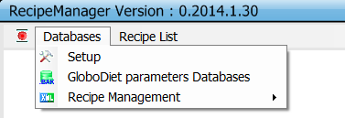
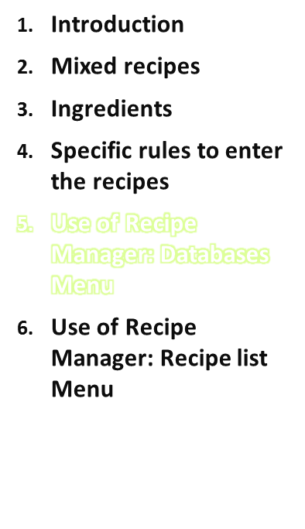
Setup
Allows to set British units
GloboDiet parameters Databases
Allows to select, restore or remove a GloboDiet database. Functions are the same as in the GloboDiet or DataEntry application.
Useful when an update of GD database (e.g. food list) has been made or to switch between languages.
Recipe Management (details follow)
Recipe Manager
IARC, Lyon - France

Slide 27
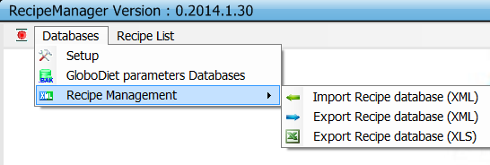
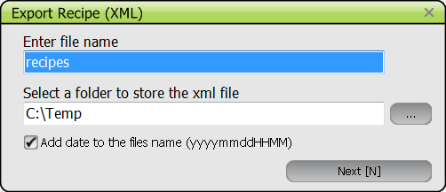
Recipe Management
Allows the handling of recipe databases (recipe list and related ingredient information) from a computer to another
XML files are used by GloboDiet, Recipe Manager and Interview Manager applications
XLS files are provided for country internal use
Recipe manager
IARC, Lyon - France

Slide 28
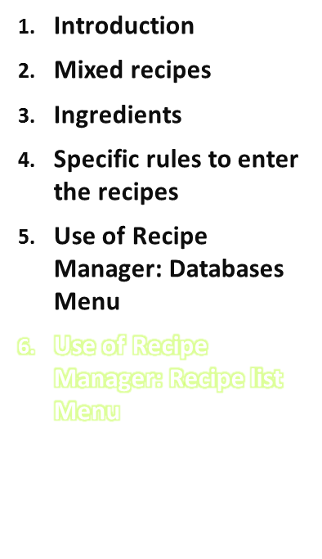
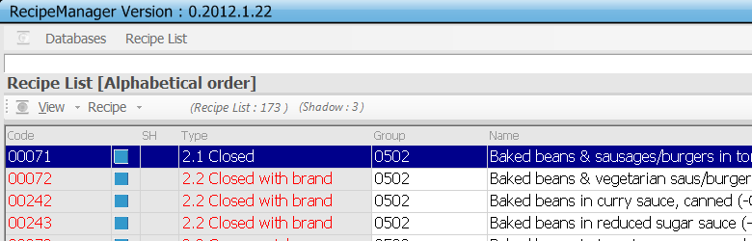
By clicking on ‘Recipe list’ on the top menu bar, the list of entered recipes is provided.
By default, recipes are listed alphabetically.
The recipes may be sorted by clicking on the heading of the columns:
  by recipe code by clicking on the header ‘Code’,
  by recipe type by clicking on ‘Type’,
  by recipe classification by clicking on ‘Group’,
  alphabetically by clicking on ‘Name’.
  Shadow recipes may be grouped by clicking on the header ‘SH’.
Recipe Manager
IARC, Lyon - France

Slide 29
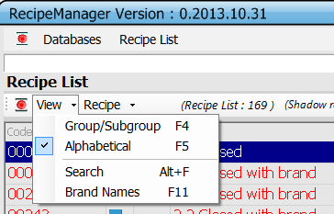
View menu
To search an existing recipe, type its name. Alphabetical search.
As in GloboDiet, the search of the recipe may alternatively be done by searching based on Group/Subgroup (F4) or Search on string (Alt + F).
Brand Name (F11): if selected (ticked) this displays a modified recipe list where the brand names are listed in front of the recipe names, instead of after the name as in the normal recipe list.
Recipe manager
IARC, Lyon - France

Slide 30
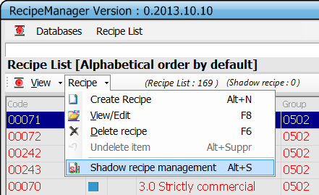
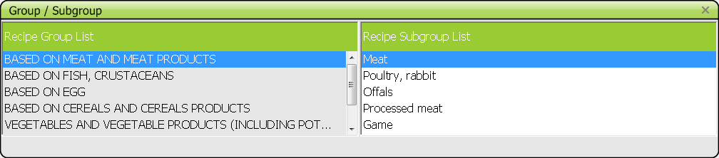
Recipe menu – Create recipe
Create: two steps:
1- provide general info on the recipe (name, type, classification and brand)
2- provide specific info on its ingredients (name, description, quantification) in the Recipe ingredient manager screen
Recipe manager
IARC, Lyon - France

Slide 31
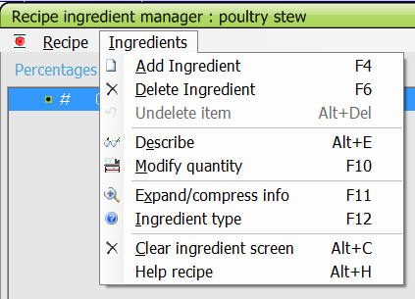
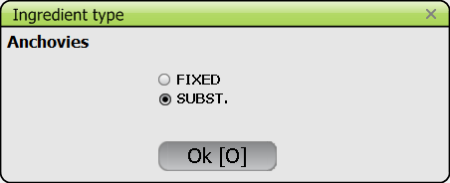
Recipe ingredient manager- Creation
To fill in the recipe, you need to select, describe and quantify each ingredient :
→select ‘Add ingredient (F4)’
Then choose one from the food list, describe and quantify it following the provided instructions (in Recipe Manager user manual and previous slides).
Then Indicate whether
fixed or substitutable:
Note that when the cursor is on an ingredient ,‘return’ enables to re-describe, quantify the ingredient or change its type.
Recipe manager
IARC, Lyon - France

Slide 32
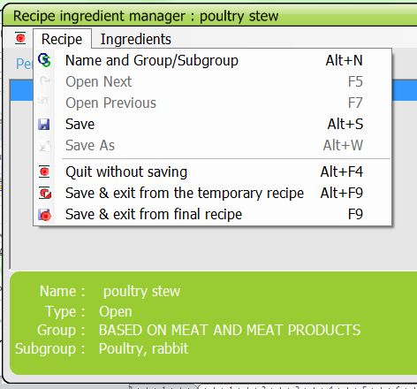
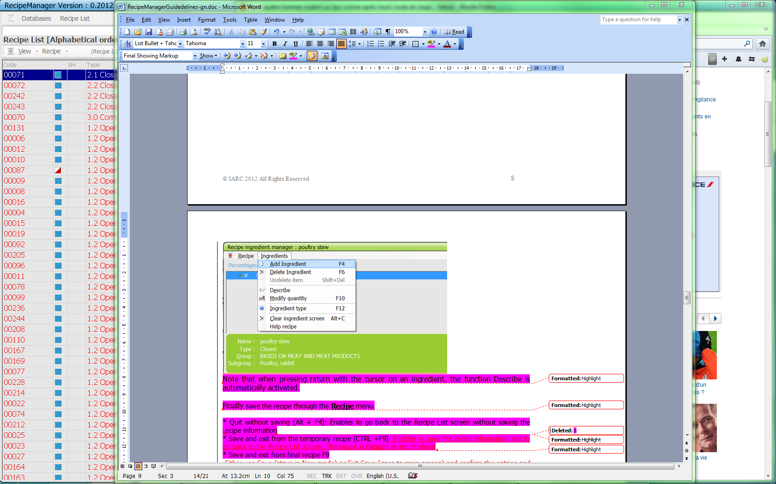
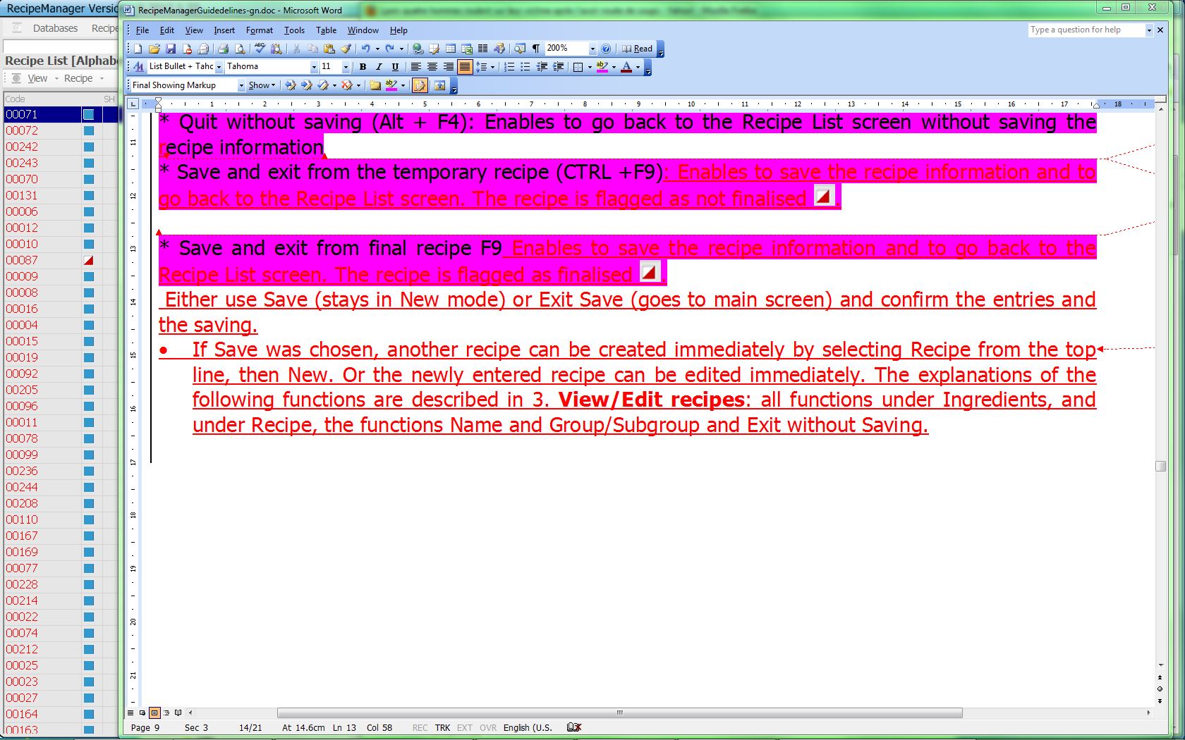
Recipe ingredient manager - Creation
Then
Save the recipe
* Save (Alt +S): you remain in the recipe ing. manager screen
* Quit without saving (Alt + F4): back to the Recipe List screen without saving
* Save and exit from the temporary recipe (Alt + F9): Enables to save the recipe information and to go back to
the Recipe List screen. The recipe is flagged as not finalised :
* Save and exit from final recipe (F9): Enables to save the recipe information and to go back to the Recipe List screen. The recipe is flagged as finalised :
→Automatic coding by the Recipe Manager
Recipe manager
IARC, Lyon - France

Slide 33
Practice #2
Open the Recipe Manager
Check you have the correct database (language)
Create a recipe, e.g. Ross il-Forn (Baked Rice)
  In the Recipe list, menu Recipe, choose Create a recipe
  Enter the recipe information
  Enter the ingredients
  Choose whether fixed or substitutable
Recipe manager
IARC, Lyon - France

Slide 34
Practice #2 (cont’d)
Specific points to be checked:
Generic items cannot be fixed
Ingredients cooked with fat → ingredient fat
Legumes, rice, pasta → rehydration water not listed
Use of broth cube vs. liquid
No alcoholic beverages in cooked dish
Processed foods and fish products, not described as 03-99
Fish physical state: be careful
Battered/breaded items: described as “cooked” +batter ingredients OR as “battered/breaded”
Recipe manager
IARC, Lyon - France

Slide 35
Recipe menu - Edit
Edit:
A recipe must first be selected in the recipe list. Then you may either:
Double click on it
Choose ‘Edit’ in the Recipe menu
Right click then choose ‘Edit’ in the menu
Then
you access the Recipe ingredient manager screen, which allows you to view and change any information on the existing recipe.
Note that when selecting a shadow, the general information of the original recipe is displayed, not the name, group etc. of the shadow.
Recipe manager
IARC, Lyon - France

Slide 36
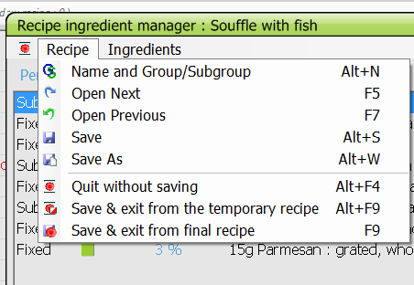
Recipe ingredient manager - Edition
Recipe menu
Name and group/subgroup (Alt+N):
update recipe name, type, classification and brand name. Confirm by OK, or Cancel.
Open Next (F5)/Previous (F7):
Open the next/previous recipe, in alphabetical order (not the
next higher code/previous lower code).
Save (Alt+S):
The previous entry is overwritten and the code remains the same.
Save as (Alt+W): This function can be used to copy a recipe.
The new recipe should first receive a modified name, type, classification and brand (this information is pre-filled). It will automatically receive a new code. You can then adapt the recipe as you wish.
Recipe manager
IARC, Lyon - France

Slide 37
Recipe ingredient manager - Edition
Ingredients menu
* Add Ingredient (F4)
* Delete Ingredient (F6): deleted after confirmation.
* Undelete Ingredient (Alt +Del): list all the items which have been deleted during the recipe editing. To undelete an item, set the cursor on this item and select ‘OK’. ‘Cancel’ enables to leave this window without modification.
* Describe (Alt+E): update the description and quantification of an ingredient.
* Modify Quantity (F10): modify the quantification only
* Ingredient type (F12): enables to change the type of the ingredient from fixed to substitutable and vice versa. Note that fixed ingredients of strictly commercial recipes cannot be changed.
Note that when the cursor is on an ingredient ,‘return’ enables to re-describe, quantify the ingredient or change its type.
Recipe manager
IARC, Lyon - France

Slide 38
Recipe ingredient manager – Edition (cont’d)
Ingredients menu (cont’d)
* Expand info (F11): For the selected ingredient, detailed information is displayed in a separate window [name, quantification as estimated and as consumed (including rawcook and edible coefficients), and its description]. Another ingredient is selected by moving the arrows. To leave this menu, select Ingredient from the top line, then Expand info again, or F11.
* Clear Screen (Alt + C): All ingredients are deleted if confirmed.
* Help recipe (Alt+H): as in GloboDiet, display a standard recipe chosen from the recipe list in a separate window (amounts are expressed as percentages as estimated and as consumed).
Recipe manager
IARC, Lyon - France

Slide 39
Recipe menu - Delete
Delete:
A recipe must first be selected in the recipe list. Then you may either:
Choose ‘Delete’ in the Recipe menu
Right click then choose ‘Delete’ in the menu
Then
the selected recipe is edited. After confirmation of the recipe, the question is asked on whether to delete it or not. If ‘OK’ is selected then the recipe is deleted; if ‘Cancel’ is selected, the recipe is kept.
Note that when deleting a recipe from the recipe list, all attached recipe shadows are automatically deleted.
Recipe manager
IARC, Lyon - France

Slide 40
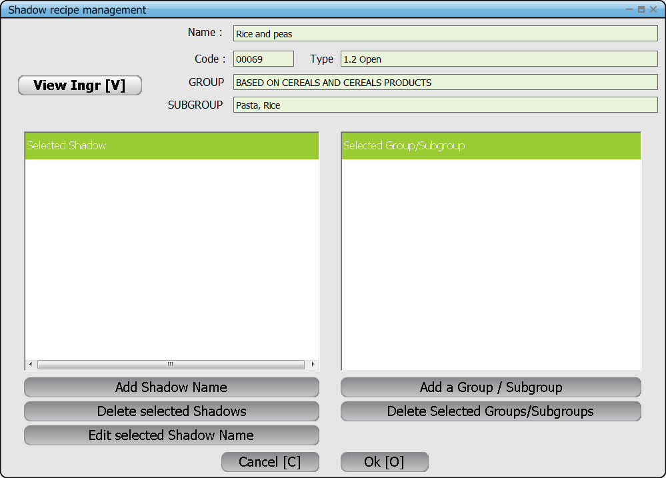
Recipe menu - Shadows
Like foods, recipes can also have synonym names and can be listed in another group or subgroup.
In the recipe list, shadows are marked by ‘SH’ after the code.
Recipe manager
IARC, Lyon - France

Slide 41
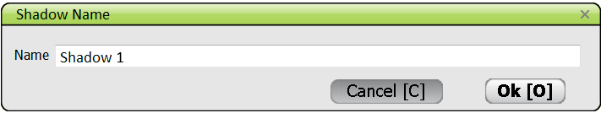
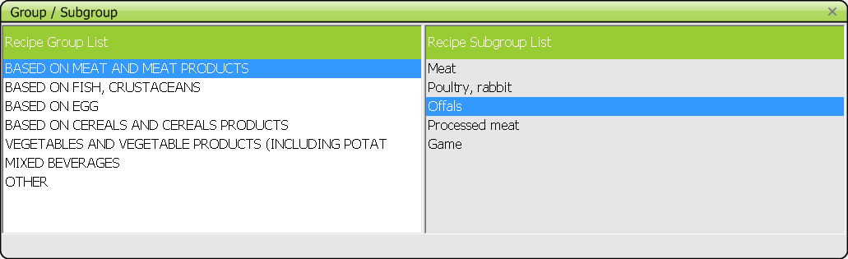
Shadow recipe management - Creation
Add shadow name
Add a Group/Subgroup
Recipe manager
IARC, Lyon - France

Slide 42
Shadow recipe management – Edit
Select from the list (left block) the shadow name to be edited/modified by setting the cursor on it
Click on ‘Edit selected Shadow name’
Modify the name and save with ‘OK’
Recipe manager
IARC, Lyon - France

Slide 43
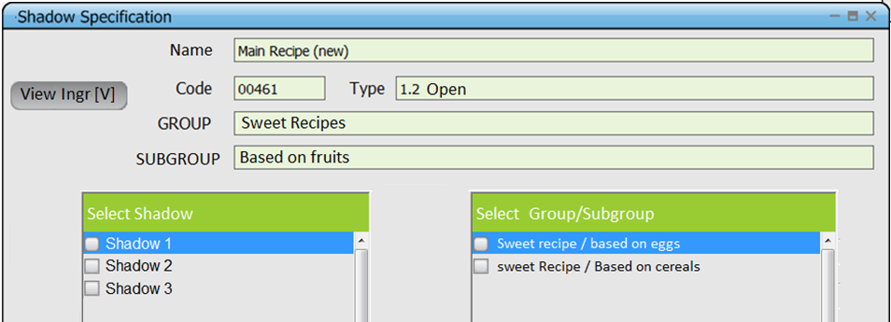
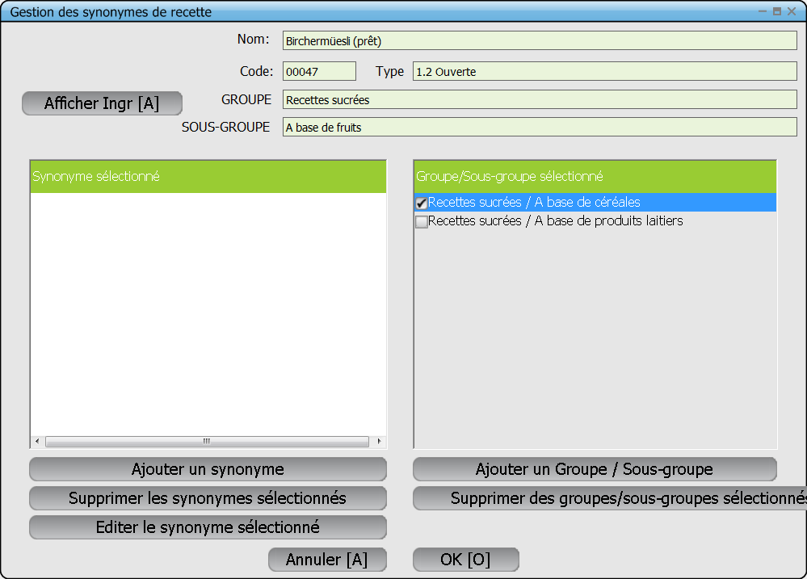
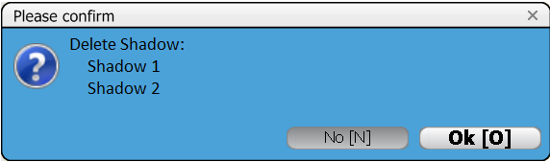
Shadow recipe management – Delete
Select the items to be deleted by ticking the corresponding boxes
Press the button(s) ‘Delete’
Confirm the deletion(s)
Recipe manager
IARC, Lyon - France

Slide 44
Shadow recipe management - close
Cancel: no changes will be taken into account AT ALL and the names will be as before you selected the function “Shadow recipe management”
OK : all the shadows items are newly created as defined in the two blocks of the pop-up “Shadow recipe management”
Back to the recipe list screen
Recipe manager
IARC, Lyon - France

Slide 45
Practice #3
Reclassify the recipe entered
  Recipe list, menu View, choose Name and group/subgroup
Use the existing recipe to create a new one
  Edit a recipe, then use Save as
Enter shadow names and alternative classifications
  Recipe list, menu Recipe, choose Shadow recipe management
Recipe manager
IARC, Lyon - France

Slide 46

Any question?
Recipe manager
IARC, Lyon - France

Slide 47
Organisation of the work for recipe entry
INTERNATIONAL AGENCY FOR RESEARCH ON CANCER LYON - FRANCE
e-SMP

Slide 48
Steps
Enter the general information of all the recipes (name, type, classification and brand) – use temporary save
Export in xml and send it to IARC
A. Enter the recipe ingredients for 10 recipes of different recipe groups
Export in xml and send it to IARC for checks
B. Start filling the recipe files RCPFACET, RCPQUANT, RCPPROBING, RCPPCTFSS, RCPDENSITY, RCPBRAND
A. Enter the recipe ingredients for the remaining recipes
B. Fill RCPSTDU and check RCPMAX
Recipe manager
IARC, Lyon - France

