Slide 1

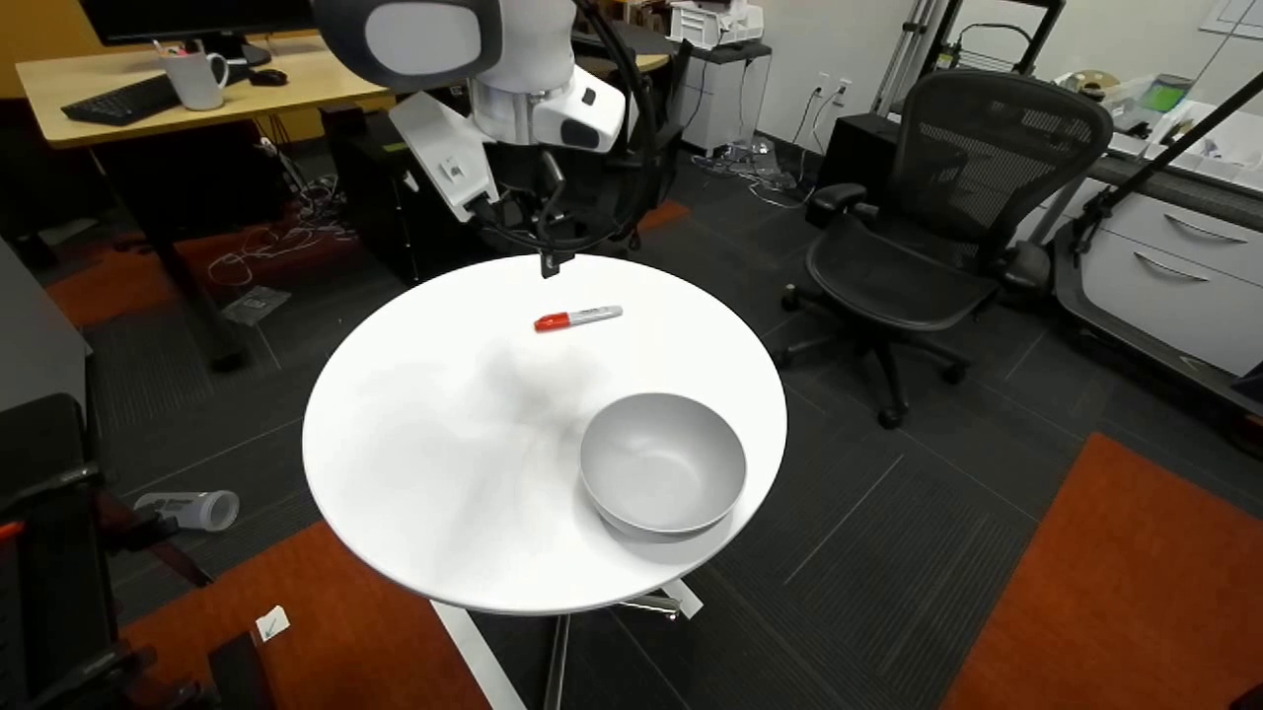
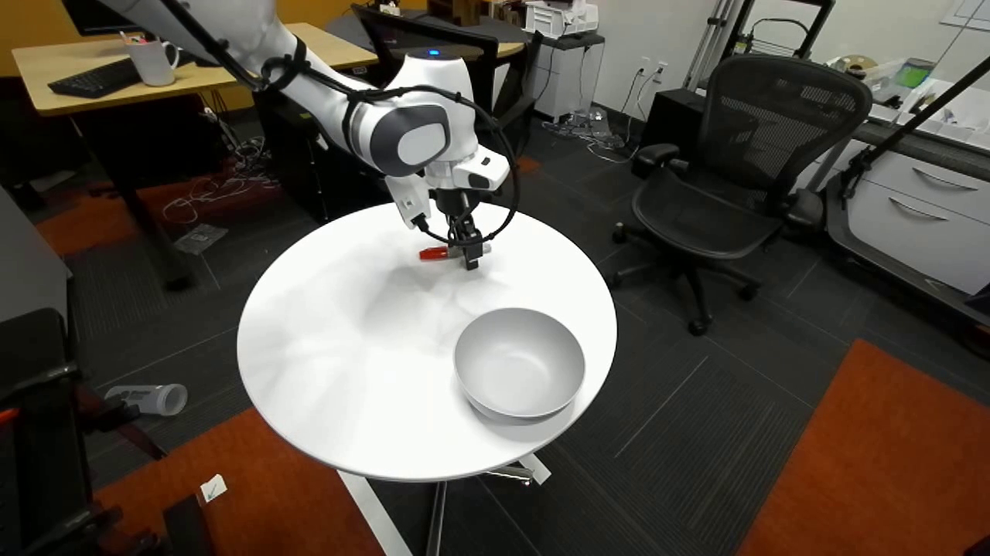
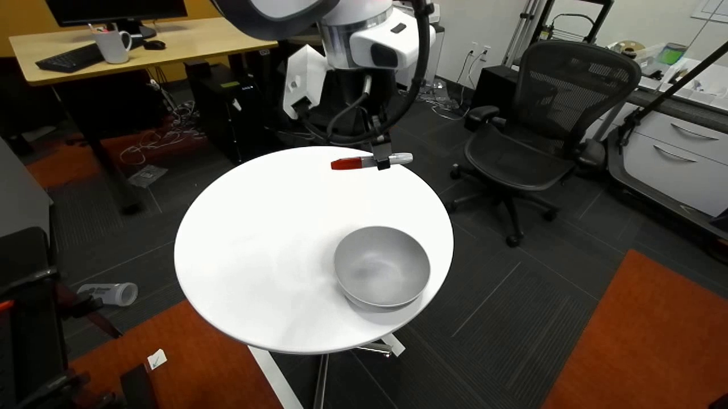
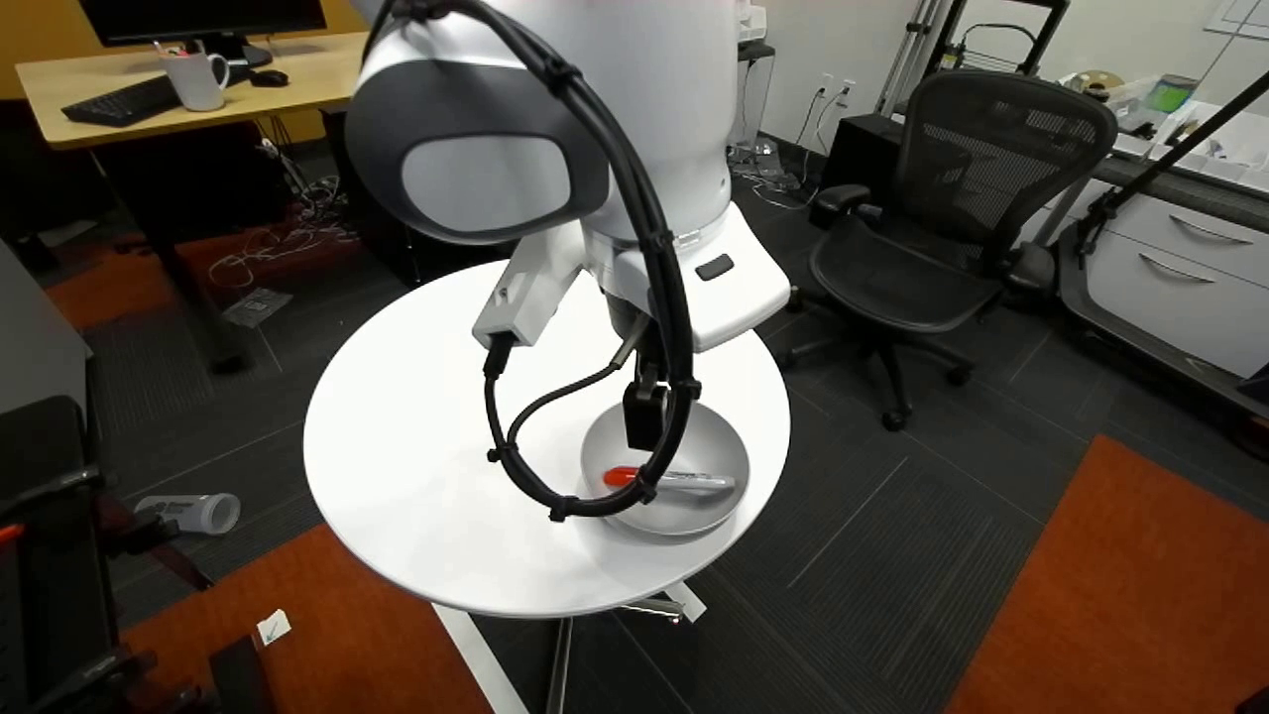
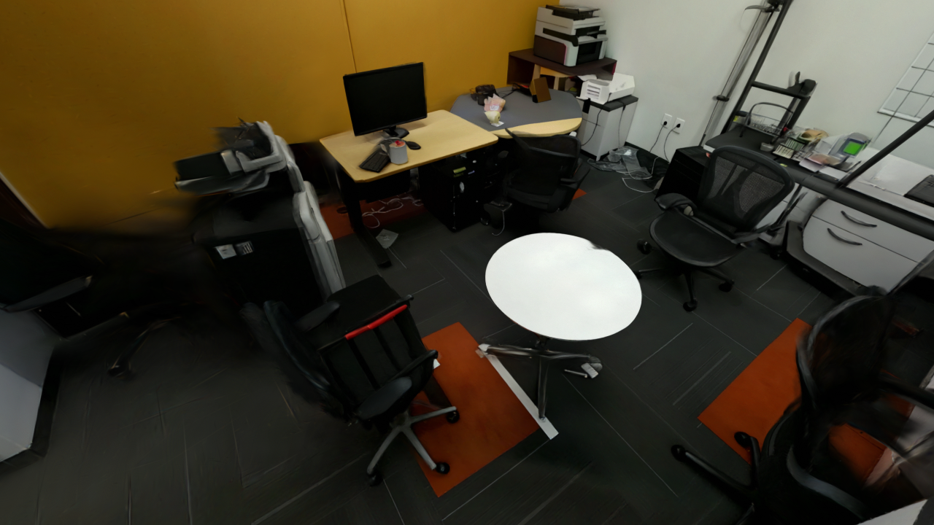
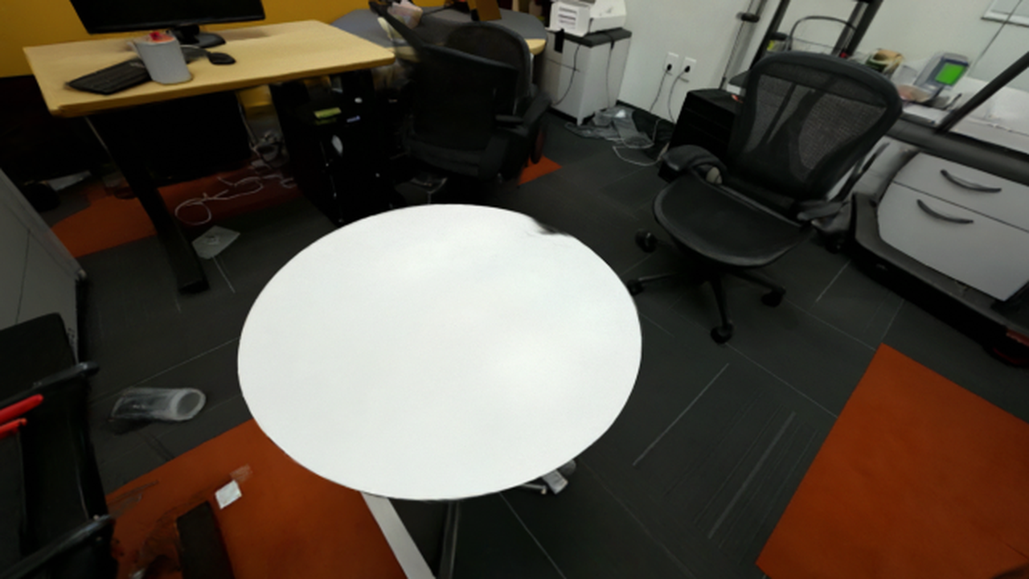
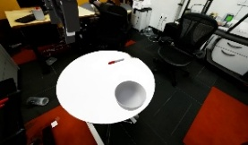



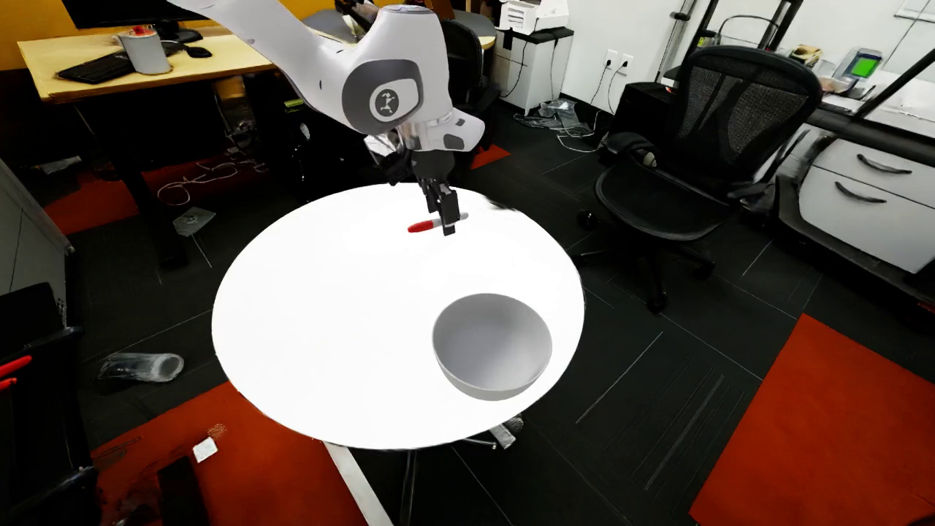






Agent Workspace
In-the-wild video
Router Agent Loop
EXPLORER
[VLM] Understand the scene: table, red marker, bowl.
[Plan] Decompose the task: reconstruct → align → simulate.
[Route] Delegate execution: invoke skills, verify results, and refine.
WorldMirror
“Put the red marker
inside the white bowl.”
static_scene_state/
Orchestrate
Coordinate
Agent-As-Tool
gaussian_scene
collision
Reconstruction Agent
Calibration Agent
Layout agent
Replay agent
clean_background
Object Generation
camera.json
Real observation
interactive_object_state/
red marker
bowl
objects
Editable object assets
Correspondence Initialization
6-DoF Pose
Optimization
Assembled
attributes.json
Scene Generation
Simulation scene
robot/T_camw.npy
T_camw_assembly.py
1
# assemble final scene
skills/
2
scene.add(red_marker, pose_red_marker)
3
scene.add(bowl, pose_bowl)
Camera-calib-judge
4
scene.set_camera(T_camw)
REPLAY SUCCESS!
Static scene
Pose Optimization
5
scene.save("scene.usdz")
Collider-fit
Scene-clean
if fails
Iteratively refine
docs/
Construction Skills Library
Verification-Guided Refinement
check_success/
result.json
Reconstruction
Judge
Layout
Judge
Replay
Judge
Meshy
Hunyuan3D
Nano Banana
Rodin
Image2ThreeJS
Marble
……
Notes:
[object Object]
Pastel colour variant: the user requested the palette of c2411feb-5c6d-4ada-928c-0957d61d9d7d.png. Dominant background colours sampled from that image are peach #FCEEE6, green #ECF6E7, blue #DFEBF7 and neutral #F8F8F8. These are applied to the existing tools, refinement-loop, workspace and reasoning panels. Headers and badges use darker related colours to keep text legible. All source wording, positions, sizes, icons, image bytes and existing directory additions are retained.
[Sources]
User-supplied c2411feb-5c6d-4ada-928c-0957d61d9d7d.png — palette reference only.
User-approved WorldMirror_Framework_Polished(2).pptx — complete composition, content and assets.
[/Sources]

