Slide 1




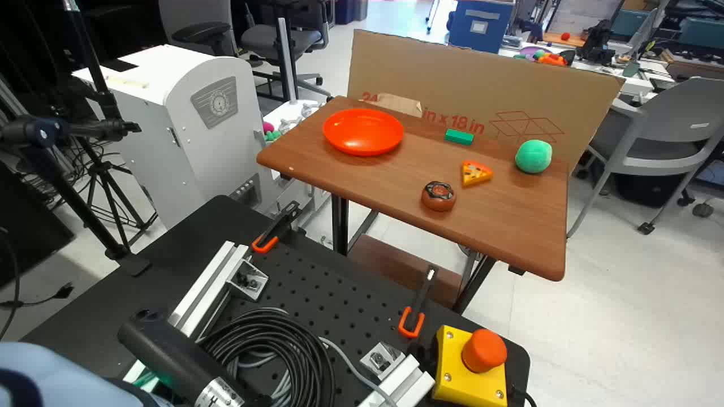
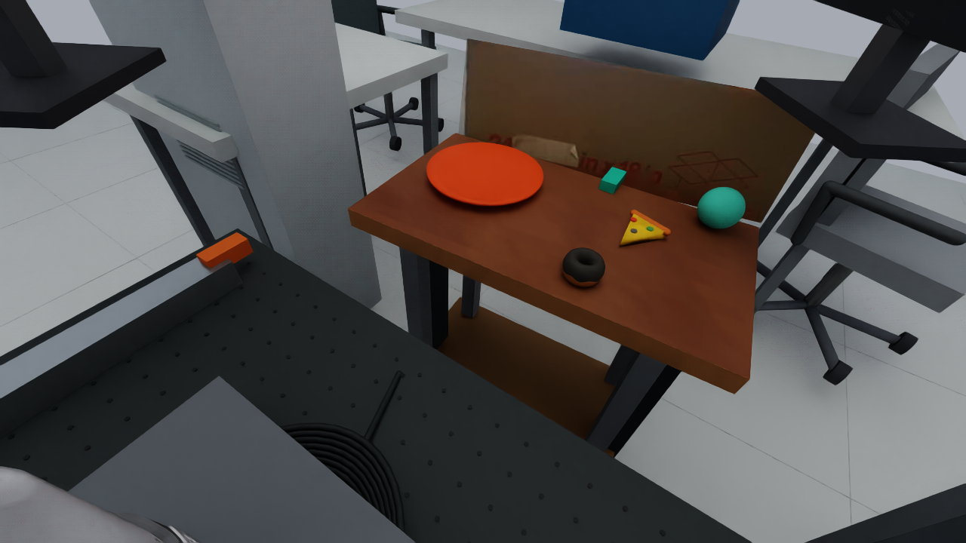
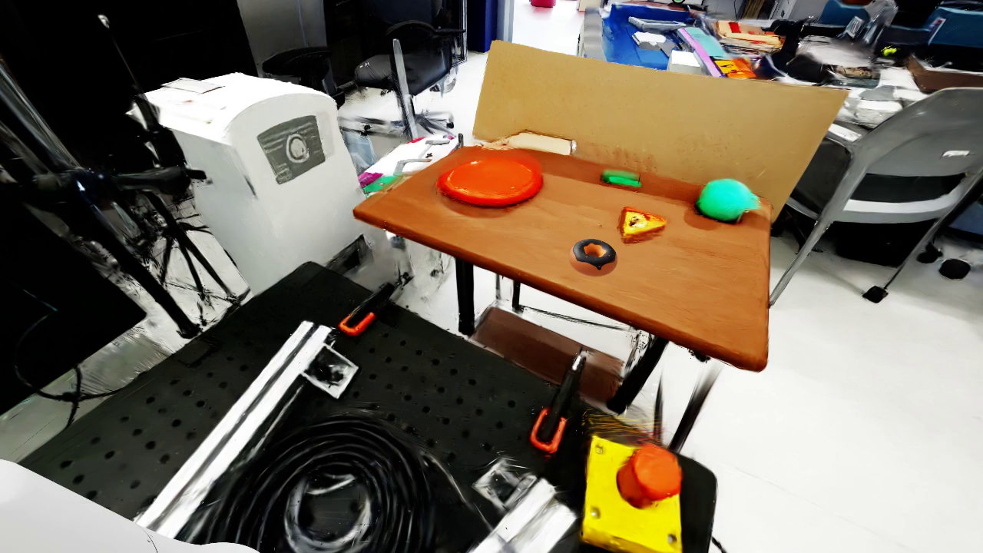

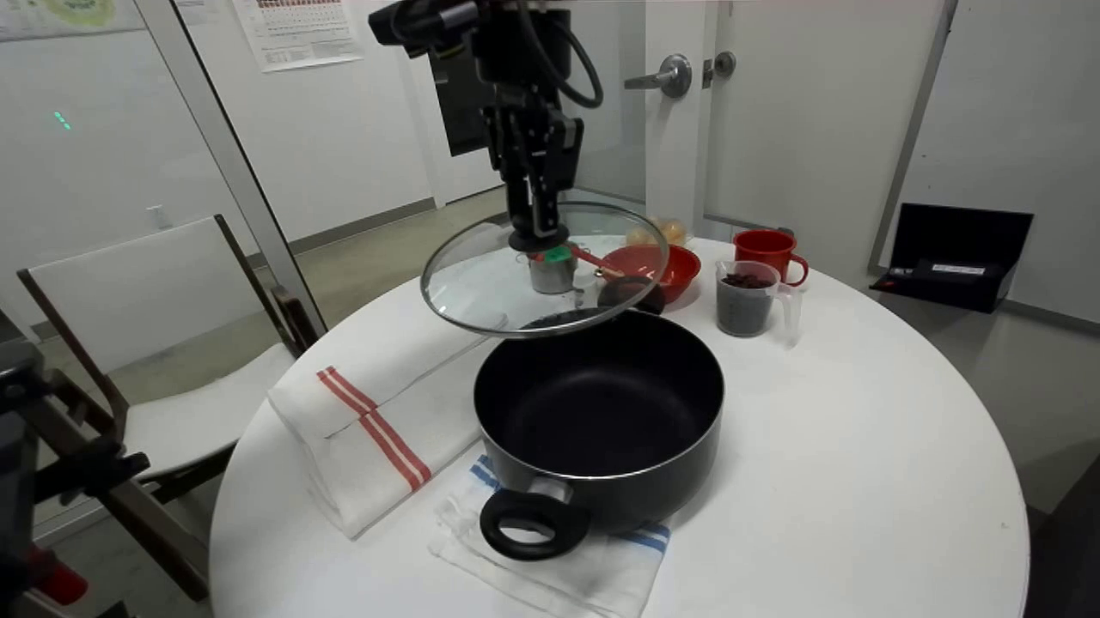
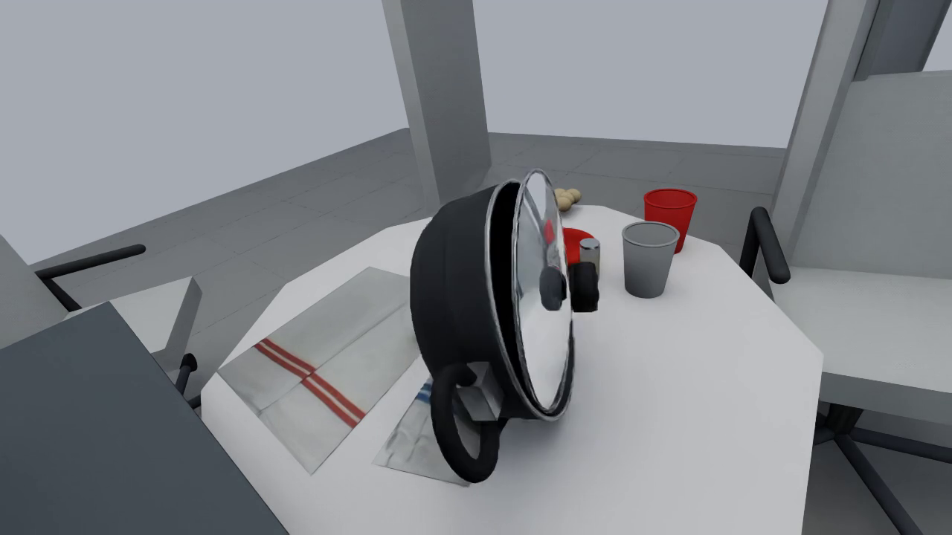
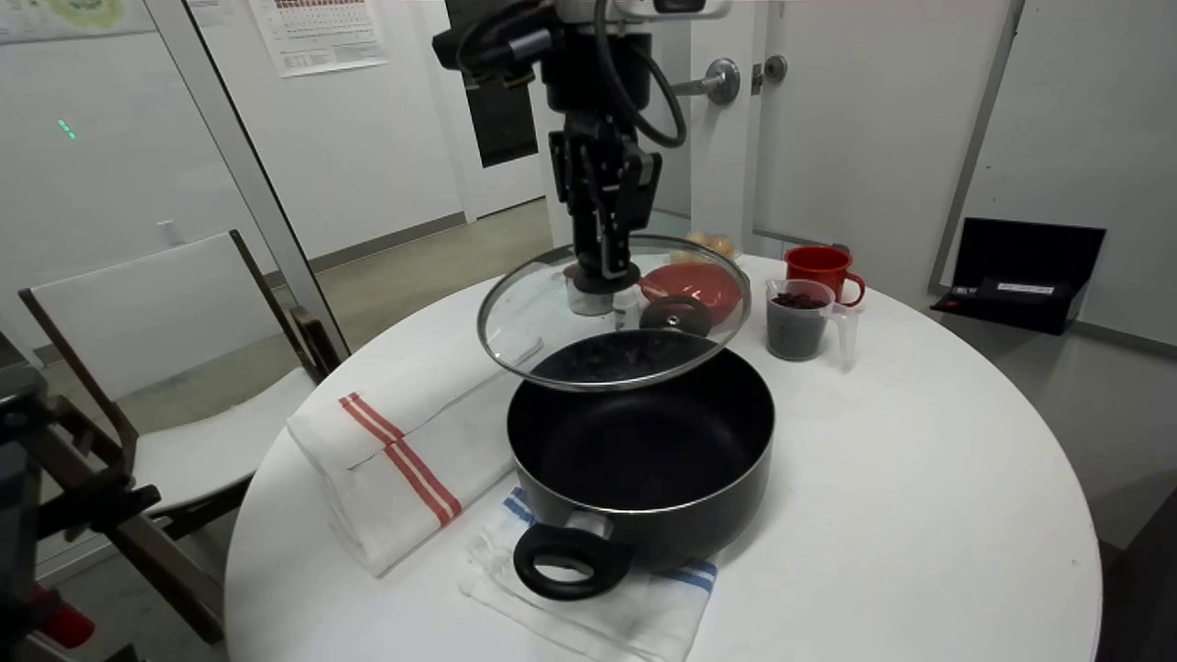
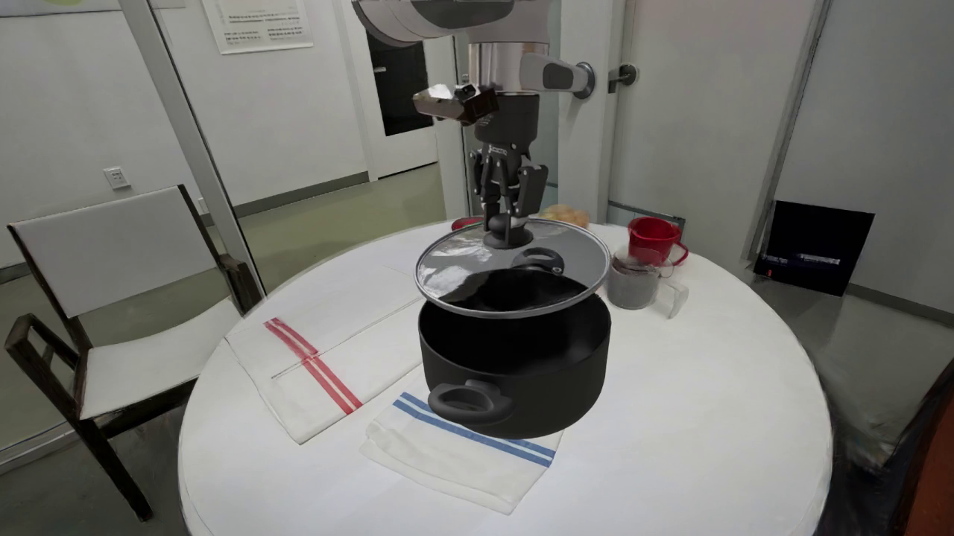

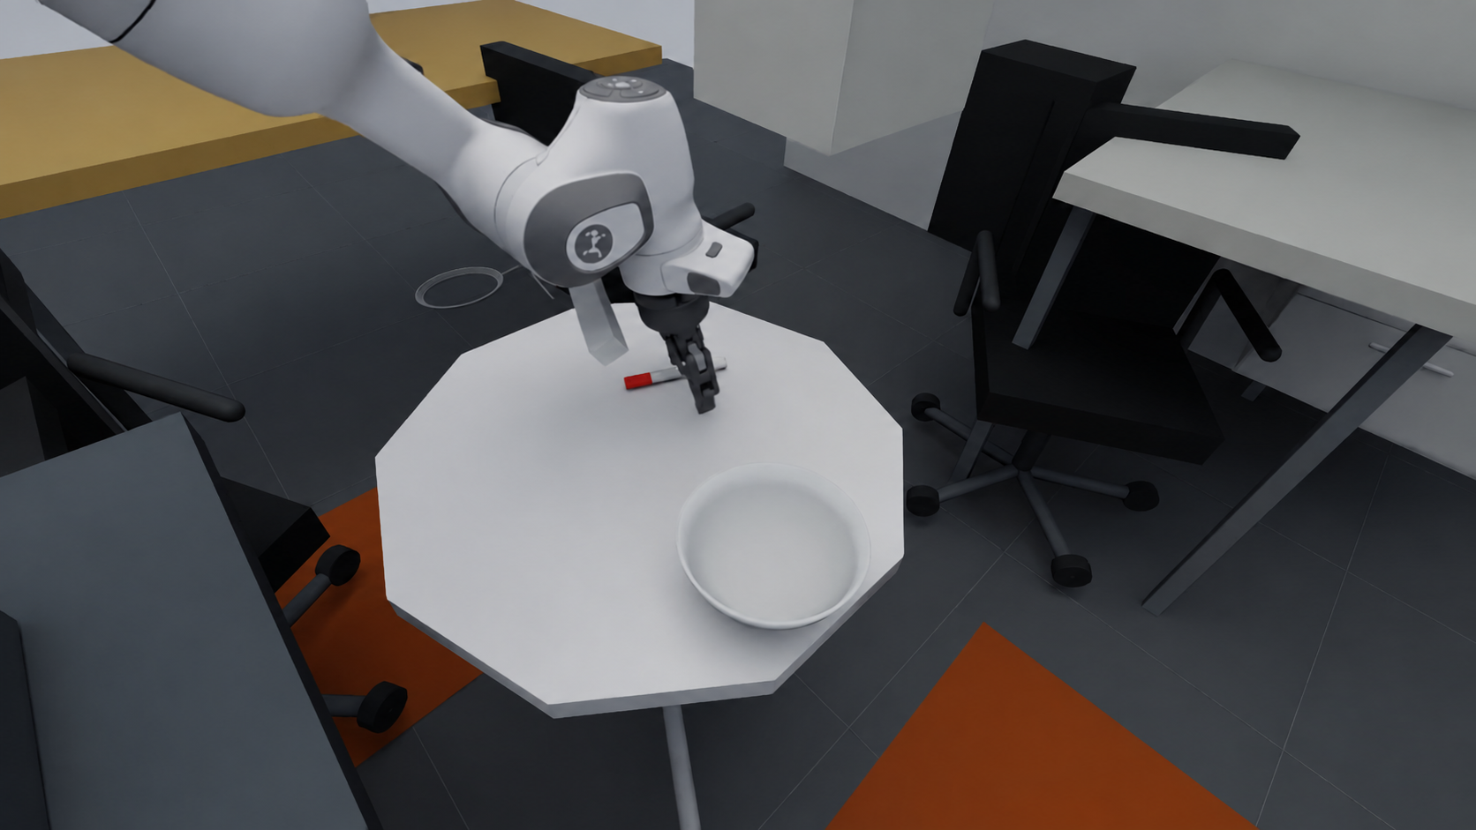
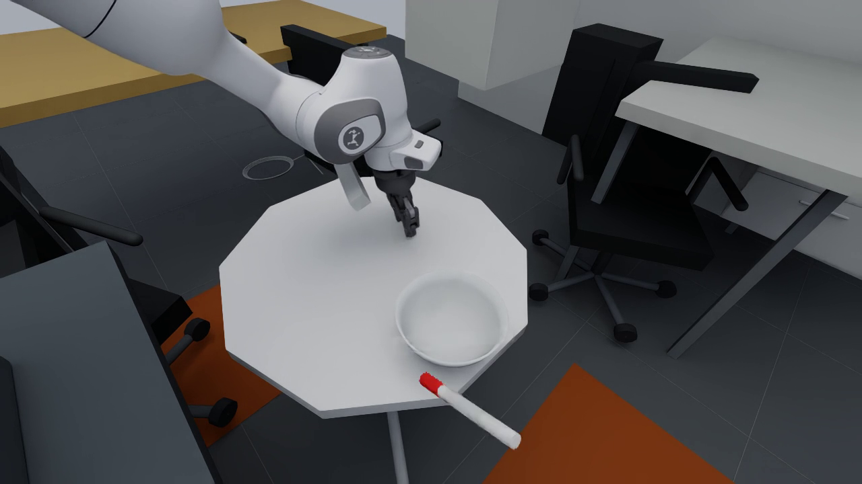
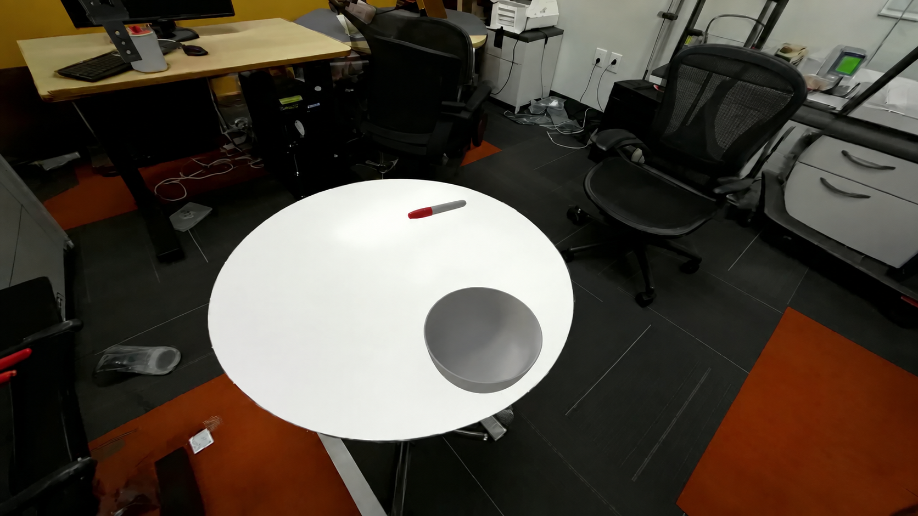
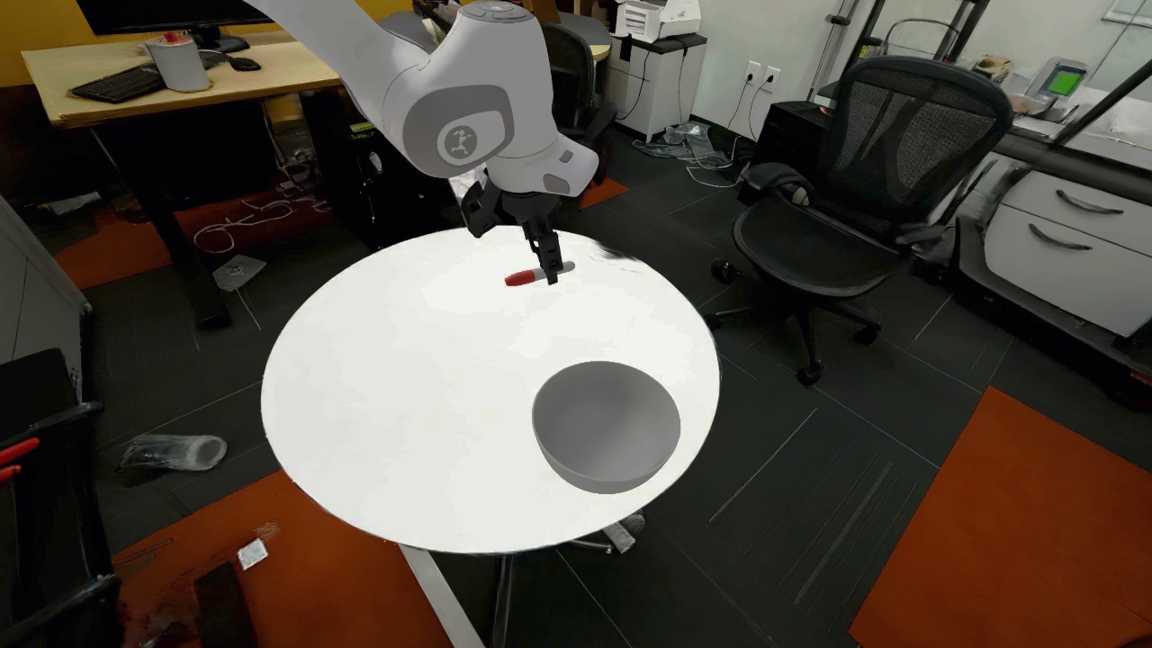
W
rld
Mirror
GPT-6 Astra
W
rld
Mirror
Spatial Structure
Spatial Structure
Accurate Layout!
Accurate Layout!
Visual Fidelity
Visual Fidelity
Low Visual Realism!
Photorealistic Reconstruction!
Collision & Physical Consistency
Collision & Physical Consistency
Unstable Interaction!
Physical Consistency!
Yes? No!
Yes? Yes!
Notes:
The light wordmarks use vector-traced outlines rendered to PNG for broad PowerPoint compatibility. The SVG files in SVG_editable preserve separate paths and embedded globe bytes. These images do not depend on external links.

