Slide 1
Master Bitcoin Chapter5 - Wallet
Cheng Ting Tsai
2018.08.09

Slide 2

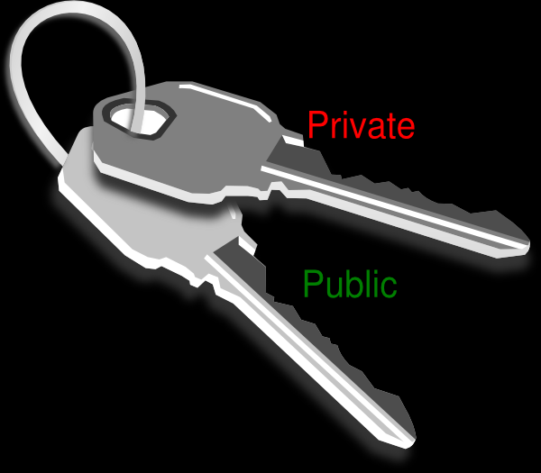

Wallet
Wallet stores
Key pairs
Wallet DO NOT store
Coins (transactions)
X

Slide 3

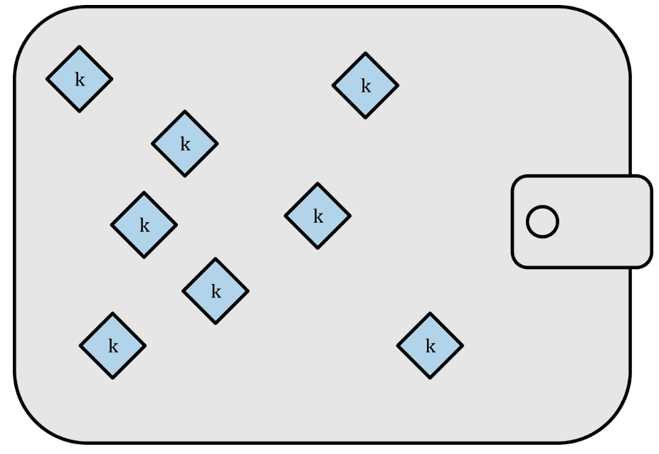

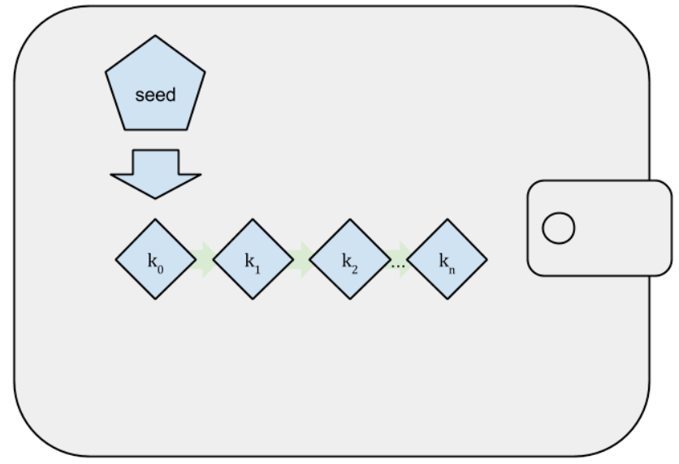
Types
Nondeterministic wallet
Random
Independent
Just a Bunch Of Keys (JBOK)
Deterministic wallet
Seed
Easy for key restoration

Slide 4
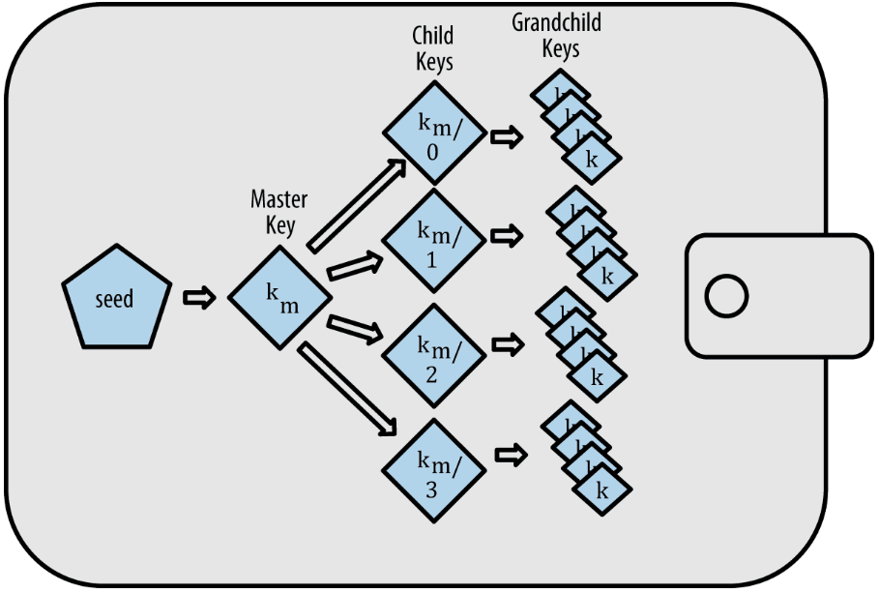
HD Wallets (1/7)
Data structure
Tree
Root
Seed
Keys production
Child key derivation (CKD)

Slide 5
HD Wallets (2/7)
Seed
512 bits
Password-Based Key Derivation Function 2 (PBKDF2)
Used to generate the first private key
Mnemonic Code Words
Bitcoin Improvement Proposals 39 (BIP-39)
Easily for user to memorize
Seed
Private key

Slide 6
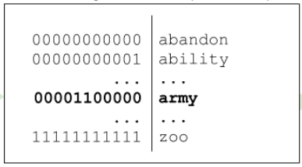
HD Wallets (3/7)
Bitcoin Improvement Proposals 39 (BIP-39)
Generate an entropy (128 or 256 bits)
Hash the entropy (SHA256)
Append first n bits of hash to entropy
n = 4 if length of entropy = 128 bits
n = 8 if length of entropy = 256 bits
Divide sequence to m parts, n bits for each (m = 12 or 24)
Map each parts to a word from the predefined dictionary of 2048 words

Slide 7
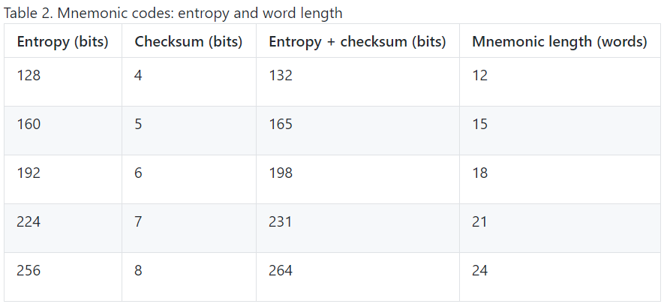
HD Wallets (4/7)

Slide 8
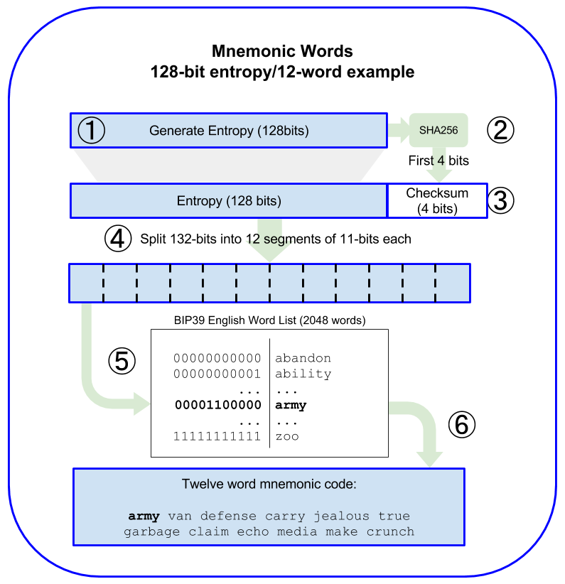
HD Wallets (5/7)
Example
E = entropy(128)
H = sha_256(E)
S = (E|H[first 4 bits])
P[] = S to 12 parts, 11 bits each
MCW = Map(P[], Dictionary)

Slide 9
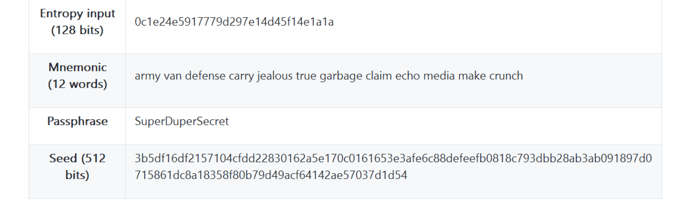
HD Wallets (6/7)
Seed
Mnemonic Code Words | Salt (optional)
PBKDF2: HMAC-SHA512

Slide 10
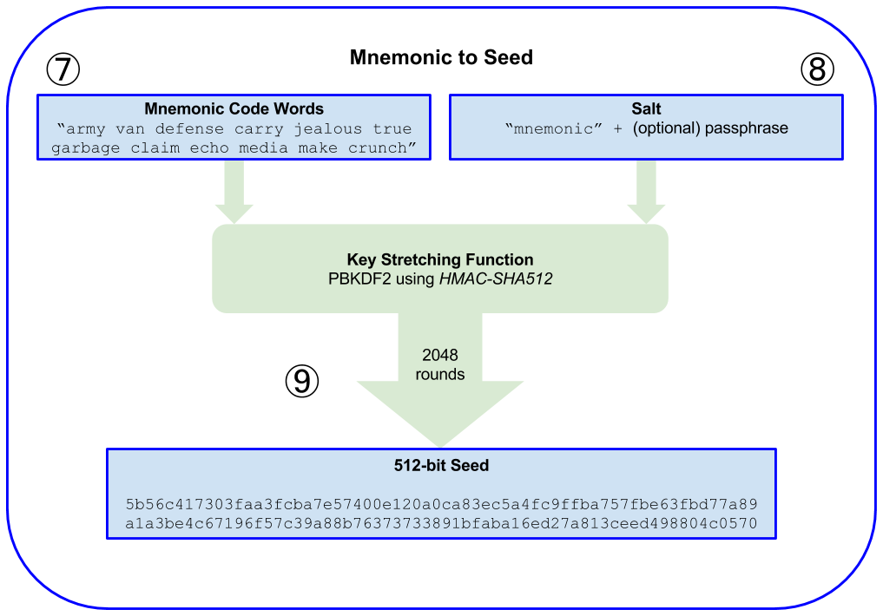
HD Wallets (7/7)

Slide 11

Short Break ~ =u=/

Slide 12
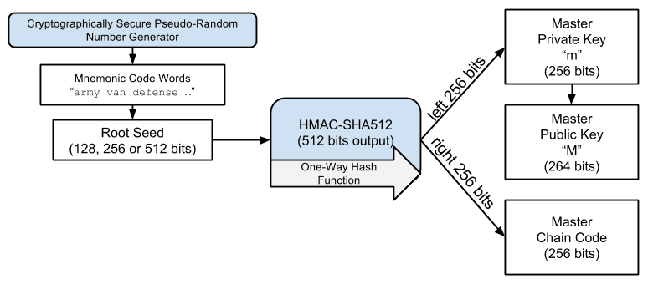
Keys (1/11)
First private key (m)
Seed
HMAC-SHA512
Left 256 bits
Chain code
Right 256 bits
Entropy for child keys
Public key (M) = m*G

Slide 13
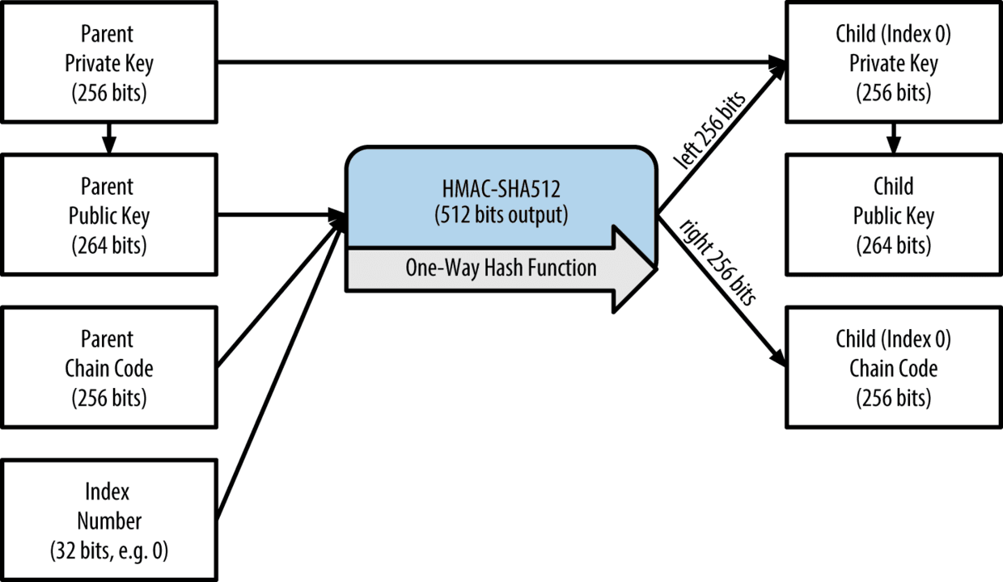
Keys (2/11)
Child private keys
Parameters
Parent public key
Parent chain code
Child key index
Parent private key (optional)
Child private key = Left 256 bits of hash + parent private key
Hash by
HMAC-SHA512

Slide 14
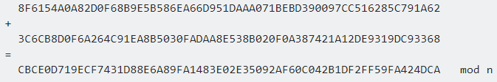
Keys (3/11)
Child private key = Left 256 bits + parent private key
HMAC-SHA512

Slide 15
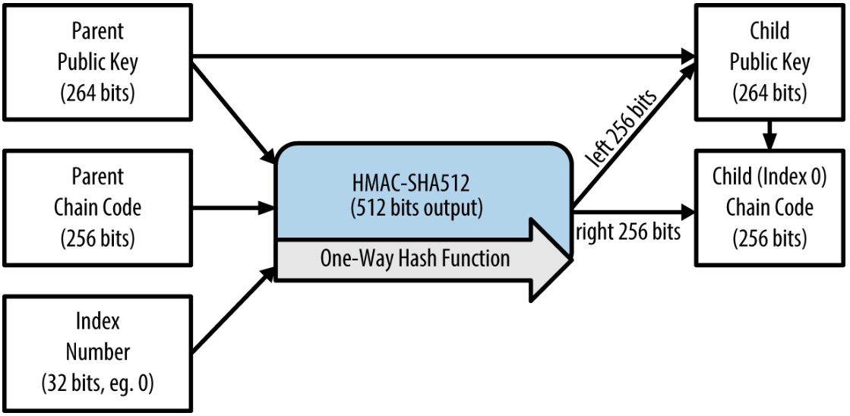
Keys (4/11)
Child public keys only
Parameters
Parent public key
Parent chain code
Child key index
HMAC-SHA512
Safety
Can receive
Can’t pay

Slide 16
Keys (5/11)
Index
0 ~ 2³¹ – 1 (0x00000000 to 0x7FFFFFFF)
The other half of index is for a more advanced usage.

Slide 17
Keys (6/11)
first 4 bytes of the hash160 of the public key
Extended key
Magic: mainnet or testnet
Depth: depth in tree
Parent fingerprint: first 4 bytes hash160 public key
Key index: key index
Chain code: chain code
Key: private key or public key
Easy to use
Combine key features that used for creating child key

Slide 18
Keys (7/11)
Extend key
[key] = Private key
[key] = Public key
Extend private key
Extend public key
xprv
xpub

Slide 19
Keys (8/11)
Another problem comes out!
If one gets
Parent xpub (contains public key and chain code)
At least one child private key
One can get all the children information
One can also get a chance to reach the parent private key
Because
Child private key = Left 256 bits of hash + parent private key
Chain code + (private key) can do everything!!

Slide 20
Keys (9/11)
xpub : public extended key
P : public key
p : private key
C : chain code
N : child public key
n : child private key
I : index of child
Find p given xpub, n:
Get P and C from xpub
Use P and C to find child public key N with index i
Try different i above steps until N fulfills N = n*G
If N = n*G, then i is found
Use i, P, C to find 512 hash code
n - Left 256 of hash = p
FOUND p
Then p, P, C can be used to find every children
Unknown
known
If matched?
Child private key

Slide 21
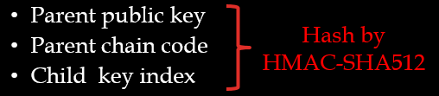
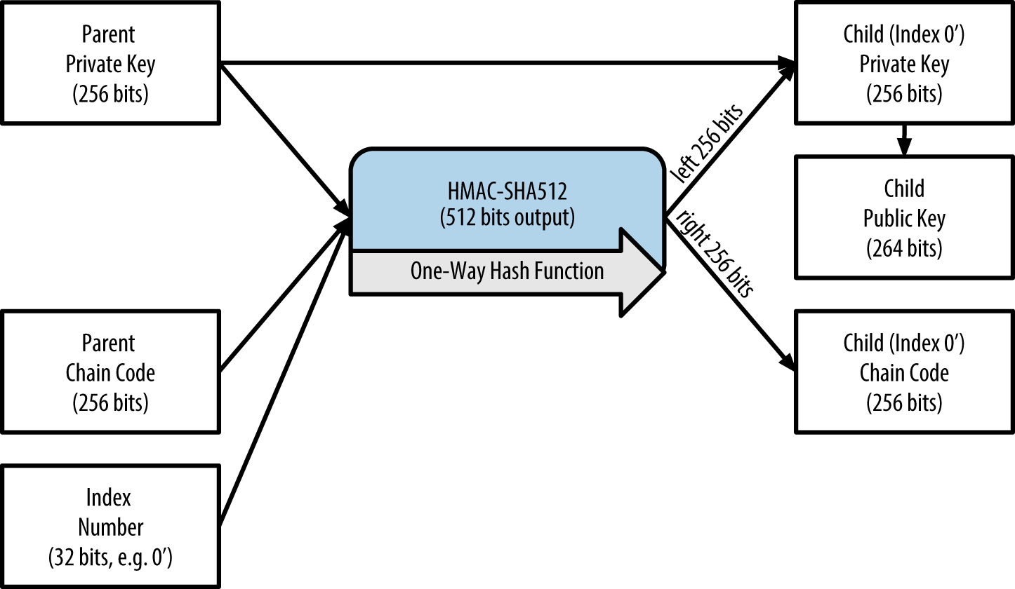
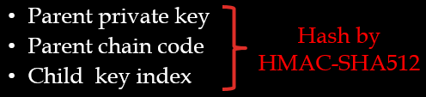
Keys (10/11)
Hardened child key derivation

Slide 22
Keys (11/11)
Hardened child key derivation
Safe
Private key is used
Gap
Index
2³¹ ~ 2³² – 1
0x80000000 to 0xFFFFFFFF
0’ ~ (2³¹ -1)’
n’ = 2³¹ + n
Private key
…
HMAC SHA256
Child
Chain code
HMAC SHA256
…
Index
Child’
Public key

Slide 23
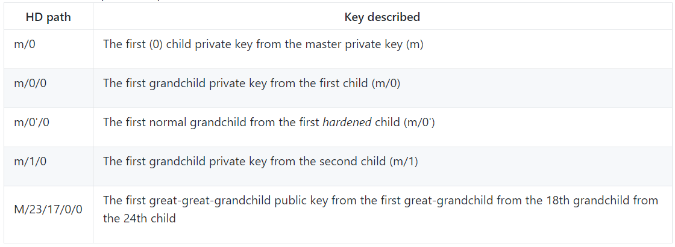
HD Wallet Key Identifier (Path)

Slide 24
Navigating HD Wallet Structure
HD path | Key described
M/44’/0’/0’/0/2 | The third receiving public key for the primary bitcoin account
M/44’/0’/3’/1/14 | The fifteenth change-address public key for the fourth bitcoin account
m/44’/2’/0’/0/1 | The second private key in the Litecoin main account, for signing transactions

Slide 25

Thanks For Your Attention!!

