Slide 1
Master Bitcoin Chapter9 - Blockchain
Cheng Ting Tsai
2018.08.27

Slide 2
Items and Definition (1/2)
Chain Data: Google LevelDB
Genesis Block: The first block
Height: Distance between a block and genesis block
Top: New block added to the chain
Header: Information of a block (see “Header and Chain”)
Parent Block: Previous block
Child Block: Next block

Slide 3
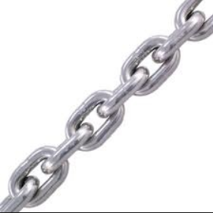
Items and Definition (2/2)
Each block allows:
Multiple child block (Fork, Chapter10)
Only one parent block
Block Chain
Hash of parent block header
No hash conflict
A block with children is unchangeable

Slide 4
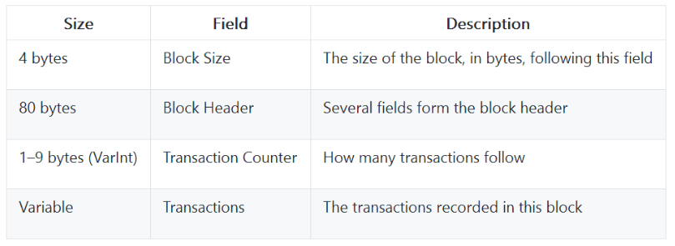
Structure

Slide 5
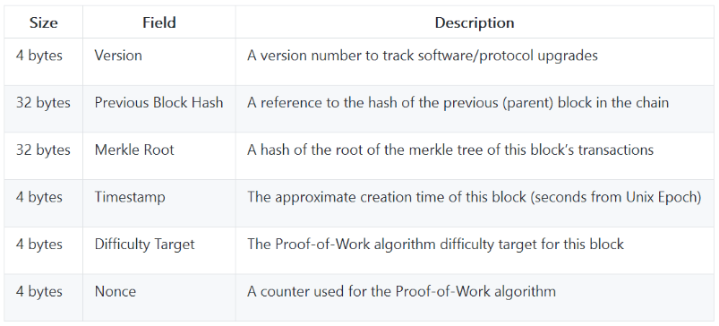
Header and Chain (1/3)

Slide 6
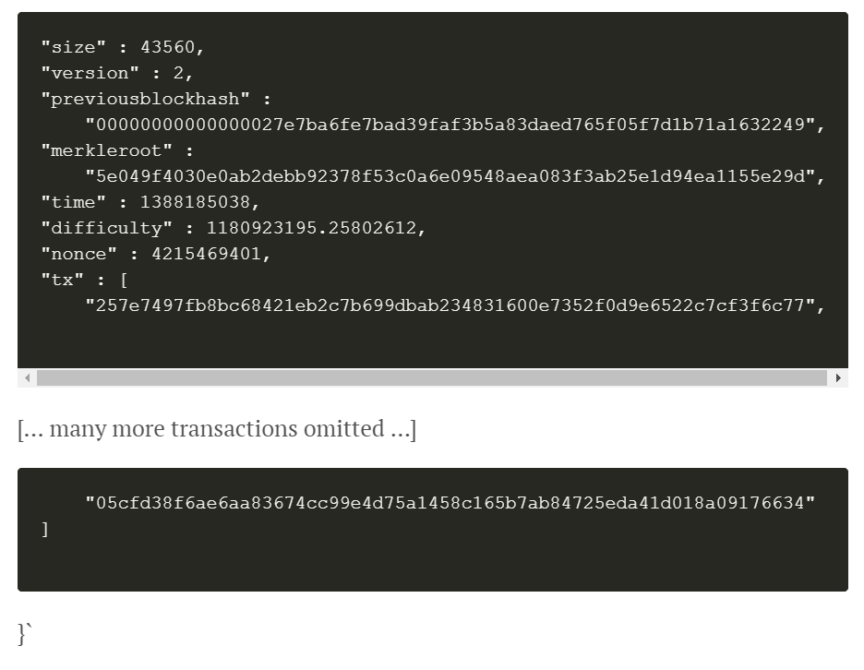
Header and Chain (2/3)

Slide 7

Header and Chain (3/3)
Block hash = hash of block header
Previous block hash
Hash of Parent block header
Assume no hash confliction
Same header can be made iif same information is given
Parent block
Current block

Slide 8
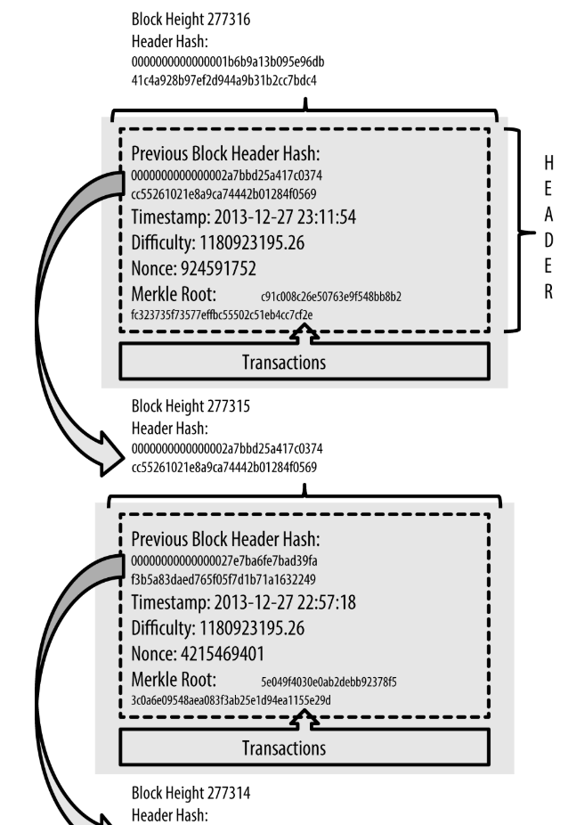

Slide 9
Block ID
Block Hash (Block Header Hash)
Hash of block header
Block Height
The order of the block in chain

Slide 10
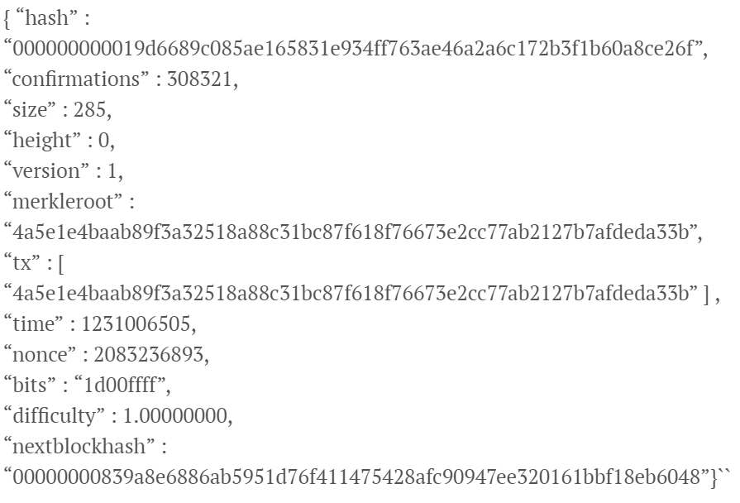
Genesis Block
First block in chain
Height: 0
Every node
Has the same Genesis Block
The input of Coinbase in Genesis Block
The Times 03/Jan/2009 Chancellor on brink of second bailout forbanks.

Slide 11
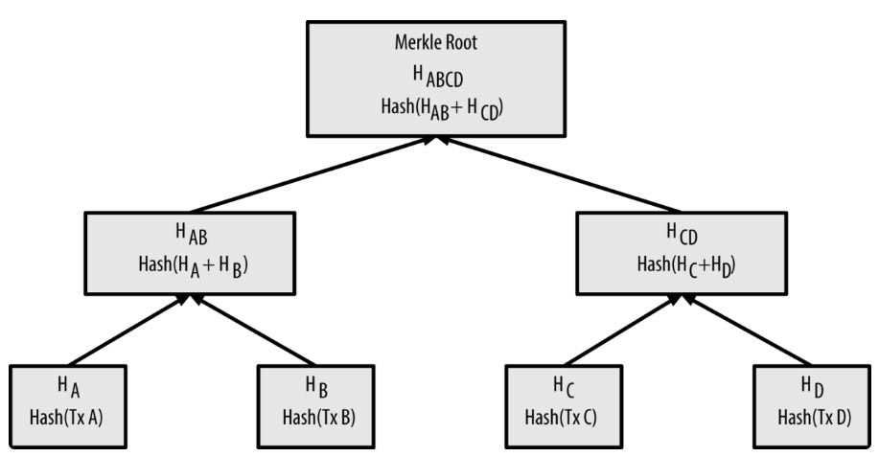
Merkle Tree (1/7)
Structure: Binary Search Tree (BST)
Store transactions (tx)
Increase search efficiency
Verify existence of transactions

Slide 12
Merkle Tree (2/7)
Tree node
Root: stored in block header, calculate by its leaves
Node with leaves: calculate by its leaves
Node without leaves: transactions
Rule
The number of each node must be even
Ex: Given transaction A, B, C, the C will the duplicated to fill the right leave of node H_{CC} (See next page.)

Slide 13
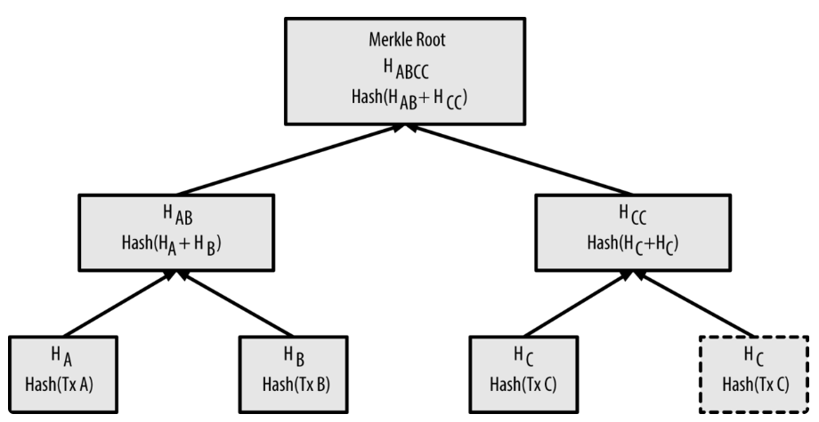
Merkle Tree (3/7)

Slide 14
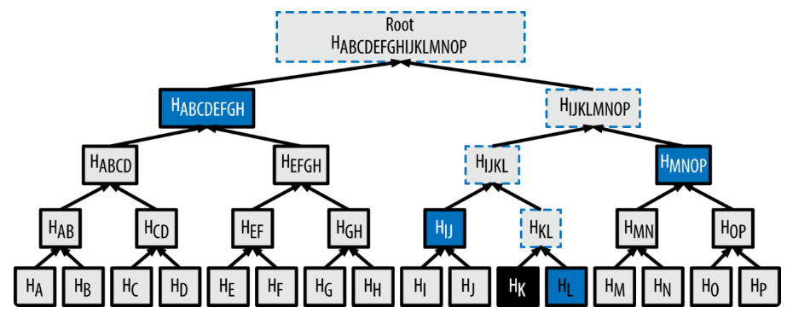
Merkle Tree (4/7)
Verify existence of a transaction
Path: combination of tree node hashes that used to calculate the parents of the transaction

Slide 15
Merkle Tree (5/7)
In this case, to verify Hk:
Parent: H_{KL}, H_{IJKL}, H_{IJKLMNOP}, H_{ABCDEFGHIJKLMNOP}
Path = [H_{L} | H_{IJ} | H_{MNOP} | H_{ABCDEFGH} ]

Slide 16
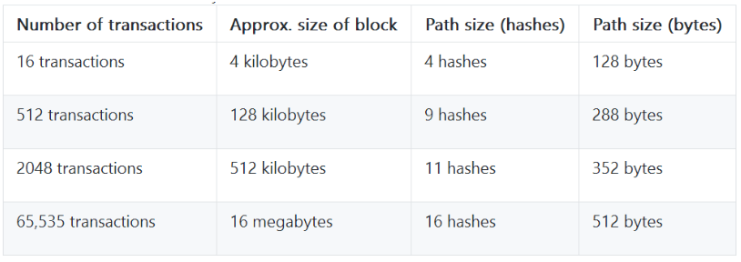
Merkle Tree (6/7)

Slide 17


Merkle Tree (7/7)
Advantage
BST: log₂(N)
Small data size require for verifications
Suitable for nodes with limited hardware device (SPV node)
Transaction size
Path size

