Slide 1
Mining and Consensus
By Gerber

Slide 2
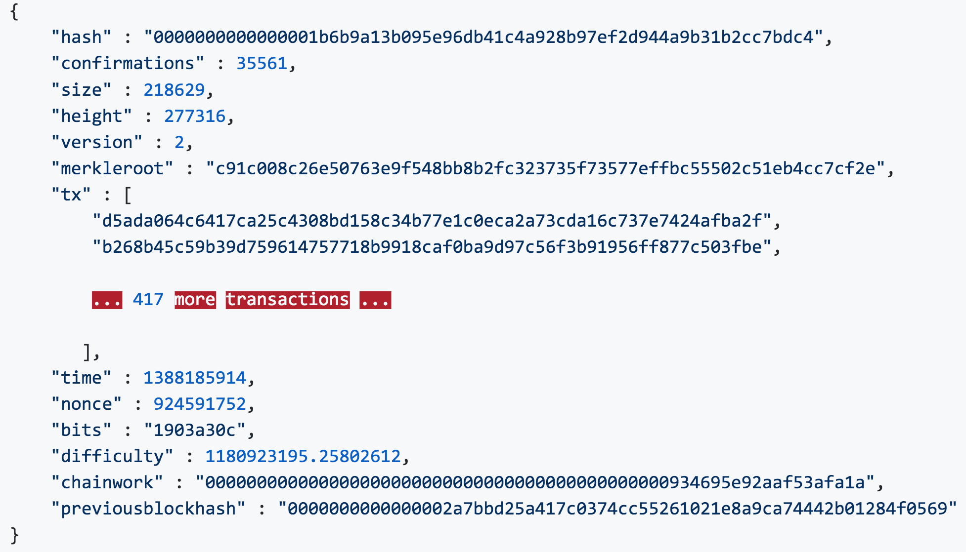
What Information does a Block Include ?
Hash
Confirmations
Size
Height
Version
Merkleroot
Tx
Time
Nonce
Bits
Difficulty
Chainwork
Previous Block Hash
Notes:
Bits : target
Difficulty : 跟創世區塊難度比較，創世區塊難度=１
Chainwork : The chainwork is used to identify the correct chain, the biggest chainwork value means the strongest or the correct chain.
for each '1' difficulty we add a chainwork amount [0x01,0001,0001].
Chainwork = previous chainwork + difficulty*0x01,0001,0001
previous chainwork在哪？在上個block裡面
A timestamp is accepted as valid if it is greater than the median timestamp of previous 11 blocks, and less than the network-adjusted time + 2 hours. "Network-adjusted time" is the median of the timestamps returned by all nodes connected to you. As a result, block timestamps are not exactly accurate, and they do not even need to be in order. Block times are accurate only to within an hour or two.

Slide 3
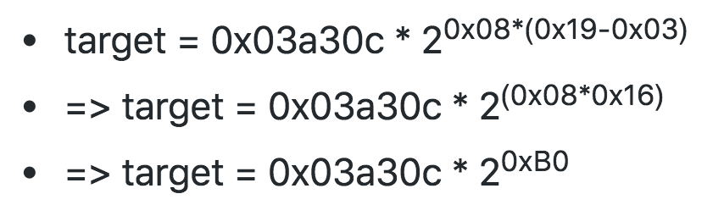
Target Representation
256 bits
First two hexadecimal digits for the exponent and the next six hex digits as the coefficient.
target = coefficient * 2^(8 * (exponent – 3))
Ex : 0x1903a30c
target = 0x0000000000000003A30C00000000000000000000000000000000000000000000

Slide 4
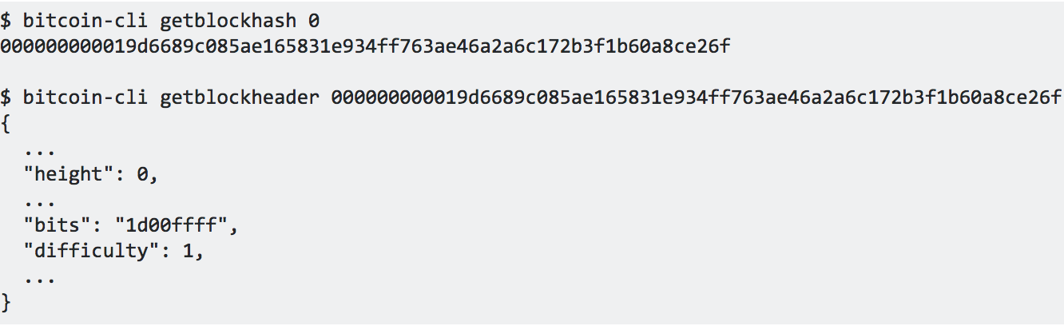
Difficulty
Difficulty of block 277316
( 0x00ffff * 256 ^ (0x1d - 0x03) ) / (0x03a30c * 256 ^ (0x19 - 0x03))
= 1180923195.25802612
Notes:
Target 與 difficulty 成反比

Slide 5
What Information does a Block Header Include ?
Version : A version number to track software/protocol upgrades
Previous Block Hash : A reference to the hash of the previous block in the chain.
Merkle Root : A hash of the root of the merkle tree of this block’s transaction.
Timestamp : The approximate creation time of this block (seconds from Unix Epoch)
Target : The Proof-of-Work algorithm target for this block.
Nonce : A counter used for the Proof-of-Work algorithm.

Slide 6
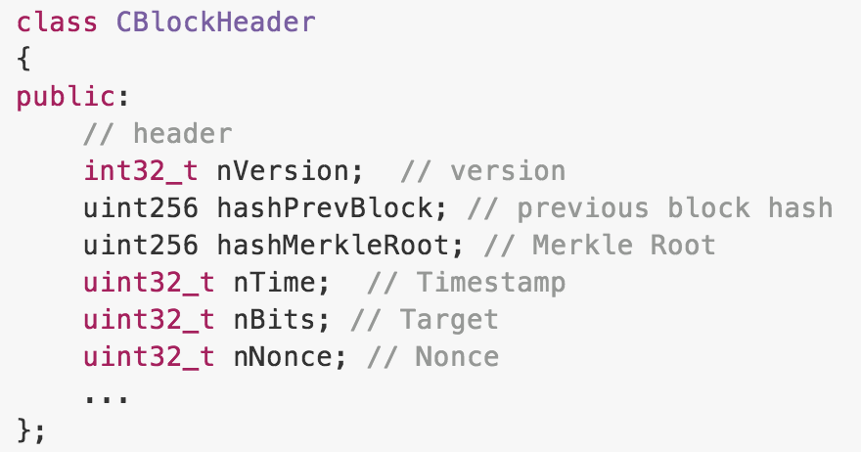
src/pow.cpp
2^32 = 4294967296 ~= 4G

Slide 7
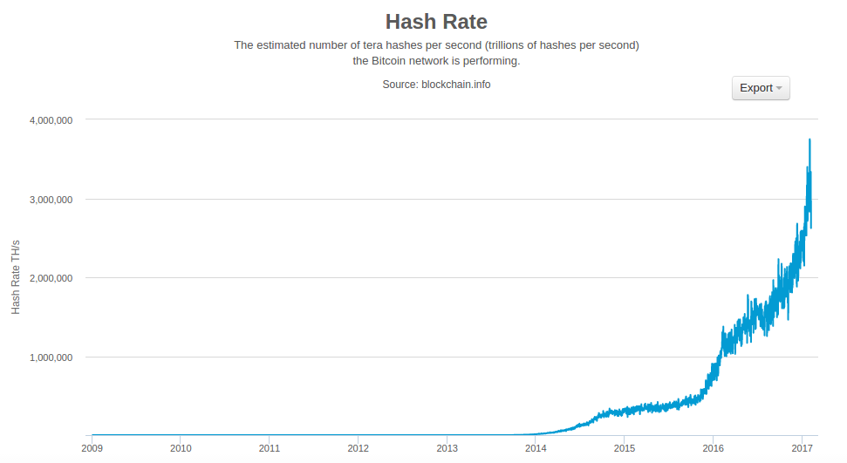
Hashing Power

Slide 8
The Extra Nonce Solution
Updating the block timestamp to account for the elapsed time.
Mining hardware > 4GH/sec, nonce values exhaust in less than a second.
Timestamp could be stretched a bit, but moving too far into the future => block invalid
Use the coinbase transaction as a source of extra nonce values.
Coinbase script can store between 2 and 100 bytes of data. => extra nonce space
Coinbase transaction is in the merkle tree => merkle root changes
Notes:
難度增長後，礦工經常在嘗試了40億個值後仍然沒有出塊。然而，這很容易通過讀取塊的時間戳併計算經過的時間來解決。因為時間戳是區塊頭的一部分，它的變化可以讓礦工用不同的隨機值再次遍歷。當挖礦硬件的速度達到了4GH/秒，這種方法變得越來越困難，因為隨機數的取值在一秒內就被用盡了。
可以把時間戳延後一點，但將來如果把它移動得太遠，會導致區塊變為無效。
使用coinbase交易作為額外的隨機值來源，因為coinbase腳本可以儲存2-100字節的數據，礦工們開始使用這個空間作為額外隨機值的來源，允許他們去探索一個大得多的區塊頭值範圍來找到有效的塊。這個coinbase交易包含在merkle樹中，這意味著任何coinbase腳本的變化將導致Merkle根的變化。

Slide 9
Coinbase Transaction
The first transaction in the block is the coinbase transaction.
Contains the reward for mining effort + transaction fees.
Doesn’t consume UTXO as inputs. Creates bitcoin from nothing.
The coinbase transaction has one output, payable to the miner’s own bitcoin address.
Coinbase transactions do not have an unlocking script.
Replaced by coinbase data. (2-100 bytes)
Notes:
創幣交易的交易額並不是50,25,12.5 ...，因為還包含了該block的所有tx fee

Slide 10
Coinbase data
Ex : 03443b0403858402062f503253482f
Instructs the script execution engine to push the next three bytes onto the script stack.
Block height : in little-endian format. 0x043b44 = 277316
Extra nonce : random value
ASCII-encoded string “/P2SH/” : Indicates that the mining node that mined this block supports the P2SH improvement defined in BIP-16.

Slide 11
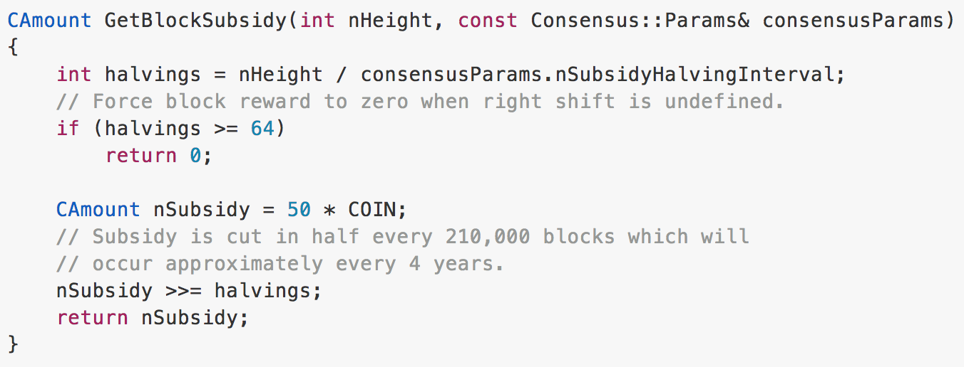
Block Reward
src/consensus/params.h
// COIN constant (100,000,000 satoshis)

Slide 12
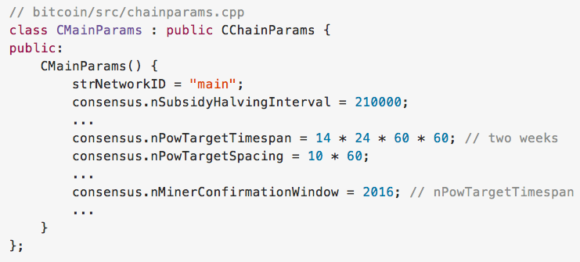
src/chainparams.cpp
nPowTargetSpacing
Notes:
src/consensus/params.h 裡面沒有 ‘’ = ’’ 右邊的東西

Slide 13
Retargeting to Adjust Difficulty
Bitcoin’s blocks are generated every 10 minutes on average.
Mining power increases over time.
The target is set so that the current mining power will result in a 10-minute block interval.
Every 2016 blocks, all nodes retarget the Proof-of-Work.
Notes:
Target越高代表越好挖到
Target 太高 => 不用10分鐘就挖到 => 降低Target
Target 太低 => 超過10分鐘才挖到 => 提高Target

Slide 14
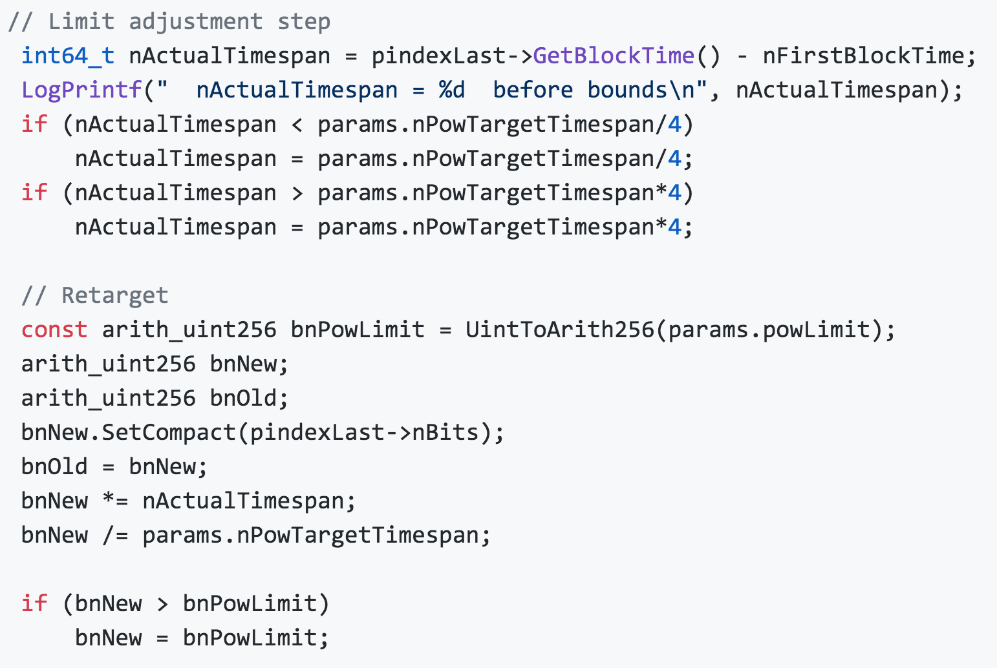
Retargeting to Adjust Difficulty

Slide 15
Validating a New Block
The block data structure is syntactically valid.
The block header hash is less than the target (enforces the Proof-of-Work).
The block timestamp is less than two hours in the future (allowing for time errors)
The block size is within acceptable limits.
The first transaction (and only the first) is a coinbase transaction.
...

Slide 16
Assembling and Selecting Chains of Blocks
Nodes maintain 3 sets of blocks :
Connected to the blockchain.
Form branches off the main blockchain (secondary chains).
Blocks that do not have a parent in the known chains (orphans).
If a valid block is received and no parent is found in the existing chains, that block is considered an “orphan.”
Two blocks that were mined in a short time are received in reverse order.
Orphan blocks are saved in the orphan block pool where they will stay until their parent is received.
Once the parent is received and linked into the existing chains, the orphan can be pulled out of the orphan pool and linked to the parent.
The main chain at any time is whichever valid chain of blocks that has the most cumulative Proof-of-Work associated with it.

Slide 17
Block Forks
A fork occurs whenever there are two candidate blocks competing to form the longest blockchain.
Two miners solve the Proof-of-Work algorithm within a short period of time from each other.
As both miners discover a solution for their respective candidate blocks, they immediately broadcast their own winning block to their immediate neighbors who begin propagating the block across the network.
Each node that receives a valid block will incorporate it into its blockchain, extending the blockchain by one block. If that node later sees another candidate block extending the same parent, it connects the second candidate on a secondary chain.
Some nodes will see one candidate block first, while other nodes will see the other candidate block and two competing versions of the blockchain will emerge.

Slide 18
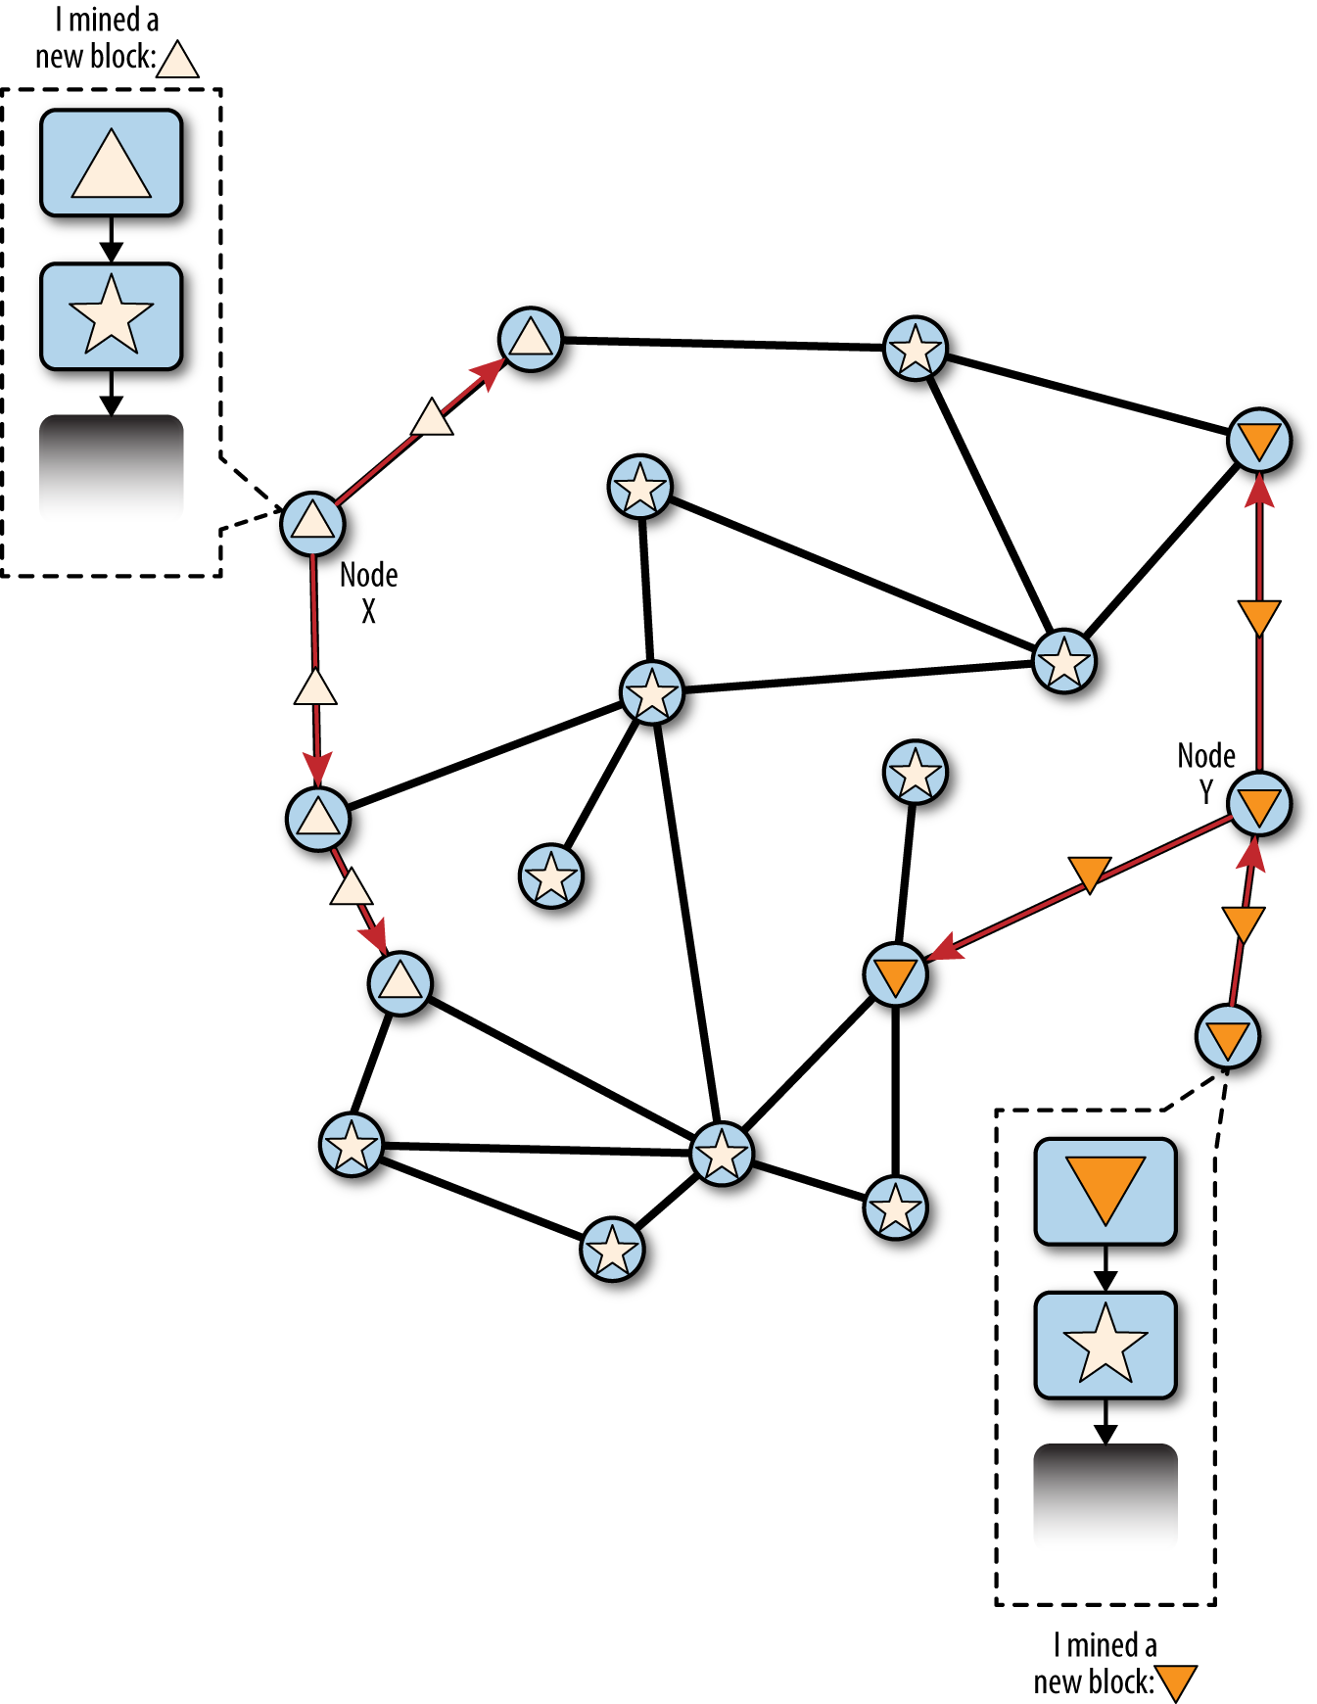
Two miners (Node X and Node Y) who mine two different blocks almost simultaneously.
Both of these blocks are children of the star block, and extend the chain by building on top of the star block.
One is visualized as a triangle block originating from Node X, and the other is shown as an upside-down triangle block originating from Node Y.

Slide 19
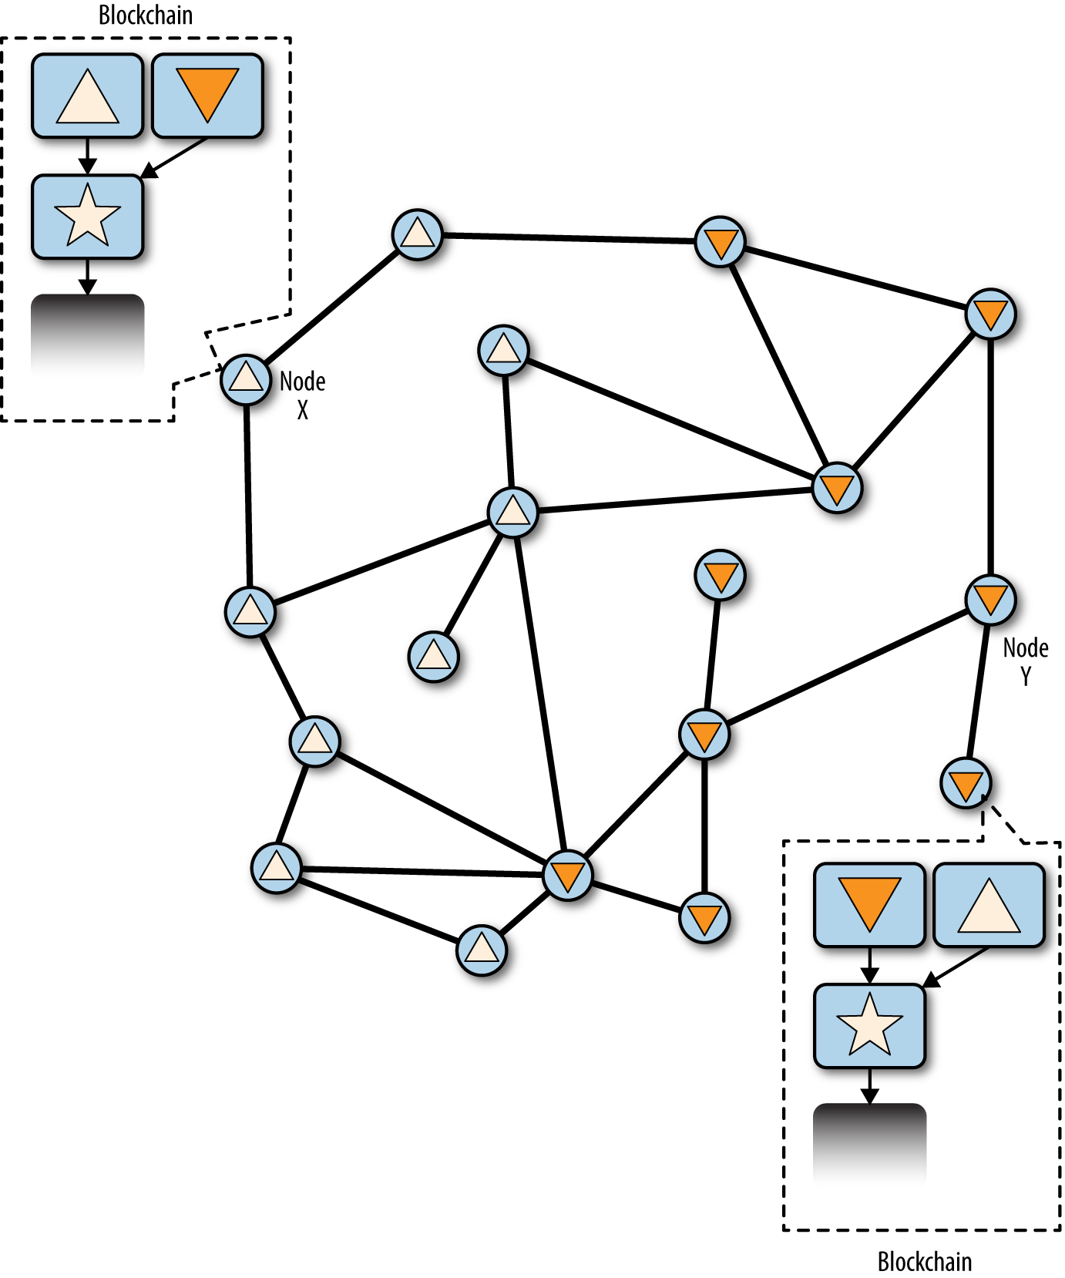
Node X :
Node Y :
Node X and Y both construct a blockchain based on their own perspectives of the sequence of events.
Neither side is “correct” or “incorrect”.
Only in hindsight will one prevail, based on how these two competing chains are extended by additional work.

Slide 20
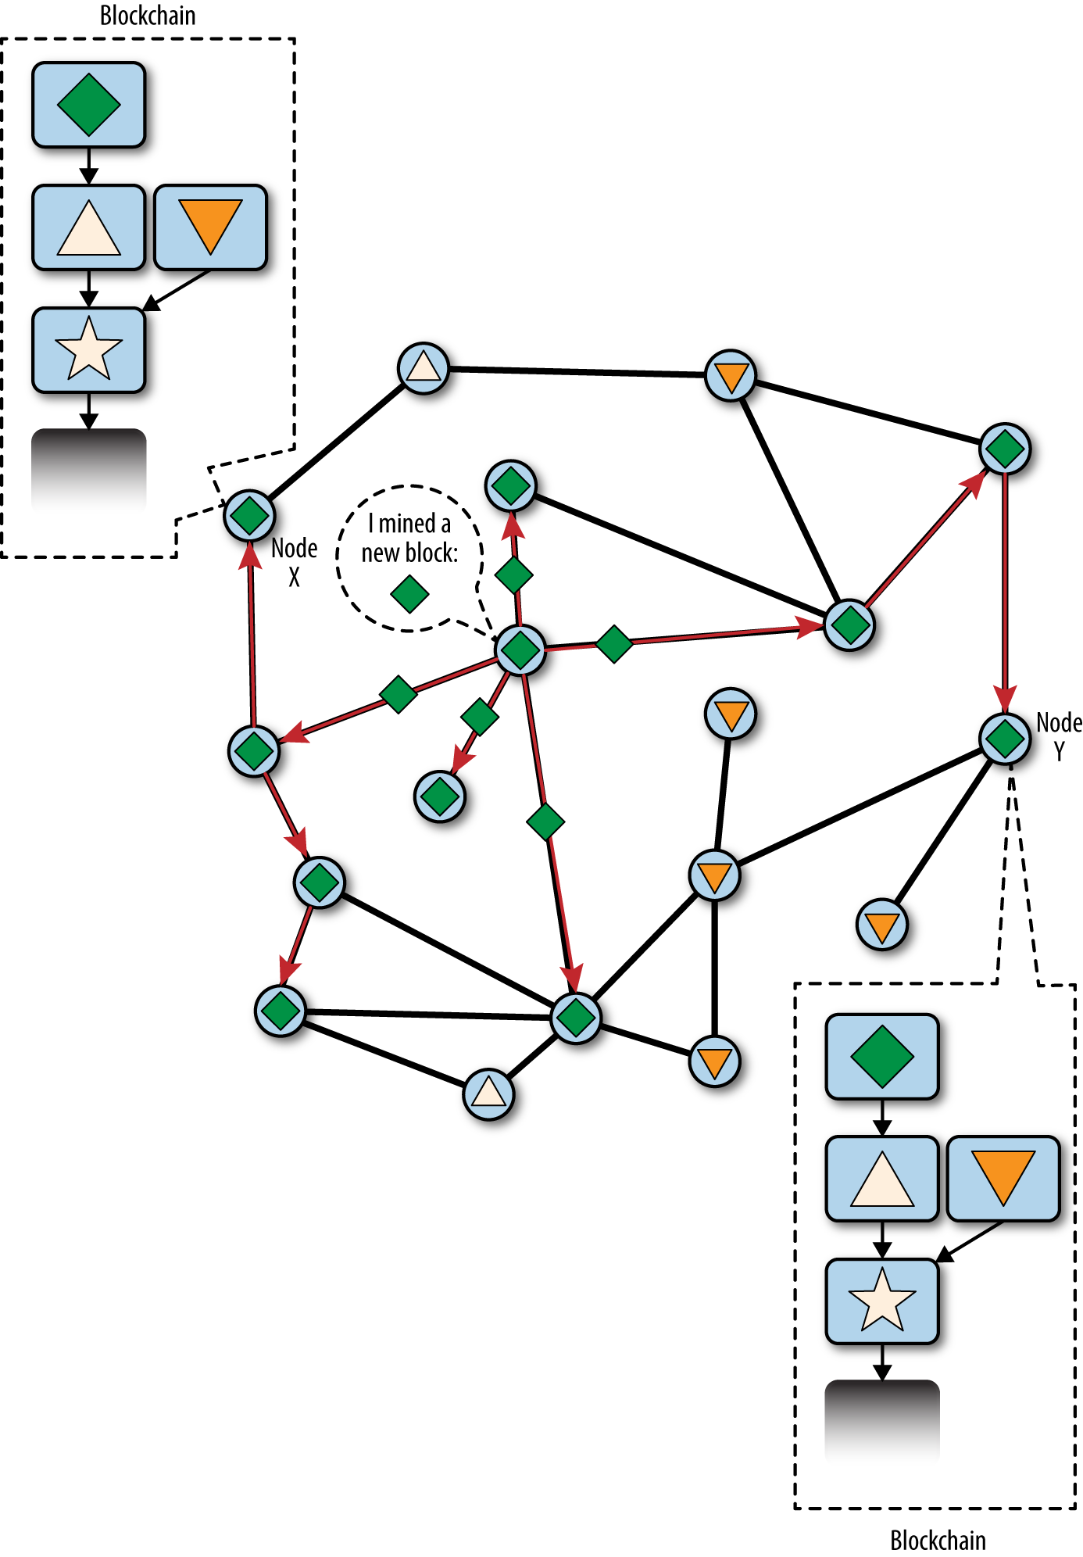
It is likely that one set of miners will find a solution and propagate it before the other set of miners have found any solutions.
Miners building on top of “triangle” find a new block “rhombus” that extends the chain. They immediately propagate this new block and the entire network sees it as a valid solution.
The chain star-triangle-rhombus is now longer.

Slide 21
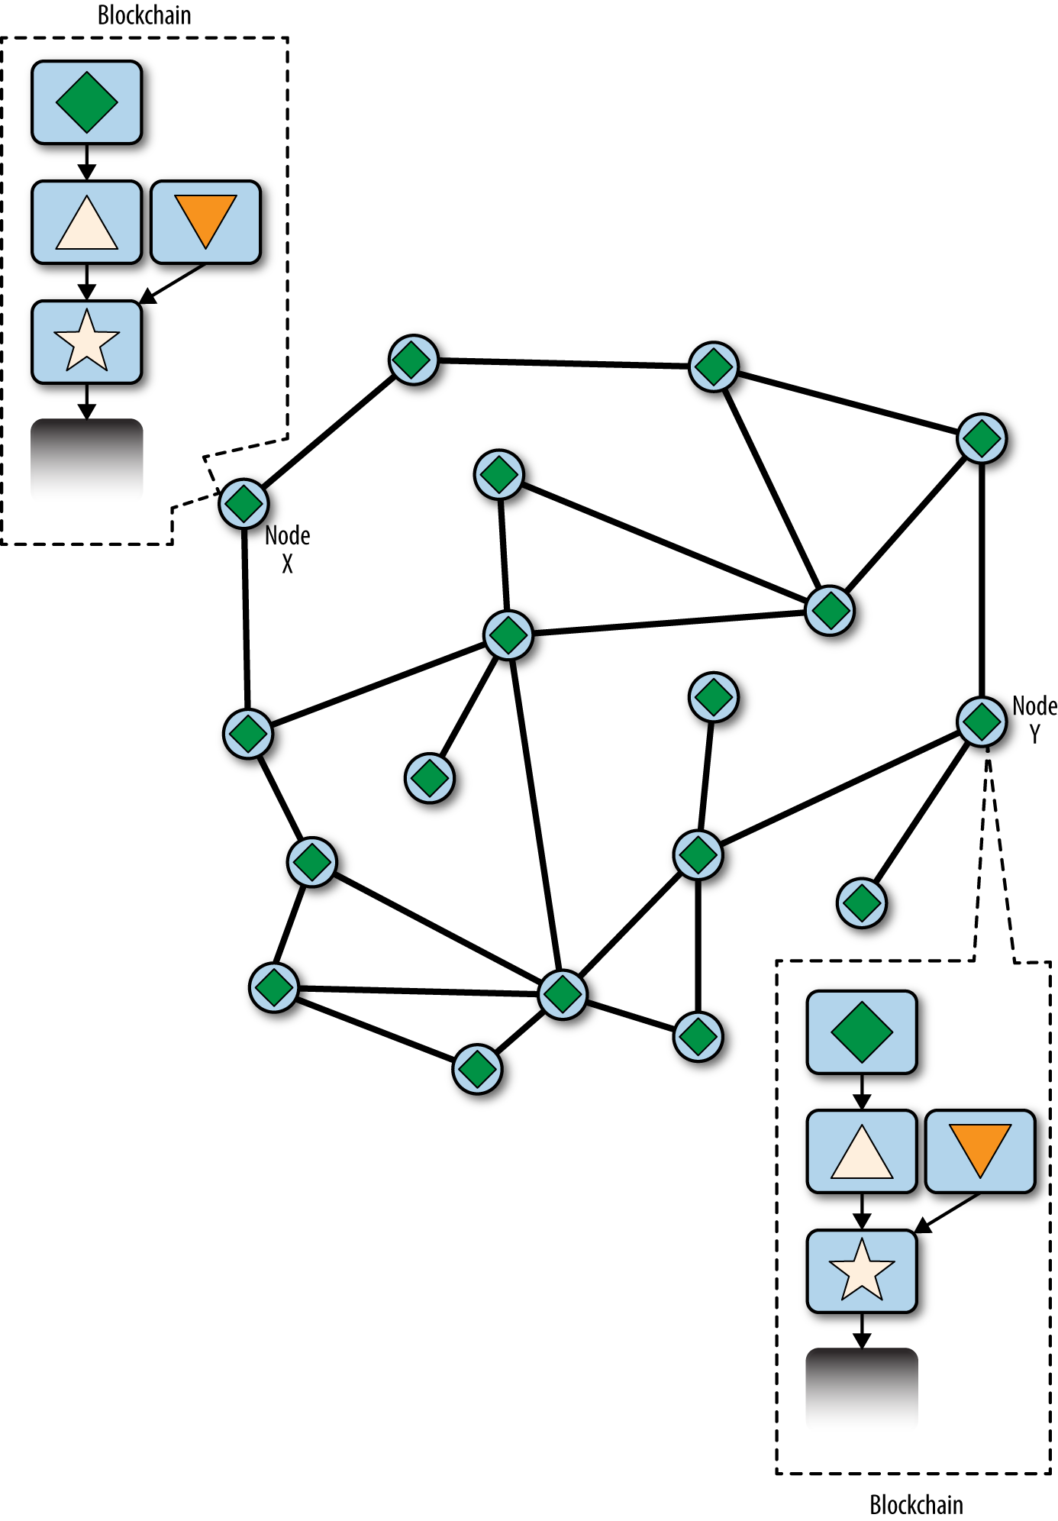
Miner working on extending the chain “star-upside-down-triangle” will now stop that work because their candidate block is an “orphan”, as its parent “upside-down-triangle” is no longer on the longest chain.
The transactions within “upside-down-triangle” that are not within “triangle” are re-inserted in the mempool for inclusion in the next block.

Slide 22
Block Forks
It is theoretically possible for a fork to extend to two blocks, if two blocks are found almost simultaneously by miners on opposite “sides” of a previous fork.
However, the chance of that happening is very low. Whereas a one-block fork might occur every day, a two-block fork occurs at most once every few weeks.

Slide 23
Mining Pools
Pooling hash power, sharing rewards
Mining pool sets a higher target (lower difficulty) for earning a share.
When someone in the pool mines a block, the reward is earned by the pool and then shared with all miners in proportion to the number of shares they contributed to the effort.

Slide 24
P2P Mining Pools
Why need P2P ?
Pool operator might direct the pool effort to double-spend transactions or invalidate blocks.
single-point-of-failure : server down or slowed by a denial-of-service attack
P2Pool makes the mining ecosystem diversified. => makes bitcoin more robust overall
P2Pool is a decentralized Bitcoin mining pool that works by creating a peer-to-peer network of miner nodes.
P2Pool creates a new blockchain in which the difficulty is adjusted so a new block is found every 30 seconds.
Blocks that get in to the P2Pool are the same blocks that would get into the Bitcoin blockchain.
P2Pool users must run a full Bitcoin node

Slide 25
Consensus Attacks
51% attack
Majority of the total hashing power of the network.
Double-spend : can only be done on the attacker’s own transactions (need signature)
Denial-of-service
What consensus attacks can’t do:
Consensus attacks also do not affect the security of the private keys and signing algorithm (ECDSA).
Steal or send bitcoin without signature.
Six confirmations considered safe.
TX

Slide 26
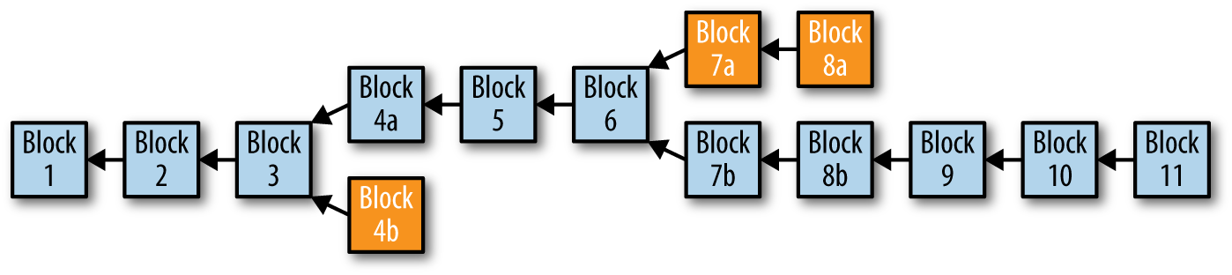
Hard Fork
Block fork mentioned earlier isn’t a hard fork.
A change in the consensus rules. (not forward-compatible)
Network doesn’t reconverge onto a single chain => evolve independently
80% - 20% split (new, old)
Mining power 20% ↓ => every block 10 min → 12.5 min => target difficulty 20% ↓
Notes:
not forward-compatible : 未升級的版本無法通過升級版本的驗證

Slide 27
Soft Fork
In practice, a soft fork is not a fork at all.
A soft fork is a forward-compatible change to the consensus rules that allows unupgraded clients to continue to operate in consensus with the new rules.
Transactions and blocks created under the new rules must be valid under the old rules too.
The new rules can only limit what is valid.

