Slide 1
Using Digital Image Processing and Computer Vision to Detect Brain Tumors in MRI Slices
Sean Webster
Computer Vision
4/19/2016

Slide 2
Introduction
The Setting
MRI scans completed
One whole brain takes roughly 60 scans, each about 2mm apart
No time to look at all scans, must do every third scan (20 scans)
We must find the volume of a tumor through these slices
The tumor(s) are circled by a radiologist

Slide 3
Introduction cont.
Problems Associated
Tumors all have different densities. Some are denser than surrounding regions, some less dense
Tumors have complex shapes, and are not always simply connected regions
There is the possibility of multiple tumors

Slide 4
Calculating the Volume
Challenges
First we have to know how many tumors there are
Is the tumor simply connected?
How will the tumor be marked by the radiologist?

Slide 5
Calculating the Volume
Approach: Finding the Marked Regions
Look for the marked region(s)
Let’s assume the region is marked in a color value not used elsewhere in the image - this allows us to easily differentiate between outside the marked region and inside
Check for closed regions of marking color– these are where our tumors are
We can now discard the rest of the image, and send each tumor to it’s own image

Slide 6
Calculating the Volume
Finding the tumor in the marked region
Tumor is different from surroundings in MRI – we can use this and threshold the image and remove anything non-tumor
Assuming the region the radiologist has circled contains mostly tumor, we can use histogramming to check which color the tumor is compared to normal brain matter
This thresholding allows us to see the tumor better and remove it from surroundings

Slide 7
Calculating the Volume
Checking for connected regions
A region is connected if two regions on any slice are touching
A tumor is continuous if it is within 1% of density of the previous image – a continuous tumor then becomes a stack of images to simulate the 3D tumor
If regions are connected in the same image, the two tumor image stacks will be merged into one image

Slide 8
Calculating the Volume
Calculating the volume
Since we know that the final image we create is all tumor, we can calculate the area based on the number of tumorous cell pixels
We know the thickness between each image
Therefore we have all necessary information for calculating by 3D slices

Slide 9
Let’s take it a step further…
What if the program finds the tumor first?
Porpoises

Slide 10
Approach
Detect brain inside of skull in each slide and remove all image material that is not brain
Detect tumors per layer
Cross reference with library of other brain tumors to determine % chance of tumor

Slide 11
Step 1: Detecting the Brain
Challenges
The shape of the brain changes for each height
Brain is not uniform color or uniform shape
Eyes and sinus cavities can be hard to differentiate from brain
Every brain is different
Tumors can distort the shape of the brain

Slide 12
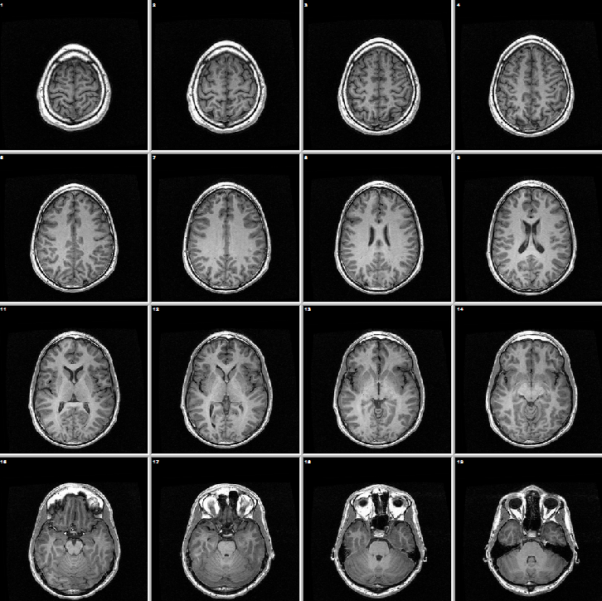
Step 1: Detecting the Brain
Different Shapes for Different Heights

Slide 13
Step 1: Detecting the Brain
Approach 1: Detecting the skull
The skull is a large, dense, thin outer perimeter of our heads – very easy to detect
This can be removed via morphology - erosion

Slide 14
Step 1: Detecting the Brain
Singling out the brain
Without the skull, we are left with the brain, the eyes, the sinuses, the mouth, and the ear canals
Good news, everyone! The mouth, sinuses, and ear canals are mostly hollow, and show up black in MRI’s – we can threshold them out of our image easily!

Slide 15
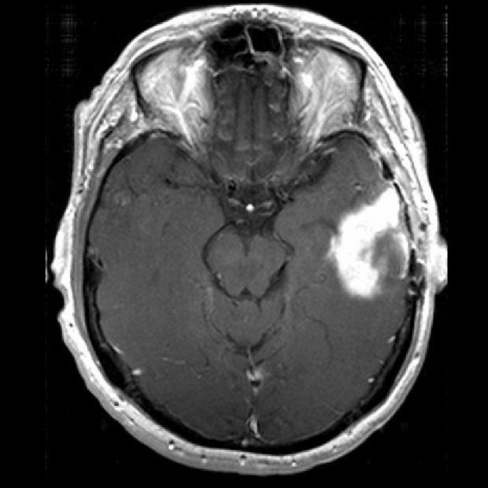
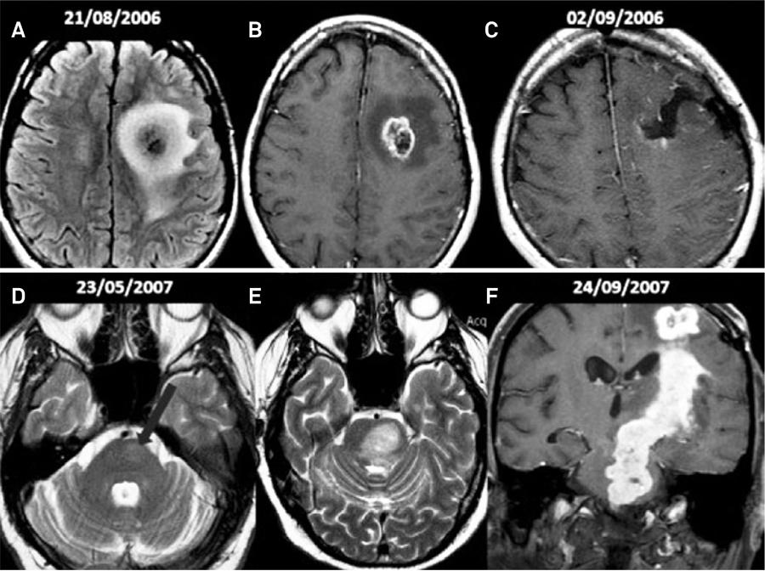
Step1: Detecting the Brains
Eyes

Slide 16
Step 1: Detecting the Brain
Eyes
Eyes present the biggest challenge – they’re roughly tumor shape and density
Usually there is a gap between them and the brain, though.
By detecting the lines between the eyes and the brain using region splitting, and histogramming each side of the line, we can tell the side with a higher concentration of gray is the brain side – we can now get rid of the eyes, and only have the brain

Slide 17
Step 2: Detecting Tumors
Challenges
Tumors rarely have uniform density/shape
Tumors are not usually the same shape/size, or in the same place – though they can be

Slide 18
Step 2: Detecting Tumors
Approach
Tumors show up as different color than the rest of the brain in MRIs – we can use this in image processing
We want to create high contrast, to make the tumor stick out – our tumor will hopefully be the brightest area
We can now remove everything except the tumor by thresholding
We can now use the before mentioned volume calculation method

Slide 19
Step 3: Deep Learning
Creating a learning model
By teaching the program the location, colors, and sizes of tumors using training data, we can improve it’s understanding of these things
Once we have the training data input, we can then use linear discrimination analysis to try and find correlations between tumors
If a correlation is found, the program is ready for testing data

Slide 20
Bibliography
http://sciencenordic.com/new-scans-aid-brain-cancer-treatment
Hackaday.com

