Slide 1
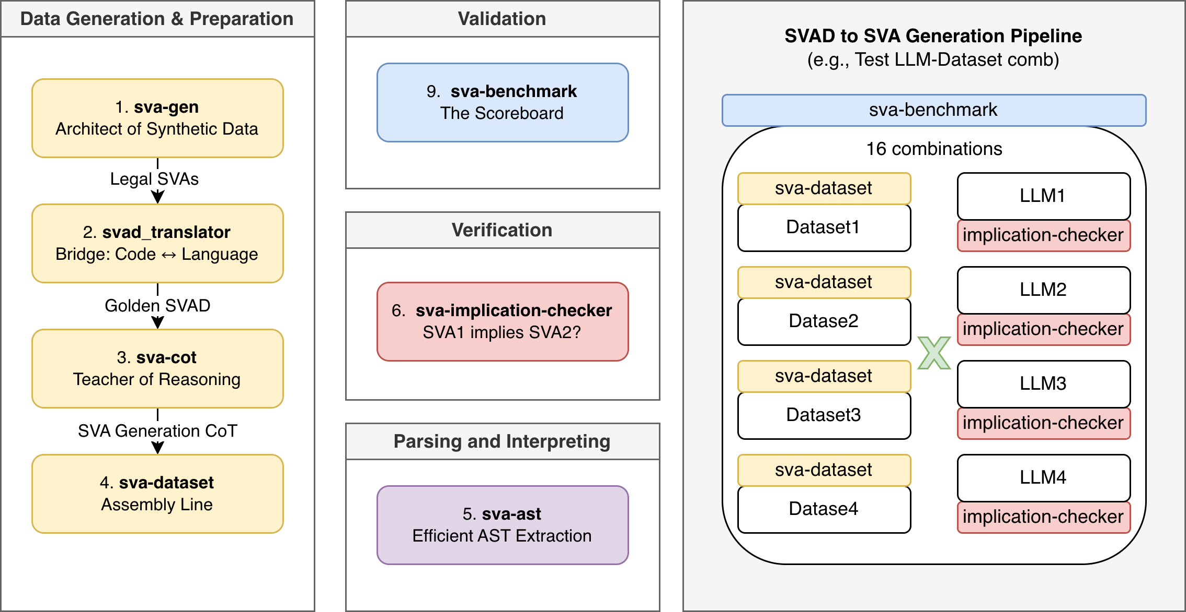
SVA TOOLKIT: INTRODUCTION

Slide 2
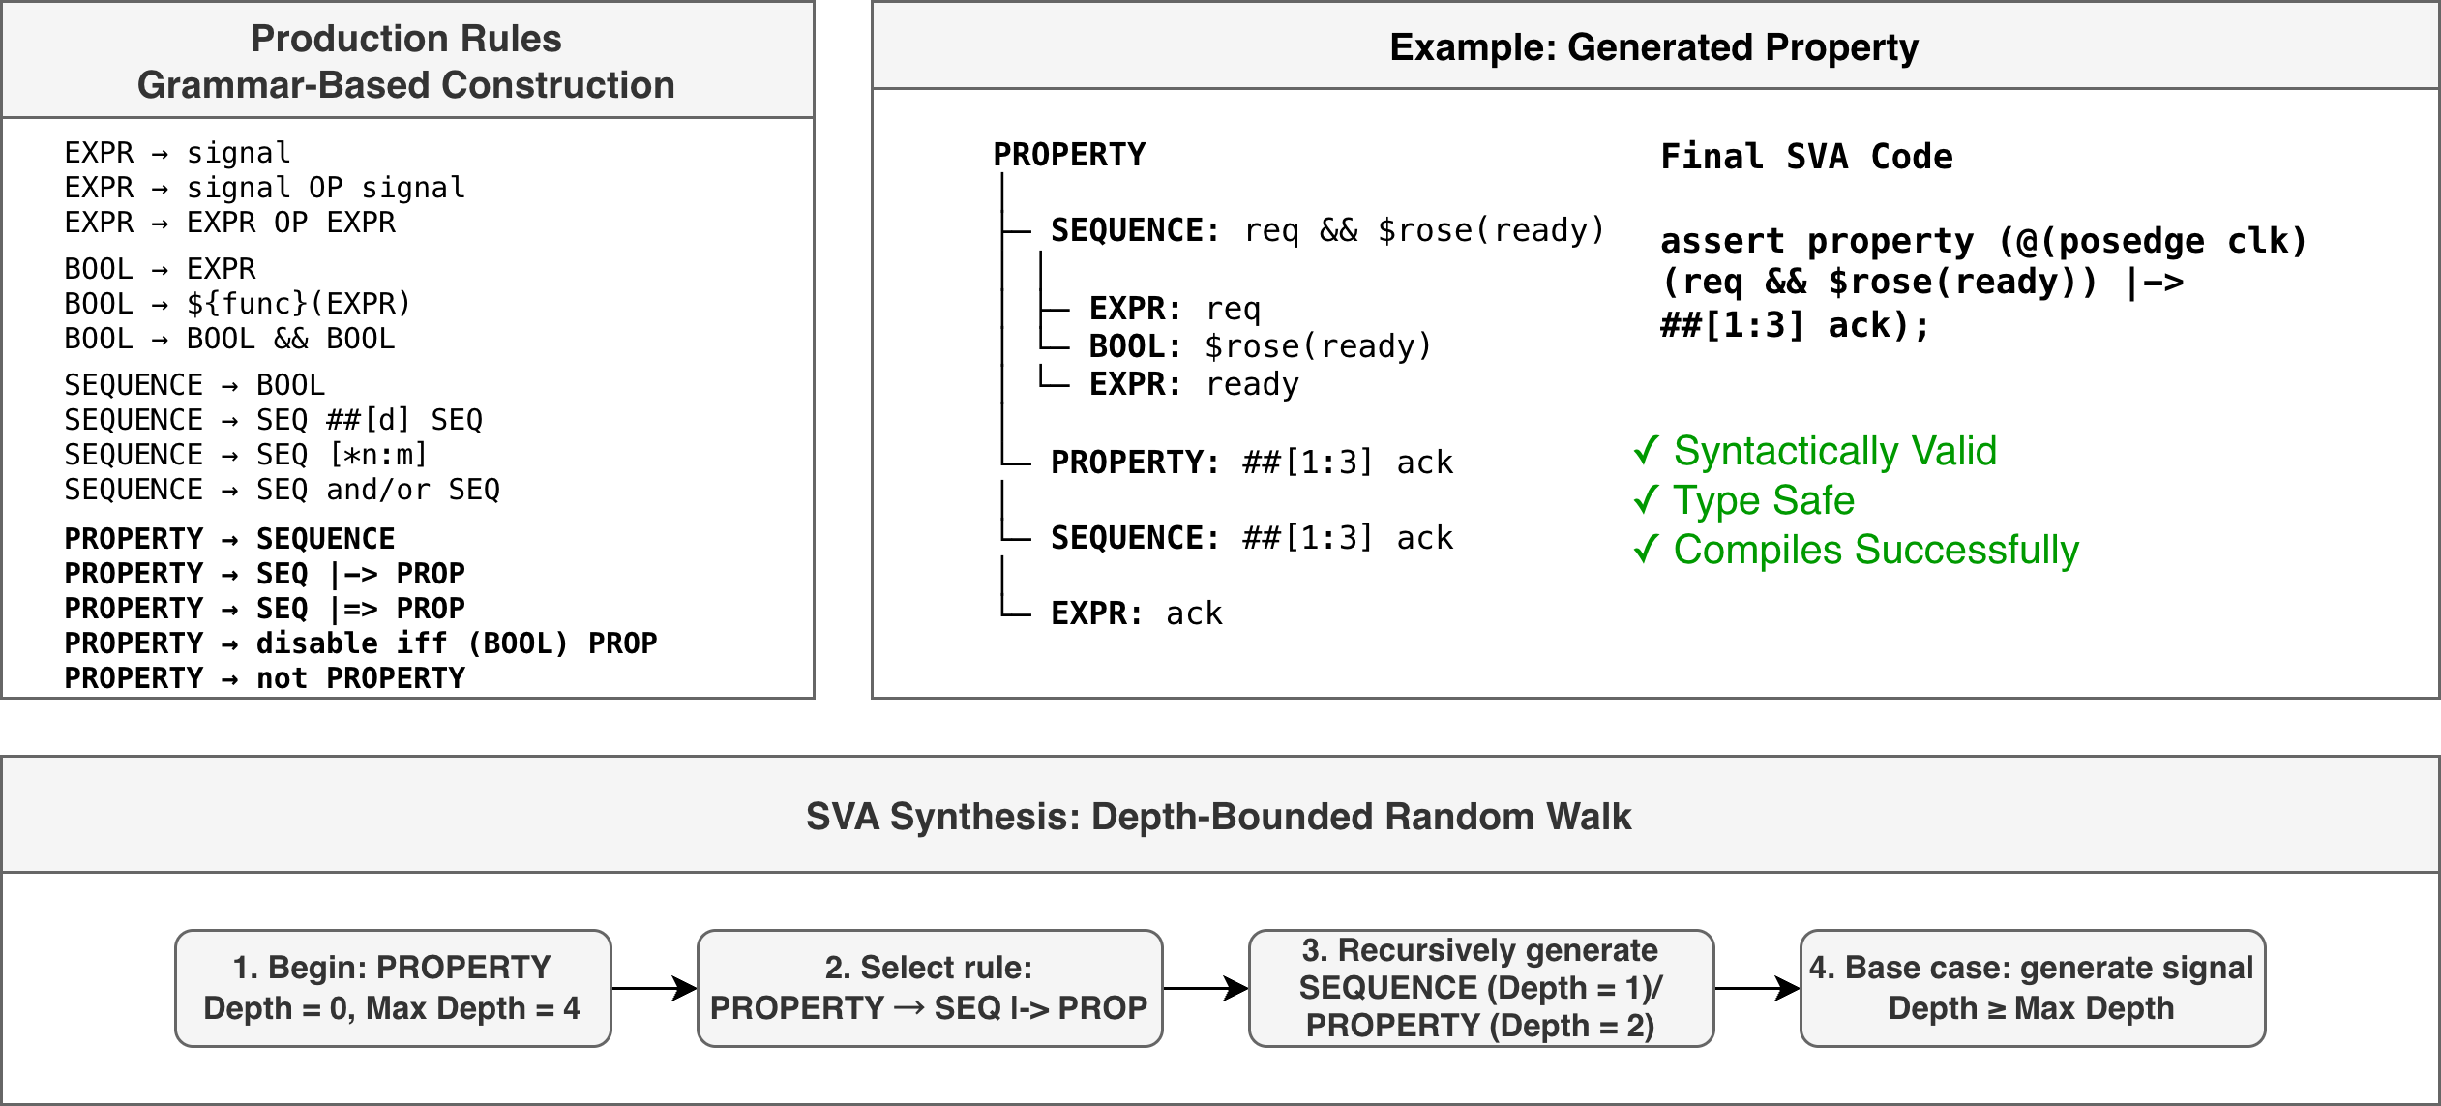
SVA TOOLKIT: SVA-GEN

Slide 3
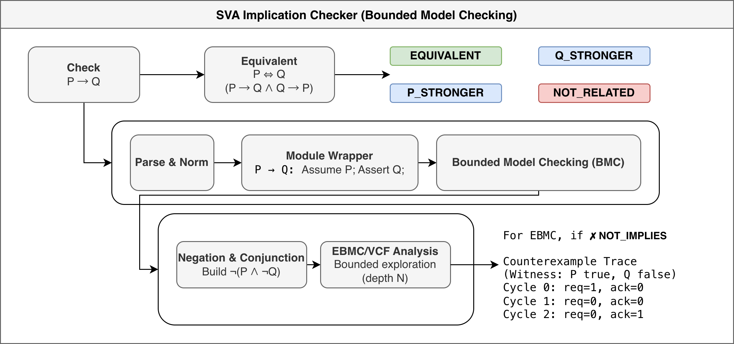
SVA TOOLKIT: IMPLICATION-CHECKER

Slide 4

SVA TOOLKIT: IMPLICATION-CHECKER

