Slide 1
Curation and Presentation of Anatomical Information
  Raymond Lee
  May 2008
  WormBase Advisory Board Meeting

Slide 2
Overview
Anatomy page: Identification, Ontology, Association
Annotation using anatomy terms
Gene Expression, Anatomy Function
Future plans

Slide 3
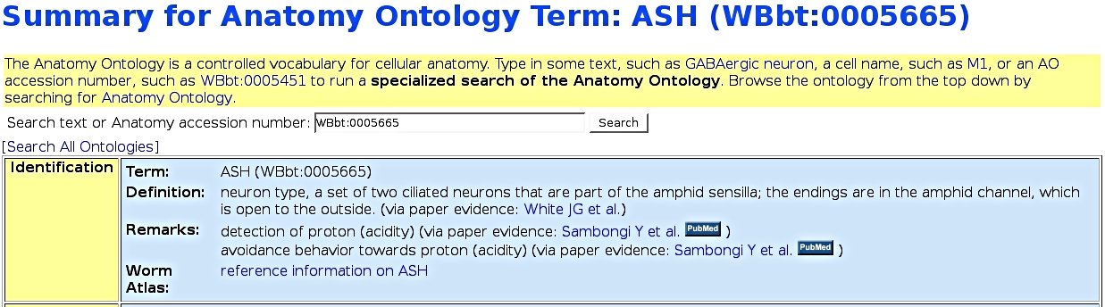
Anatomy Page - Identification
Brief description, Graphical guide, Pedigree, Link to external resources (e.g. WormAtlas, WormBook)‏

Slide 4
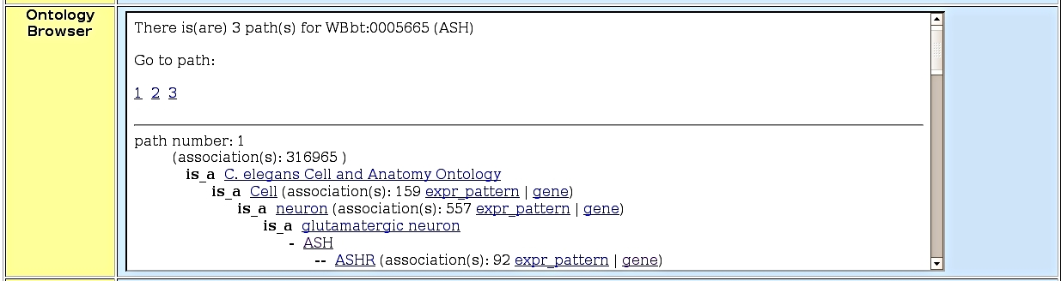
Anatomy Page - Ontology
Hierarchical graphs connecting anatomical terms.

Slide 5
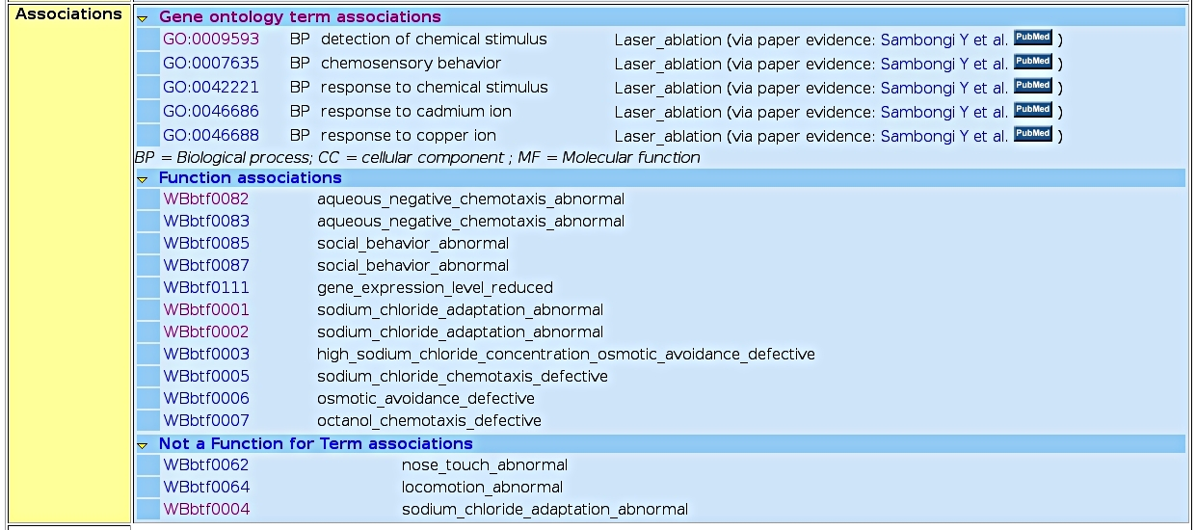
Anatomy Page - Association
Gene Expression, Anatomy Function, Neural Connectivity, Cell division timing.

Slide 6
Ontology-based Annotation -
Gene Expression
What genes are Exclusively expressed in touch cell neurons?
  (Genes expressed in any touch cell neuron) NOT (Genes expressed anywhere else) = mec-4, mec-18, mtd-1

Slide 7
Stats of Gene Expression Annotation
2270 Anatomy Terms have been used to curate 6222 Expr_pattern objects.
Each Expr_pattern object links to Nine Anatomy Terms, on average.

Slide 8
Anatomy Function
Types of Evidence for assertion
Direct: laser ablation, genetic ablation, blastomere isolation
Indirect (gene site of action): genetic mosaics, expression mosaics
Phenotype => Biological Function

Slide 9
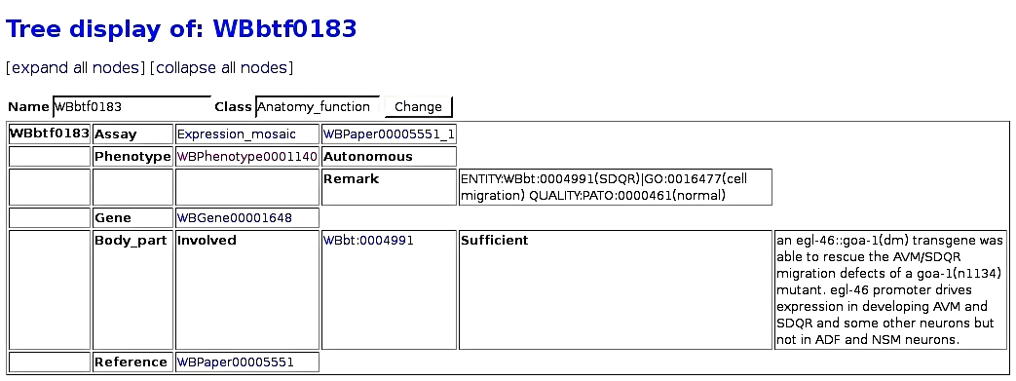
Anatomy Function
Phenotype ontology term
neuron_migration_abnormal
Assay detail
goa-1(n1134lf); Ex[pegl-46::goa-1(Q205L)]
Entity+Quality statement

Slide 10
Future Plans
Annotation
catch up on anatomy function curation (15% done).
Anatomy Term Page
add images, add external resource links, browser for neuronal connections.
Ontology
complete connecting lineage information to anatomy, enhance interoperability with other organismal anatomy ontologies (via OBO, CARO).

