Slide 1

LITERATURE CURATION
Overview & Integrated Phenotype Curation

Slide 2
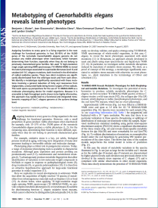

Literature Curation - Data Flow for First Pass
Paper
collection
First Pass
Data flagged with comments for
32 different data types
Postgres DB
Web
Interface
Some data types
stored for
future curation
Active Curation:
Data Extraction
Database Input Files
Complete
DB
St.Louis DB
Caltech DB
Sanger DB
Local Databases
Notes:
Kimberly - how data gets into first pass
Xiadong - gene reg stuff
Raymond Expression Data
first pass =
sorting
obtain paper = Pubmed
efficiency = curators deal w/ subsets of data
Q for andrei = how complete...what years are done????
4680 of 10095
all since jan 2002

Slide 3
First-Pass Curation Fields (based on 5787 Papers)

Slide 4
* Based on first pass papers completed unless otherwise noted † Outside of first pass
** includes one tiling array
*** Data from Sanger RT, - not only first pass

Slide 5
Many Data Types Include a Phenotype Assignment
Phenotype Annotations
- Consistency
- Efficiency
Phenotype Ontology
Provides a controlled vocabulary for phenotypic
descriptions, organized hierarchically
Can annotate phenotypes to a very granular level,
preserving associations with more general terms

Slide 6
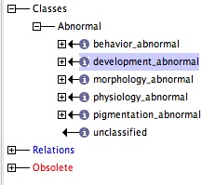
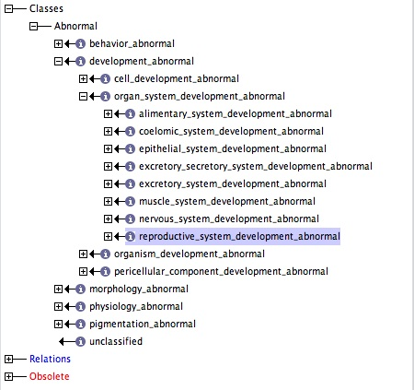
The WormBase Phenotype Ontology is Hierarchical:

Slide 7
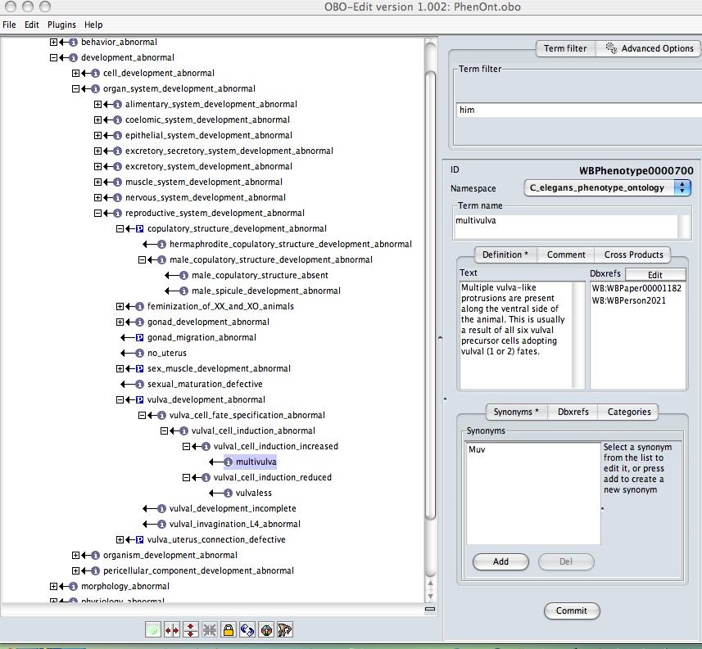
Annotate to a very granular level, preserving associations with more general terms
(OBO-EDIT)
reproductive_system_development_abnormal
vulva_development_abnormal
vulva_cell_fate_specification_abnormal
vulval_cell_induction_abnormal
vulval_cell_induction_increased
multivulva
Term Name
Definition
w/ references
Multiple vulva-like protrusions
are present along the ventral side of
the animal. This is usually a result
of all six vulval precursor cells
adopting vulval (1° or 2°) fates.
Synonyms
Muv

Slide 8
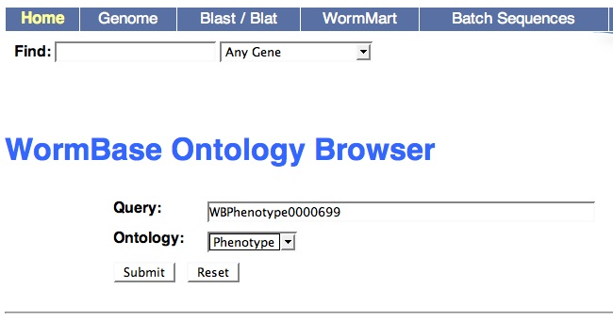
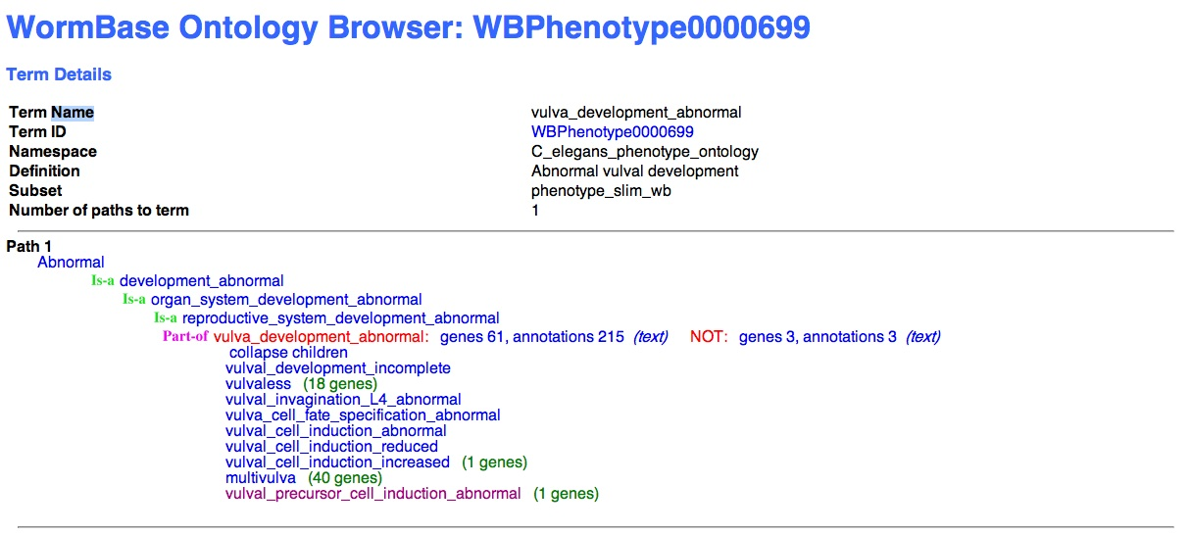
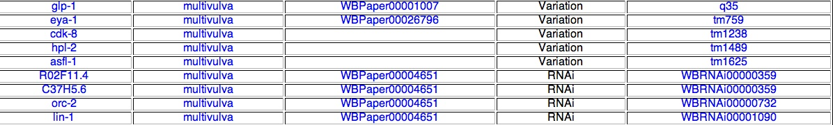
Using the Ontological Structure for Data Retrieval
Query by Name, WB ID
or Synonym
Vulva development
Also for:
Gene Ontology
Anatomy Ontology
Output: Showing children of parent term and annotations
See individual annotations with references

Slide 9
Phenotype Ontology Overview:
Release | Phenotype Terms | Defined terms | Percent Defined | Terms used (%)
WS160 - Jul, 2006 (prior to PO) | 119 | 0 | 0 | ---
WS170 -Feb, 2007 | 1394 | 237 | 17% | 40%
Current | 1677 | 708 | 42% | 60%
Development:
Refined by usage
We will continue development in parallel w/ curation
- reflects the developing complexity with which terms are described in literature
(Currently there are 4,675 alleles curated w/ 10,468 phenotype associations ~125% ↑ WS170)
Maintained with OBO-EDIT and registered with OBO foundry (NCBO)
OBO-Edit is developed by the Berkeley Bioinformatics and Ontologies Project, and is funded
by the Gene Ontology Consortium.
Community Input
Seek input from experts in certain fields to develop ontology

Slide 10
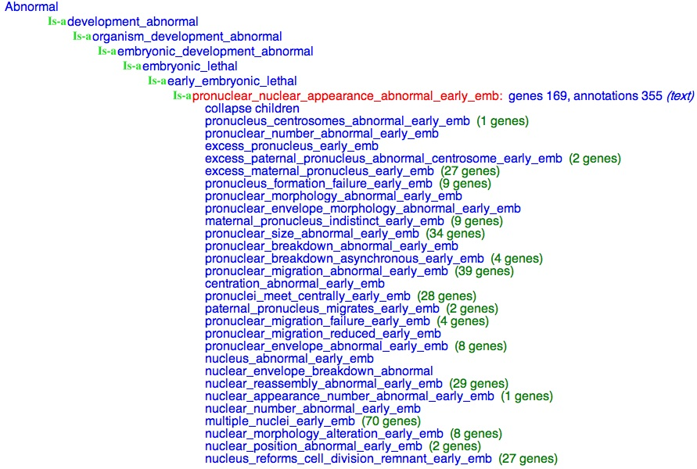
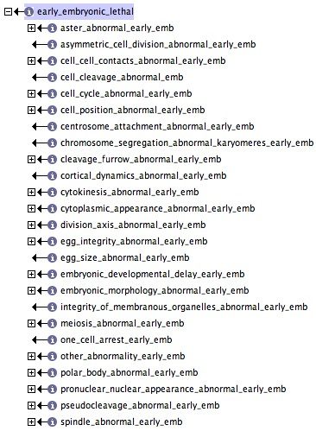
Expert input leads to granularity that reflects term usage
The embryonic_lethal branch - Fabio Piano and Kris Gunsalus
annotations 355

Slide 11



Integrated Phenotype Curation
Initial paradigm - one curator = one data type
First Pass
Gene Regulation
Interactions
(change in expression)
(genetic)
RNAi
Paper:
Chromatin regulation and sumoylation in the inhibition of Ras-induced vulval development
in Caenorhabditis elegans.
Poulin et al - EMBO J. 2005 Jul 20;24(14):2613-23.
smo-1:
RNAi → Phenotype
“RNAi of smo-1 on its own induces a low percentage of Muv animals”.
RNAi based Interaction (Enhancement)
“let-60(n2021) increase in the percentage of Muv animals compared to smo-1(RNAi) alone”
RNAi based Interaction (Synthetic)
“smo-1 displays synMuv activity in both class A and class B backgrounds”
RNAi based Gene Regulation (Ectopic)
“RNAi of the sumoylation pathway gene smo-1 leads to ectopic lag-2 expression”

Slide 12
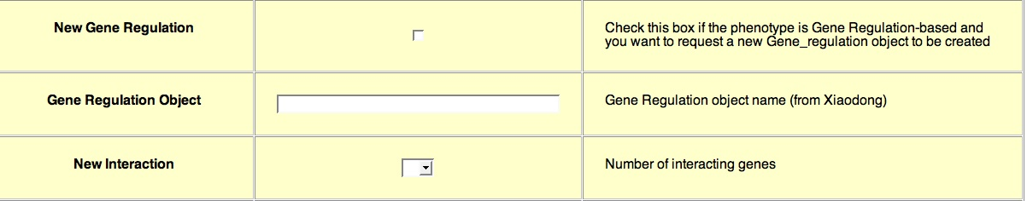
Need for curation integration: RNAi curation as an example
First Pass
Gene Regulation
RNAi
Interactions
RNAi based Interactions
RNAi curation form has functionality to generate interaction objects
Enter number of interacting genes

Slide 13
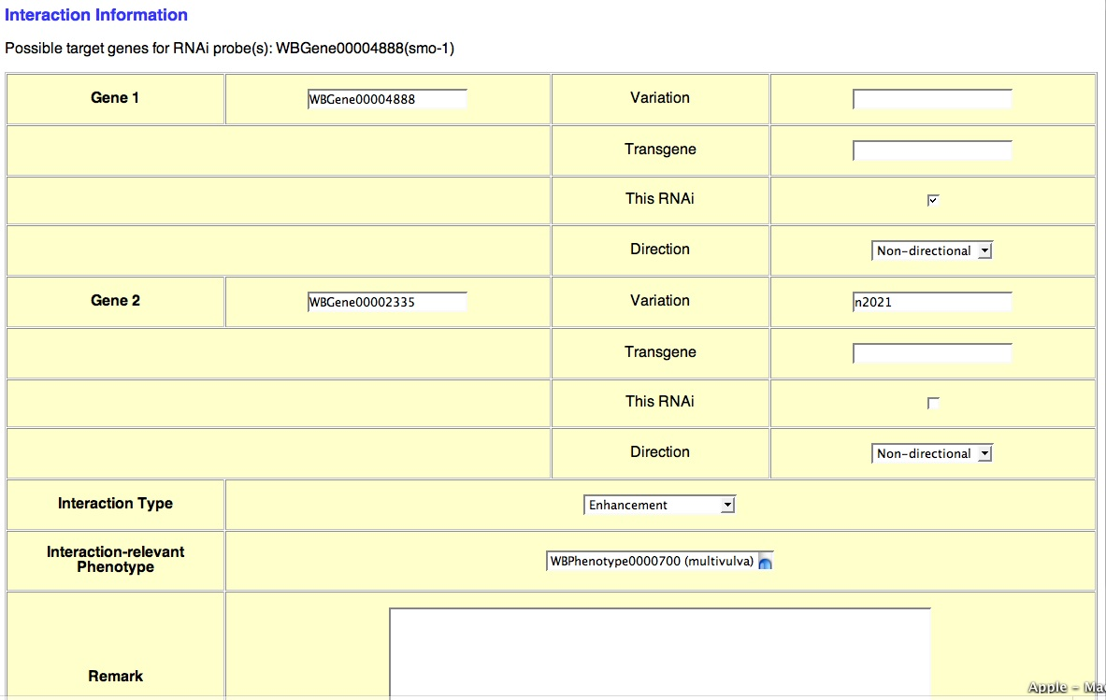
“let-60(n2021) increase in the percentage of Muv animals compared to smo-1(RNAi) alone”
smo-1(RNAi)
let-60(n2021)
Enhancement
Muv
- Keep track in Postgres database - avoids redundant curation
- Currently there are 2493 RNAi-based interactions in WormBase

Slide 14
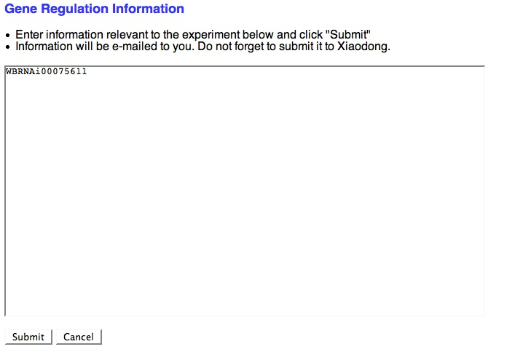
Coordination of RNAi based Gene Regulation
· If an RNAi object is created first:
I enter information here so that Xiaodong can create a gene regulation object for the RNAi object
· If a gene regulation object is created first:
Xiaodong creates a gene regulation object and I input the object name here
· Currently there are 365 RNAi-based gene regulations (46% ↑ from WS170)
· Need to set up a tracking system in Postgres

Slide 15
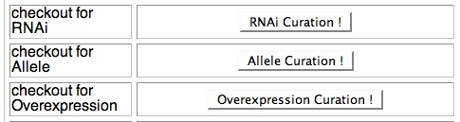
Towards Integrating RNAi and Allele Curation
First pass
Alleles
RNAi
Postgres
RNAi Checkout
Allele Checkout

Slide 17
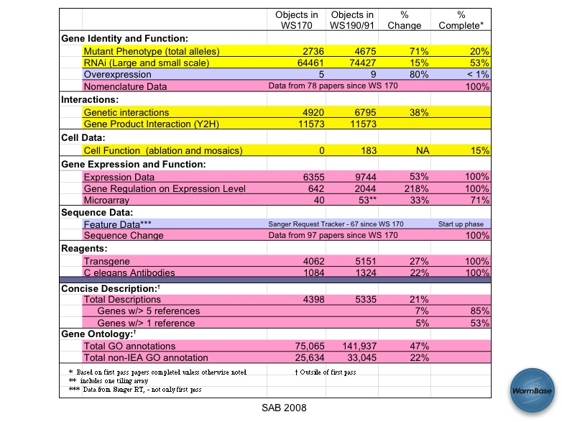

Slide 18
