Slide 1
Non-elegans Gene Structure Curation

Slide 2
Tier II Genomes
Current status in WormBase:
C. briggsae – just heard from Darin
C. remanei – “preliminary” gene set and ngasp
C. brenneri – nGASP predictions
C. japonica – mGene only
P. pacificus – nothing, but genes from Ralf Sommer
H. bacteriophora – nothing
Current activity:
Only C. briggsae is being curated.

Slide 3
Tier II Gene Structure Curation
Is it necessary?
  Aren’t automatic predictions sufficient?
Is it possible?
  Resource availability.
  Continued C. elegans priority.

Slide 4
nGASP predictors are still not perfect
Out of 100 C. elegans Jigsaw predictions checked:
  81 (55) were predicted correctly
  1 (0) correctly indicated a required change
  10 (25) differed from the curated CDS
  3 (7) merged/split genes incorrectly
  3 (1) CDS where there was a pseudogene
  1 (2) missed a gene entirely
  1 (6) gene predicted where there was none
. . But they’re a pretty good start.
(Twinscan)

Slide 5
TierII - nGASP inclusion
For species with existing genes (remanei & briggsae) we’ll incorporate nGASP genes and map identifiers from old to new using ensembl stable id mapping software
  Appraisal of problematic cases
For other tierII species we’ll create new gene objects based on nGASP predictions
For all this will for the basis for on-going curation efforts.

Slide 6
Tier II Curation plans
Driven by user submissions & publications
Data will be processed, analysed and stored in a curation database the same as C. elegans. This will allow easy curation when required.
Data can be dumped and displayed on the genome browser to highlight potential discrepancies.
Division of labour?

Slide 7
Automatic Updates
We will investigate methods to update gene predictions automatically when new evidence is found.
Curation tool tracks evidence conflicting with gene predictions.
At time zero all evidence will have been considered by nGASP predictors so we’ll start from a clean slate.

Slide 8
Automatic updates
Existing
structure
New
structure
Alignment of
new data
Auto
replace
Manual
appraisal
Check for
discrepancies
New alternative
structure
Dump local data
(e.g. GFF,
genomic alignments)
Run prediction
tools

Slide 9
Tier III Genomes
Much more community based.
  Their gene predictions.
Community annotation
both gene structure and function
  WormBase more of an infrastructure provider
eg genome browser, wiki, forum,
possibility of web / apollo based gene editor
We will still provide automatic analysis eg ,
  transcript alignments,
  Protein annotation
  Orthologue determination
Less frequent updates.
We will help when and where requested but are unlikely to be driving these annotations.

Slide 10
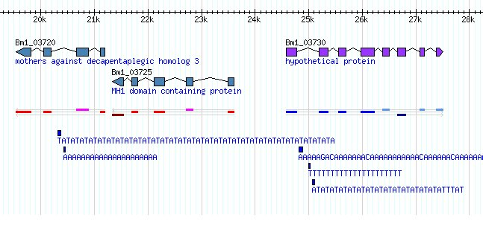
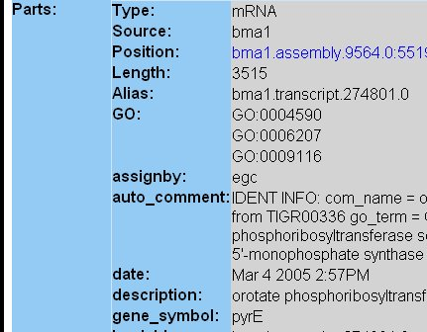
Brugia malayi genome browser http://www.wormbase.org/db/seq/gbrowse/brugia/
Each gene links to a simple Gene page
BLAST hits and protein domains to come . .

