Slide 1
1. C. briggsae sequence curation
2. SNP data handling

Slide 2
C. briggsae sequence curation
What’s involved:
  ACeDB database (brigace) with gene models and alignments
  Curator to make changes, be point of contact for user submissions
  Upload all gene data each release to Sanger
    Scripts that can be generalized to any genome
  Sanger generates various flat files (brigpep) and integrates into build

Slide 3
C. briggsae sequence curation
Current curation:
  175 changes so far
    Orthologues (personal communication)
    Protein families (chemoreceptors)
  Submit to EMBL every frozen release
  Few systematic problems with original gene set:
    2324 Start_not_found
    60 don’t start in frame=0
  Sequence changes : 1 waiting

Slide 4
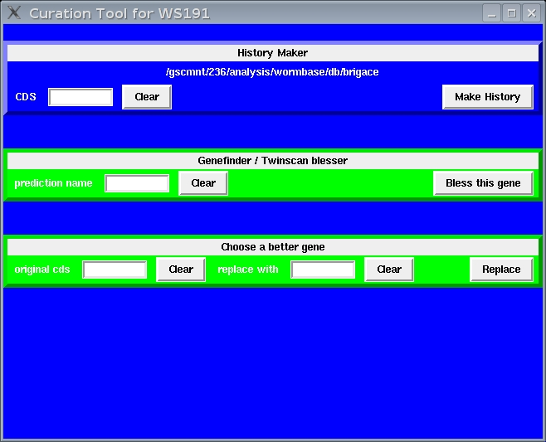
Curation tool add-on for transferring new CDS structure

Slide 5
SNP curation
What’s involved:
  ACeDB database (snpace) contains all SNPs for all species
  Curator to make changes and be point of contact for user submissions
  Scripts to upload ace files to Sanger to be integrated in build process

Slide 6
SNP curation
Current curation:
  C. elegans:
    Large datasets in last year:
      50906 pas* (CB4858)
      112101 hw* (CB4856)
    Individually entered: 225
      Personal communication
      Papers
  C. briggsae:
    Currently 58000

Slide 7
SNP curation
Future plans:
  New web form for submission
  More robust error checking
  Web interface improvement

Slide 8
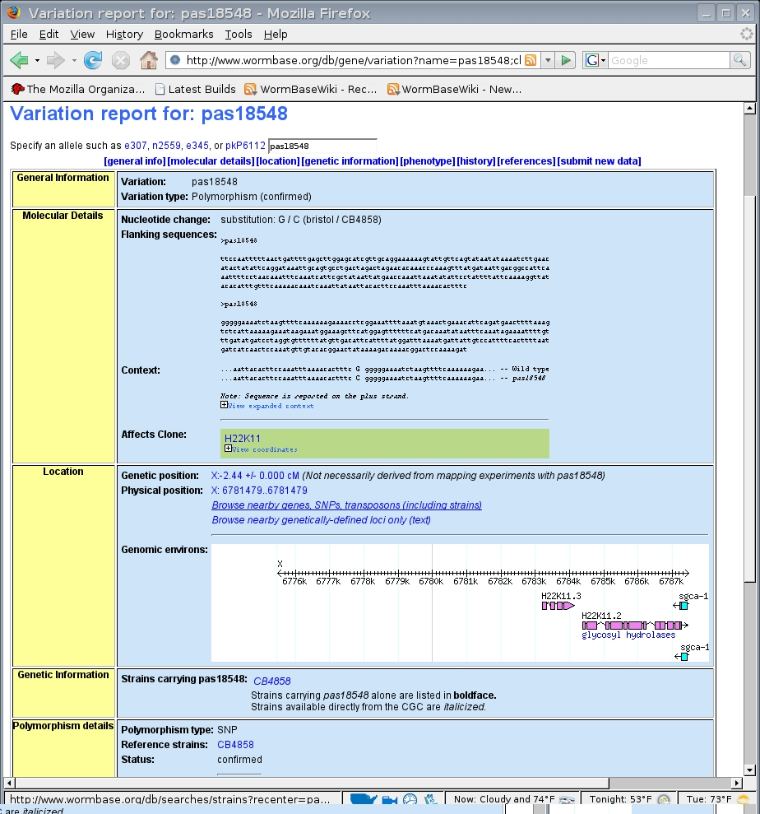
Current Variation
report page

Slide 9
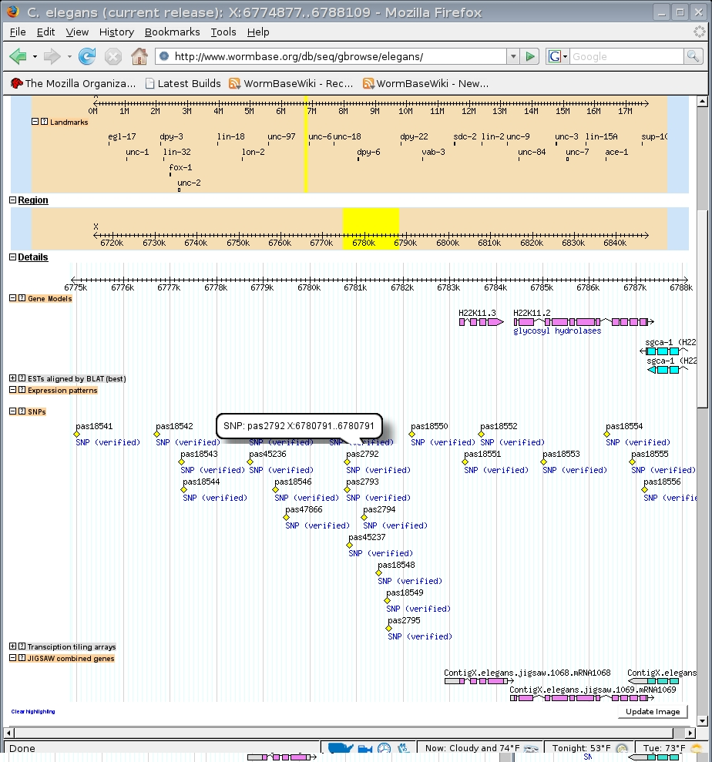
SNP track visible
on genome
browser

Slide 10
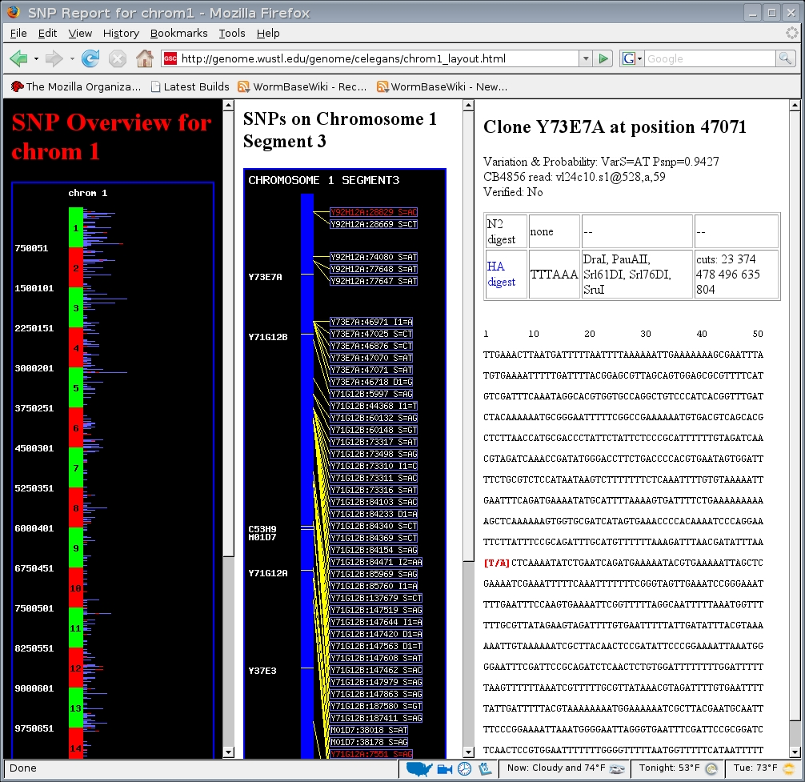
Old WashU
SNP display

Slide 11
nGASP gene predictions are good, but still not perfect
Out of 100 Jigsaw (Twinscan) predictions checked:
  81 (55) were predicted correctly
  1 (0) correctly indicated a required change
  10 (25) differed from the curated CDS
  3 (7) merged/split genes incorrectly
  3 (1) CDS where there was a pseudogene
  1 (2) missed a gene entirely
  1 (6) gene predicted where there was none

Slide 12
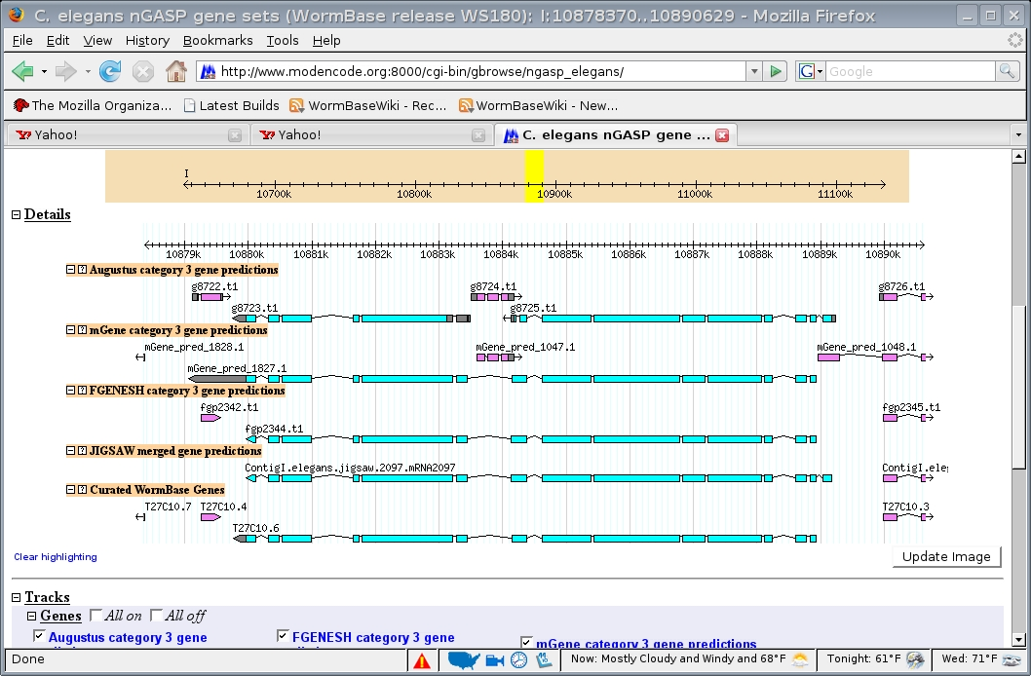
Jigsaw genes for C. elegans

Slide 13
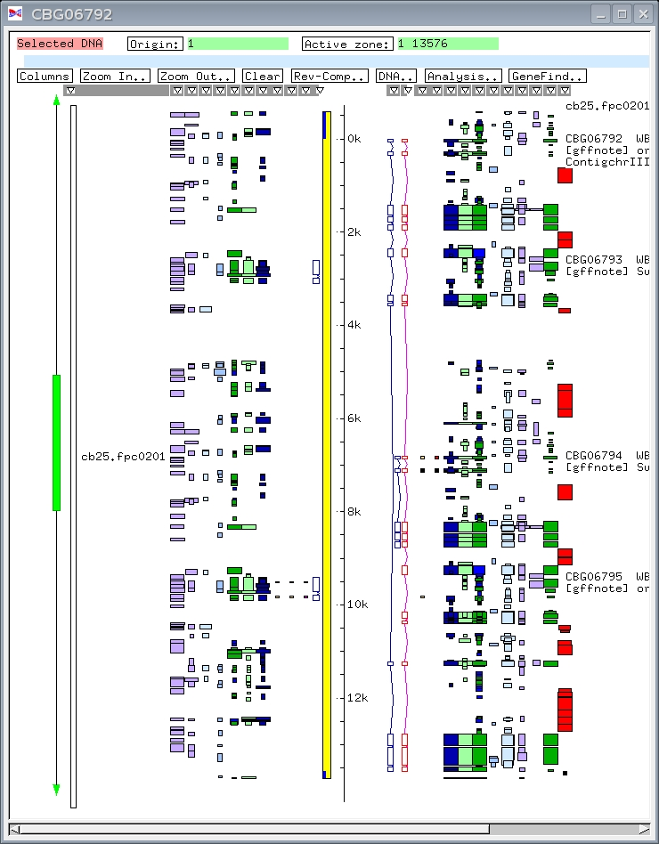
Jigsaw merges two
curated CDSs
- transfer gene IDs
Jigsaw
curated

Slide 14
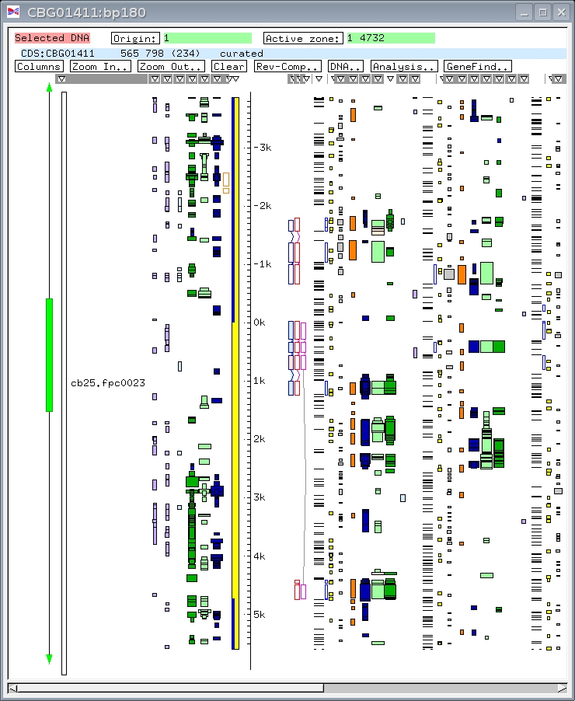
Jigsaw correctly
makes same change
as curator to
chemoreceptor
curated
Jigsaw
history

