Slide 1
Orthologs, Diseases, and Interactions
Norie de la Cruz

Slide 2
Moving through and across the data
Interaction
Orthologs
Gene
Disease
Ontology
Notes:
Most of these arrows are one to many relationships… One challenge is data representation and cueing user to access to more related information…

Slide 3
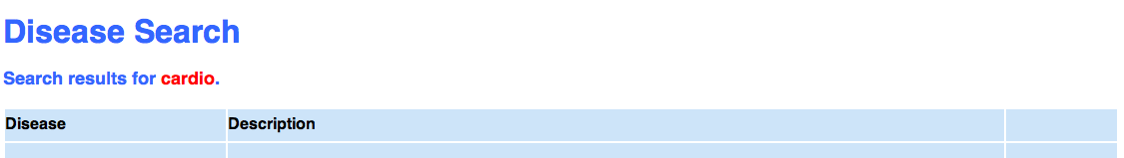
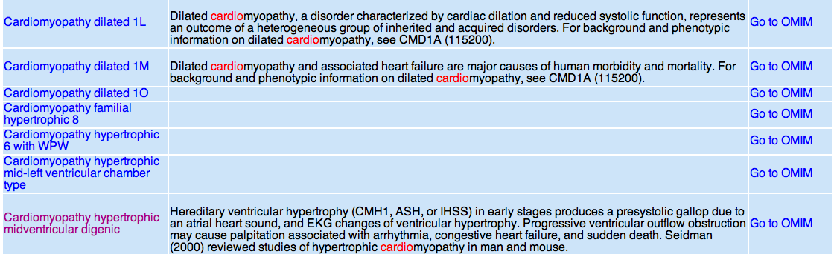
Disease Search for “cardio”
Notes:
As good a place to start as any (not directed graph)…. Start with disease search results

Slide 4
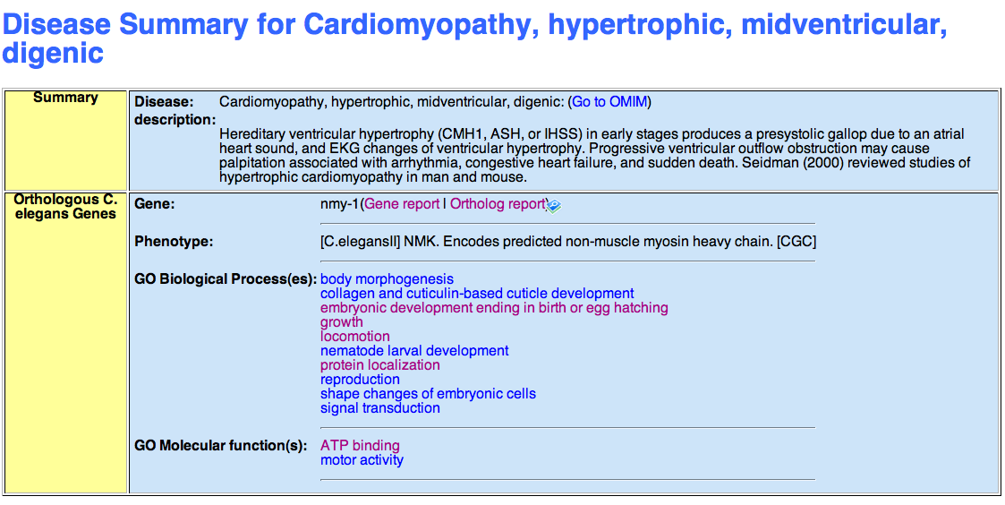
Genes and Diseases
Notes:
Go to gene report link, will discuss ortholog link later

Slide 5
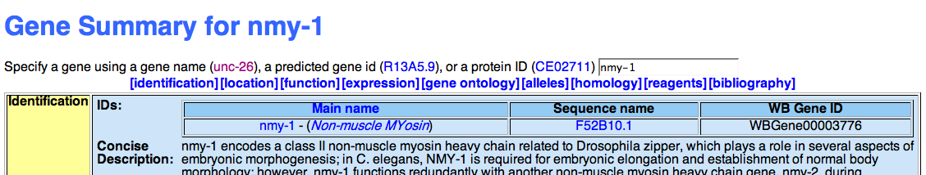
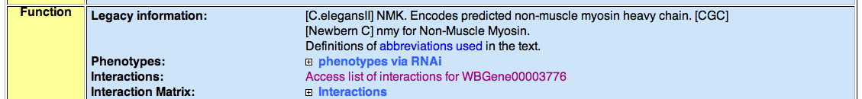
To and from genes
Gene to interactions ….

Slide 6
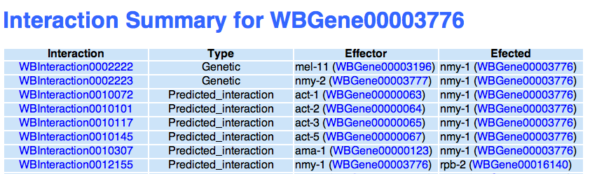
Interactions Summary for gene

Slide 7
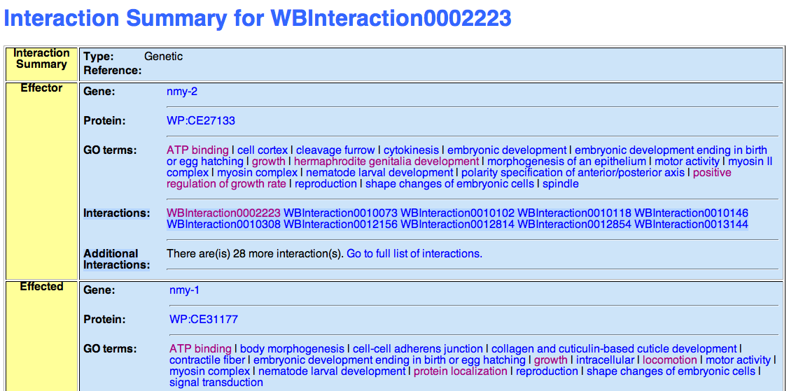
Interaction Report

Slide 8
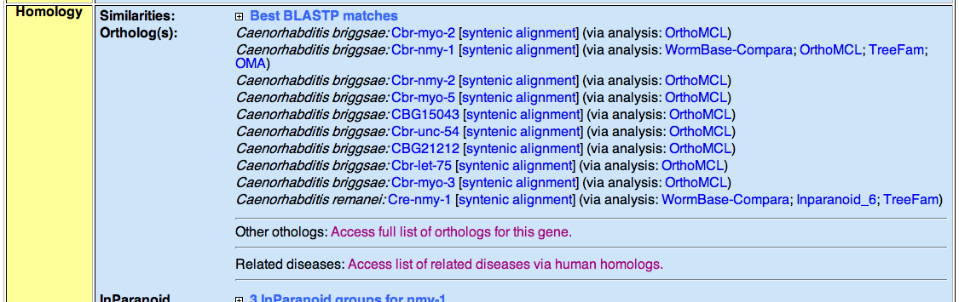
To and from genes
Gene to Other orthologs and diseases ….

Slide 9
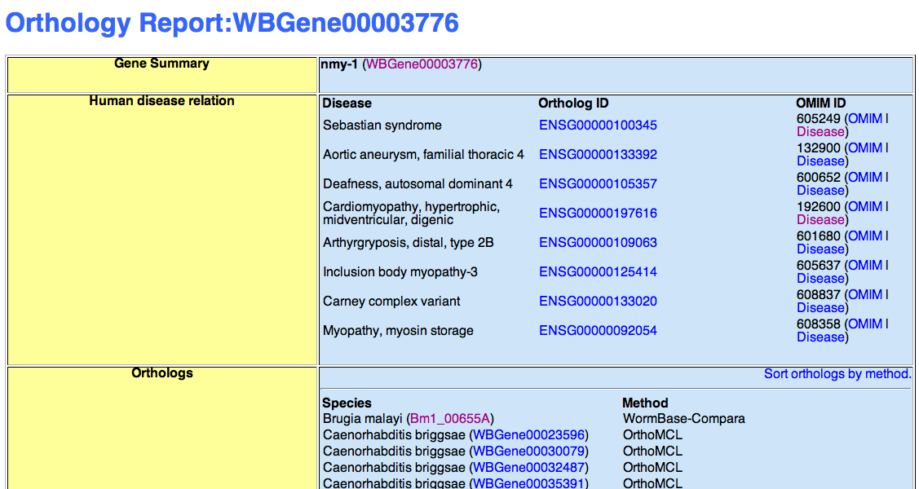
List of orthologs for gene

Slide 10
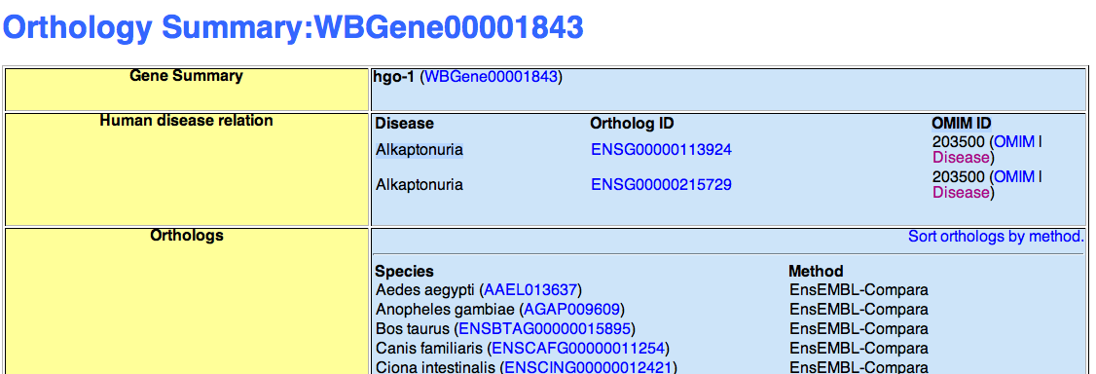
Orthology Report

Slide 11
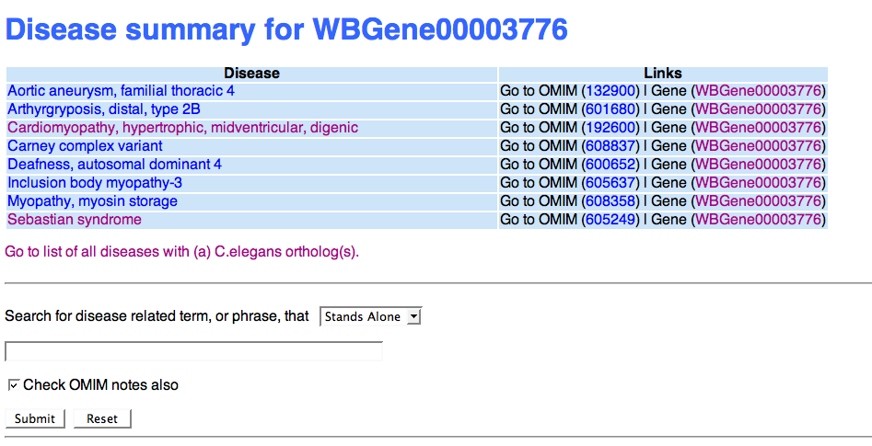
List of diseases for gene

Slide 12
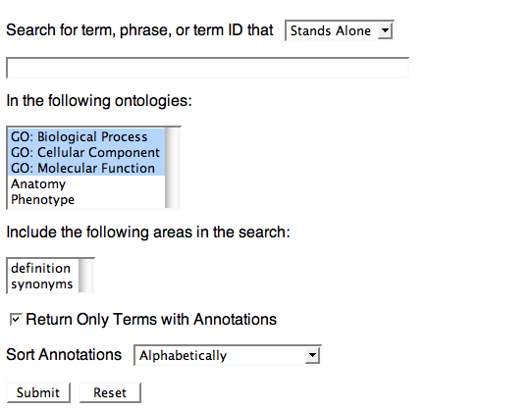
Searching Multiple Ontologies

Slide 13
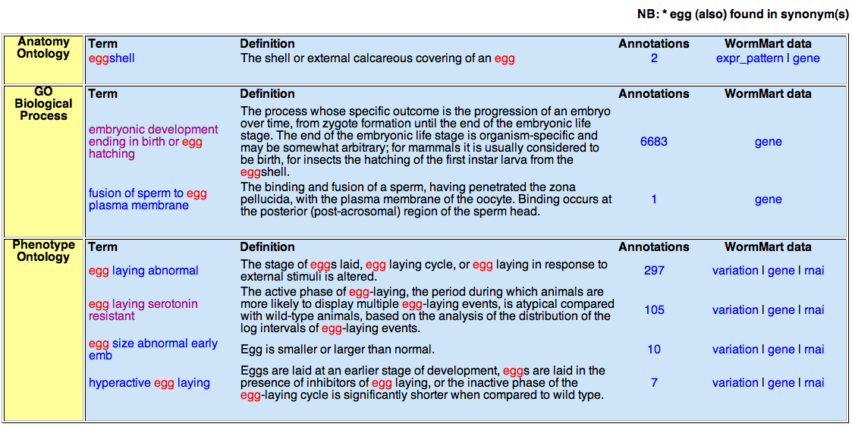
Multiple ontology search results

Slide 14
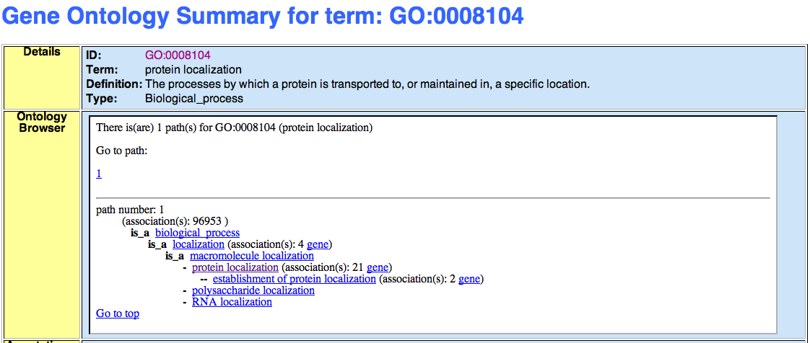
Ontology browser upgrade

Slide 15
The fun goes on ….
Work with OMIM to link back to WB
Addition of OMIM data to AceDB
Links to and from Reactome and HapMap projects

Slide 16
Thank you!

Slide 17
End
Succeeding slides are extra !!!

Slide 18
Reports
Back and forth links between ontologies and associated objects
Back and forth links to related terms in other ontologies
Browser with links to WormMart

Slide 19
Orthology and Disease
Search functionalities
Interlinking between pages

Slide 20
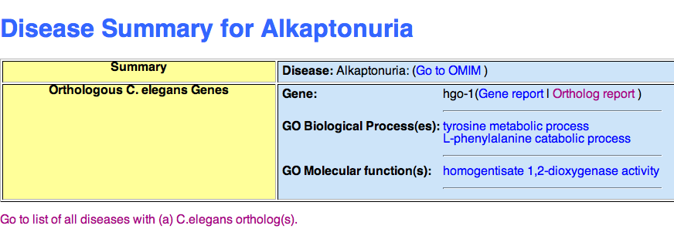
Disease Report

Slide 21
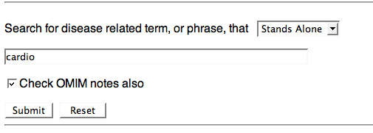
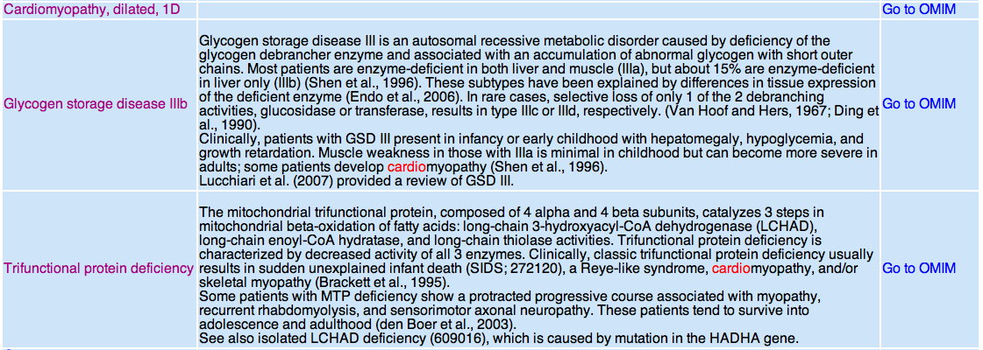
Disease Search

Slide 22
Acknowledgements
Todd Harris
Lincoln Stein
Dev Group: Sheldon Mckay, Will Spooner, Zheng Zha
WormBase staff

