Slide 1
Genetic Data in
Mary Ann Tuli

Slide 2
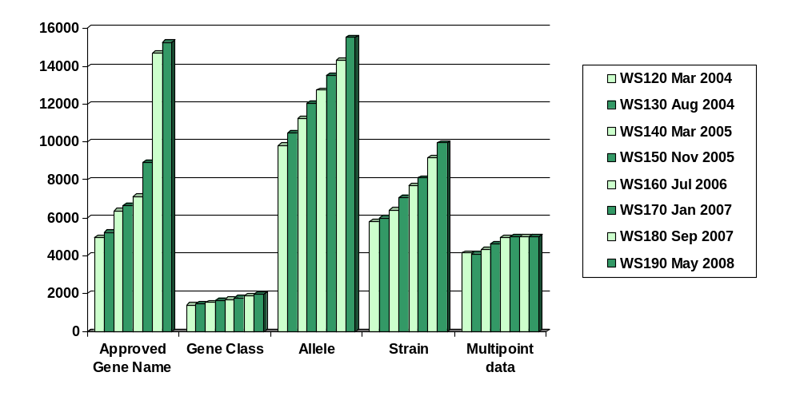
Growth of Genetic Data
SAB 2008

Slide 3
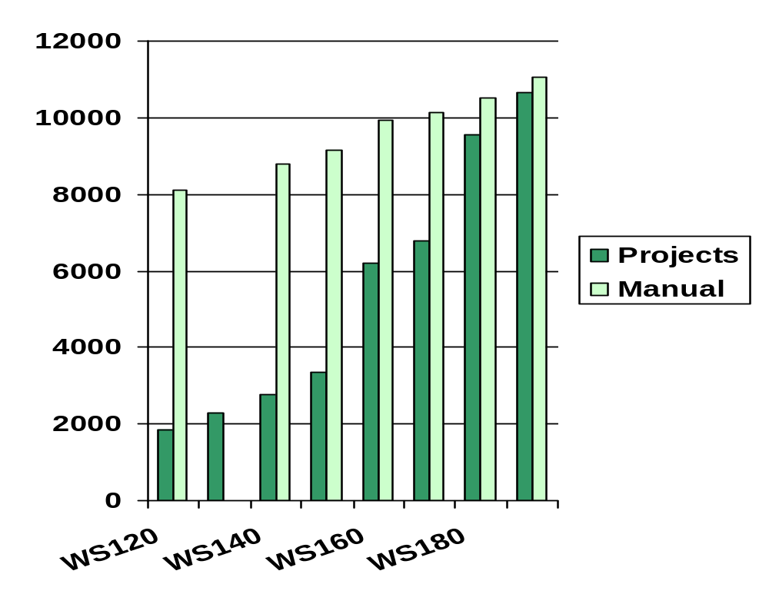
Growth in Variation Data - 1
SAB 2008

Slide 4

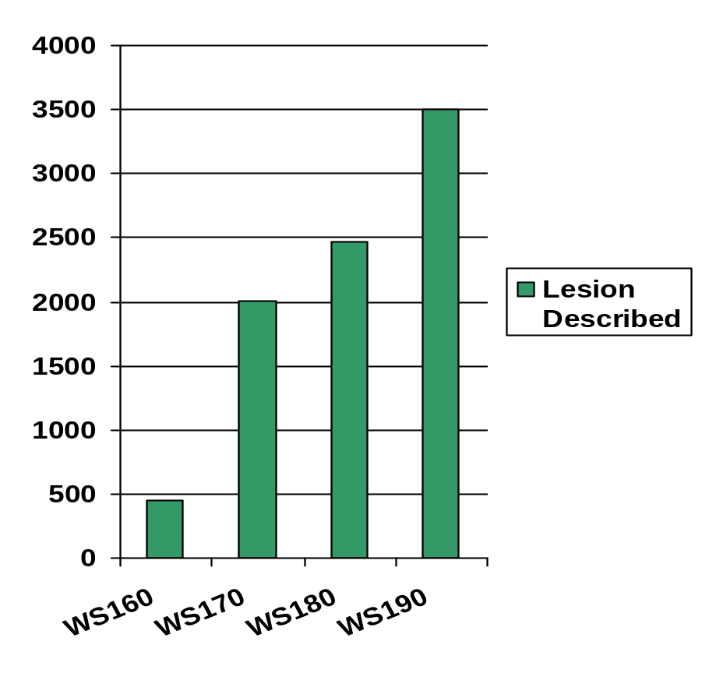
Growth in Variation Data - 2
3500 have rich annotation
  Description of lesion
  Connection to sequence
  Connection to strain
In maintenance
SAB 2008

Slide 5
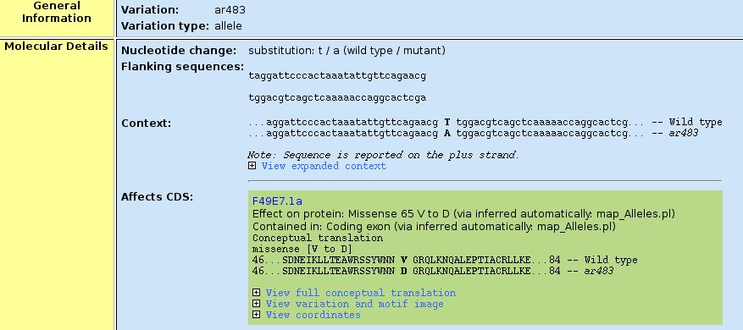
Molecular Change Presentation
SAB 2008

Slide 6
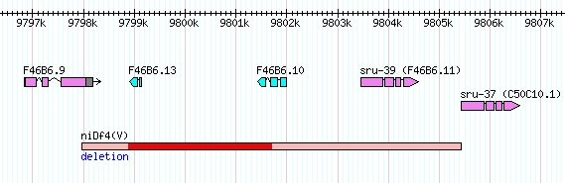
Copy Number Variants
Generated by Comparative Genome Hybridization (CGH)‏
The University of British of Columbia, Vancouver Gene Knockout Laboratory
249 in WS190
Displays region which is either definitely or probably deleted
SAB 2008
Notes:
First data added Sept 2007
Dataset completed in Feb 2008

Slide 7
Growth in Variation Data - 1
SAB 2008

Slide 8
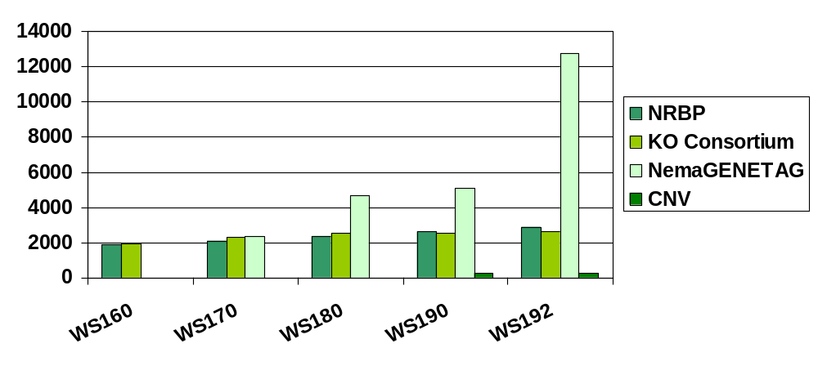
Large Scale Allele Projects - developments
Phenotype information for NRBP alleles sent to CalTech
NemaGENETAG project data all submitted
CNV data from KO Consortium
SAB 2008

Slide 9
Genetic Map Data
We continue to receive data from web submission forms and publications
Acedb improvements
briggsae genetic map - Hillier
SAB 2008

Slide 10
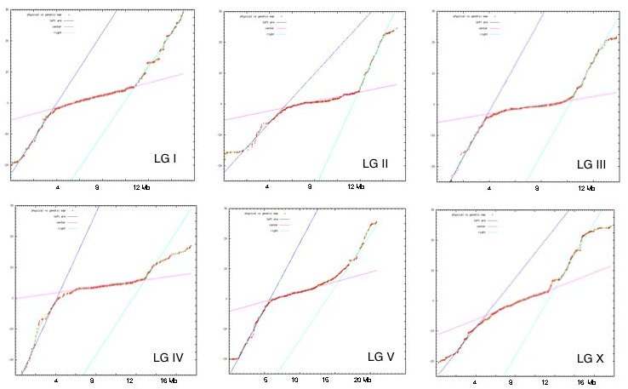
Marey Maps for C. elegans
SAB 2008

Slide 11
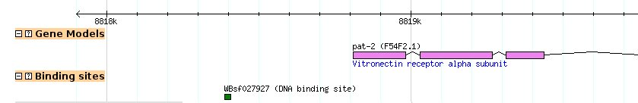
Feature Curation
Will capture
  Binding sites - Consensus sequences - Promoters
Literature curation (start up)
  Request Tracker (RT) system
Model changes
~60 pending papers
SAB 2008

Slide 12
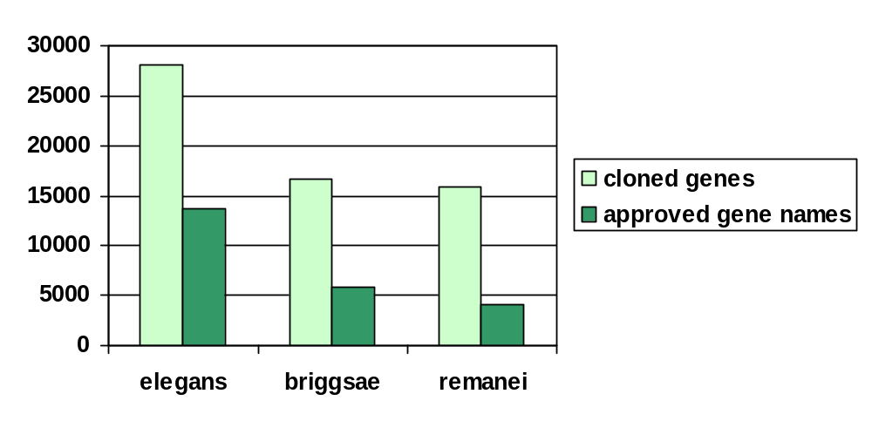
Other Genomes – Tier II
Orthologs
  connections stored in Geneace
  names mainly automatically assigned
Nomenclature guidelines available in Wiki
Will update WormBook
SAB 2008

Slide 13
Nameservers
Eases site-to-site collaboration
Gene Nameserver
  since 2006
  Pre-build checks & scripts
Variation Nameserver - test version available
Feature Nameserver
  since 2007
  scripts
SAB 2008

Slide 14
Capturing Data
From Collaborators
  In-house Web forms – NBP & NemaGENETAG
  E-mail – KO Consortium
From Users
  WormBase Submission forms
  E-mail – genenames@wormbase
Within WormBase
  E-mail – Jonathan & First Pass
  Request Tracker (RT)‏ - Feature data
  CalTech forms – Variation
SAB 2008

Slide 15
International Biocurator Society
Based in Geneva
~13 databases
  3 conference calls
  Wiki
Sub group formed to compose letter to journals asking for metadata.
Next meeting Spring 2009 - Germany
SAB 2008

Slide 16
Future Plans
Allele curation
  Pre-2001 allele literature
  Richer annotation of existing objects
Feature literature curation
Improved capture of data – CalTech
NemaGENETAG
Continued website display improvements
SAB 2008

Slide 17
Collaborators
Nomenclature
  Jonathan Hodgkin
The CGC
  Ann Rougvie & Theresa Stiernagle
The Knockout Consortium
  Mark Edgley
  Jeff Holmes
National BioResource Centre, Japan
  Shohei Mitani
NemaGENETAG
  Laurent Ségalat
Acedb
SAB 2008

