Slide 1
Building WormBase database(s)

Slide 2
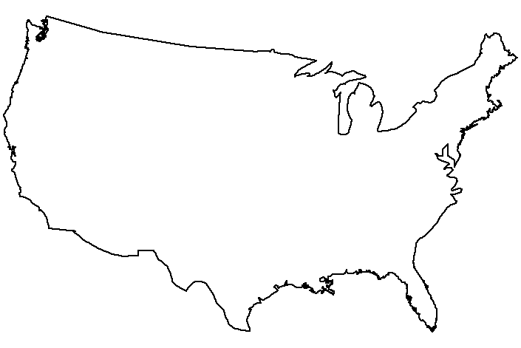
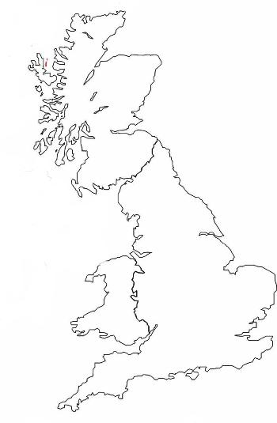




The WormBase Consortium
Washington University in St. Louis
Cold Spring
Harbor Laboratory
Wellcome Trust
Sanger Insitute
California Institute
of Technology
Gene prediction annotation
SNPs
Gene Structure curation
PCR_products / Oligos
3D structures
Website and tools
Gene prediction annotation
Comparative analysis
Genetic Data
Alleles
Gene name info ( incl unique ids )
Strains
Data Integration and analysis
RNAi
Microarray
Anatomy / Cell
Homology groups
SAGE data
Gene Ontology
Papers / References
Person / Author
Detailed Functional Annotation
Expression Patterns
Literature Curation

Slide 3
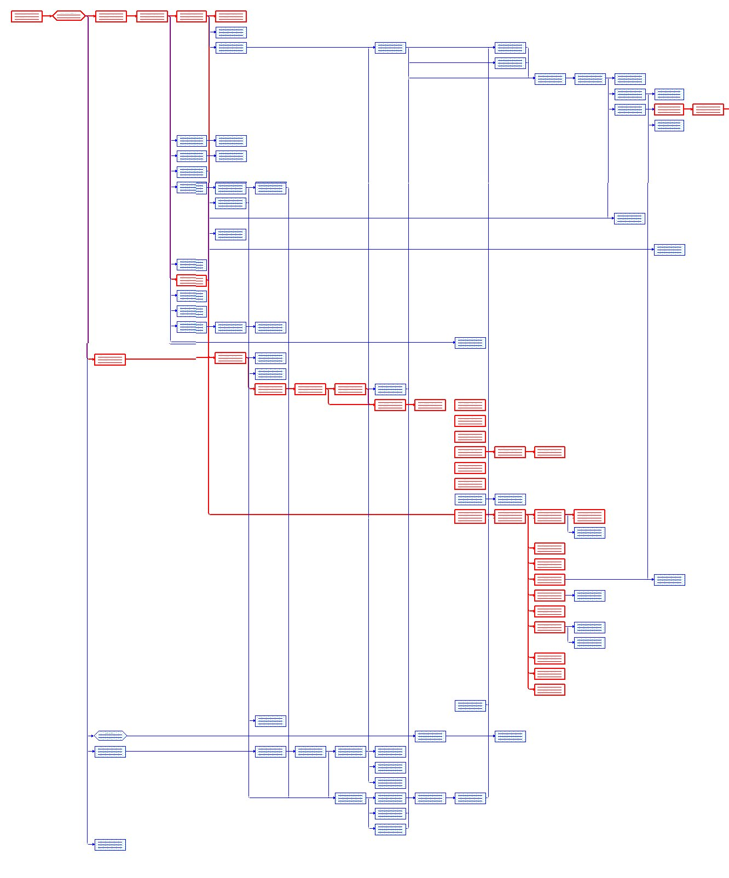
Build Process
99% perl scripts
Continued improvements in
  modularistation
  logging and error checking
  de-eleganisation
eg Species modules
  Inherited classes
  1 per species
  access to names, sequences paths etc

Slide 4
Build Overview
Initiate
FTP uploads from other sites
Recreate primary databases
Class by class extraction
Load to fresh database
INITIALISE
BLAT
BLAST
PIPELINE
BUILD
TRANSCRIPTS
ONTOLOGY
Blat
Align cDNAs etc to genome
COMPARA
MAPPING
Transcript building
Use alignments etc to construct coding transcripts
Generate UTRs and genespans
GFF
POST-PROCESS
FINAL
CHECK
RELEASE
CLEAN UP

Slide 5
Build Overview
BLAST Pipeline
Genomic DNA
RepeatMasker
Blastx
Human, fly, yeast, other worms, SwissProt/ TrEMBL
Proteins
Blastp
PFAM, InterPro, TMHMM
Ensembl
mysql databases using Ensembl schema and code
Results dumped as ace or GFF3
Compara
Provides gene families and multi genome alignments.
INITIALISE
BLAT
BLAST
PIPELINE
BUILD
TRANSCRIPTS
ONTOLOGY
COMPARA
MAPPING
GFF
POST-PROCESS
FINAL
CHECK
RELEASE
CLEAN UP

Slide 6
Build Overview
Mapping
Ensure correct location of features and experimental data on genome sequence regardless of changes
Ensure connection to correct genes even after gene model changes.
Done for eg RNAi, Variations, PCR_products,
We have also developed a publicly available tool to easily transform coordinates between any pair of releases.
Ontology
Infer GO terms from InterPro domains and phenotypes
Write out files for ?
INITIALISE
BLAT
BLAST
PIPELINE
BUILD
TRANSCRIPTS
ONTOLOGY
COMPARA
MAPPING
GFF
POST-PROCESS
FINAL
CHECK
RELEASE
CLEAN UP

Slide 7
Build Overview
GFF Processing
  Add extra info to GFF files to enhance genome browser
  eg Gene names to CDS
  Landmark genes
  Species info to transcripts alignments
Final Checks
  Consistency between GFF and acedb.
  Class counts
  objects loaded
Release
  Autogenerate release notes
  FTP and websites
INITIALISE
BLAT
BLAST
PIPELINE
BUILD
TRANSCRIPTS
ONTOLOGY
COMPARA
MAPPING
GFF
POST-PROCESS
FINAL
CHECK
RELEASE
CLEAN UP

Slide 8
Building other species databases
All tierII species stored as acedb databases.
All build scripts are (will be) species independent.
All tierII can be rebuilt exactly same as C. elegans.
Update frequency - Why not every release?
  Effort : value

Slide 9

Build Process

Slide 10
What’s the point?
10% of our time.
Faster builds – no “dead time”.
No chance of missing things out.
Better use of system resource.
Forces better coding & error checking.

Slide 11
What’s the hold up?
Tighten up error reporting
  Differentiate “show stoppers” from undefined variables.
Make sure of dependancies.
LSF conversion to LSF::JobManager for parallel work.

Slide 12
TierIII Builds
No acedb database, all stored in Ensembl mysql databases.
All automatic annotation (blasts, protein domains)
GFF3 dumping process improved to add extra info eg GO_terms
Will be included in comparative analyses
Syntenic regions determined where applicable (closely related species)

Slide 13
TierIII Collaborations
Sanger Institute Pathogens group.
  Managing the sequencing projects.
  Initial gene predictions.
  Community links.
  Ongoing annotation and gene improvement.
WormBase help with Ensembl infrastructure
  Alignment and comparative pipelines.
  Automatic protein alignments.
  Some gene prediction assessment.
  Integrated and linked genome browsers.

Slide 14
TierIII Collaborations
Ensembl-metazoa
  New ensembl branded websites covering much wider range organisms as replacement for Genome Reviews.
  Display in Ensembl environment
  Link to other EBI resources, e.g. UniProt
Proposed model of data providers within established communities.
  Shared data to ensure consistancy

