Slide 1
Curation Tools
  Gary Williams
  Sanger Institute

Slide 2
Gene curation – prediction software
Gene prediction software is good, but not perfect.
Out of 100 Twinscan predictions checked:
  55 were predicted correctly
  29 differed from the curated sequence
  7 merged/split genes incorrectly
  1 predicted pseudogenes as CDS
  2 missed a gene entirely
  6 genes predicted where none

Slide 3
Gene curation – sources of data
We have traditionally relied heavily on EST transcription data to correct predictions.
Now we have many extra data sources
  Protein homology
  Mass-spec peptides
  Chip-based expression data
  Comparative species synteny/homology
  Other data coming (ENCODE etc.)

Slide 4
Confirming the correct structure
Evidence for a correct structure:
  Protein homology, transcript data, ab initio predictions, mass-spec peptides, tiling array, trans-spliced leader sequence, strong splice sites, etc.
Evidence against a correct structure
  Unmatched instances of the above
  Frameshifts in protein alignment
  Overlapping exons
  Genes overlapping repeat regions

Slide 5


How to curate efficiently
Ad hoc lists of problems
Scan by eye
Find anomalous regions

Slide 6
Curation methodology
Lists of problems
  Keep returning to previously curated regions
  Tedious to get to next genome position
Scan by eye
  Pilot scan of 1Mb done
  Inefficient & error-prone because most gene models are now correct
Find problem areas
  Database of evidence against “good” gene structure.
  Look for concentrations of anomalies

Slide 7
Anomalous regions database
Have a database of problem regions.
Anomaly = conflicts with the curated data
Assumption: problem areas that need the most curation will have more anomalies than other places.
Anomalies
Problem areas

Slide 8
Anomaly database
Anomalies that have been seen can be flagged to be ignored in future.
All anomalies in a region are presented for inspection en masse.
We can track what has been seen and measure progress.

Slide 9
Simple anomalies
Protein homology unmatched by curated CDS
Unmatched conserved coding regions
Unmatched TSL sites
Unmatched Twinscan/Genefinder
Short exons (< 30 bases)
CDS exons overlapping repeat region

Slide 10
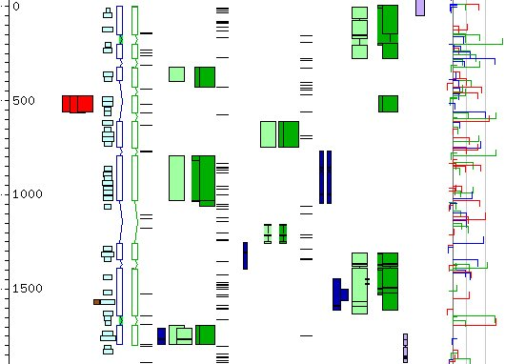
Unmatched anomalies
Twinscan
Splice sites
CDS
Anomalies
Expression
Protein hits

Slide 11
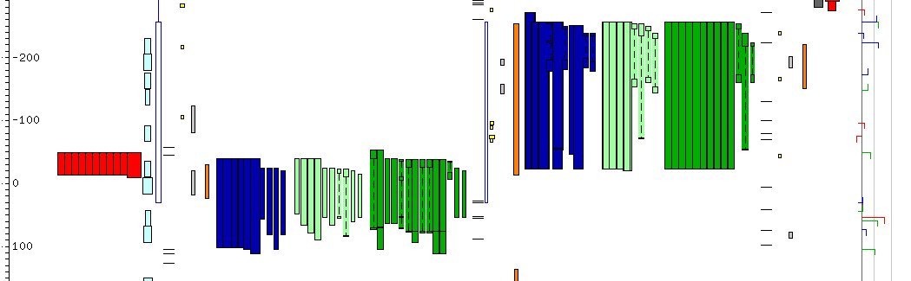
Frameshift in exon
CDS exon
Frame 1
Frame 2
Frame 3
Expression
Anomalies
Protein hits

Slide 12
Anomaly database
Store anomalies in each 10 Kb region
Sort windows by sum of anomaly scores
Curator selects next 10 Kb window
Curator selects anomaly to curate
Acedb editor displays region

Slide 13
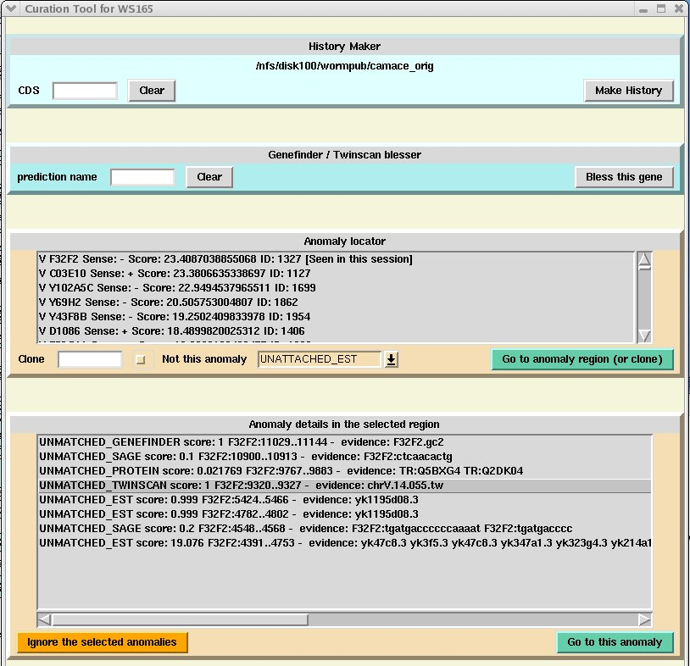
Anomaly database – list of regions
List of 10Kb windows sorted by anomaly score.

Slide 14
Anomaly database – select region
Select a region
List of
anomalies
in region

Slide 15
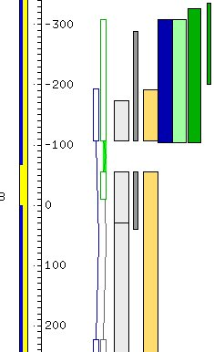
Anomaly database – select anomaly
Select an anomaly
Display of the anomaly
(Unmatched twinscan)

Slide 16
Efficiency
Standard set of anomalies for curators to work on.
Anomalies are not missed.
Can quickly accept or reject regions to curate after a cursory glance.
Makes finding problem areas easy
  concentrate efforts on problem regions
  no unnecessary repeat visits to a region.
Complex problem areas can still take a long time to solve.

Slide 17
Other anomalies
Work is continuing to add new types of anomaly.
  Tiling array expressed regions
  Conflicts with nGASP prediction
  Missing/extra exons compared to other genes in homologs
Adding a new anomaly type requires no changes to the database or curation tool and it is amalgamated with the existing anomalies.
Any new data can easily be added.

Slide 18
Other species
The anomaly database system can be used for curating the Tier II species.
We will make the anomalies data for Tier II species available on the Genome Browser for users to see
  As with C. elegans
The curation database system could be made avalailable for the use of other model organism projects

Slide 19
end

Slide 21
More anomalies
Frame-shifts defined by protein homologies.
Genes to potentially be merged by protein homology evidence.
Genes to potentially be split by protein groups evidence.

Slide 22
Megabase scan changes
St. Louis only
Hinxton
only
57
26
5
Plus 7 agreed discrepancies
Agreed by both

Slide 23
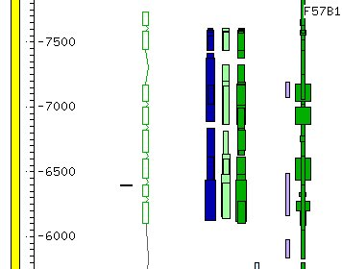
Unmatched anomalies
Twinscan
No curated CDS
C. briggsae
sequence conservations
(codingWABA)
TSL
C. elegans
Protein
C. briggsae
Protein
C. remanei
Protein

Slide 24
Frame-shifts by protein homology
A protein aligned by BLAST.
Frame-shift
Small/no apparent intron.
Near-contiguous regions
of the protein.
Frame 1
Frame 2

Slide 25
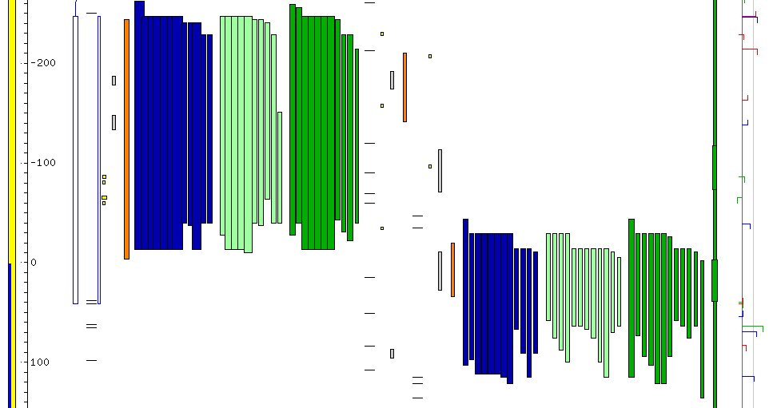
Frameshift in exon

Slide 26
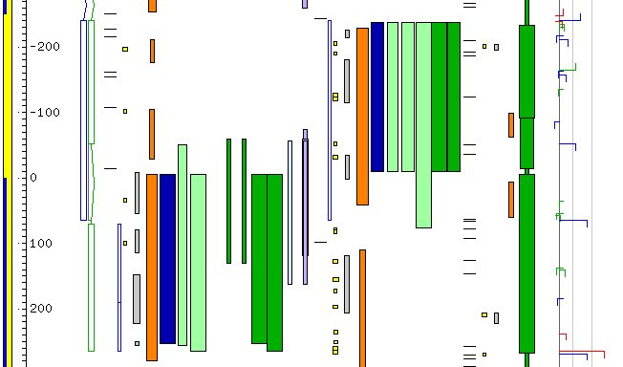
Frameshift in exon

Slide 27
Genes to merge by protein homology?
CDS 1
One protein matches two CDS in contiguous regions of the protein
CDS 2

Slide 28
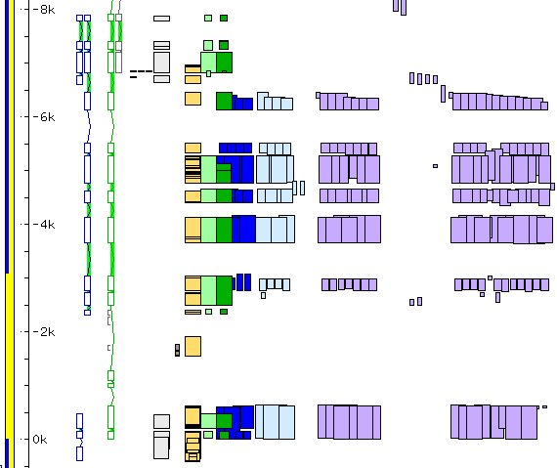
Genes to merge by protein homology?
CDS 1
CDS 2
Flybase, Human, SwissProt, TrEMBL Proteins homologous to the two CDS

Slide 29
Gene to split by protein groups?
CDS
Protein group 2
Protein group 1
No members in common between the two non-overlapping groups.

Slide 30
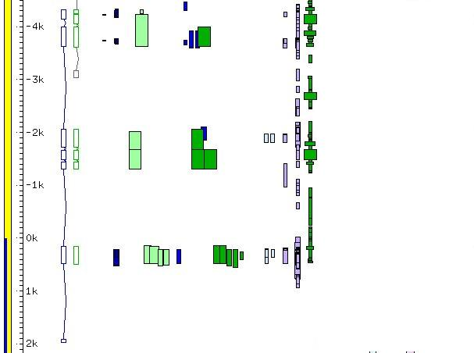
Gene to split by protein groups?
protein group 1
protein group 2
protein group 3

Slide 31
We will continue to do…
C. elegans genomic sequence changes
  Transcript data
  3rd party submissions
C. elegans gene model curation
  Curation tool anomalies
  User input
  Literature

Slide 32
Progress – anomalies checked

Slide 33
nGASP problems in C. elegans
nGASP gene predictors are still not perfect.
Out of 100 Jigsaw (Twinscan) predictions checked:
  81 (55) were predicted correctly
  1 (0) correctly indicated a required change
  10 (25) differed (7 probably incorrectly)
  3 (7) merged/split genes incorrectly
  3 (1) predicted pseudogenes as CDS
  1 (2) missed a gene entirely
  1 (6) gene predicted where none

