Slide 1
Sequence Curation
Paul Davis
Sanger Institute

Slide 2
Overview
Sequence curation within WormBase consortium.
Import of sequence data.
Prediction stats.
Work metrics and infrastructure.
New Collaborations.
Submission of data to Public data repositories.
Sequence curation and modENCODE.
SAB 2008

Slide 3
Sequence Curation
Curation from multiple sources.
  Transcript data: NDB (EMBL).
  Anomalies Database.
  1st pass paper curation – CalTech.
    Talks this afternoon.
  Direct user submissions pre and post publication.
SAB 2008

Slide 4



Transcript Data Retrieval
& Processing
Retrieval of Transcript data for C. elegans and all tier II species.
Transcript data is feature rich.
Going to mention 2 Feature oriented classes.
Sequences processed to identify Feature data.
2 fold application:
    Cleanup - masking problems for genomic placement.
      Improves quality of coding transcripts (has been a problem in the past).
    Routine Identification of novel features.
      Trans-splice leader sequences (SL1/2).
      PolyA features.
SAB 2008

Slide 5
Feature Data for Improvement & Enrichment.
Type | WS170 | WS190
PolyA | 4505 | 14367
PolyA_site | 3518 | 9542
PolyA_signal | 12 | 5497
Trans-splice leader TSL | 37896 | 40882
SL1 | 31784 | 33830
SL2 | 6109 | 6802
Unknown | 3 | 250
Blat_discrepancies | 79 | 1538
Low_complexity | 1 | 5237
Misc | 37 | 55
Total | 46048 | 77265
SAB 2008

Slide 6
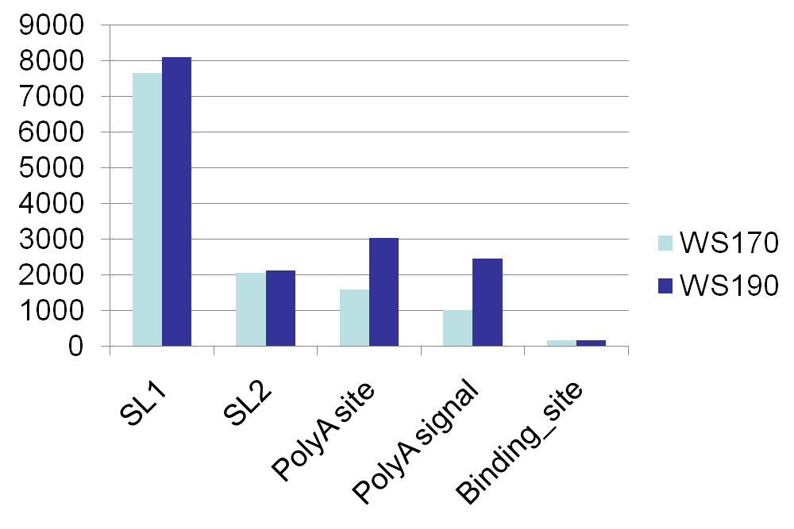
Annotated Features
Features annotated from:
  Feature generation from non-redundant feature data.
  1st pass paper curation.
No.
Binding sites and new Feature type initiative in re-start phase.
Automated & Paper curation.
Feature type
SAB 2008

Slide 7

Example Cleanup with Collaborative Feedback (pre publication).
Race Sequence Tags (RST) reads the RACE project submitted following IWM (International Worm Meeting @ UCLA).
  Assumption: 5’ reads have TSL sequences. 3’ reads have polyA sequence based on experiment methodology.
5’ reads.
  82% SL1/SL2 canonical sequences.
  Additional analysis revealed 18% have SL-like sequences.
  Experimental confirmation of mixed sequencing reaction (SL1 + SL2).

Slide 8
Continued…….
3’ reads.
  0% using standard code base.
  New code looks for polyA runs >10nt
  Evaluate sequence post polyA and score.
  72% PolyA tail identification and masking.
    Remainder mis-primed to genomic polyA……
New code implemented.
Feature data was used to identify 472 new unique features.
SAB 2008

Slide 9
Current WormBase Gene Status.
Coding genes only
Only utilises transcript data evidence.
Exploring option to upgrade.
Predicted – No available transcript evidence.
Partially confirmed – Some but not all bp are covered by
transcript evidence.
Confirmed – Every base has supporting transcript data.
SAB 2008

Slide 10
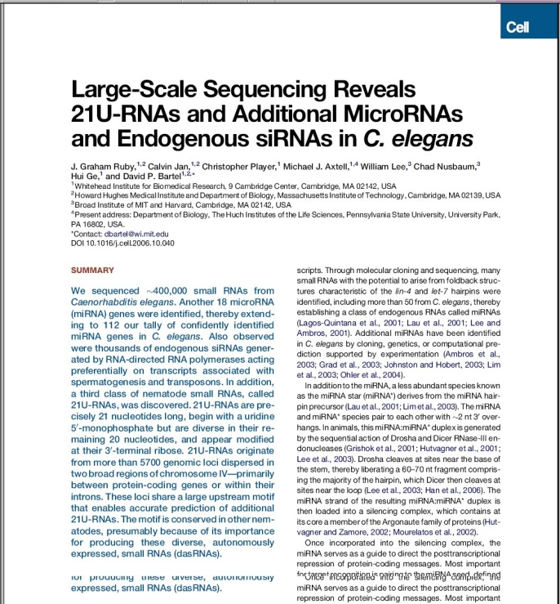
Curation Stats 07/08
WS170 (19th Jan 07) – WS190 (Current Live site)
Data Type | WS170 | WS190 | % change
CDS | 20082 | 20177 | 0.47%
CDS changes - ~1800
Isoform | 3142 | 3594 | 14.3%
WB Status
Confirmed (35.5%) | 7825 | 8418 | 7.5%
Partially Confirmed (46%) | 10746 | 10964 | 2%
Predicted (18.5%) | 4653 | 4389 | -5.7%
Pseudogenes | 1154 | 1462 | 26% (~30% ↑ CDS)
RNA Genes | 1105 | 6543 | 492%
Total number of genes* | 22341 | 28182 | 26%
* Genes with a known sequence and structure
SAB 2008

Slide 11
Curation Tool and Anomalies Database.
Gary introduced the development of the tools.
Curation tool is essential for day to day curation.
Utilised by both sequence curation sites.
  Tracking.
  Prioritisation.
SAB 2008

Slide 12
C. elegans Curation Time Scale.
Expect to take between 5-12 months to finish C. elegans.
Estimate based on ~1500 anomalies month
  Assuming no new anomaly data is added…which there will be!!!
No. of anomalies flagged as seen.
SAB 2008

Slide 13
Infrastructure for Distributed Curation
Sequence curation based at 2 centres
  Anomalies tool for consistent prioritisation.
  Request Tracker (RT) systems for curation ticket generation.
    Utilised by CalTech 1st pass curation flagging:
      Gene model curation discrepancies/new data.
      Feature annotation.
      Etc.
    Curator::curator interaction as projects are split between curators
      e.g. C. elegans is split into 12 regions for curation.
SAB 2008

Slide 14


Submission of Data to NDB
  Submission of sequence updates for C. elegans back to the NDBs.
  Synchronised to build cycle.
  HSF (Hinxton Sequence Forum).
    Collaboration at Wellcome Trust Genome campus.
      Weekly meetings.
    HSF presentation brought about change in how we represent ncRNAs in our submissions.
    Include ncRNA_class and description.
GenBank
SAB 2008

Slide 15


modENCODE Data.
Integration and collaboration with UTRome project.
Annotated UTRs along side WormBase coding transcripts.
Binding site data will also be annotated.
  Requires model changes to accommodate available data.
Link out for detailed experimental results.
SAB 2008

Slide 16
Summary
C. elegans manual annotation necessary as new data identifies gene refinements.
Tools in place to allow for distributed curation.
Collaborating with external groups to refine data and achieve better representation.
Always looking to integrate new data.
SAB 2008

