Slide 1
Gene Regulation
Xiaodong Wang
Erich Schwarz
WormBase at Caltech
2008 Advisory Board Meeting

Slide 2
Gene_Regulation curation
Trans_regulation
  gene A regulates gene B at expression level
  Yeast two-hybrid data
Cis_regulation
  Sequence features
  PFMs and PWMs

Slide 3
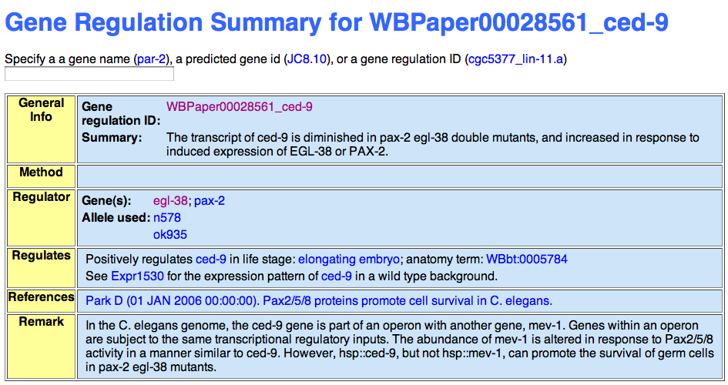
GR shown on the website
Feature : WBsf027925
Sequence T07C4
DNA_text "gtaacgctgctcc”
Flanking_sequences T07C4 "ctcccgaatgtcatccacaaaccccgactc”"gaaacagattttcactgcctgggggcatca”
Associated_with_gene WBGene00000423 Paper_evidenceWBPaper00028561
Associated_with_operon CEOP3666 Paper_evidence WBPaper00028561
Associated_with_gene_regulation WBPaper00028561_ced-9 Paper_evidenceWBPaper00028561
Associated_with_expression_pattern Expr4230 Paper_evidence WBPaper00028561
Species "Caenorhabditis elegans”
Defined_by_paper WBPaper00028561
Bound_by_product_of WBGene00001204
Bound_by_product_of WBGene00003938
Method binding_site

Slide 4
Curation Progress
WS170
WS190
GR objects
642
2044
Y1H objects
0
428

Slide 5
PFM/PWM curation
Introduction
  Position Frequency Matrices (PFMs) and Position Weight Matrices (PWMs) are used to generalize sets of known binding sites
  PFMs/PWMs can be used for genome-wide searches of binding sites
  Experimentally well-validated DNA-binding profiles and individual binding sites from transcription factors are available in ~300 C.elegans publications
  Lack of tools that will allow biologists to create matrix-based motifs from lists of known sites

Slide 6
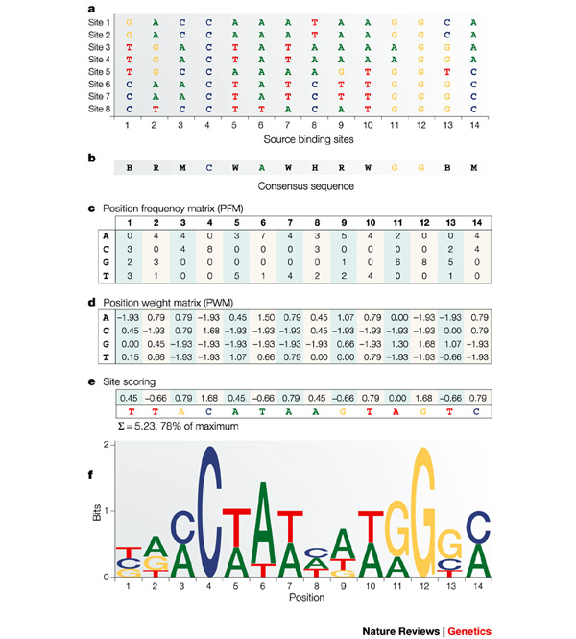
PFM/PWM curation
Steps of building a model
  Data collection
  Position weight matrix (PWM)
  Sequence logo
  Position frequency matrix (PFM)
Nature Reviews Genetics 5, 276-287 (April 2004)

Slide 7
PFM/PWM curation
New Position_Matrix model
?Position_Matrix Description ?Text #Evidence
Type UNIQUE Frequency
Weight
Background_model Text UNIQUE Float
Site_values Text UNIQUE Float REPEAT
Threshold Float
Associated_feature ?Feature XREF Associated_with_Position_Matrix
#Evidence
Remark ?Text #Evidence
?Feature Associations Associated_with_Position_Matrix ?Position_Matrix XREF
Associated_feature #Evidence

Slide 8
PFM/PWM curation
Position_Matrix objects
PFM form WBPaper:
Position_Matrix : "WBPmat00000001" // DAF-16.pfm
Description "DAF-16 binding sites; frequency matrix."
Paper_evidence "WBPaper00004249"
Type Frequency
Site_values A 4 4 4 1 0 1 0 0 0 22 0 10 8 3
Site_values C 3 3 4 0 0 0 0 1 0 0 21 3 5 10
Site_values G 9 7 12 1 0 24 0 0 0 2 0 6 3 1
Site_values T 7 10 5 23 25 0 25 24 25 1 4 5 7 8
PWM conversion using TBFS software (http://tfbs.genereg.net/):
Position_Matrix : "WBPmat00000007” //DAF-16.pwm
Description "DAF-16 binding sites; weight matrix, derived by TFBS::Matrix::PFM
from frequency matrix WBPmat00000001." Paper_evidence "WBPaper00004249"
Type Weight
Site_values A -0.38881165 -0.38881165 -0.38881165 -1.4977858 -2.2006314
-1.4977858 -2.2006314 -2.2006314 -2.2006314 1.6878359 -2.2006314
0.66273647 0.38953873 -0.67299231
Site_values C -0.91842357 -0.91842357 -0.58718412 -3.0658256 -3.0658256
-3.0658256 -3.0658256 -1.9659037 -3.0658256 -3.0658256 1.5787258
-0.91842357 -0.31797537 0.57042885
Site_values G 0.43126021 0.10474309 0.81399493 -1.9659037 -3.0658256
1.7641428 -3.0658256 -3.0658256 -3.0658256 -1.3491148 -3.0658256
-0.091188821 -0.91842357 -1.9659037
Site_values T 0.23072009 0.66273647 -0.1515023 1.7477245 1.860523
-2.2006314 1.860523 1.8052259 1.860523 -1.4977858 -0.38881165
-0.1515023 0.23072009 0.38953873

Slide 9
PFM/PWM curation
How biologists could use our data
  Use Genome Browser with existing software for mapping restriction sites on-the-fly
  Scan pre-computed genomic instances/sites of PFMs/PWMs
  Available online software: CisOrtho, JASPAR, CONSITE, etc.

Slide 10
PFM/PWM curation
Our plan for curation
  Annotate ~200 sites from ~300 papers
  Make data available online in WormBase
  Map and link PFMs/PWMs to the genome
  Provide search tool for matches to PFMs/PWMs

