Slide 1

Genome Browsers
Sheldon McKay
Cold Spring Harbor Laboratory

Slide 2
New Genome Browsers
Genome Browser User Interface
nGASP Overview
Outline

Slide 3
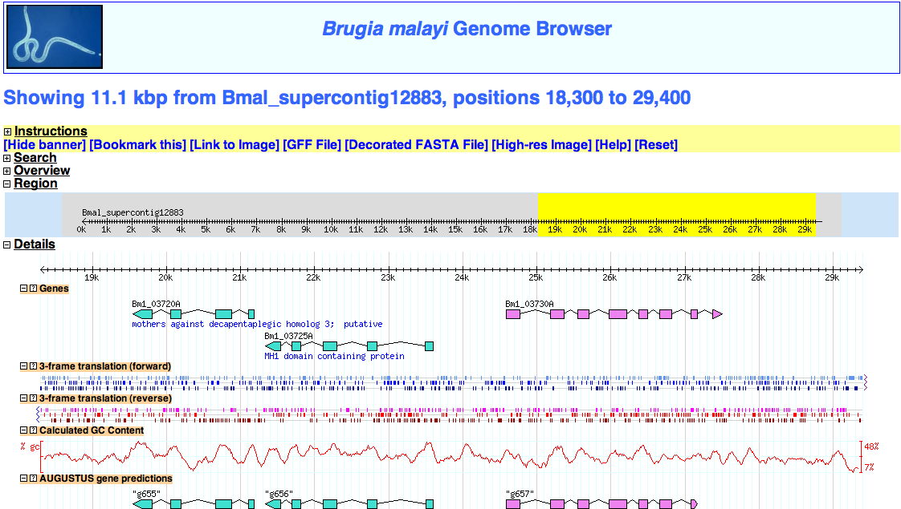
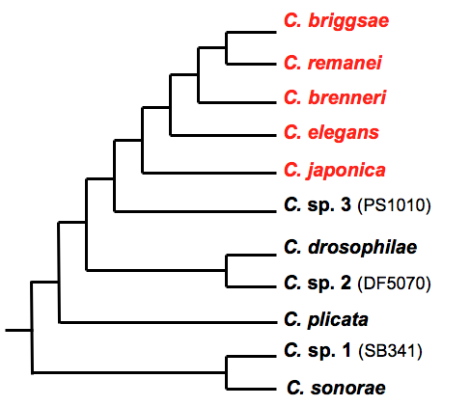
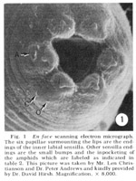
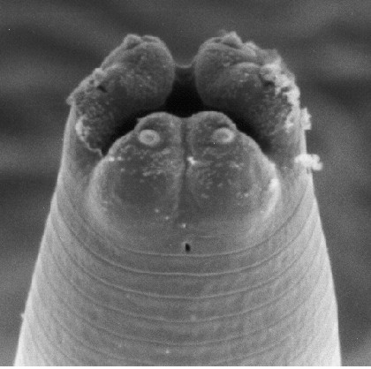
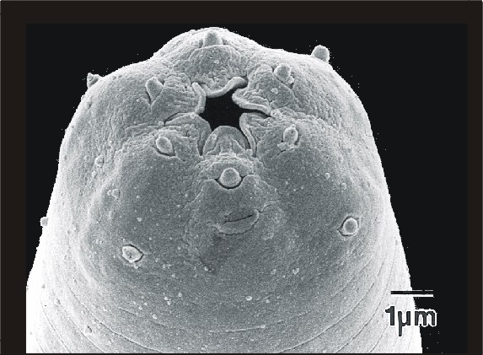
New Genomes
C. elegans
C. japonica
C. sp. 3 PS1010

Slide 4
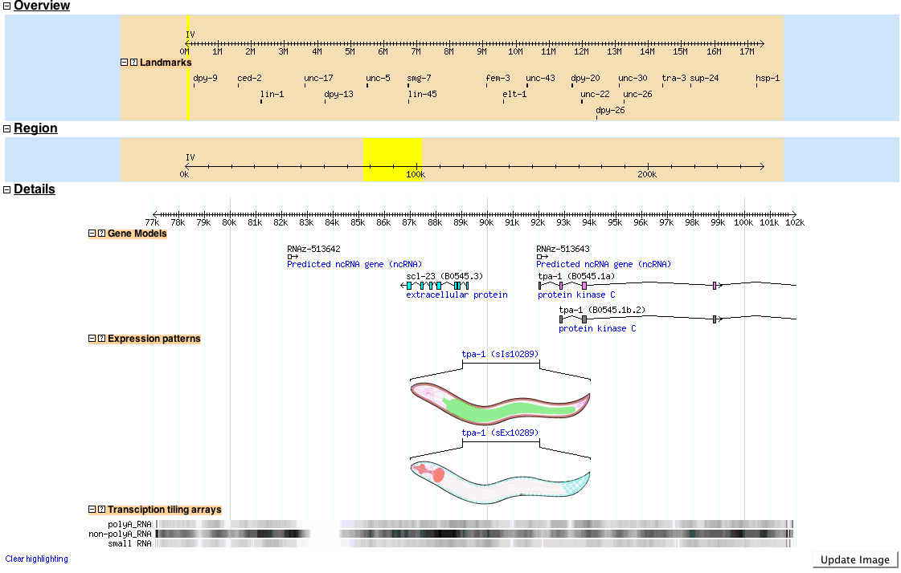
New Features in the WormBase Genome Browser

Slide 5
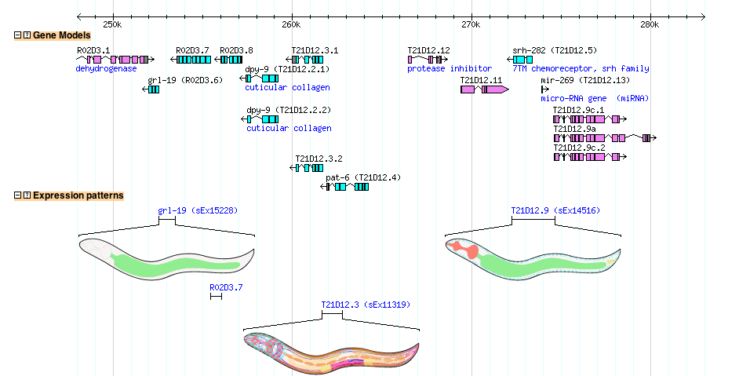
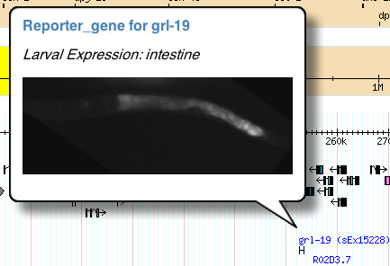

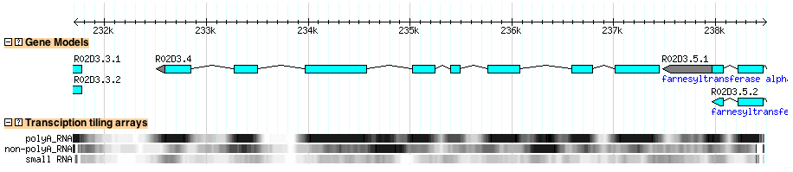
Expression Patterns
Wiggle tracks/Tiling arrays

Slide 6
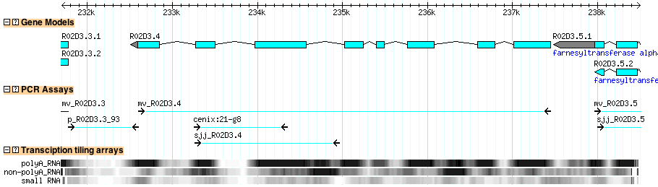
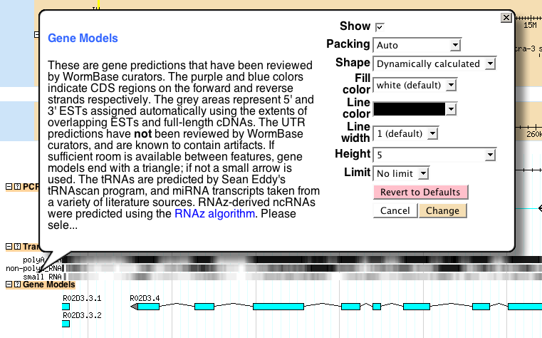
Draggable Tracks
Inline track configuration

Slide 7

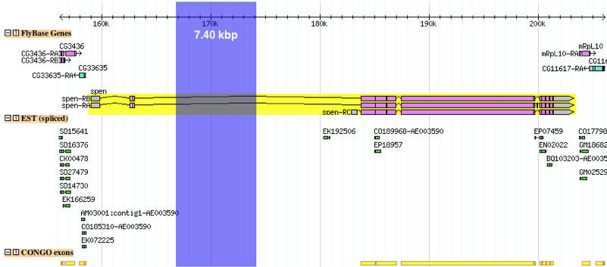
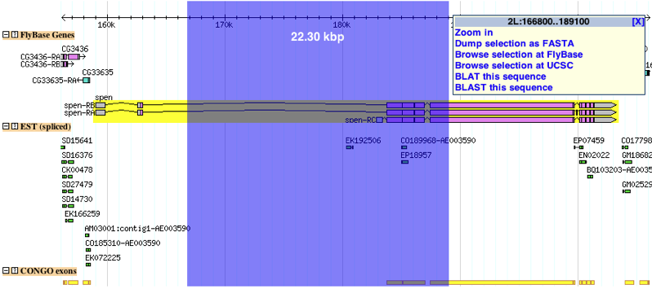

Rubber-band selection

Slide 8
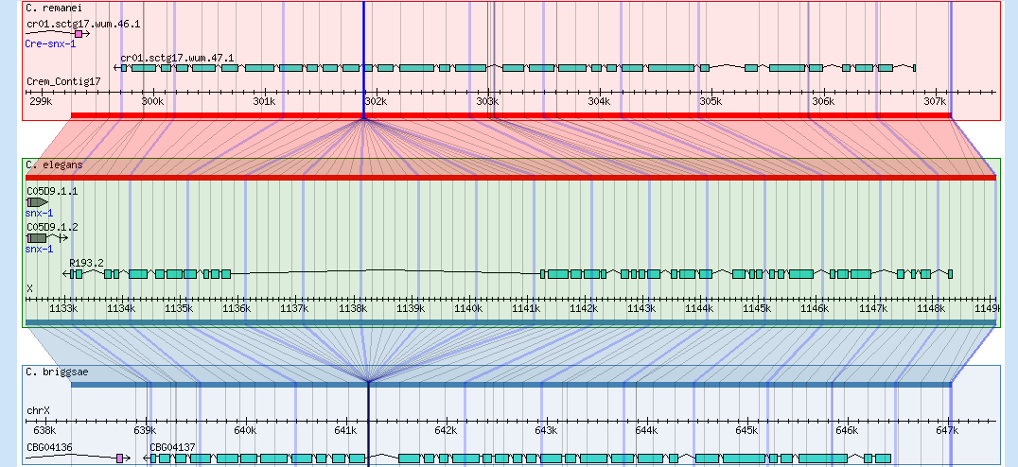
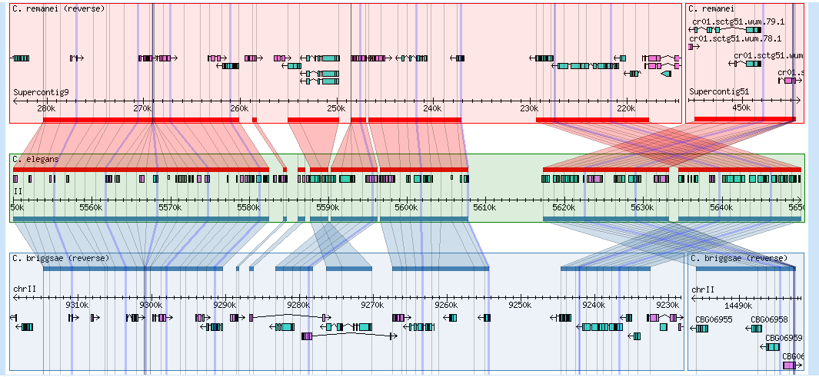
Synteny Browser
Gene level
Synteny level

Slide 9
nGASP Overview
C. elegans WS160 test & training genome sequence‡
Repeat sequences in test & training regions‡
Confirmed and unconfirmed genes in training regions‡
Category 1
ab initio
Phase 1
C. briggsae and C. remanei genome assemblies
Multi-genome alignment (MLAGAN)
Category 2
multi-genome
Category 3
expressed sequences
Protein, EST, cDNA, alignments to test regions
All information available to Categories 1-3
Gene predictions from Phase I
Category 4
combiners
Phase 2
‡ available to all Categories

Slide 10

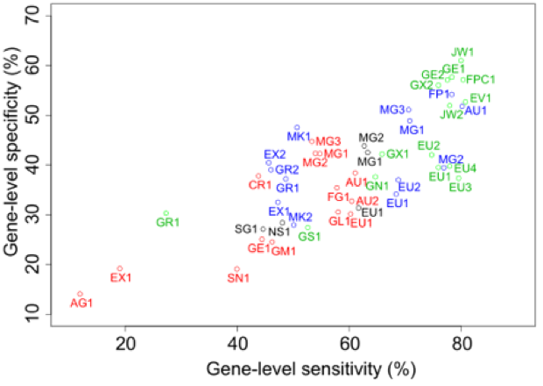
Gene calls for six nematode species
mGENE
AUGUSTUS
FGENESH
nGASP
gene set
JIGSAW
cat1 < cat2 < cat 3 < cat 4

Slide 11


LIVE DEMO

Slide 12
nGASP
Avril Cochlan
Paul Fliceck
Todd Harris
Tristan Fiedler
Darin Blasiar
Acknowledgments
Peter
van Buren
WormBase
GMOD
Michael Han
Will Spooner
Norie de la Cruz
Payan Canaran
Erich Schwartz
Vicky Zhou
Zheng Zha
Lincoln Stein
Scott Cain
Dave Clements

