Slide 1
Comparative Genomics with
by Michael Han
Sanger Wormbase Group
SAB 2008

Slide 2
Overview
Comparative Genomics in WormBase
  Orthology
  Synteny

Slide 3
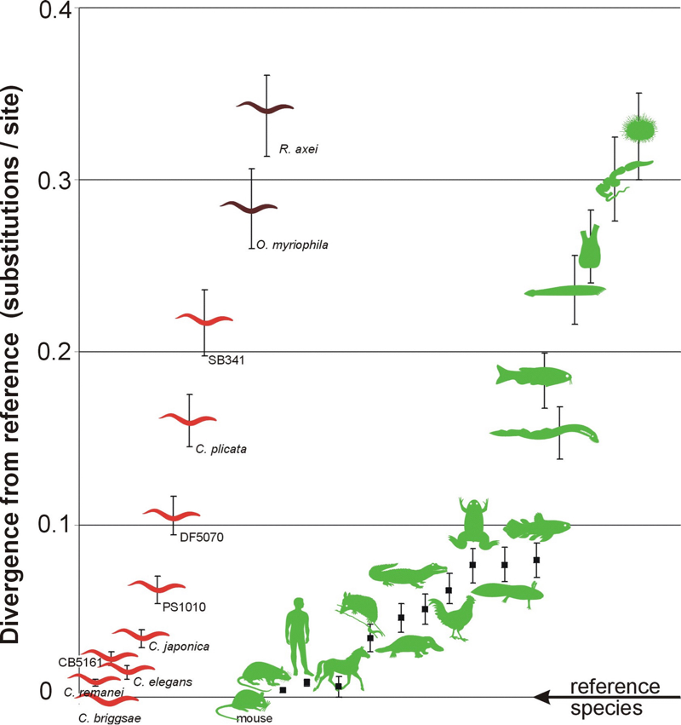
Divergence
(wormbook.org 10/06)‏
“closely related” means something different

Slide 4




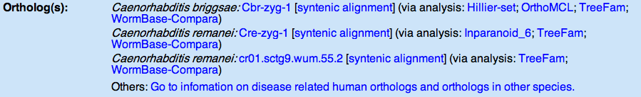
Orthology Data
imported from external sources
(TreeFam,EnsEMBL-Compara, Inparanoid, OMA)
Created during the build process for nematodes
(WormBase-Compara)
created outside of the build process (KOGs / OrthoMCL)
from user submission (e.g. LaDeanna Hillier)‏

Slide 5
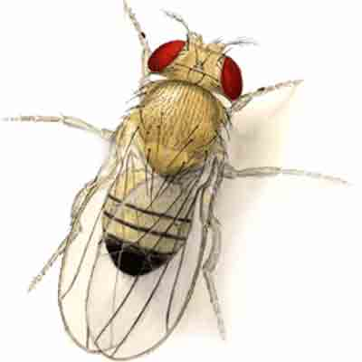
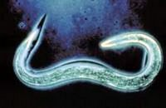
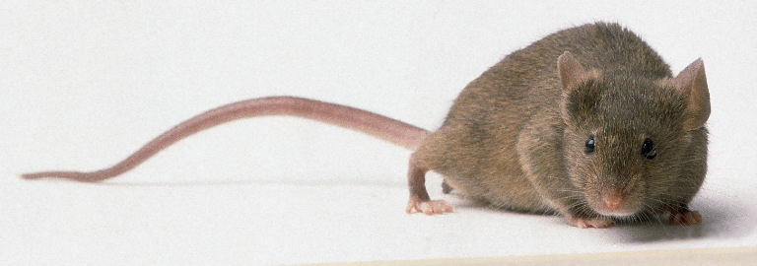

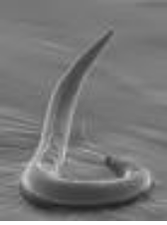
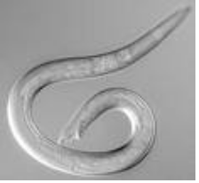
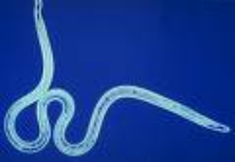
Ortholog Genes
Fly
Fly
C. elegans
C. elegans
C. bruggia
C. bruggia
C. remanei
C. remanei
Mouse
Mouse
Human
Human
C. elegans
4868
D.melanogaster
5147
16583
3864
5149
15935
M.musculus
H.sapiens
C.remanei
C.briggsae
B.malayi
4868
4868
3864
3864
5147
15935
16583
5147
15935
16583
5149
5149

Slide 6
Usage
flag gene models for curation
projecting Worm Gene Names
adding external crossreferences
  human disease orthologs (OMIM)‏
  non-WormBase orthologs

Slide 7

Gene Model
Split Gene ?
missed gene ?
1:2
M:N
1:1
1:1
1:1
Orphan

Slide 8




WormBase-Compara
AceDB build database
synchronisation
Ensembl-core databases
C.elegans / C.briggsae / C.remanei / C.brenneri / B.malayi
Blast / Protein Annotation /Repeats
Orthologs
Ensembl-compara databases
1. Orthology
II. Synteny
Orthology
1. all vs all blast (proteins)‏
2. linkage clustering
3. Protein alignments (MUSCLE)‏
4. Tree building (PHYML)‏
5. dN/dS (CODEML)‏
Synteny
1. all vs all blast (exons)‏
2. synteny (MERCATOR)‏
3. alignments (PECAN)‏
(4. conserved elements)‏
Ensembl-Hive
Job Management on LSF
(about 8 hours for 5 species)‏

Slide 9
WormBase-Compara
uses the Ensembl-compara code from EBI/Ensembl
5(7) internal Ensembl core / 2 compara databases
Nematode orthologs assigned to
  17,443 of 20,177 (~87%) coding C.elegans genes (WS190)‏
Whole Genome Alignments
  synteny blocks MERCATOR
  4-genome alignments PECAN

Slide 10
Synteny Data
WABA pairwise alignments
MERCATOR synteny blocks
PECAN multi-genome alignments

Slide 11
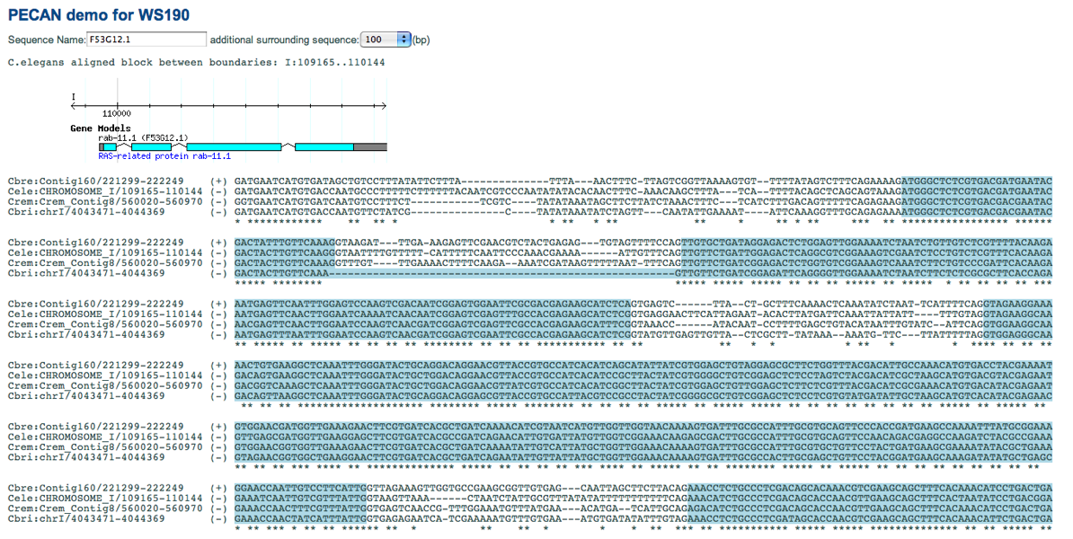
PECAN

Slide 12
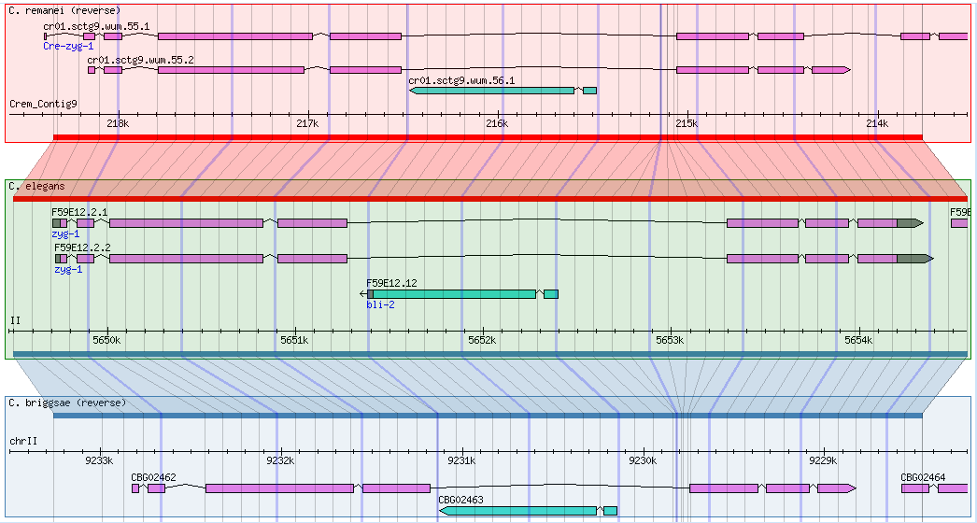
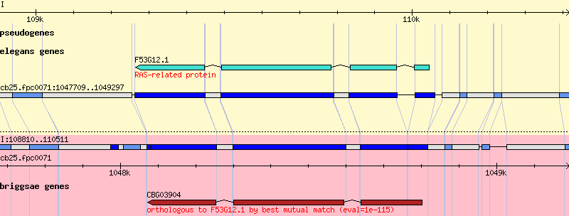
Viewers
web display
  GBrowse tracks
  alignments

Slide 13
(Near) Future
add new genesets for new species (parasitic nematodes)‏
try whole genome alignments with more distant species (Heterorhabditis / Brugia / Pristionchus)‏
unified TreeFam / Compara
improved QC on ortholog relationships
additional paralog information

Slide 14
Aknowledgements
Sanger:
Avril Coghlan (Treefam / NGASP)‏
Heng Li (TreeFam)‏
Ed Griffith (AceDB)‏
EBI:
Javier Herrero and Albert Viella (Compara)‏
Patrick Meindel and Andreas Kahari (stableid_mapping)
WashU:
LaDeanna Hillier (C.briggsae orthologs)‏
Eidgenössische Technische Hochschule Zürich (ETH):
Adrian Schneider (OMA)‏
Stockholm Bioinformatics Center (SBC):
Gabriel Östlund (Inparanoid)‏

