Slide 1
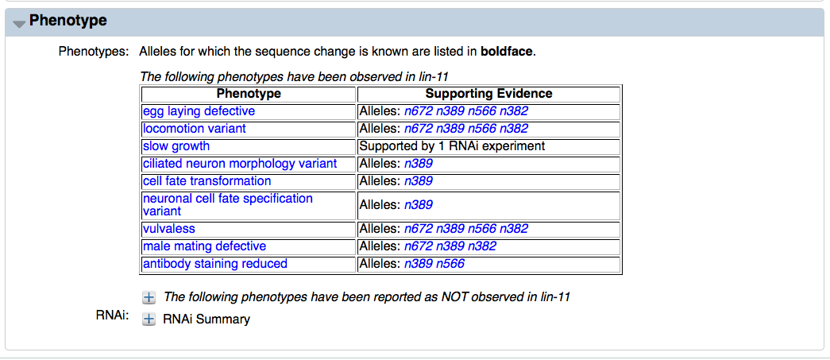
Interaction-based Phenotypes: – click here
Add this - This will redirect to the interaction table

Slide 2
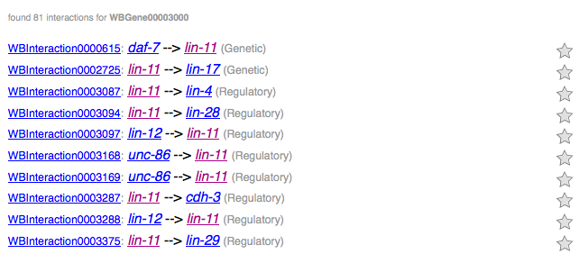
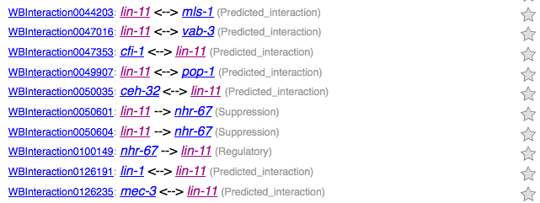
Current Interaction table
To do
Reorganize into table: with the following columns
interactors / type / phenotype / interaction ID
2) Add phenotype to interaction summary page (see next picture)

Slide 3
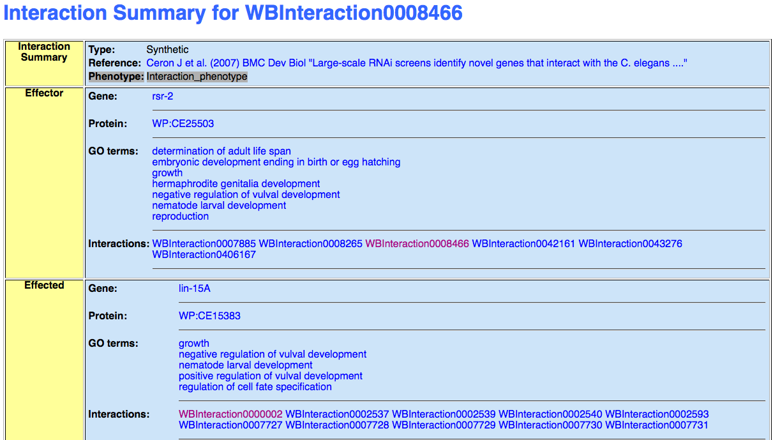
Multivulva

Slide 4
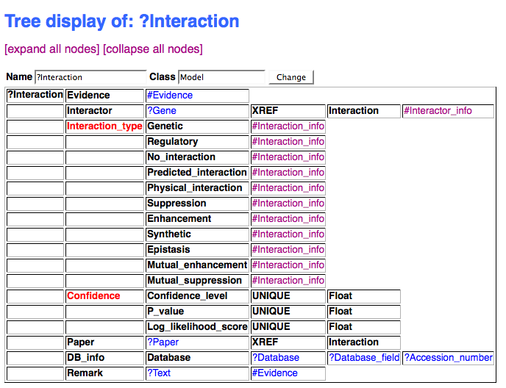

Slide 5
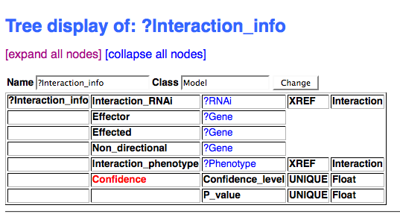
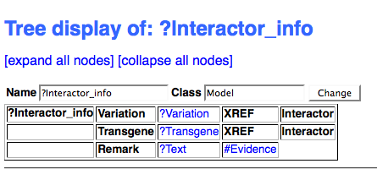

Slide 6



