Slide 1
Java-based curation tool with a spreadsheet-like interface
Supports .obo ontologies
Developed by the Bioinformatics Core of the National Center for
Biomedical Ontology (NCBO)
Funded by Flybase, Zfin, and mouseBIRN
Developed mainly by Mark Gibson

Slide 2
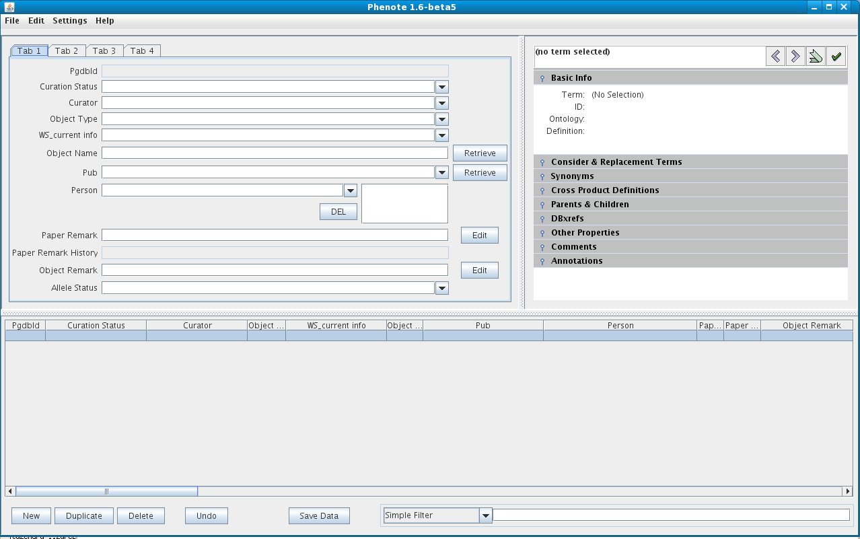
Phenote for WormBase

Slide 3
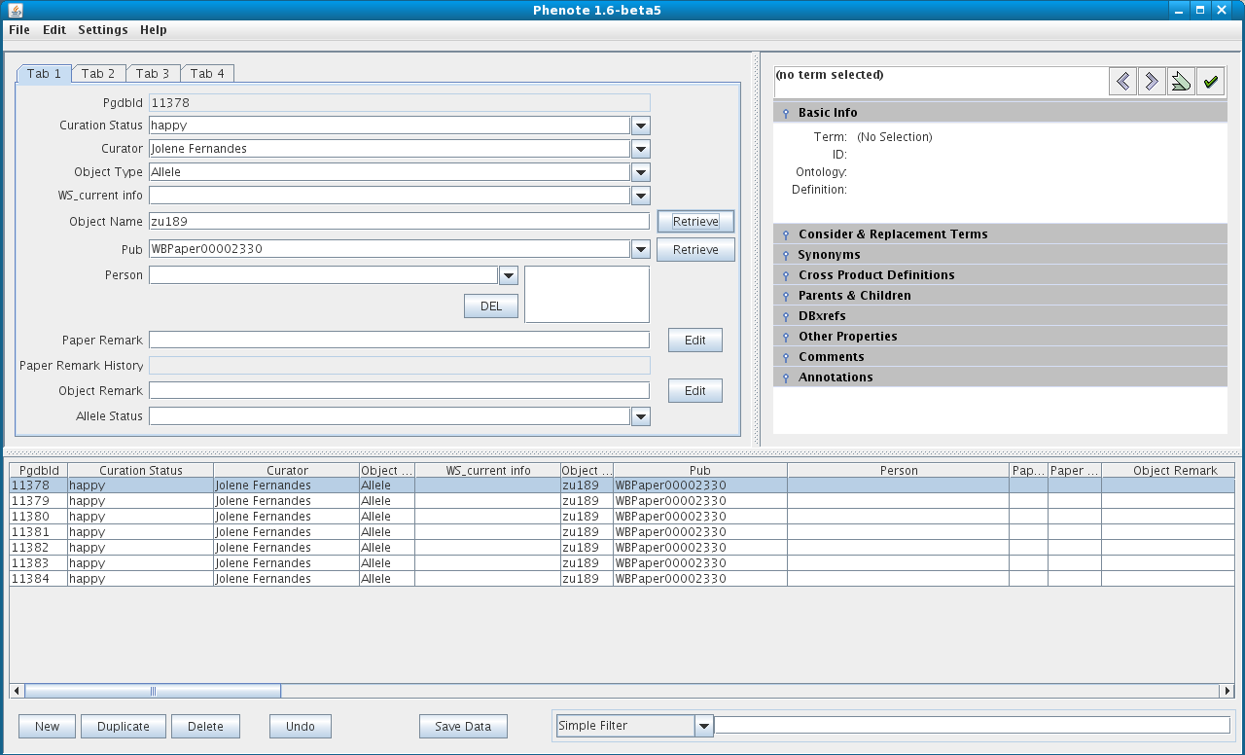
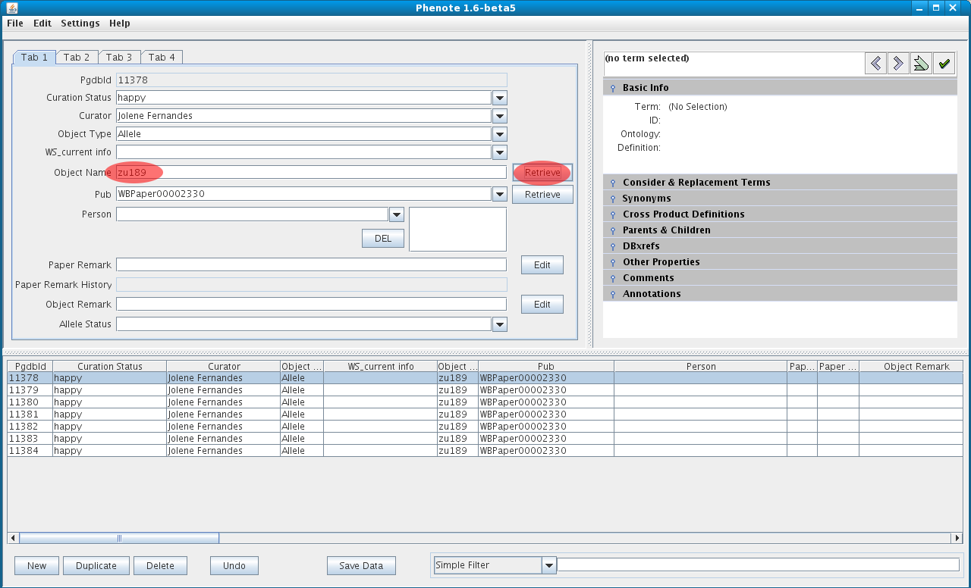
Type object name into field and click Retrieve to query postgreSQL

Slide 4
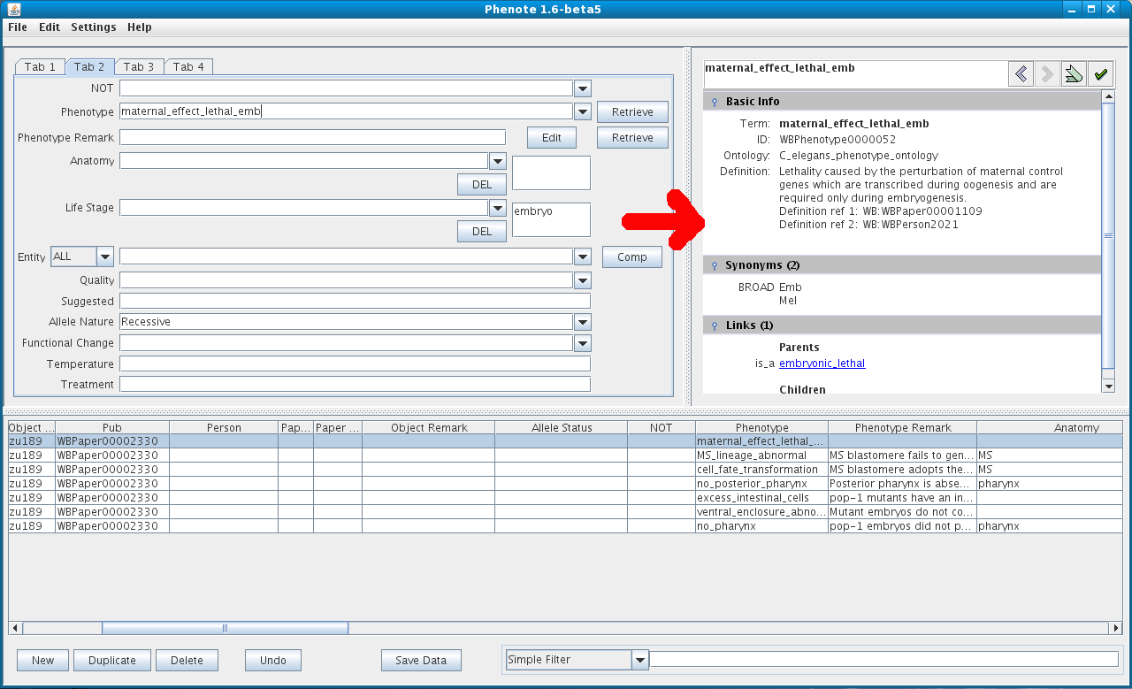
.obo ontologies allow Term completion and view on Term Info window

Slide 5
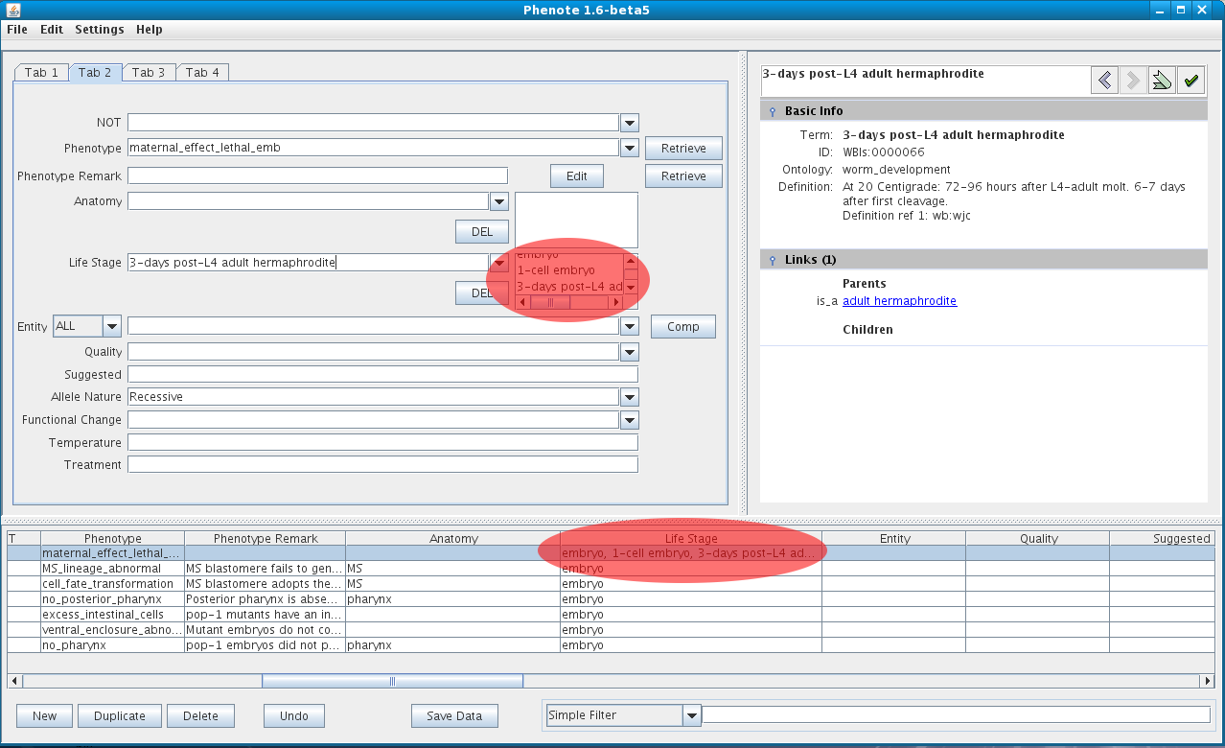
Multiple value selection from ontologies

Slide 6
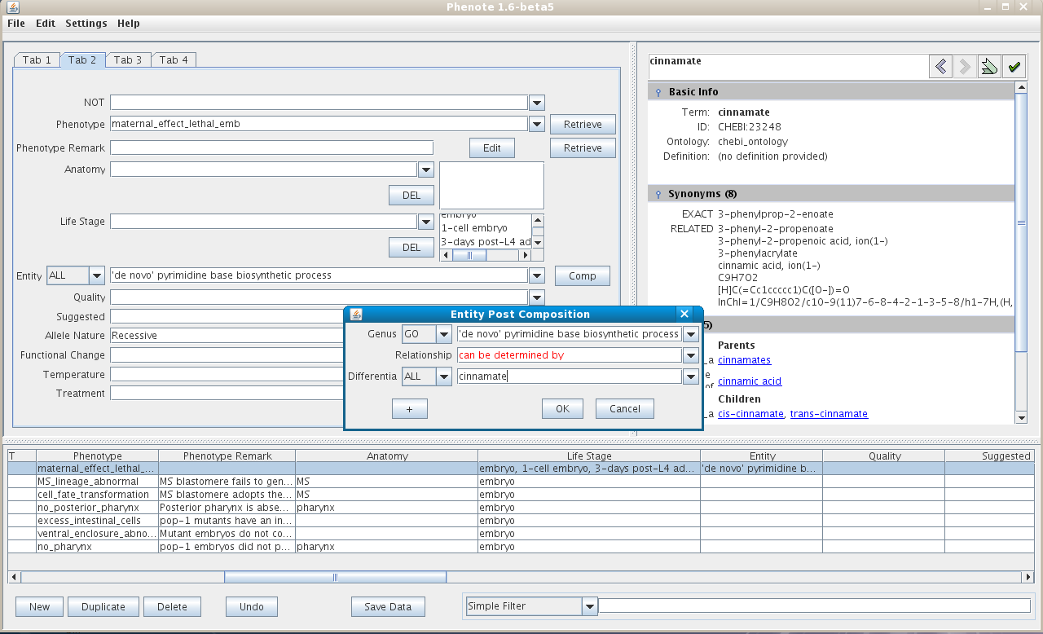
Entity / Quality and Post Composition

Slide 7
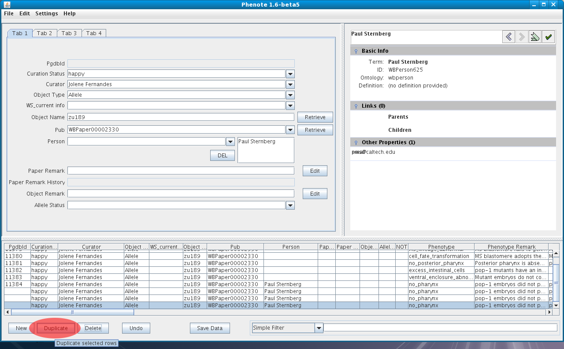
Easily duplicate objects

Slide 8
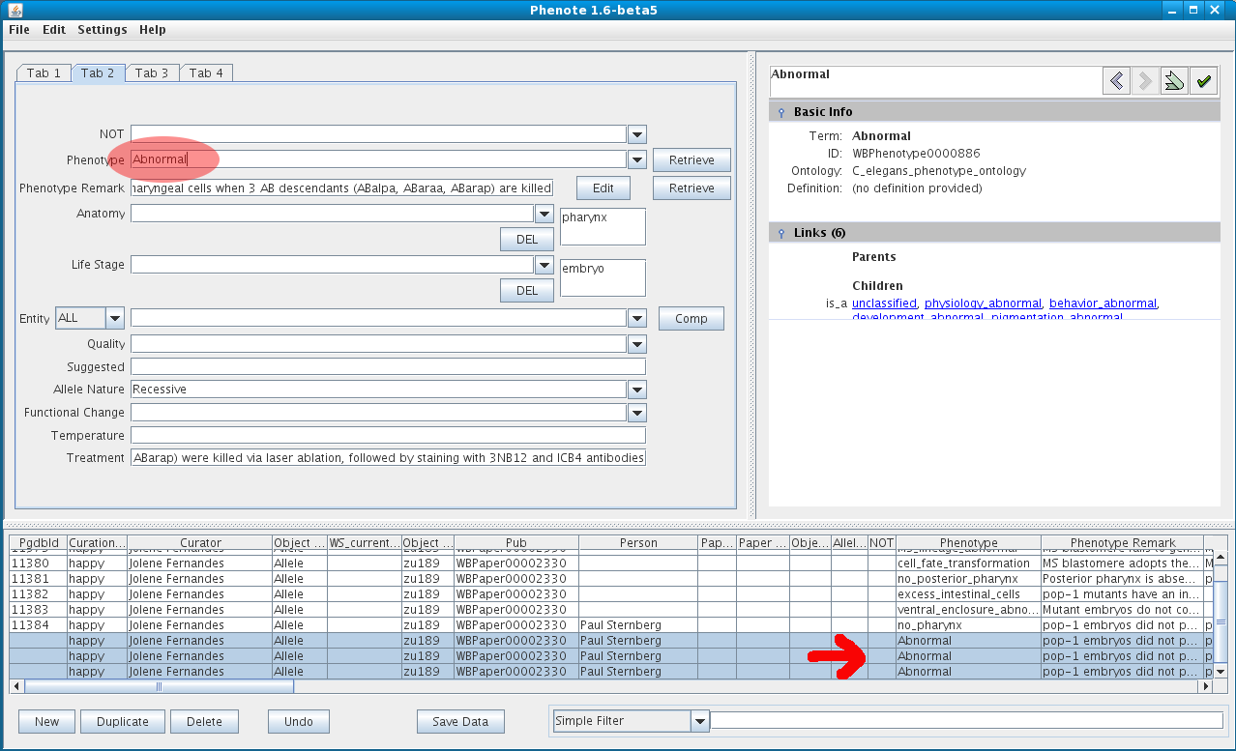
Select multiple characters (rows / objects) and change values for selection

Slide 9
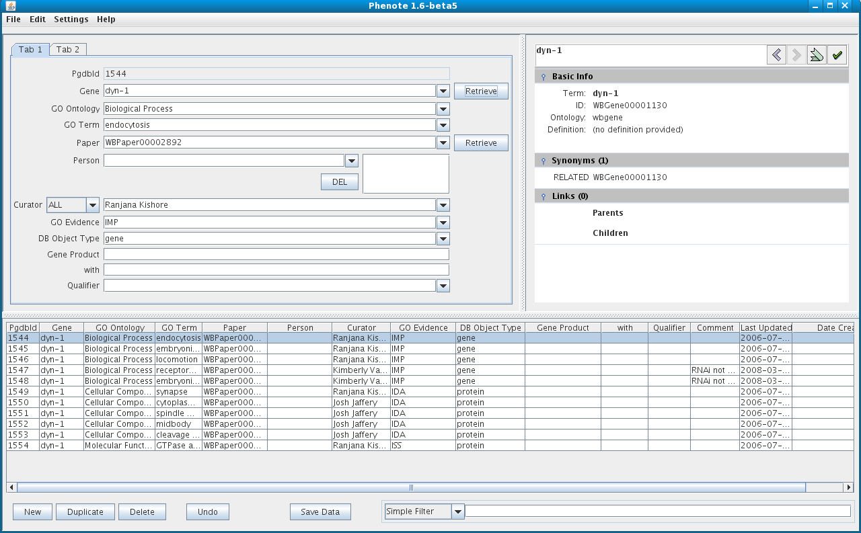
Phenote for GO curation

Slide 10
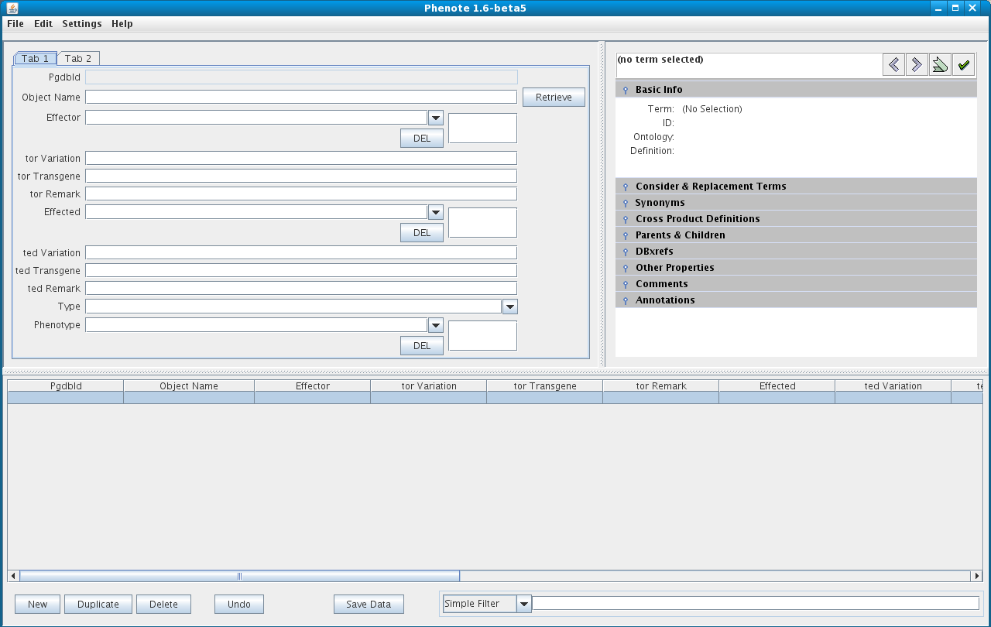
Phenote for Interaction curation

