Slide 1
Federate learning in DL

Slide 2
Algorithm
FedAvg

Slide 3
Framework
FedScale:
Testing of failed as Given input size: (512x1x1). Calculated output size: (512x-5x-5). Output size is too small.
ValueError: setting an array element with a sequence. The requested array has an inhomogeneous shape after 1 dimensions. The detected shape was (122,) + inhomogeneous part.
FATE:
File "share_mac/pipeline_hetero_sbt.py", line 43, in pipeline.fit()

Slide 4
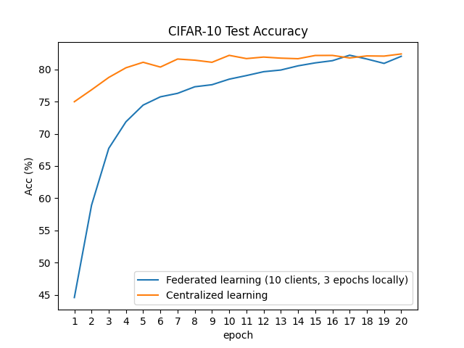
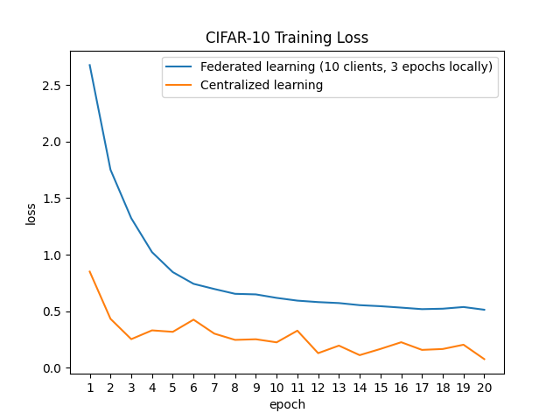
CIFAR-10
60000 samples, 32*32*3 images
10 clients, select 5 for local training
Resnet-18
Notes:
Homogeneous

Slide 5
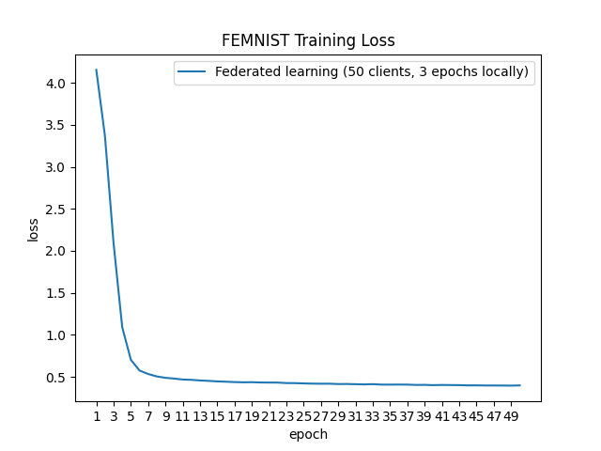
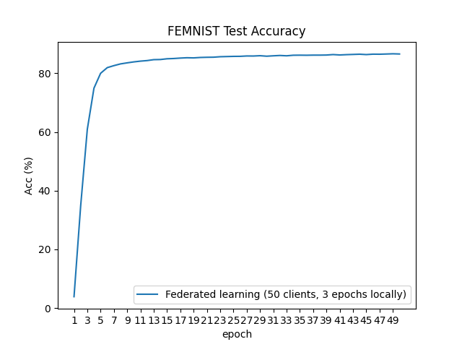
FEMNIST
637877 samples, 32*32*3 images
50 clients，select 5 for local training
Resnet-18

