Slide 1
Distributed Systems 2 - Assignment

Slide 2
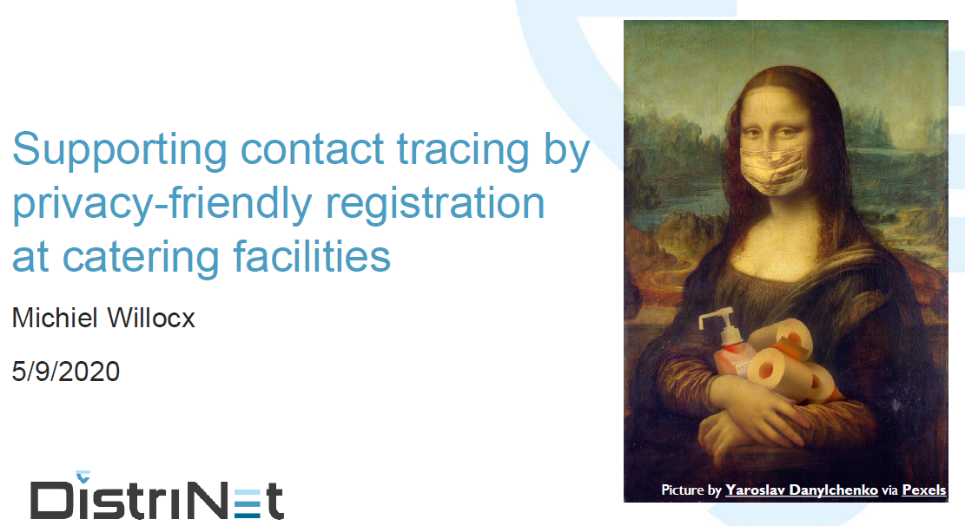

Slide 3
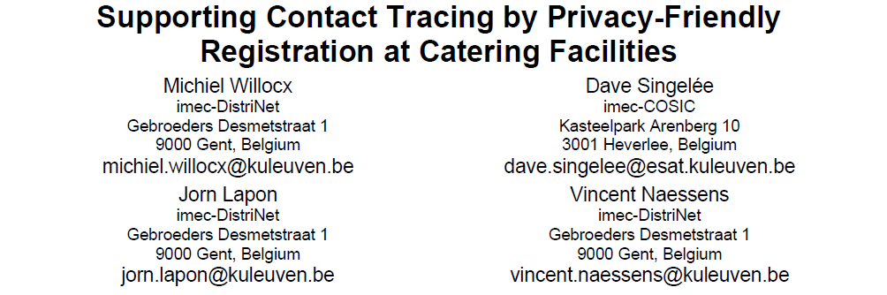

Slide 4
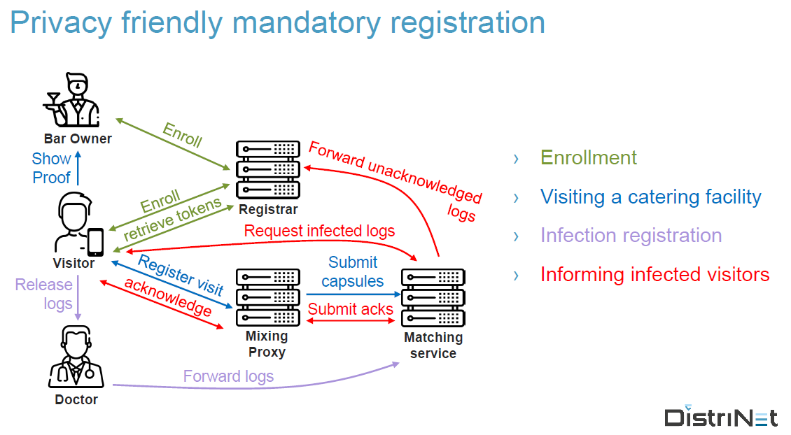

Slide 5
Assignment
Implement the proposed HORECA registration system (Client + Server application)
Java RMI as communication technology
Java JCA/JCE to realise crypto protocols
Submit code on github and making link available
Submit a report -- max 2 pages -- including following aspects
Relevant design decisions (+ extensions) (0,5 pages)
Detailed SWOT analysis (1,5 pages)
Link to code on github
Project can be made in groups of 3 students

Slide 6
Detailed overview of the assignment
Application ‘Bar Owner’:
Minimal interface – may be command line
Application ‘Doctor’:
Minimal interface
Data transfer between ‘Visitor’ and ‘Doctor’ can be done by sharing a file
Application ‘Visitor’:
Interface must be feature complete but does not need to be super fancy ;)
Mobile app is an option but certainly no requirement
QR code can be transformed to datastring (if no mobile app is developed)

Slide 7
Detailed overview of the assignment
Registrar
Server application, reacts on input of bar owners, visitors and matching service
Interface shows current content of the database at each time
Mixing proxy
Interface shows queue at each time
For demo purposes, foresee a button to flush the queue
Matching service
Interface visualizes the state of the matching service (~ content of DB)
(Optional) Inspector
Can control whether QR code of pub is legitimate

Slide 8
Assignment
Deadline code and report submission: Sunday 11th of December 2022
Oral evaluation (date: last week of December - TBD)
Slide presentation [max. 15 slides – max. 20 minutes] containing:
Overview of functionality and architecture
Overview design decisions + some implementation details
(Possible extensions)
Critical reflection
Demonstration
Q&A

