Slide 1
Red hood’s adventure

Slide 2
Overview
Main character
Enemy slime
Enemy bat

Slide 3
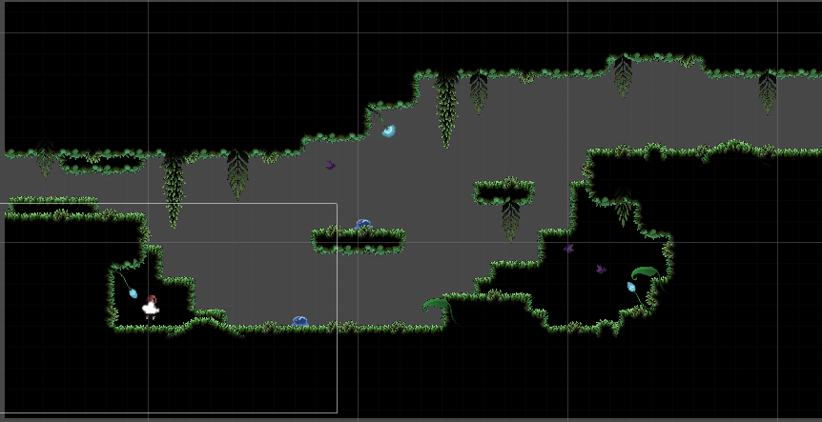
Overview
Map

Slide 4
Backstory
Red hood takes the shortcut through the dark forest to make her way to grandma’s house, disregarding her mum’s advice.

Slide 5
Overview
Objective: make your way to grandma
Extra objective: clear the area of enemies

Slide 6
Demo

Slide 7
Questions and Answers

