Slide 1
SonarQube
A brief analysis

Slide 2
Overview
Architecture
Key concepts
Design
Testing
Extending SonarQube
Notes:
Last couple of weeks we analysed SonarQube. We will know give a short presentation of how we think the system works.
First we will look at the global architecture, then we will dig a bit deeper. We will cover some of the key concepts used in Sonar. Then we will give a short opinion about the design and testing. Finally we will discuss how we will use this information to extend the program.

Slide 3
Architecture
SonarRunner
SonarQube
MySQL database
WebService
Notes:
SonarQube is roughly divided into three main components: Runner, Qube, DB. The runner will scan the project and generate values for different metrics. These values are then stored on the mysql database. SonarQube offers a webservice which provides a user interface which also allows to do queries etc. These queries are handled by the ws-client module. SonarQube also consists of a few other important modules. The Core package controls database communication. Batch is used for the scanning of the project. Plugin-API then contains measures, metrics and other key elements that can be used by plugins.

Slide 4
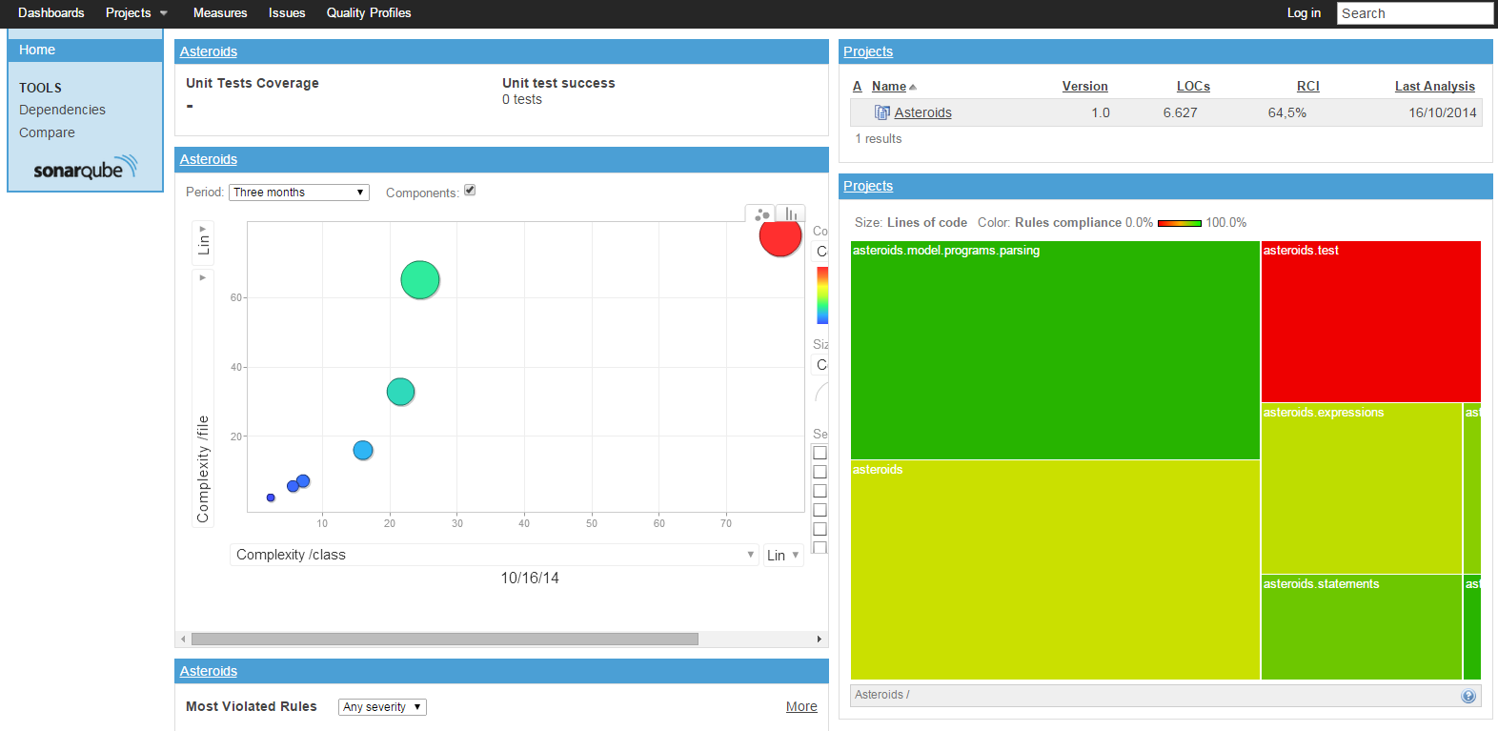
Notes:
Key concepts : Here you see a Dashboard which contains multiple Widgets. Widgets can use different metrics, issues or Measures for one or more projects. At the top of the page there’s a possibility to go to Measures. This is a confusing term, since a measure is also a value for a metric. In Measures however it is possible to create queries about projects and save them. At the top you can also go to Issues. A resource can become an issue if it does not satisfy a certain rule in the quality profile. A resource can be a class, a file, a package of even a whole project. On the left you can click on dependencies which allows you to check which parts of a project rely on certain libraries.

Slide 5
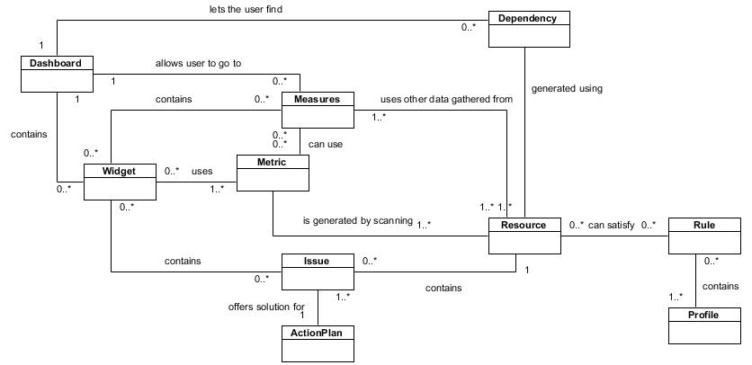
Key concepts
Notes:
The same concepts can be seen here in the domain model. As you can see the dashboard contains widgets. A widget can use one or more metrics. And metrics are generated by scanning different resources.

Slide 6
Design
Small amount of bad classes
Some data classes and feature envy methods
➔ Pretty good design
Few comments
Testing
Notes:
We analyzed the project using tools such as inCode, findBugs, jArchitect and even SonarQube itself. The results were similar. SonarQube contains only a few bad classes. Most of those were considered data classes and there were a few others. There were also some feature envy methods. Considering the large amount of classes the project as a whole has a pretty good design. Although we think it lacks some documentation. It does have a lot of testing.

Slide 7
Testing
Unit tests
High coverage
Boundary testing
Notes:
All tests are unit tests. There is a lot of code coverage (more than 70% on average). Most methods are covered with boundary testing. Seeing this we conclude that our own testing suite should be at least as extensive as this one.

Slide 8
Extending SonarQube
Create plugin
Extension points
Notes:
In our assignment we have to create a plugin. As told before SonarQube has a plugin-api package which offers some extension points. Extension points are most of the time interfaces that can or must be implemented by our plugin. (This plugin should be put in the extensions folder) These extension points are meant to help create the plugin and should be of great use since they are most of time commented. If however we need certain classes that are not included in these extension points, it will become trickier since there is no documentation.

Slide 9
Extending SonarQube
Polymorphic View
New widget
Contact database
Use metric values
Notes:
More concrete we have to be able to generate a polymorphic view for scanned projects. To understand better this works we analyzed a few existing plugins like the one that could have been seen on the screenshot. We concluded we will need a new widget that can be added to the dashboard. This widget will have to be able to use metric values from the right resources and probably change the kind of metrics that are used. These values are generated by the runner and stored in the database. When we request a widget the database will need to be queried for the right values.

Slide 10
Questions?

