Slide 1
SonarQube
PolymorphicViews Extension
Maxim D’Hollander
Thijs Dieltjens
Simon Dierckx
Wout Vekemans
Yannick Laevaert

Slide 2
Overview
Result
Class diagram
Sequence diagram
Design decisions
Analysis and testing

Slide 3
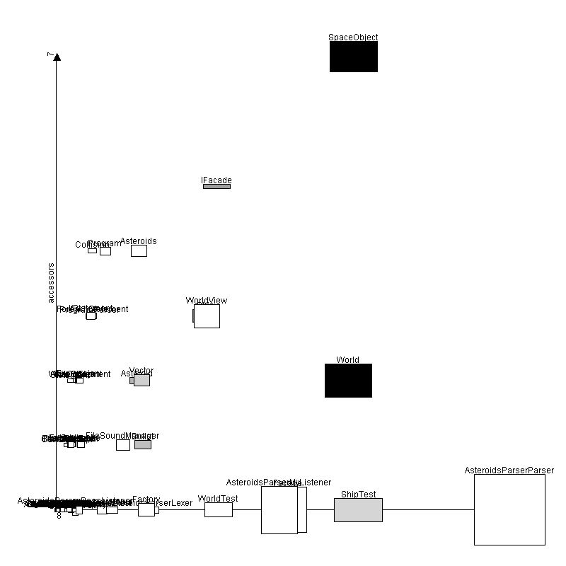
Result

Slide 4
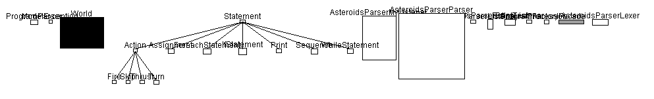
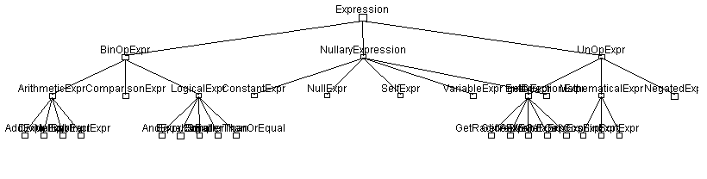
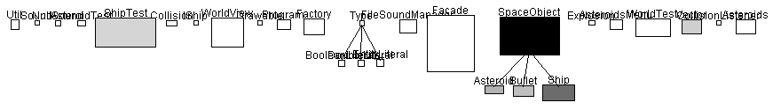
Result

Slide 5
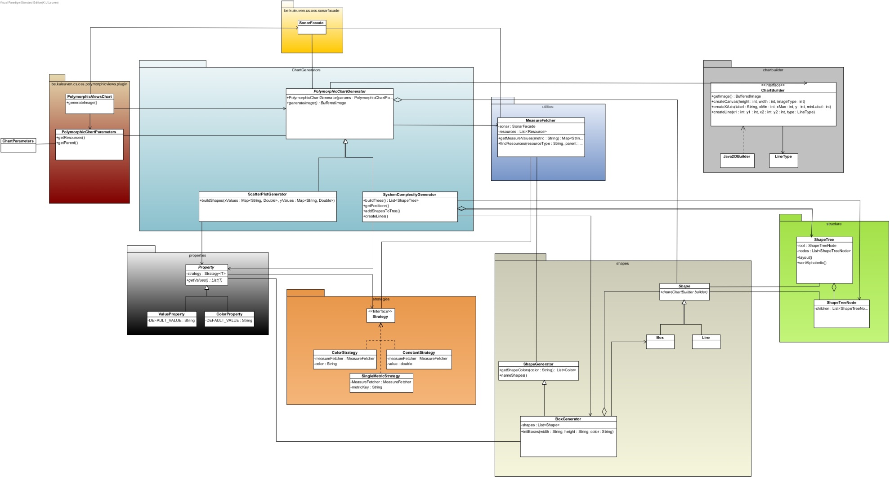
Class Diagram
Notes:
This is our class diagram. We’ll go more in depth later, but first we will explain shortly the main responsibilities of the important packages and classes.
The generating of the charts itself takes place in the charts generators package.
The data representation is done by Shape objects, for now there are only boxes and lines.
Chart generators create data representation classes who will be drawn later by an image builder located in the grey package.
You can see here one of our design decisions was to separate the visualisation from the representation of the charts, using a builder pattern. The classes for the drawing part are located in the builder package (grey).
Another design decision was to create a separate class to handle information retrieval, because all classes would be loaded with database accesses if we didn’t.

Slide 6
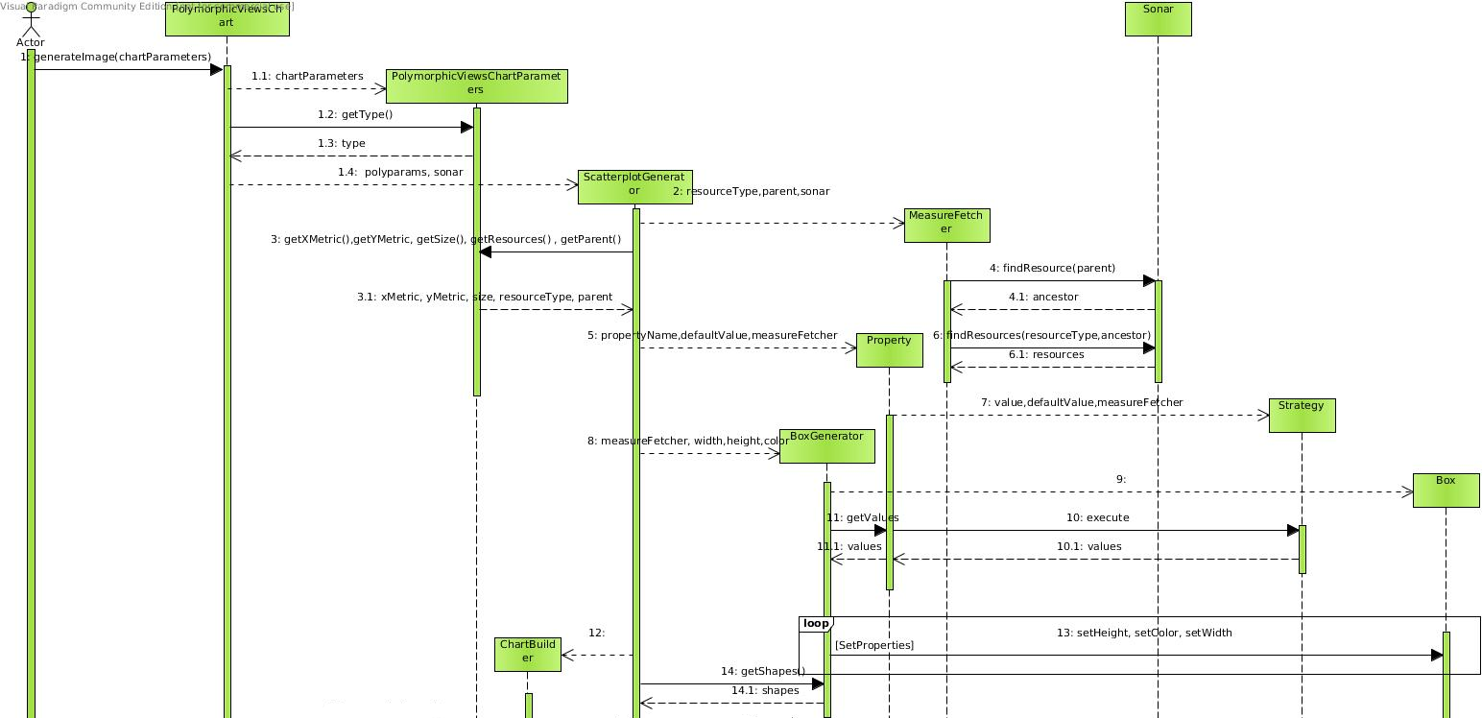
Sequence diagram (1/2)
Notes:
Here you see a detail of the creation of a scatterplot. The user wants to create an image, with given parameters. These parameters then get wrapped in our own class, polymorphicchartparameters,to provide us easier access to the properties of the chart that we need (WRAPPER). The chart then gets the type from the parameters, and creates a ScatterplotGenerator. This generator uses a Sonarfacade, to access the database, and the parameters to extract the properties as needed. The measureFetcher is created, with a reference to the sonar, to have uniform database access. The needed resources and parameters are retrieved from the sonar object. The plotgenerator then creates the needed properties of its shapes. In this example these are width, height and color. They are used to provide uniform lists of shapeproperties, independent of the user input. These properties then create a strategy, depending on user input (singlemetric, constant,…). After that, a boxgenerator is created, this object creates a list of Shapes, with the properties that are given. These shapes are returned to the scatterplotgenerator.

Slide 7
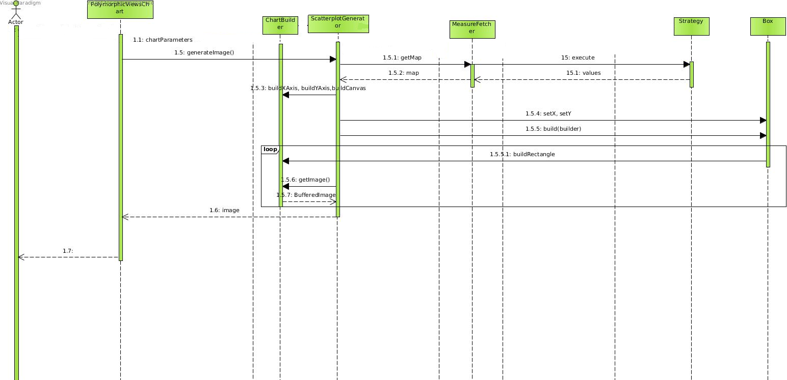
Sequence diagram (2/2)
Notes:
After the creation of the shapes, the chart is generated. The plotgenerator uses a chartbuilder to create an empty canvas, and 2 axes, depending on the plotted data. After that, the generator iterates over all the shapes, gives them the right coordinates and uses the builder to draw them all on the screen. The builder then returns its image, which is sent to the initial caller.

Slide 8
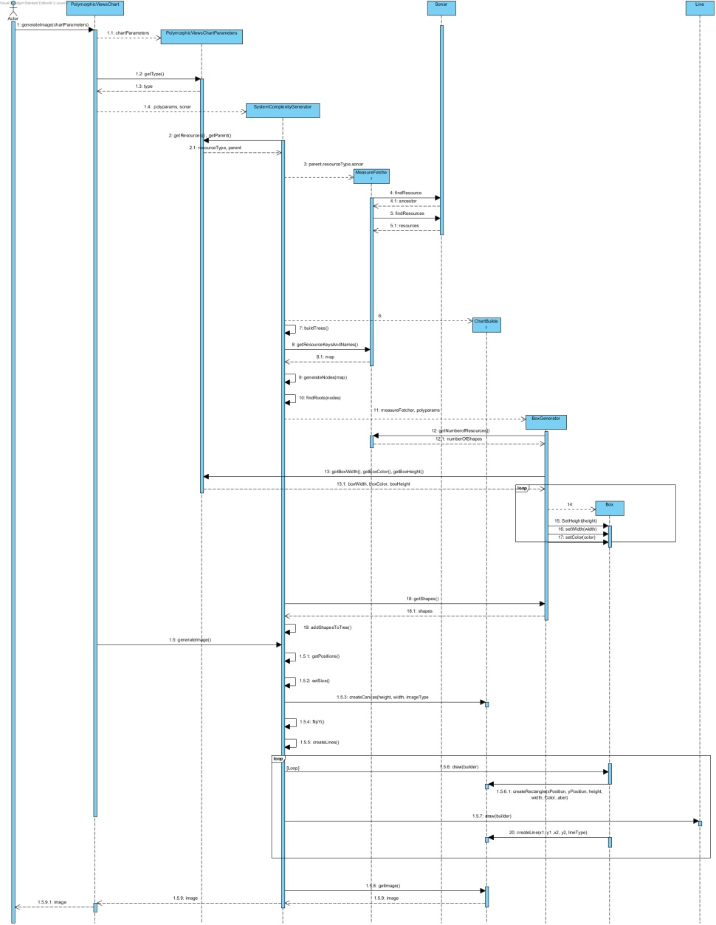
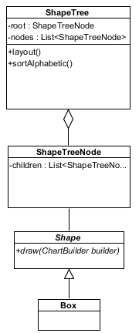
System Complexity
Notes:
The system complexity chart is generated in roughly the same way. The only difference is the internal data representation. Whereas the scatterplot uses just shapes, with coordinates en dimensions, this plot makes use of tree structures;
All resources are looked up via measureFetcher, for each resource, a shapetreenode is created, this node encapsulates a shape object. Then we look for tree roots. Then all other nodes are linked to their parent, and so a tree is created, starting from the root. Each tree is then sorted, and the right positions for the shapes are set. After that, the lines between children and parents are created. At last, all shapes (boxes and lines) get drawn on the screen.

Slide 9
General Decisions
Generator interface
Shapes
Util class
Notes:
We splitted the chart generation in two different classes, with a generator interface. This makes it easier to reuse certain methods, in case we should implement different views.
For the chart representation, we splitted the chart in tiny pieces, and thus created a shape hierarchy. For now we only have Boxes and Lines, but it will be easy to add circles, or triangles, or … These shapes are created by a shapeGenerator, which creates a list of shapes, when given some properties, and a measurefetcher.
We also created a “toolbox” class, with static methods that are used in different classes. It includes a method to scale an array, a method to split a string on given delimiters, …
For the drawing specific part of the assignment, we also had to make some major decisions. See next slide.

Slide 10
Drawing decisions
Strategy
Builder
Notes:
To simplify the drawing, and to make it extendable, we created a drawingstrategy. Each plot has a strategy for all properties of its shapes, for example: scatterplot has a width, height and color property. In these properties, a strategy is stored. This way, the plot generator does not need to worry about “should this square be gray, or red, or …” the strategy takes care of generating the values for shape properties.
To separate the internal representation from the visualisation of the chart, we used a builder. This way we can create different representations with the same constructions. This allows us to extend our plugin with different backend technology. The Builder object
provides PolymorphicChartGenerator with an abstract interface for constructing the
chart. This way, the builder does not know about how the chart looks. It only knows that it has to draw a lot of shapes. Because the chart is constructed through an abstract interface, all you
have to do to change the visualistaion is to define a new
kind of builder.

Slide 11
Testing
Mocking
Coverage
Notes:
For our unit tests we use Junit. We only tested the public methods of our most important classes, boxgenerator, shapetree, and shapetreenode.
We tested on invalid input, empty input, etc… We also created a scenario to test the builder. We watched if the visualisation of the scenario matched our expectations for this test.
In the tests of boxgenerator we used mocking. This is because this class makes use of a MeasureFetcher. Since that class relies on the database, it is impossible to test. We thus created a mock of the measurefetcher.

Slide 12
?

