Slide 1
SonarQube
PolymorphicViews Extension
Maxim D’Hollander
Thijs Dieltjens
Simon Dierckx
Wout Vekemans
Yannick Laevaert
Notes:
Goodafternoon, in this presentation I’ll show you our final design of the assignment and the changes we made for the last iteration.

Slide 2
Overview
Result
Class diagram
Analysis and testing
Notes:
First we’ll have a brief look at the result, then we’ll talk about the changes by showing the class diagram. Finally we’ll talk about analysing our project and the testing aproach.

Slide 3
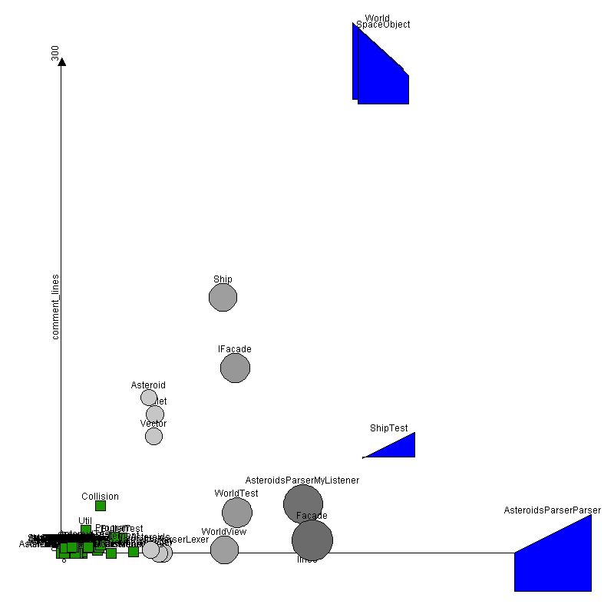
Result
Notes:
Here you see the circles and trapezoids implemented in the scatterplot…

Slide 4
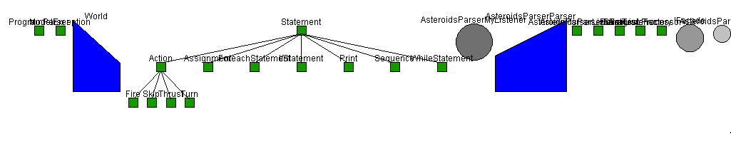
Result
Notes:
…and here in the systemcomplexityview.

Slide 5
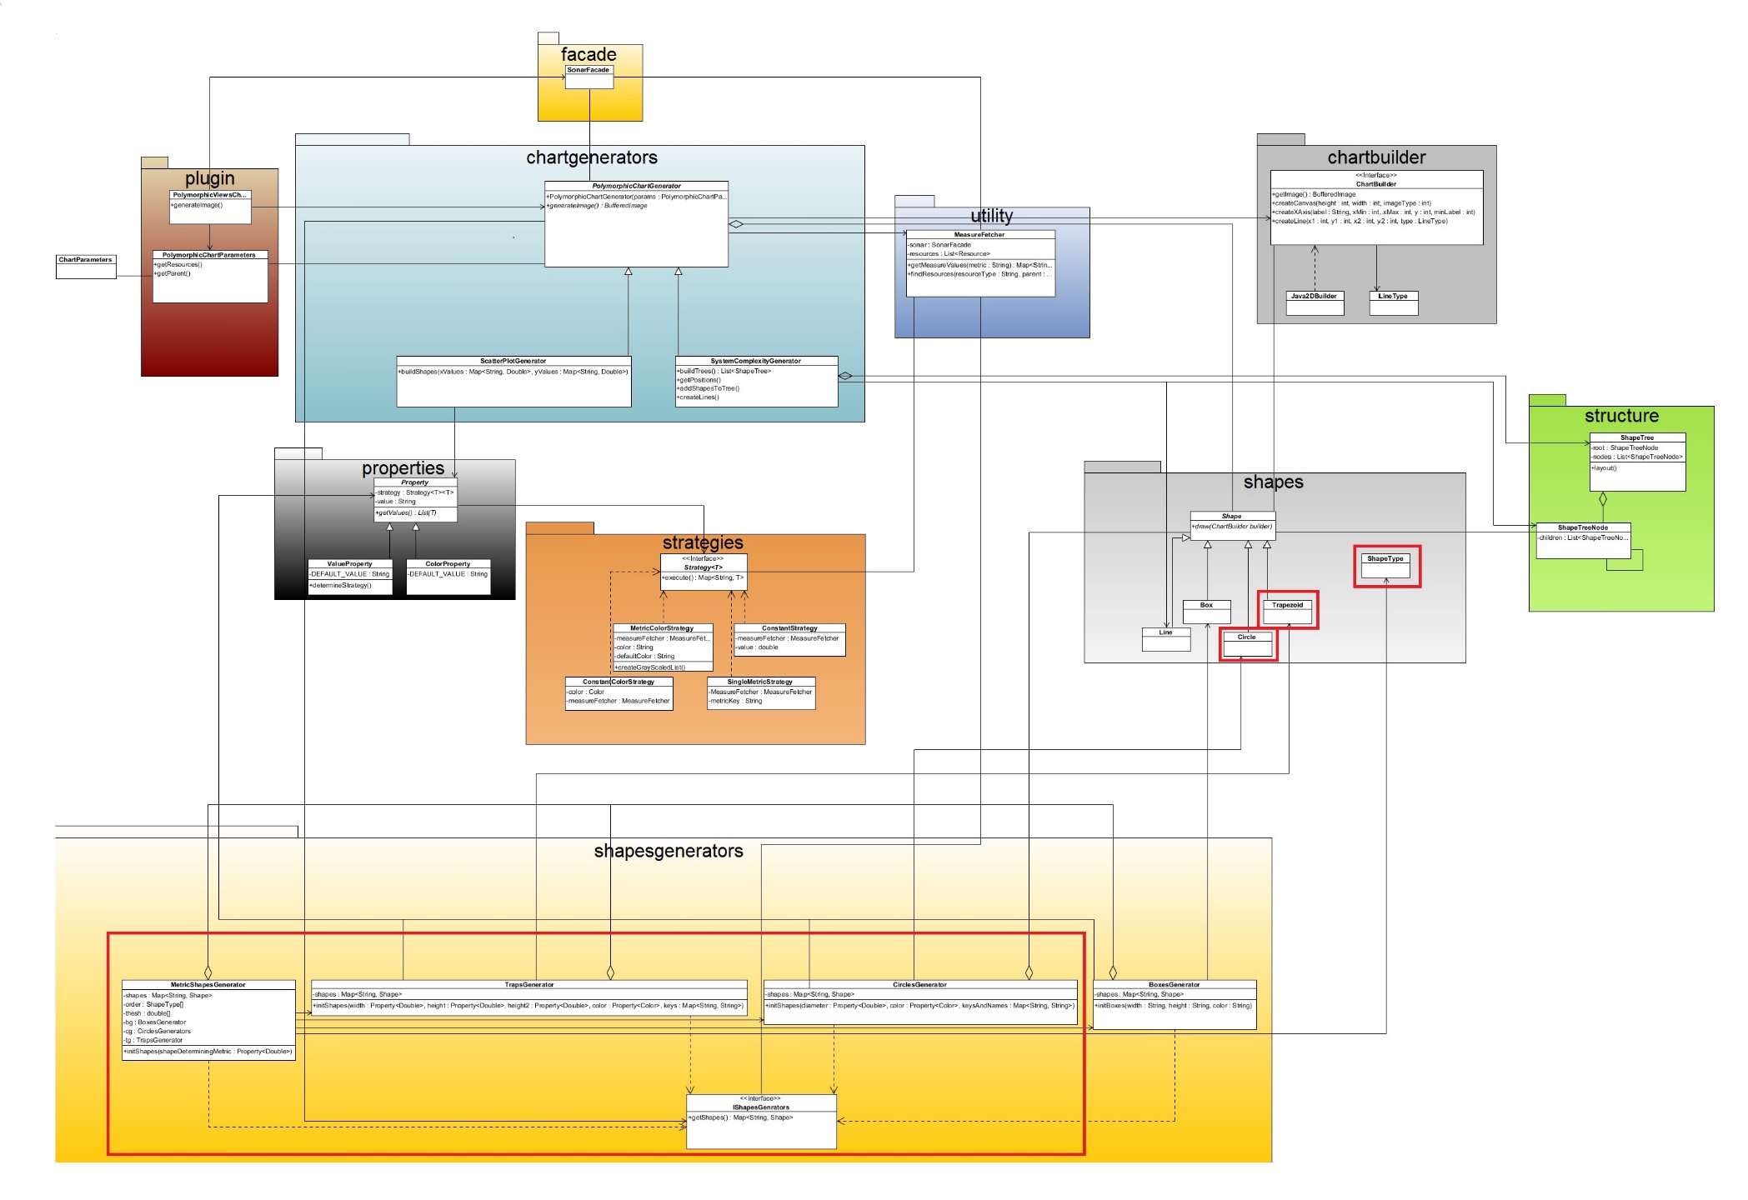
Class Diagram
Notes:
We divided our implementation into different packages with their own functionality like last presentation. Changes or additions are shown in the red rectangles. As before we have a chartgenerator packages that creates the charts. To do so it needs a list of shapes which will be generated by a ShapesGenerator (which we will discuss later). We added circles and trapezoids to the possible shapes. Implementation still uses a builder to build the image step by step. Each shape has a method draw that calls the builder to draw itself. Properties are used to get necessary data for the shapes. To get this data it can use some sort of strategy. The structure package is used in the systemcomplexityview to build trees of shapes.

Slide 6
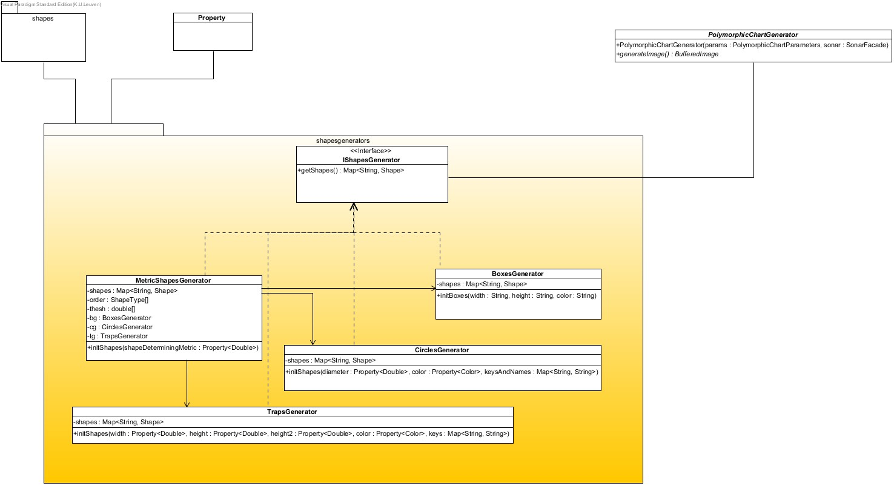
ShapesGenerators
Notes:
The biggest changes we made happened in the shapesgenerators package. First there was only one generator a boxesgenerator. We generalized this into an interface which is implemented by similar classes like circlesgenerator and trapsggenerator. Boxes, circles en trapsgenerators each create the necessary properties based on the given parameters. From these properties it gets the necessary data to be able to generate the specific shapes. A fourth class MetricShapesGenerator also implements the interface but behaves diffently. It creates a generator for each shapetype and gets the shapes it needs from the correct generator. This way we have less redundant code, more cohesion and less coupling between the metricshapesgenerator and all the different shapes.

Slide 7
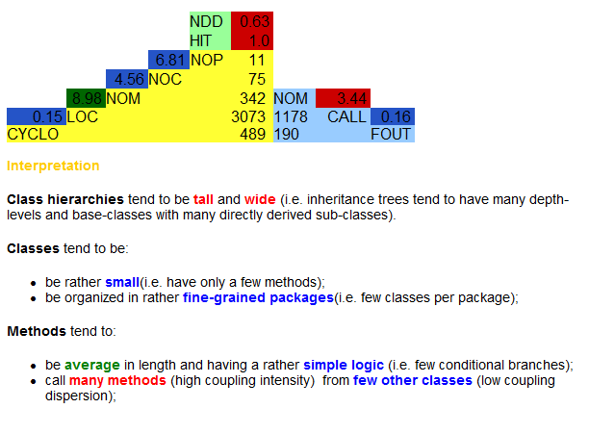
Analysis
Notes:
We ran analysis with both incode and sonarQube. Incode showed classes hierarchies tend to be tall and wide, we believe this is caused because the number of classes is relatively small to classes in hierarchies and hierachies depth. We also seem to call relatively many methods within a class which we believe comes from the fact that we use a lot of private methods so other methods do not become to big.

Slide 8
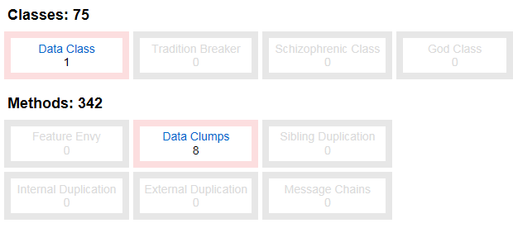
Analysis
Notes:
Incode shows one data class which is the Shape class and some data clumps which are mostly related to this shape. In conclusion we believe we did not make too many design flaws.

Slide 9
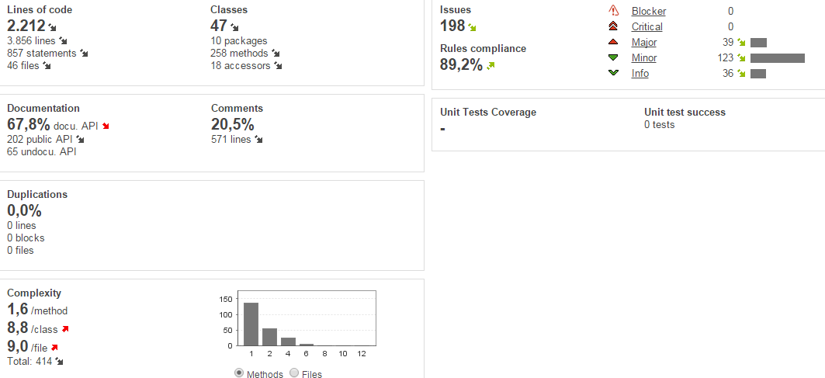
Analysis
Notes:
We used sonarqube to enhance our code. Now we see we do not have many important issues and also have a decent documentation.

Slide 10
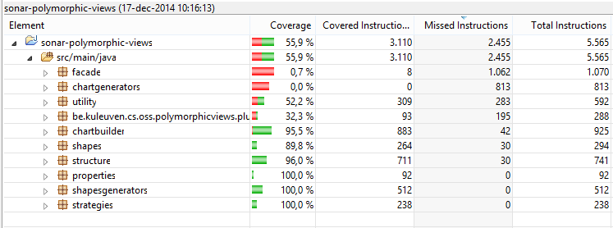
Testing
Mocking
Coverage
Notes:
In the first iteration we aimed for a test coverage comparable to that of sonarqube. We can see from this image that we achieve this goal in our own packages. We used mocking to be able to get this high coverage.
Only the chartgenerator package is not tested because it’s the same as running the plugin.

Slide 11
?

Slide 12
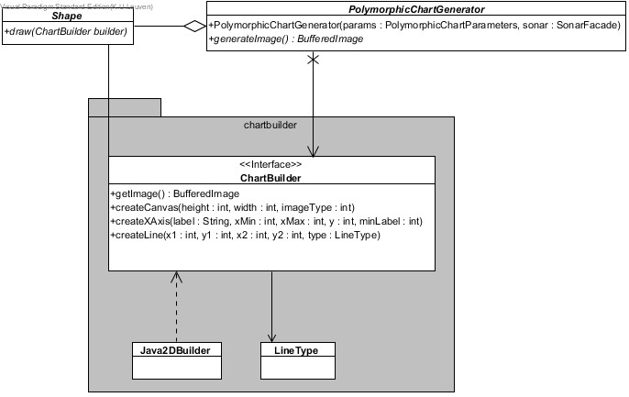

Slide 13
