Slide 1


1-year Checkpoint
Investigating top-down processing in the neural microcircuit of early visual areas
Wouter Kroot
Top-down vision lab
Donders Centre for Neuroscience, Neurophysics, Radboud, Nijmegen, Netherlands
February, 2026
Notes:
Thank you all for being here this morning, for my 1-year checkpoint meeting.
I am excited to share with you the progress over the last year. And would love to discuss ideas with you.
The title of my presentation today and the topic for my PhD, is investigating top-down processing in the neural microcircuit of early visual areas

Slide 2



Top-down
processing
Psychophysics
Human contour detection
Physiology
Multi-photon imaging
Computational Model
Recurrent microcircuit
Notes:
As you might know my project aims to integrate three complementary disciplines.
We would like to develop a computational model that respects biological constraints. The model really serves as a way to quantify how cognitive function arises from tangible dynamics.
And gives us a framework where we can combine cell-specific neurophysiology found in macaques with behavioural and cognitive findings in humans.
---
Intro:
The project aims to integrate three complementary disciplines.
The first stage is developing a computational model, in which we can experiment and get mathematical predictions of receptive fields properties can be leveraged for computation
Then we have three photon imaging to directly test our ideas in a cell-specific manner.
And lastly, we can translate our predictions and findings to human perception with behavioural psychophysics.
Next:
And ofcourse these projects are heavily intertwined. For example, the stimuli used in the psychophysics and imaging studies are dependent on findings from the computational part. And the dynamics within the computational model will be learned from neuronal dynamics.
In any case the goal is to find a neuronal architecture that accounts for ideas generated on each level.

Slide 3
Overview
TSP
Center-surround modulation in a canonical microcircuit
Psychophysics
Passive vision: center-surround modulation
Active vision: spatial- and feature-specific attention
Cell-type specific RNN
Network stability
Recurrent feature amplification through top-down disinhibition
Research Goals
Notes:
Today I would like to discuss some goals that were set in the training and supervision plan.
Give a general introduction about center-surround modulation.
And share with you some results from the psychophysics experiments and our dynamical system model.
I would like to specifically focus on the role of attention and how the integration of feedforward and feedback information allows for flexible gating of information.
----
Training and Supervision Plan
Introduction on center surround modulation and a canonical microcircuit
Active versus Passive vision
And how a cell-type specific network can be used for flexible feature representation

Slide 4
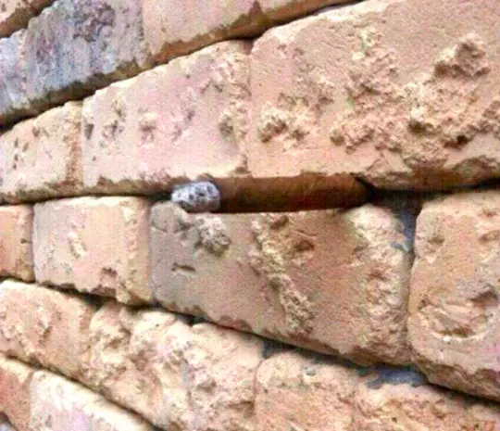
Notes:
I always like to give an example of what I think top-down processing really boils down to,
Are you familiar with this image?
Then im curious to hear what you see in this image?

Slide 5
“Top-down processing is how knowledge, expectations, or past experiences shape the interpretation of sensory information” ( Gazzaniga, Heatherton, & Halpern, 2016, p. 173 ).
Notes:
It’s actually a cigar stuck in between 2 bricks. And with this experience, you will never see this image the same.
That’s also why I like this definition so much, as it hints to conscious perception as an active process rather than passively taking in information for simple object classification.
I think these kinds of images can give us great insight in how our visual system actually works and why we are prone to certain visual illusions.

Slide 6
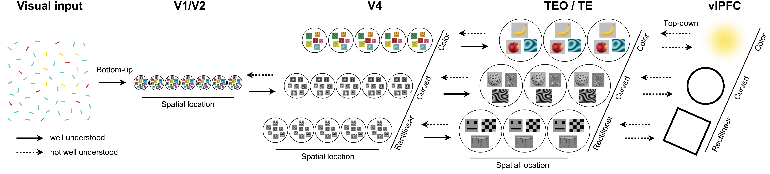
Representation in the visual cortex
Notes:
Cause that is often how the feedforward ventral stream is explained, a CNN for object classification, in which filters are learned and become more complex along an hierarchy. In human and non human primates particular feature dimensions are preserved along the hierarchy. And this feedforward process is generally thought to be well understood.
However, what is much less understood is how Top-down Feedback between layers can be used for the encoding of context-specific information and how our perception seems so stable while our external environment demands flexibility.

Slide 7
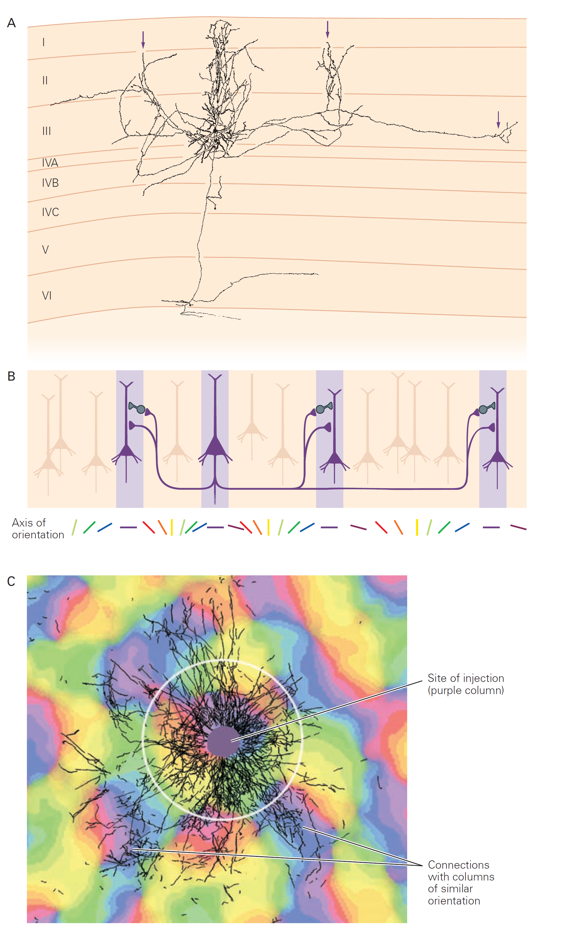
Orientation selectivity in V1
Notes:
Even though deep CNN’s rival human performance, their efficiency of computation is still lacking compared to the brain. So it is not surprising that the brain differ fundamentally in its organisation. For example, in neurophysiological studies in different animals we see that neurons that encode similar features are well connected, while orthogonally tuned neurons tend to avoid each other, creating orientation pinwheel columns in animals with larger brains.
Interestingly not all neurons are excitatory and sharply tuned to external stimulation, you also have various inhibitory interneurons that heaviliy shape and modulate neural activity.

Slide 8
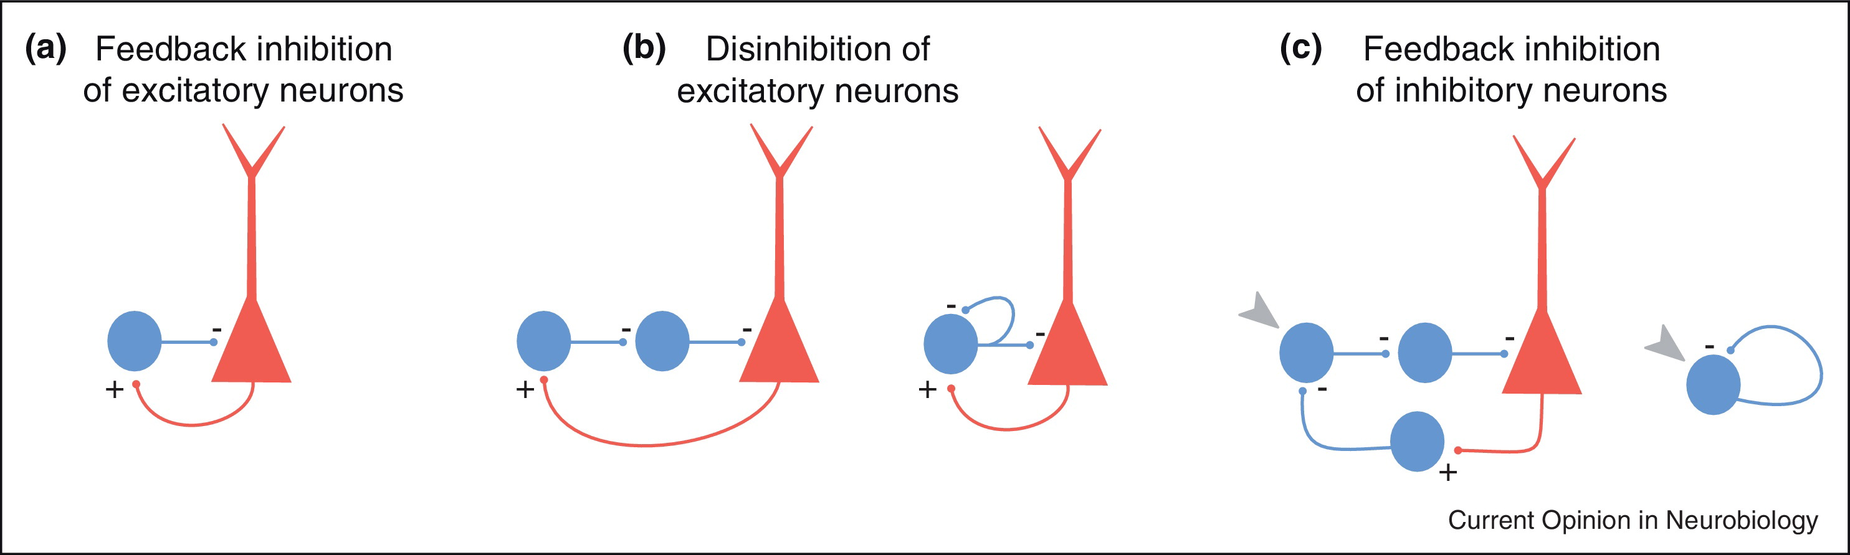
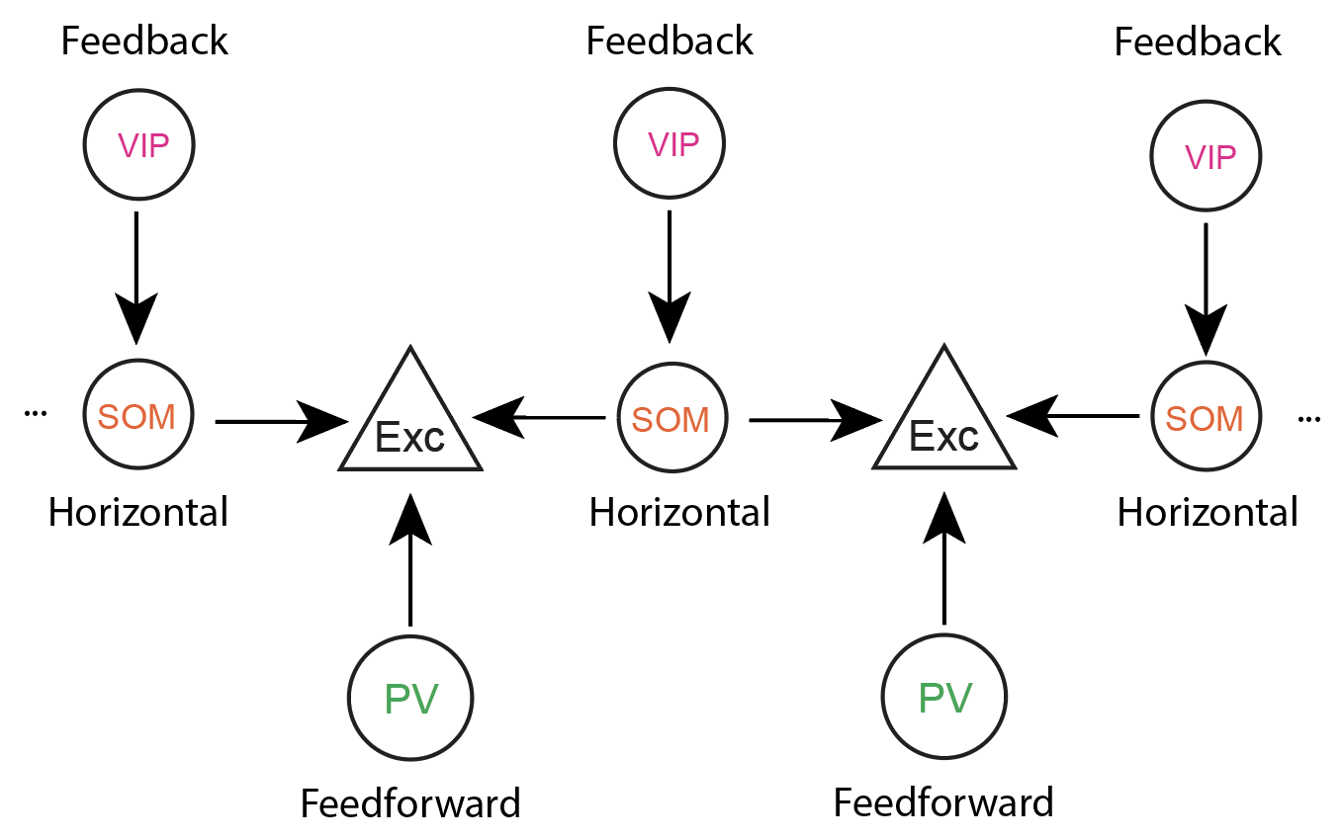
Inhibitory modulators
Deleuze et al. 2014
Inhibitory interneurons:
Parvalbumin (PV):
Feedforward normalisation and stability
Somatostatin (SOM):
Horizontal modulation
Vasoactive intestinal peptide (VIP):
Feedback disinhibition
Notes:
With a few simple connectivity schemes you can already create a complex network structure.
Inhibition can have suppressive effects when directly connected to excitatory cells, but can also have facilitatory effects when connected to other inhibitory interneurons.
95% of different interneurons can be categorised in 3 major neuronal subtypes. These subtypes can in turn be mapped to specific connectivity architectures.
Feedforward inhibition targets PV, functionally stabilising the network.
Feedback inhibition targets preferentially VIP interneurons, which inhibit SOM cells.
And SOM cells connect and inhibit horizontally.

Slide 9
Cell-type specific RNN
Notes:
To make it even more complex, the brain is full of recurrent connectivity between these neuronal subtypes.
However, from the perspective of a single population in the visual cortex it does not know where projections are coming from.
That is why we need a mathematical model to quantify connectivity and explain nonlinear effects.

Slide 10
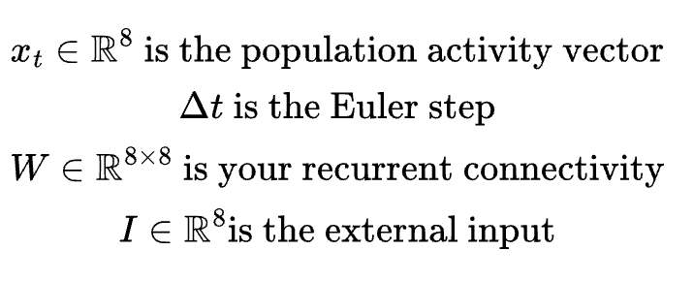
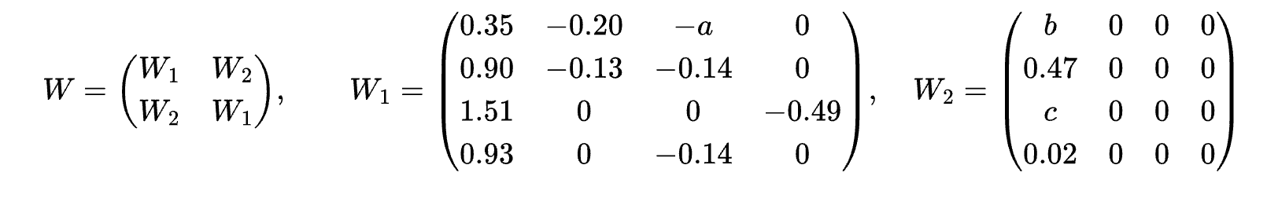
The recurrent microcircuit model
Center
Surround
Internal connectivity
E PV SOM VIP
Horizontal connectivity
E PV SOM VIP
Rows are Postsynaptic
Columns are Presynaptic
a = SOM 1→ Exc 1
b: Exc 1→ Exc 2
c: Exc 1 → SOM 2
Notes:
So now I show you a different image, however the main structure of feedback projections and feedforward information is still the same. The most important part is that we can see that we can define a microcircuit of our 4 neuron subtypes and that we can connect them over space.
We have a continuous system of nonlinear ordinary differential equations, where x is the state vector, delta t is the Euler step size and W is the recurrent connectivity matrix
The input is 8 dimensional and specifies the input to each individual neuron
--------------------------------------
Recurrent Population Dynamics
x_{t+1} = (1-\Delta t)x_t + \Delta t \, \phi(Wx_t + I),
\qquad
\phi(z) = [\max(0,z)]^2
W=
\begin{pmatrix}
W_1 & W_2 \\
W_2 & W_1
\end{pmatrix}
W_{1} =
\begin{pmatrix}
a & -0.20 & -0.29 & 0 \\
0.90 & -0.13 & -0.14 & 0 \\
b & 0 & 0 & -0.49 \\
0.93 & 0 & -0.14 & 0
\end{pmatrix},
\quad
W_{2} =
\begin{pmatrix}
c & 0 & 0 & 0 \\
0.47 & 0 & 0 & 0 \\
2 & 0 & 0 & 0 \\
d & 0 & 0 & 0
\end{pmatrix}
Fixed point:
x^* = \phi(W x^* + I)
Jacobian:
J = -I + D_\phi(Wx^* + I)W
Stability:
\Re(\lambda_i(J)) < 0
Format; x_t \in \mathbb{R}^8 \text{ is the population activity vector}
\newline
\Delta t \text{ is the Euler step}
\newline
W \in \mathbb{R}^{8\times 8} \text{ is your recurrent connectivity}
\newline
I \in \mathbb{R}^8 \text{is the external input}

Slide 11

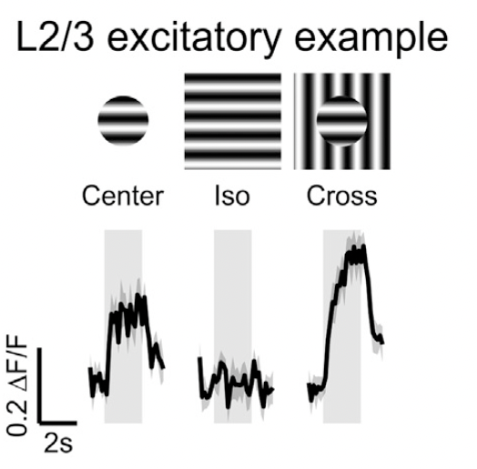
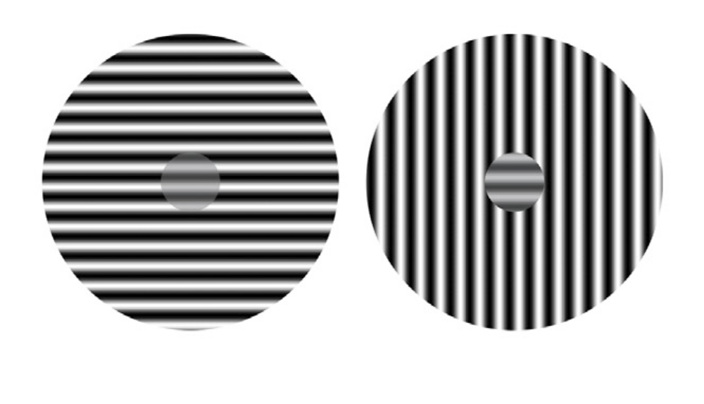
Surrounding information increases figure-ground segmentation through feedback
Pop-out effect
Keller et al. 2020
Notes:
The baseline weights that I am using in the model are learned from mice data where the mice looked at iso and cross oriented gratings.
It seems that if the background is orthogonally oriented compared to the center that the foreground really pops out.
In the paper of Keller 2020, where Alessandro was also part of. They showed that L2/3 of V1, the feedback recipient from V2 neuronally shows that cross oriented stimuli evoke larger resposes than center alone and that iso is suppressed.
This effect was local to L2/3 and not found in L4.
-----
these center circles have the same contrast, but the right ones seem to really pop out from the background. When we look at the activity of V1 pyramidal cells
Mouse study,
Relief of surround suppression give the impression of a pop out, and is located in L2/3
On the left here you can see the activity elicited in pyramidal cells, when only the center is shown these neurons have some response, this is completely suppressed when iso oriented bars are shown, now when you have an orthogonal background you can see a large increase, but only in L2/3.
L2/3 in the cortical column receives inputs from both L4 and from higher cortical areas. Somehow
---
In
contrast, the response to cross stimuli was similar to the
response to center stimuli alone, consistent with the fact that
cross stimuli generate less surround suppression than iso stimuli,
or no surround suppression, as previously described (Self
et al., 2014; Sillito et al., 1995; Walker et al., 1999).
Strikingly, the responses
of SOM neurons to iso and cross stimuli were opposite to what
we observed in excitatory neurons. While iso stimuli elicited
strong responses in SOM neurons, as previously observed
(Adesnik et al., 2012; Dipoppa et al., 2018; Keller et al., 2020),
cross stimuli elicited smaller responses (Figure 2B).
If VIP neurons prevent SOM neurons from
responding to cross but not to iso stimuli, they should be more
excited by cross than by iso stimuli.
Finally, surround suppression, though triggered by a
transient increase in inhibition received by suppressed neurons,
involves a steady-state decrease in the inhibition they receive.
However, this decrease in inhibition is outweighed by a decrease
in the excitation the neurons receive (Adesnik, 2017; Ozeki et al.,
2009). This reflects the ‘‘paradoxical’’ response of inhibitory neurons
in an inhibition-stabilized network (Ozeki et al., 2009; Tsodyks
et al., 1997).
The fact that our networks are ISNs likely underlies some of
their intriguing behaviors. When an input is given only to VIP
units, all the excitatory units increase their fixed-point firing rates.
In this case, because the network is an ISN, a weighted sum of
the inhibition received by each of the excitatory units will show
biphasic behavior, initially decreasing due to inhibition of SOM
units, but ultimately being increased in the new fixed point due
to recurrent excitation of SOM and PV units (Litwin-Kumar
et al., 2016; Rubin et al., 2015) (Discussion S1). The biphasic
behavior seen in the SOM unit of the centered and preferredorientation
subnetwork after VIP-unit activation (Figures 4I–4L
and S3) likely reflects its role in this larger ISN dynamics. In the
transition from iso- to cross-response levels, this unit shows
similar biphasic behavior in many solutions. Although this case
is more complex (Discussion S1), this could reflect similar
dynamics.

Slide 12
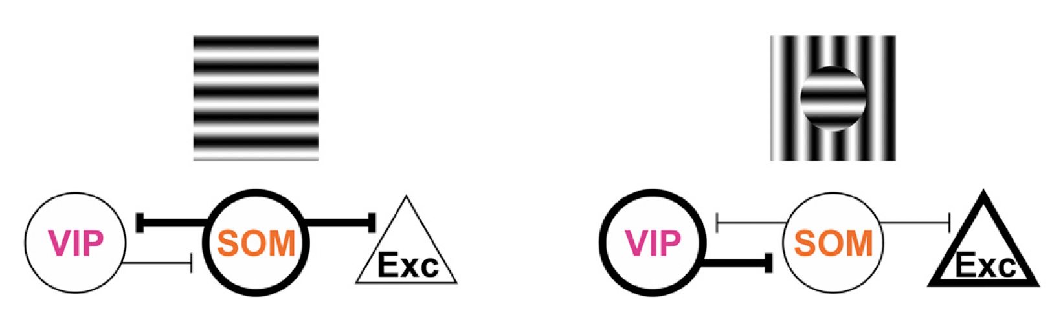
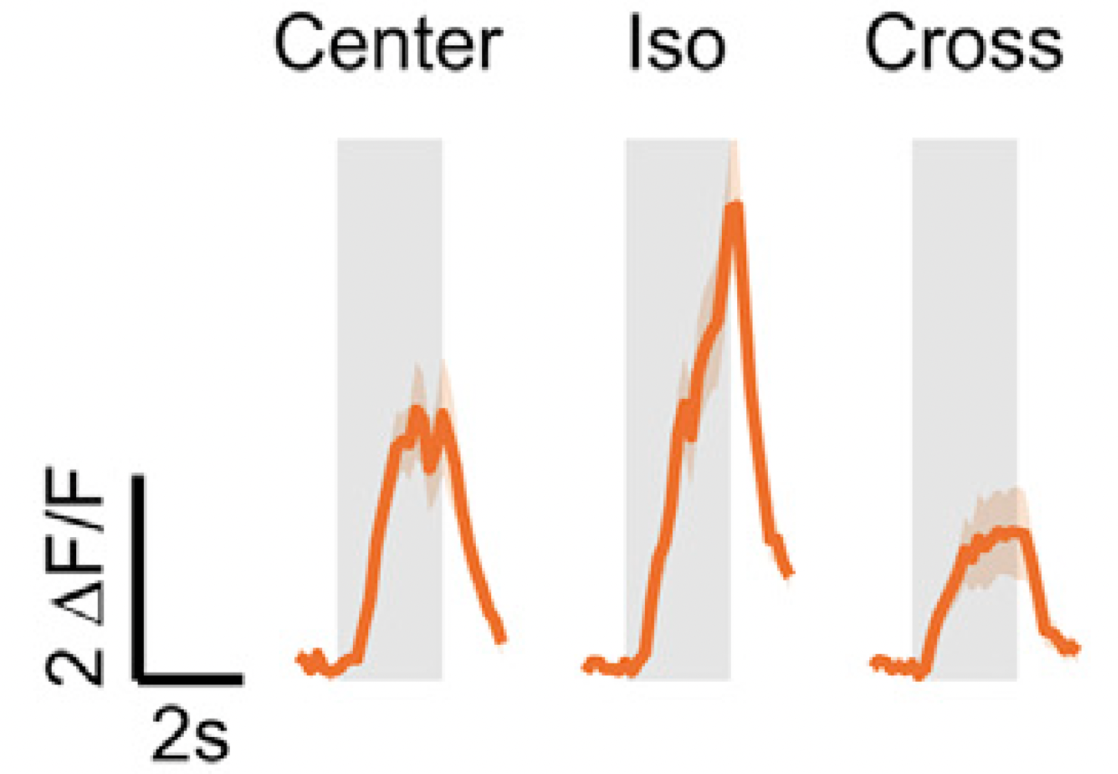
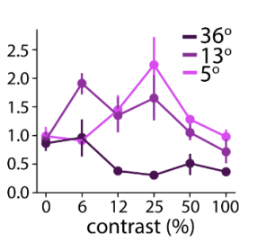
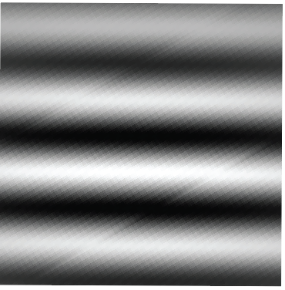


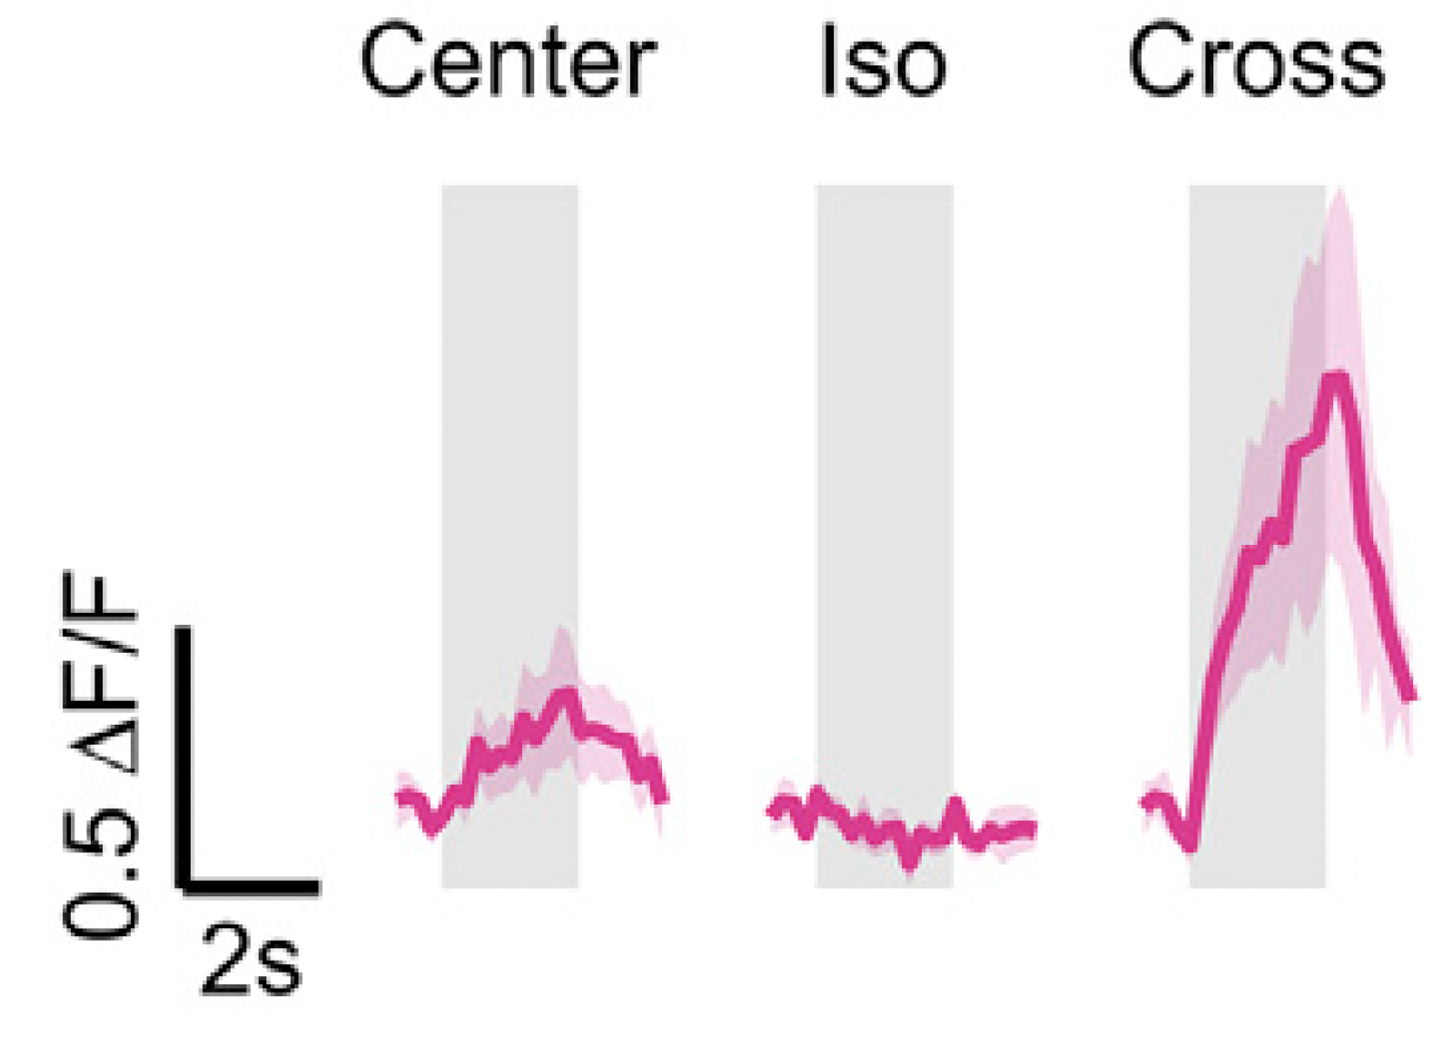
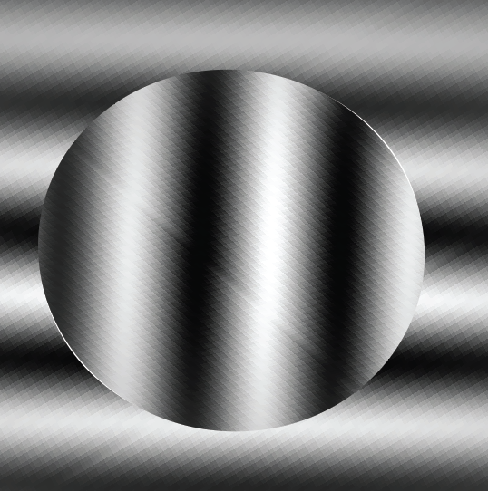

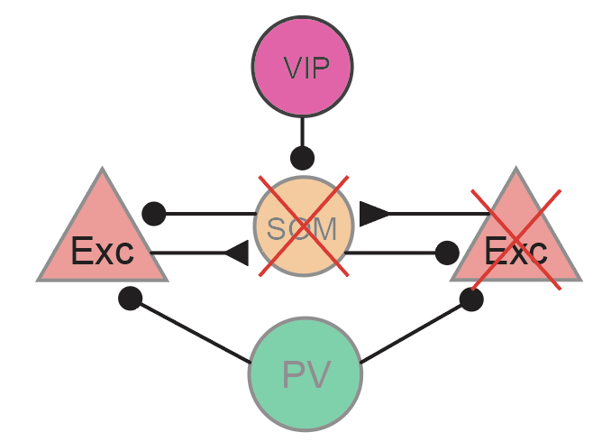
L2/3 Vip encodes contextual information
High contrast - Iso
SOM
Low contrast - Iso
VIP
Keller et al. 2020
Mossing et al. 2021
High contrast - Cross
VIP
Low contrast - Cross
Hypothesis:
Cross = Center
Keller et al. 2020
Notes:
They show that SOM is most active during the Iso stimulus, giving VIP a base activity to inhibit and thereby increasing activity in the cross stimulus.
In another paper by Mossing et al. they show that a similar effect can be seen when you change the contrast of the iso sstimulus, where VIP neurons are very active and win the tug of war against somatostatin
A valid next question would be what would happen if you decrease the contrast of the cross oriented stimulus, where we expect the activity elicted on the level of pyramidal cells to be practiaclly the same as in the center only condition, because somatostin is mostlikely already fully inhibited.

Slide 13
Psychophysics
Contour detection

Slide 14
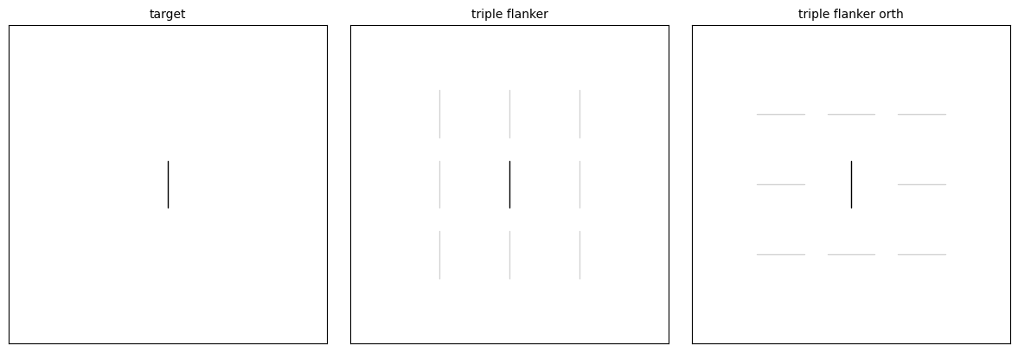
‘Passive vision’: center-surround modulation
Center
Iso-surround
Cross-surround
Notes:
These are the stimuli used in the experiment. In each block you can see a center stimulus, and in the iso and cross surround we have surrounding flanker stimuli. The main idea is that we can change the contrast of the center and the surround independently, to:
1: get the orientation specific modulation of the surround and:
2: the contrast specific effects of the surround.

Slide 15
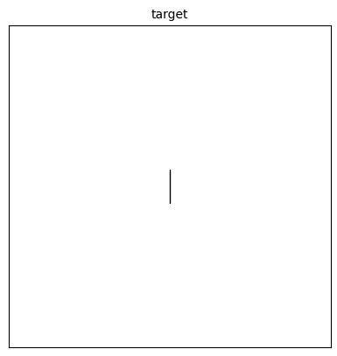
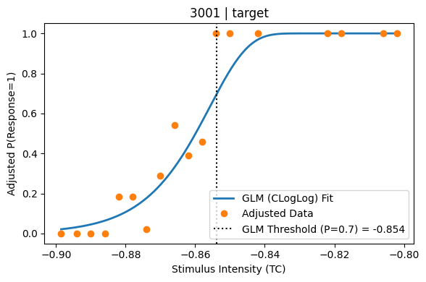

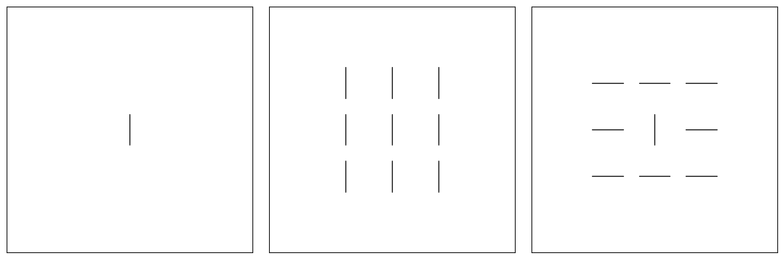
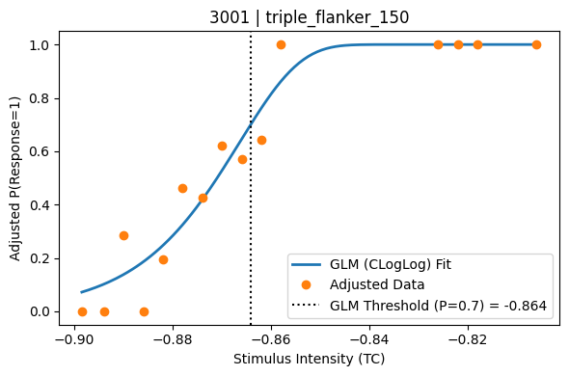
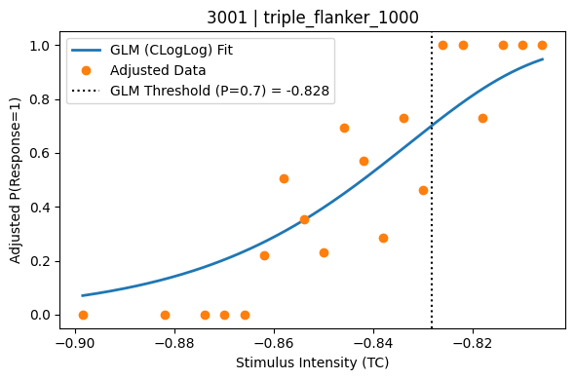
surround modulation is contrast-dependent
Cross-Surround: low contrast
Iso-Surround: high contrast
Notes:
To find how well people are at detecting a stimulus we fit a stimulus response function, in this case we do logistic regression on the detection probability.
We find the necessary contrast it takes to detect the stimulus, we do this per suround orientation for different predefined contrasts and calculate the horizontal shift on the x-axis the Contrast of the middle target/ center stimulus

Slide 16
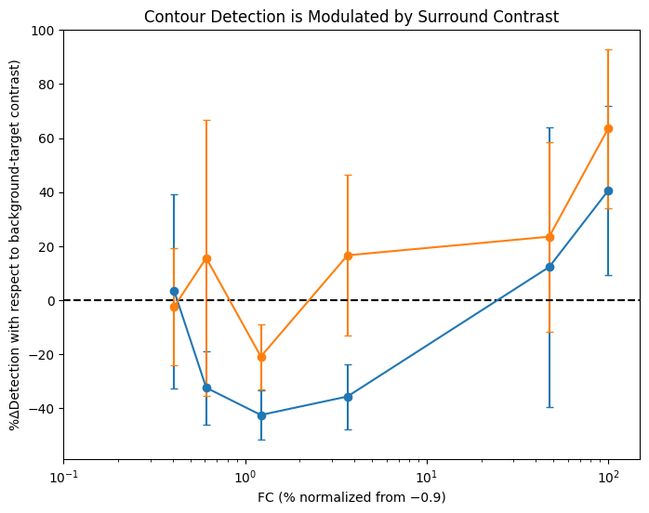

Orientation-specific dipper function
N = 3
Cross
Hypothesis:
Low contrast
Cross = Center
Center
Iso
% surround contrast (log)
Notes:
So each dot now represents the 0.7 detection probability at a particular flanker contrast.
The lower the points means that people require less contrast to detect a stimulus, meaning that the Iso orientation shows a smooth facilitatory curve where low flanker contrasts are facilitatory and high contrast surround is suppressive

Slide 17
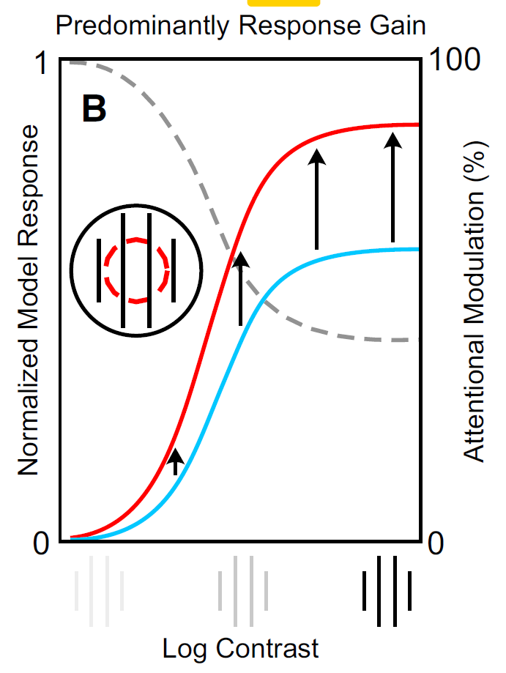
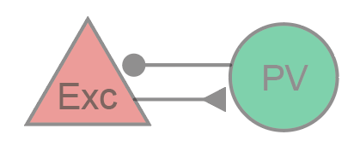
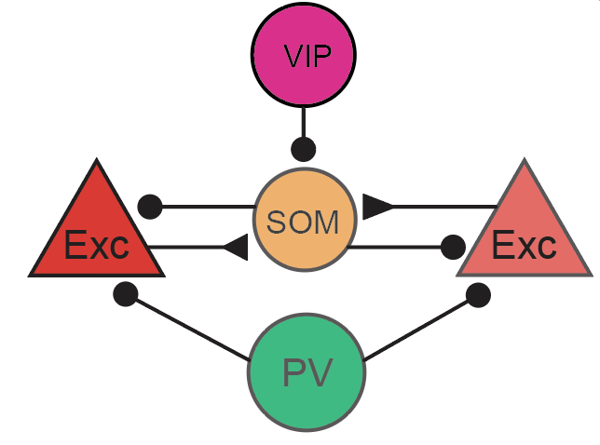
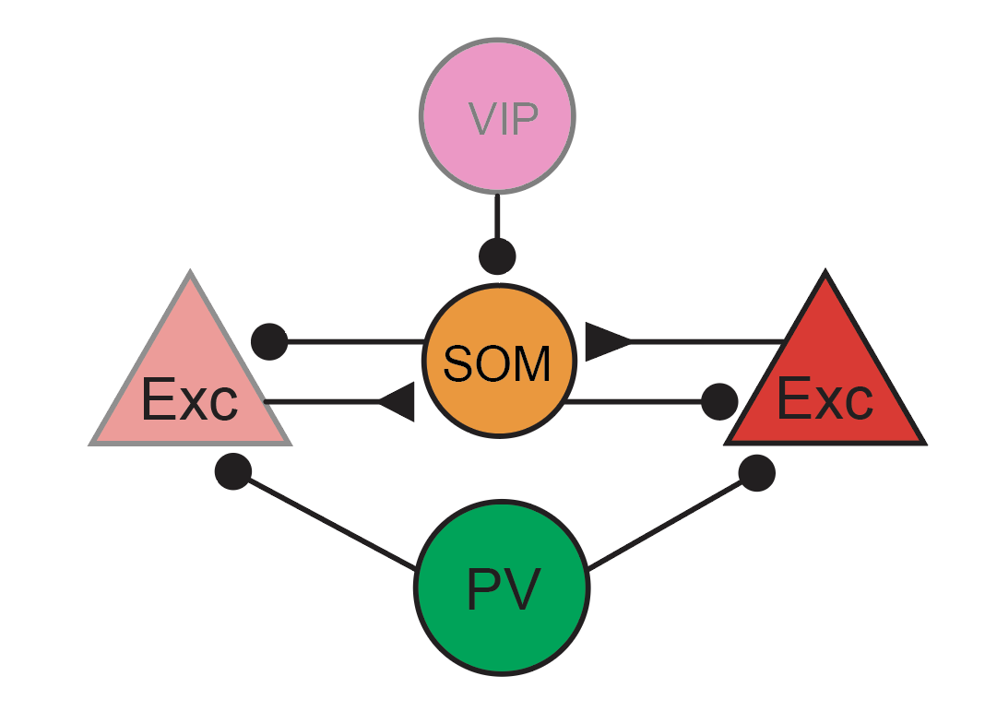
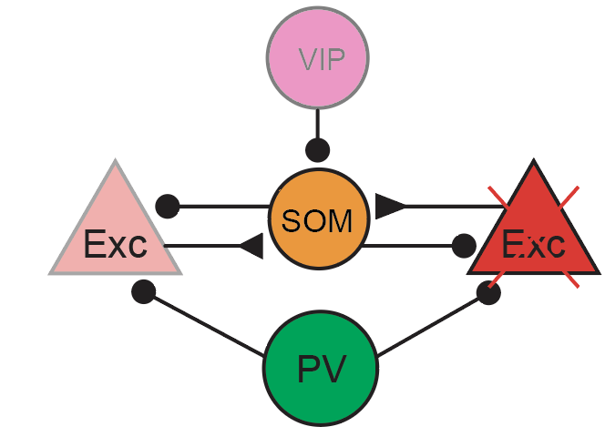
Normalisation model of attention
Surround low contrast
Surround high contrast
Center
=
Iso
++
-
Cross
--
=
Reynolds & Heeger, 2009
Notes:
In a classical paper on attention John Reynolds and David Heeger showed that a normalization effect of surrounding neurons could account for the different gain. They show that the size of the stimulus relative to the attention field changes how activity is increased by attention.
In low contrast regimes, attentional effects are greatest in terms of percentages, however in high contrast regimes absolute gain is highest.
Unfortunatley, they do not give an exact neural mechanism for normalization.
One of the goals for the current project is to relate the different gain findings of the normalization paper to cell specific components. Where one hypothesis is that interaction between VIP, SOM and PV interneurons result in attentional effects.
We see in the visual hierarchy that feedback projections predominantly target other excitatory cells and VIP cells, in which VIP cells become more prevalent in higher areas.
In the previous psychophysics experiment we did not manipulate spatial or feature attention, it was always present. But maybe it is possible to draw some similarties of expected microcircuit dynamics, psychophysics results and literature.

Slide 18
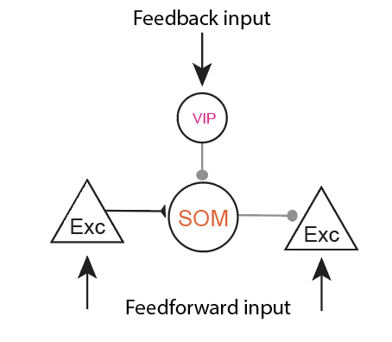
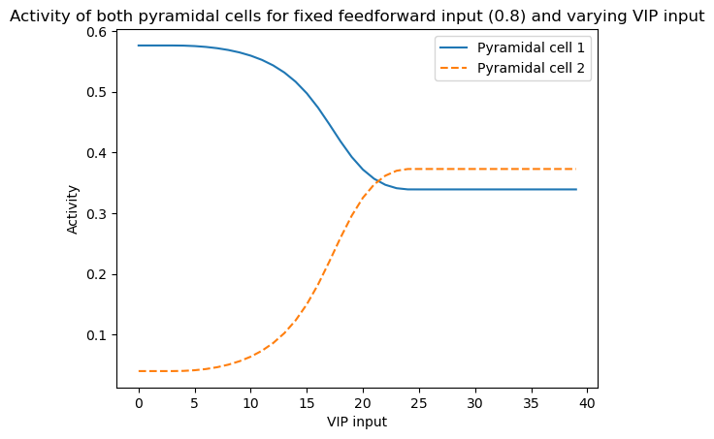
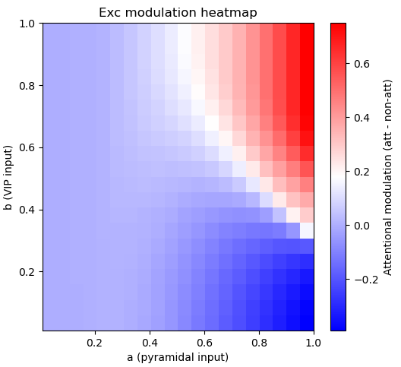
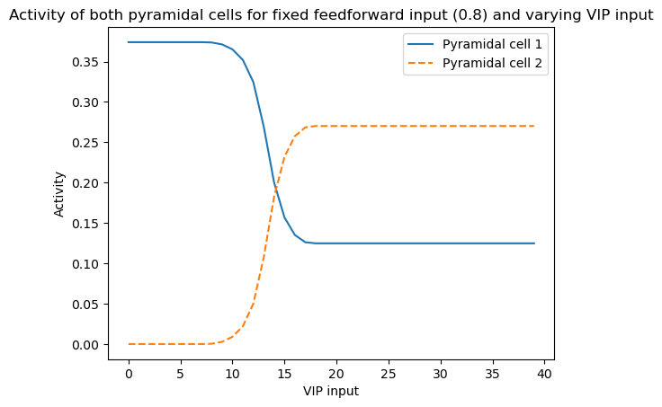
Top-down disinhibition interacts with surround for flexible modulation
Surround suppression weak: Exc -> SOM = -0,29
***
Surround suppression strong: Exc -> SOM = -1,09
Notes:
Something interesting happens if we use our model to zoom in on the interaction between top-down disinhibition and the horizontal inhibitory effects.
The model does predict that changing the strength of surround suppression between 2 features, gives top-down projections a flexible way of either suppressing or facilitating a stimulus over another stimulus.

Slide 19
Psychophysics of ‘active vision’:
Spatial- and feature-specific attention

Slide 20
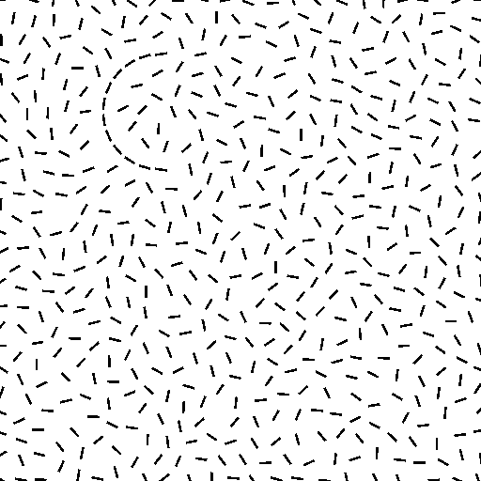
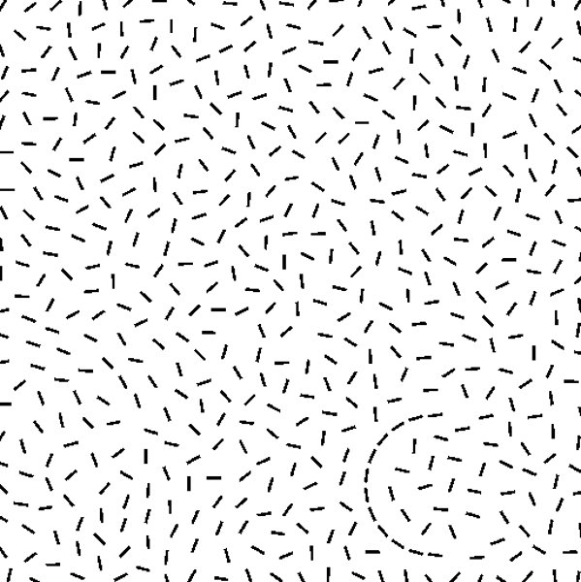
Feature attention
Stimulus
Feature + Location
Feature
Priming:
Feature (80/20)
Location (80/20)
TL
C
C
C
C
TR
BL
BR
C
C
C
C
Notes:
So in the first step to manipulate feature and spatial attention during contrast detection, we need a way to discriminate between the two. For this we use the current method:
We have 2 features, a C and a mirrored C, and this feature can be presented in either 1 of 2 location pairs.
We prime a given feature and a given location 80/20, in which 80% a feature is presented on one diagonal. Then in 20% of the time we see a primed feature in the non dominant spatial quadrant. Where we can calculate the performance.

Slide 21
Psychophysics Active Vision methods
Fixation
Stimulus
Response
4
5
1
2
0
300 ms
300 ms
1200 ms or keypress

Slide 22
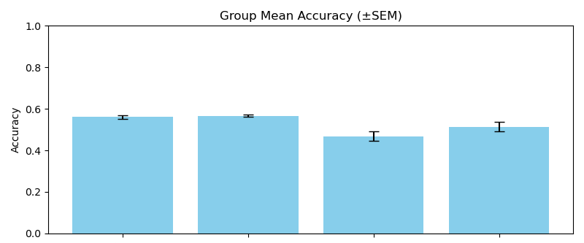
Preliminary results: feature-specific attention
N=3
Expected:
Feature: C
Spatial: TL -BR
nDom-Dom

Slide 23
Next goals

Slide 24
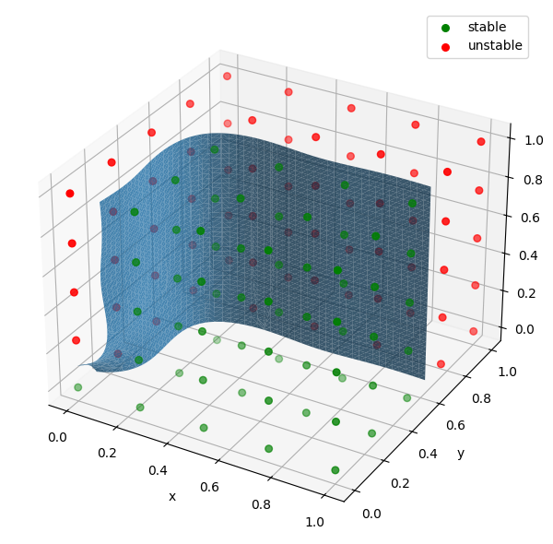
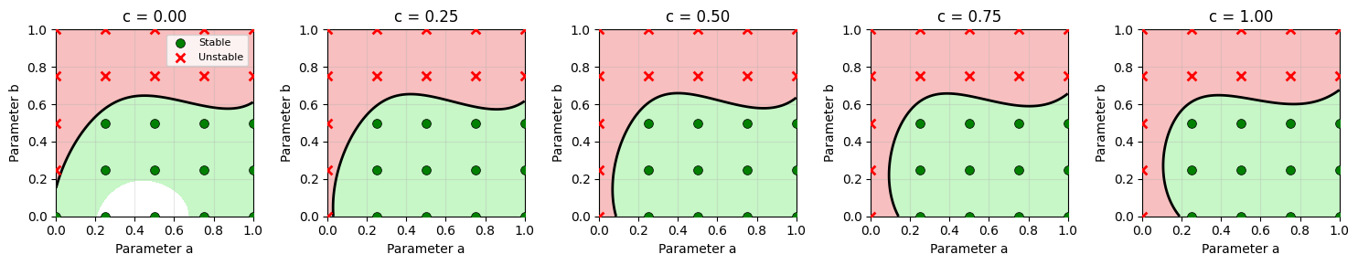
Recurrent Microcircuit optimisation for temporal representation

Slide 25
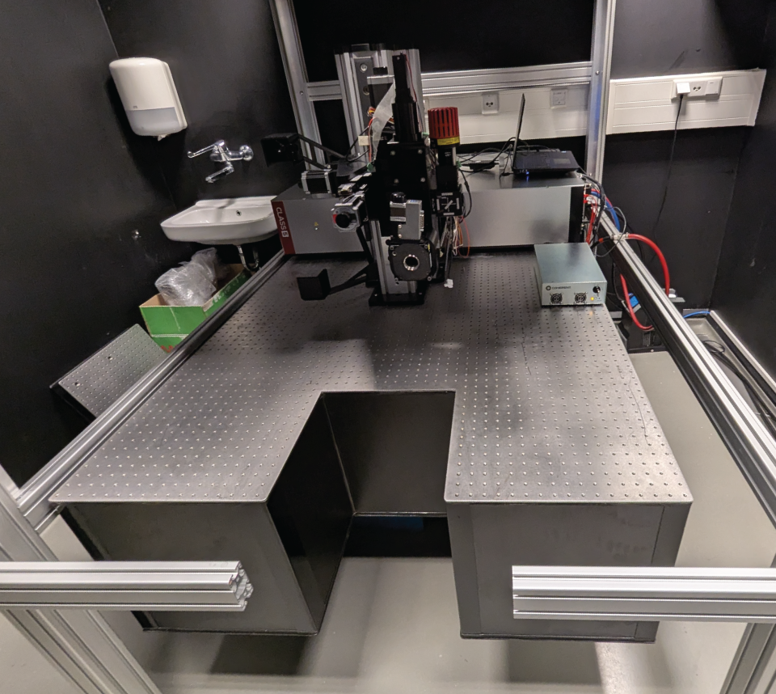
3-photon microscopy
CCD
Viral vector electromicroscopy
FELASA course

Slide 26
Thank you! Any questions?
Notes:
And with that I want to thank my supervisors and collaborators, and would love to answer some of your questions.

Slide 27




Thank you! Any questions?
dr. Timo van Kerkoerle
Top-down Vision lab
dr. Alessandro
Ingrosso
Prof. dr. Francesco Battaglia
Neuronal Networks
Of Memory
Prof. dr Floris de Lange
Predictive Brain lab
https://www.neuroscience.vision/home
Notes:
And with that I want to thank my supervisors and collaborators, and would love to answer some of your questions.

Slide 28
Literature
Tuan Nguyen, Kenneth D Miller, Agostina Palmigiano (Interaction untuned modulatory and tuned sensory)
Ho Yin Chau, Kenneth D Miller, Agostina Palmigiano (Linear perturbation theory)
Chemnitz dynamical system analysis of neural networks 2025
Minggui yin Gilbert, Wu 2014 (Incremental integration of global contours)
Garcia del Molino, Xiao-Jing Wang, Jorge Mejias (Paradoxical responses reversal of top-down modulation)
Miller, Palmigiano, Generalised paradoxical effects in E/I networks 2020
Heeger Recurrent circuit implements normalization 2020
Laura Naumann, Keijser, Sprekeler (Invariant neural subspaces maintend by feedback; slow/fast)
Burg, Cadena, Tolias, Ecker 2021 (Learning Divisive normalization)
Keller et al. 2020 Disinhibitory system for contextual modulation
Flexible gating neural subspaces Liu, Xiao-Jing Wang 2024
Strong recurrent networks compute the orientation tuning of surround modulation V1, Shusruth Angelucci 2012

Slide 29
Schedule
Introduction
Literature
Keller et al. 2020
Mossing et al. 2021
Reynolds 2009, 2025
Psychophysics (Experiment + data fitting analysis):
Passive vision
Active vision
Intro to computational neuroscience
The perceptron (Linear algebra)
Normalization model of attention (If interested)
Cell-specific coupled differential equations and stability

