Slide 1
HDMI Transmitter
Suraj Khan

Slide 2
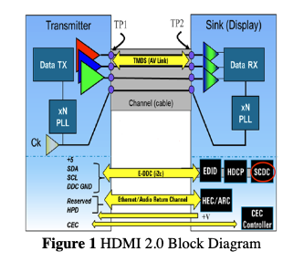
Introduction
HDMI or High Definition Multimedia interface is actually protocol which allows to transmit video as well as audio data
The protocol consists of two main system architectures
Source
Sink
Became an IEEE official standard in 2003.

Slide 3
Introduction
HDMI specs until version 2.0
Encoding Scheme : TMDS – Transition Minimized Differential Signaling (8b/10b scheme)
Max Data Rate : upto 18 Gbps
Data Channels: 3
Supported Colour Bits: from 8 Bit per channel all the way to 16 bits per channel
Audio specifications: Max Sampling Rate: 192 KHz with support for upto 32 channels with each sample size from 16 to 32 bits.

Slide 4
Goals for this project
Build a simple HDMI transmitter which outputs a simple image of resolution of 640 x 480
Implement the system on the Verilog
Use the hardware to display an output of your choice on the monitor

Slide 5
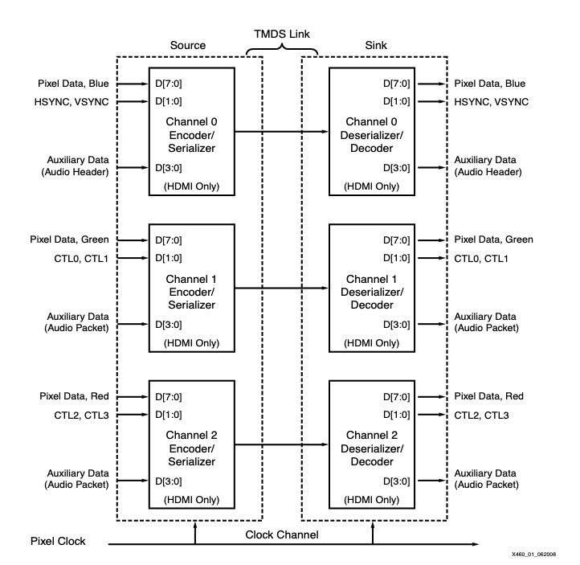
Overview of the Transmitter System

Slide 6
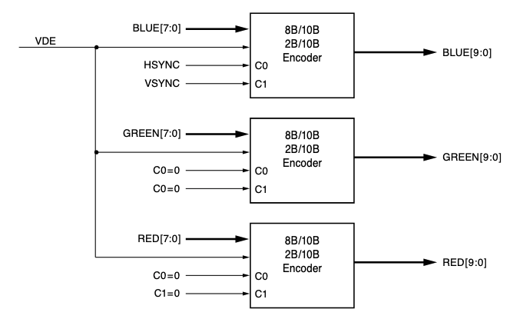
Overview of the Transmitter System

Slide 7
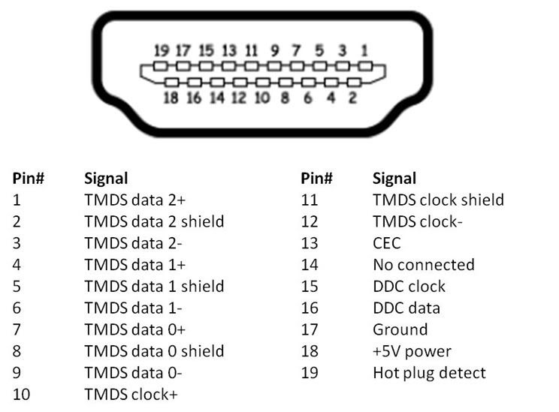
HDMI Pins layout
Notes:
2+,2-,1+,1-,clk+,clk-

Slide 8
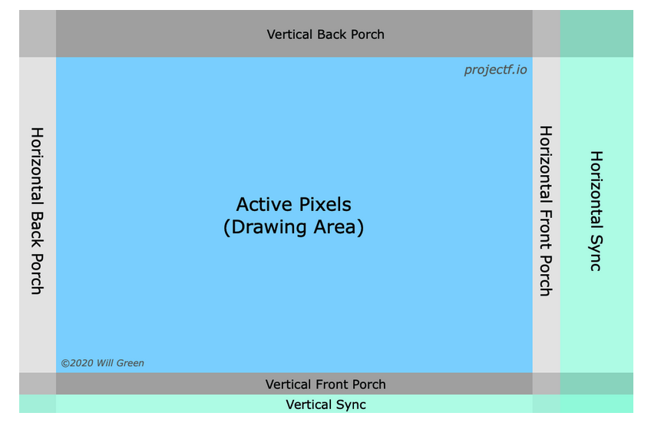
Overview of the Video Signals
The video signals have two main phases
Blanking Intervals
Active Pixels or the actual image draw area
Blanking intervals contain the sync data as well as can also carry audio data

Slide 9
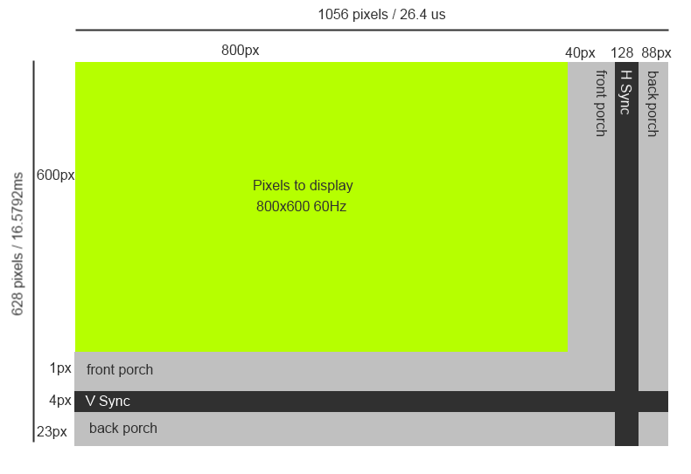
800px
640px
16px
96px
48px
480px
640x480px
525px
10px
2px
33px

Slide 10
Timing specifications for 640x480
Aspect Ratio 4:3
Pixel Clock 25.175 MHz , TMDS Clock 251.750 MHz , Pixel Time 39.7 ns ±0.5%
Frame Time 16.7 ms
Horizontal Timings
Active Pixels 640
Front Porch 16 , Sync Width 96, Back Porch 48 Blanking Total 160
Total Pixels 800
Vertical Timings
Active Lines 480
Front Porch 10 , Sync Width 2 ,Back Porch 33 , Blanking Total 45
Total Lines 525
Active Pixels 307,200 and Data Rate: 0.60 Gbps

Slide 11
Overall Verilog Blocks
Clock Generator
HDMI
Pixel
Output Logic
TMDS
Encoding
8b/10b
&
Serializer
TMDS R
Pix_clk
TMDS G
sysclk
TMDS B
sync
TMDS
clk
TMDS PixClk
VDE
Offered to you
Your Task for the Lab

Slide 12
Clocking Generator
Inbuilt FPGA clock: 125 MHz
Required clocking signals:
25 MHz for pixel clock
250 MHz for TMDS clock
Techniques for generating two clocks from same clock?
CMT - Clock Management Tiles
Each CMT contains MMCM – Mixed Mode Clock generator and PLL (Phase Locked Loop)
Advantages of MMCM over PLL
Fractional Multiplication and Divide as compared to PLL
Fine phase shifting as well as Dynamic Phase Shifting
Inverted Clock Outputs

Slide 13
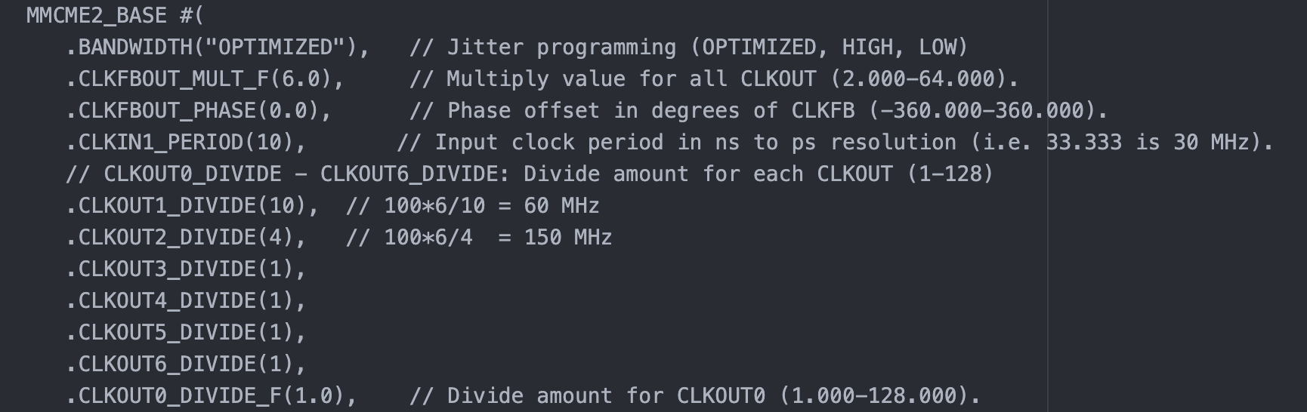
MMCM Instances in series 7 FPGAs
First instantiate the base MMCM parameters

Slide 14
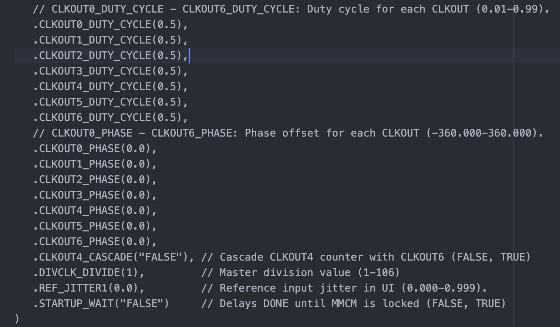
MMCM Instances in series 7 FPGAs

Slide 15
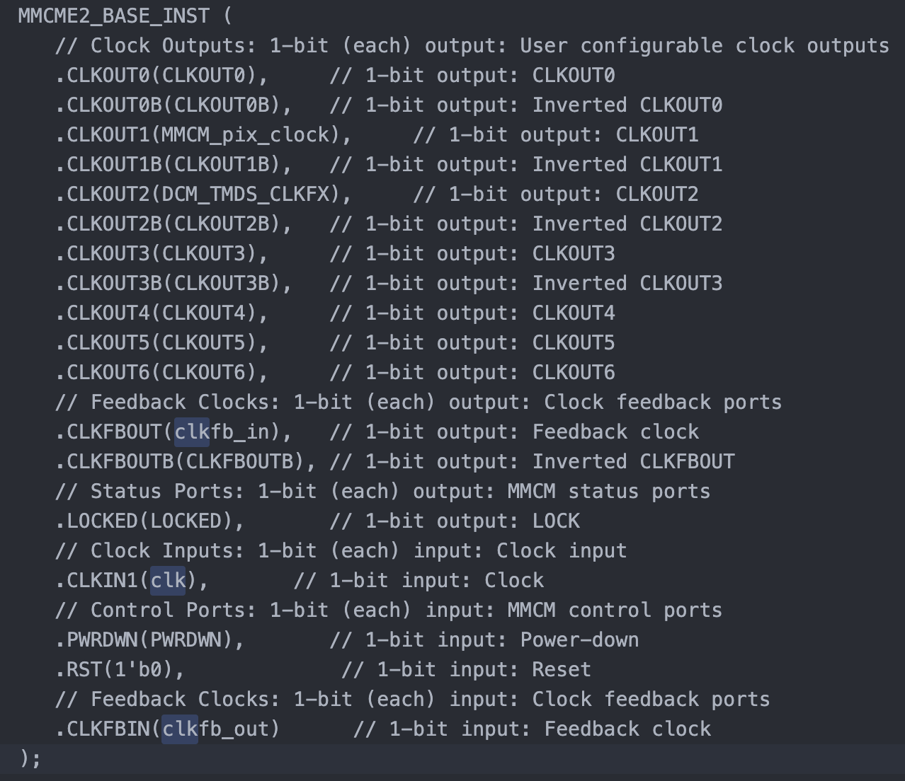
Instantiate the actual clock

Slide 16
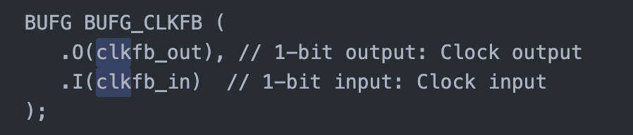
Additional Global Buffers
Global buffers are essential for clocks signals to keep stability
Preferable to have a global buffer for each divided clock output
Ideal to also include a buffer for feedback clock for the MMCM module to keep the phase locked.

Slide 17
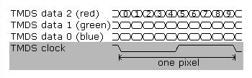
TMDS Signalling
The TMDS Encoder contains of two parts
Transition Minimizing. If number of transitions in the 8bit signal is greater than 4 apply XOR or else XNOR. 9th Bit indicates if XOR is used.
DC balancing: The number of ones and zeros in the 10 bits should be equal. So the 10th bit is decided accordingly.

Slide 18
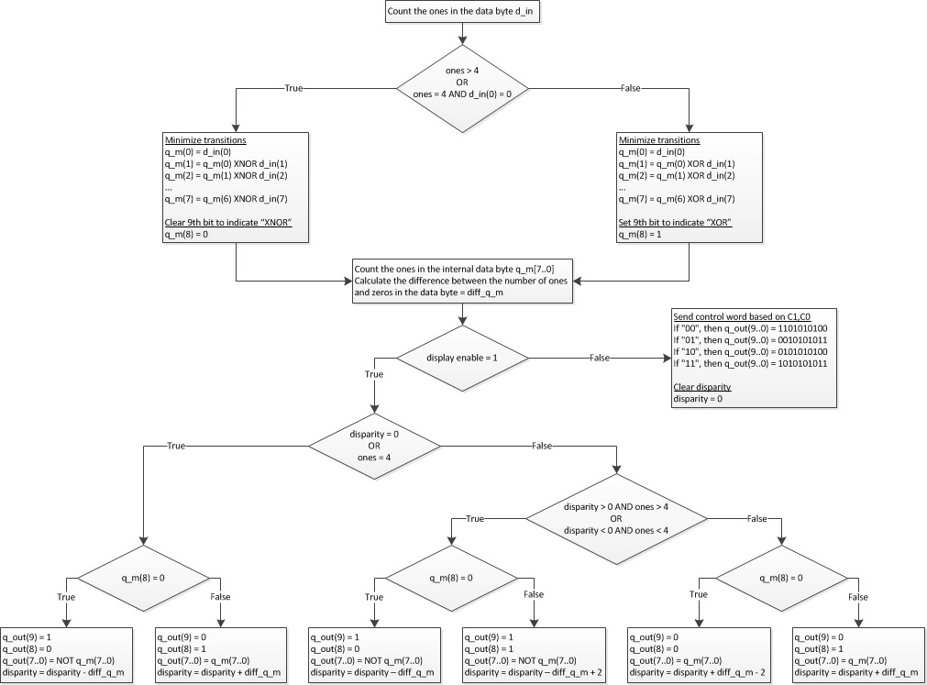
TMDS Encoding Algorithm

Slide 19
HDMI Sync Signals
Hsync and Vsync signals on the blue channel
Hsync signal is high for 96 pixels for pixels starting from 656 till 751(inclusive) horizontal pixel.
Vsync signal is high for signals for vertical pixel 490 to 491 (inclusive)
For red and green channels send 2 bit zeros as sync signals
Red and Green channels carries HDCP and other control signals, not required in this case of lab.

Slide 20
Interfacing on the board
Use constraints to connect your Verilog logic to the ports on the board
Use appropriate constraint to connect to the 125 MHz crystal clock output for the FPGA
Define appropriate constraints to connect to the TMDS Red, Green and Blue and clock lines on the HDMI output connector
Select 3V3 as the output signalling for the HDMI TMDS connection

Slide 21
Goals for this Lab
Building the appropriate clock generator for Pixel and TMDS clocks
Build the HDMI color generation logic
Apply constraints to connect to appropriate ports on the board

Slide 22
Summary
Specs
Ports
HDMI transmitter
Resolution : 640x480
Two clocks: Pixel and TMDS clock of 25MHz and 125 MHz respectively
sys_clk: 125 MHz system clock
HDMI TMDS for Red, Blue, Green and Clock channel.

