Slide 1

OGS
The Open GIS Stack
“A maximalist docker based server side geospatial stack”

Slide 2







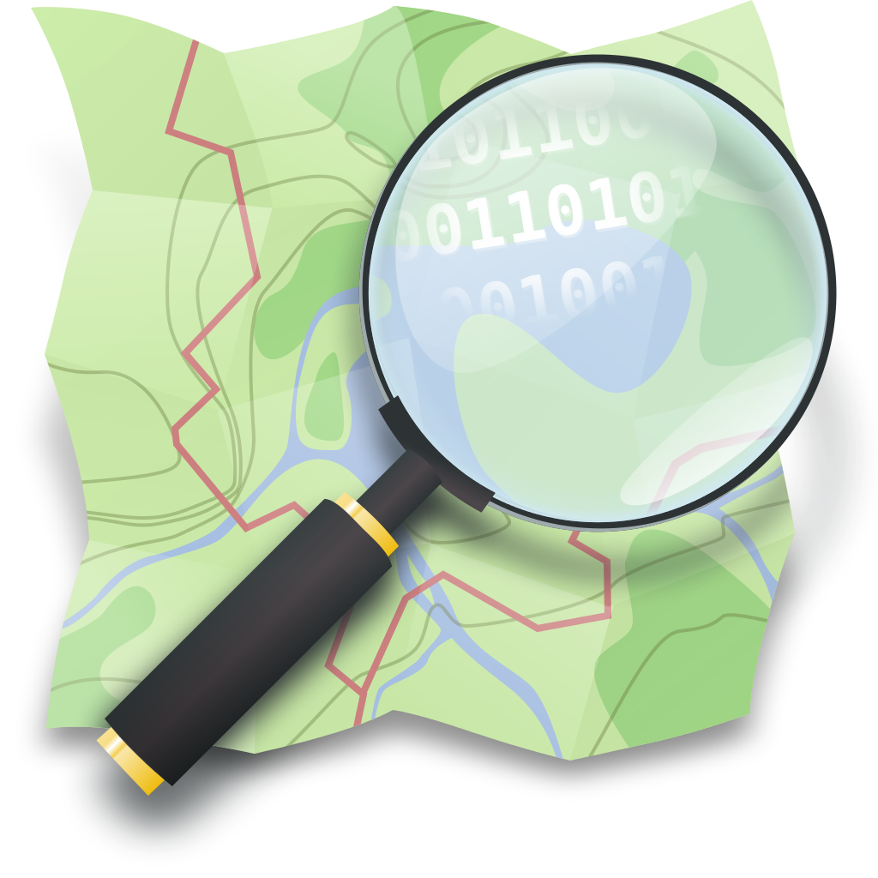



Slide 3
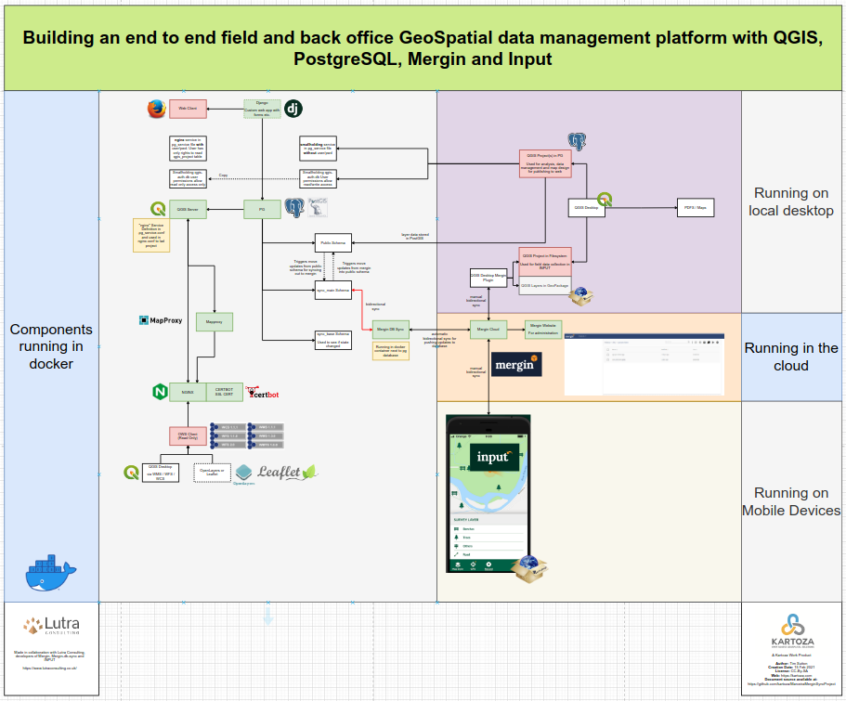

Slide 4
1.
Deploying your stack
“from zero to hero”

Slide 5
2.
Connecting to PostgreSQL
“select * from postgis”

Slide 6
3.
in review
Open Street Map Data
“docker-compose --profile=osm up -d”

Slide 7
4.
Publishing a QGIS Project
“scp all the things”

Slide 8
5.
Mapproxy
“save cash use a cache”

Slide 9
6.
GeoServer
“because nice people use standards”

Slide 10
7.
Mergin
“docker-compose --profile=mergin up -d mergin-sync”

Slide 11
GitHub
https://github.com/kartoza/OpenSource-GIS-Stack
“You too can be a maximalist!”

