Slide 1
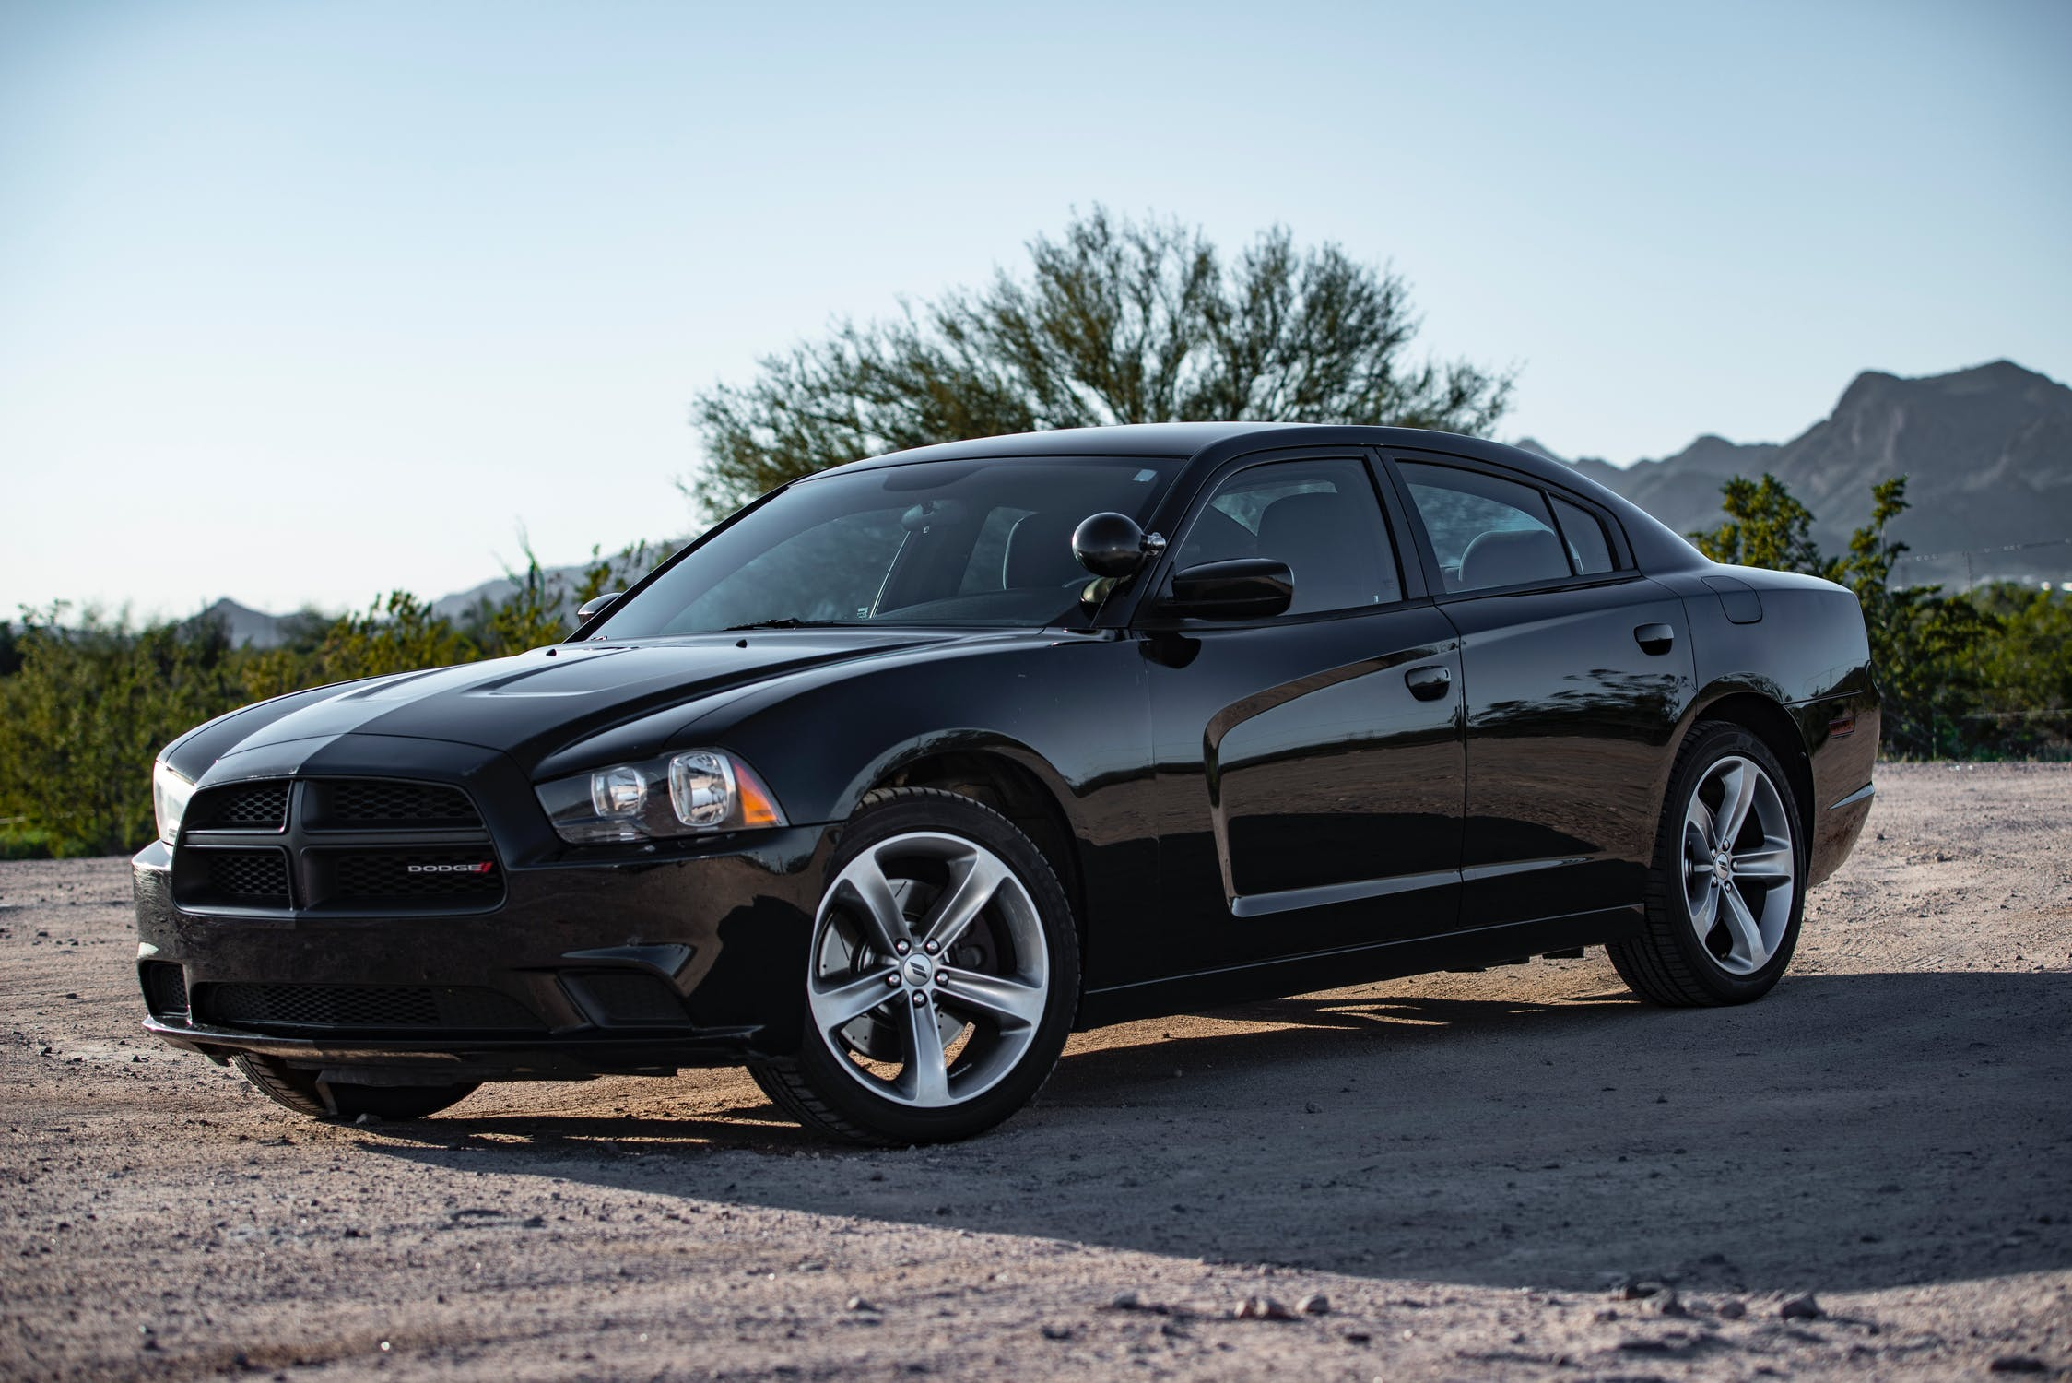
The building of Awesome Auto Reviews awesomeautoreviews.com
Woz-U-Group-Projects/nerds-of-a-feather

Slide 2
Team Background
Team Members:
Ameka Ali
Ryan Tartar
Robert Banda
Nico Cossou
Charles Dalton
Five team members from different parts of the country, and different backgrounds, coming together to create a web app that provides user reviews and ratings on new and used automobiles.

Slide 3
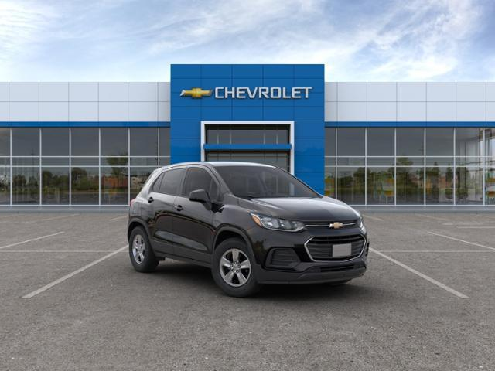
How will the app work?
The user will create an account, and then search for the vehicle they want to leave a review on. They can also search for a vehicle they are interested in purchasing to get more information. The user will be able to rate the vehicle, and then post a review. The user will be able to access a link to find the vehicle of choice nearby.

Slide 4


Building the Front-End
The Front-End will be built using REACT and AXIOS. REACT, which is a JavaScript library for building user interfaces, can be used as a base in the development of single-page or mobile applications. However, React is only concerned with rendering data to the DOM, and so creating React applications usually requires the use of additional libraries for state management and routing. Axios, is a library that helps us make http requests to external resources. Axios is designed to handle HTTP requests and responses.

Slide 5


Building the back-end
The Back-End will be built using Node.JS: Express. Node.js allows the creation of web servers and networking tools using JavaScript and a collection of "modules" that handle various core functionalities. Express, is a web application framework for Node.js. It is designed for building web applications and APIs. It has been called the de facto standard server framework for Node.js.

Slide 6

The database
The database will be created using MySQL, which is an open-source relational database management system. Oracle MySQL offers a high availability solution with a mix of tools including the MySQL router and the MySQL shell. They are based on group replication, open source tools.

Slide 7
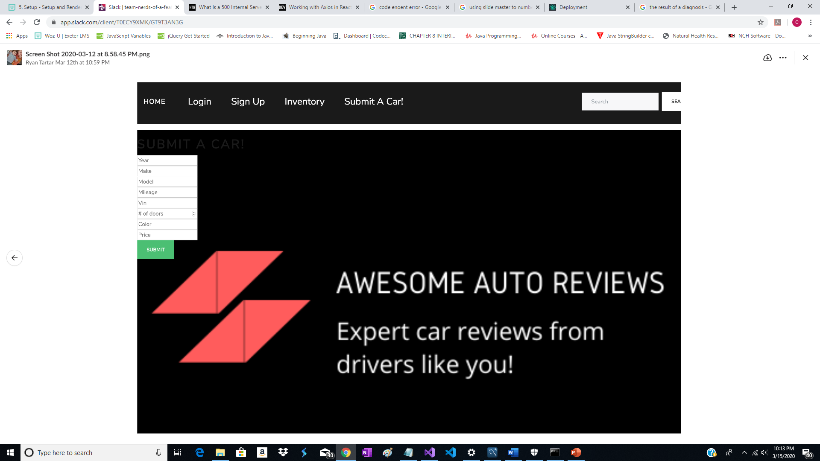
Group contributions
All team members worked on various portions of the project, using different technologies. Team collaboration between Ameka, Ryan, Robert, Nico, and Charles lead to the development and deployment of the Front, and Back ends, along with the created database for “Awesome Auto Reviews”.

Slide 8
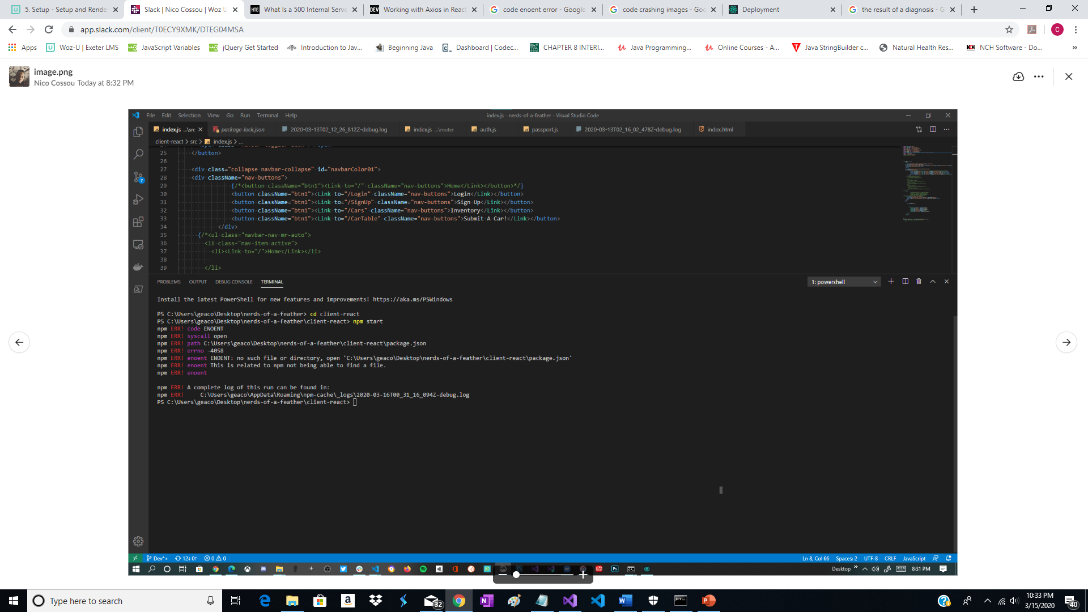
Development milestones:
Each stage of development had one, or more problem areas. These areas include:
Alignment of forms.
Consistency in routing.
Naming conventions.
Server connections.

Slide 9

How we overcome:
Each problem area was overcome with team effort. Research, trial and error, helped each student grow and evolve as the project developed. With the use of Google, and the thoughts of other team members, and the help of the team instructor we were able to create a functioning app to help individuals find, review, and comment on automobiles.

Slide 10

Future Stretch Goals:
Continued refining of the code to remove glitches and improve the functions with research to help identify and correct any coding errors. Continued team communications to assure a complete professional project.

