Slide 1

LAVA ESCAPE
Anjuma Rouf
Natalia Wozniakowska
Dan LUBEK

Slide 2
LIST OF FEATURES
Movement
Moving Platforms
Disappearing Platforms
Collect Health
Collect Timer
Timer Countdown
Obstacles
Cheat Menu (Z key to damage X Key to heal)
Shooting
Destroyable objects

Slide 3
Movement
Use of enhanced input:
Jumping
Move forwards
Move left
Move right
Move backwards
Crouch

Slide 4
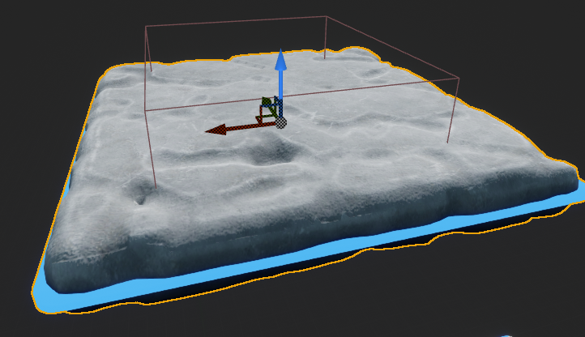
Platforms
Static platforms (Blue neon colour flashing)
Doesn’t do anything. Just a static platform.
Moving Platforms (Green neon colour flashing)
Moves the platforms horizontally and vertically by getting current location of the actor.
If isMoving = true, the platforms will either move in X or Z location to a set distance which can be adjusted in blueprint detail properties.
Disappearing platform (Purple neon colour flashing)
If the overlapping actor is the player (Main character) it will disable collection and hide the platform visible to player.
BoxCollisionComponent->SetCollisionEnabled(ECollisionEnabled::NoCollision); // disable collision
SetActorHiddenInGame(true); // hide the platform
After 5 seconds the platform will respawn with collision enabled.
SetActorHiddenInGame(false); // enable the platform
BoxCollisionComponent->SetCollisionEnabled(ECollisionEnabled::QueryAndPhysics); // enable platform collision

Slide 5
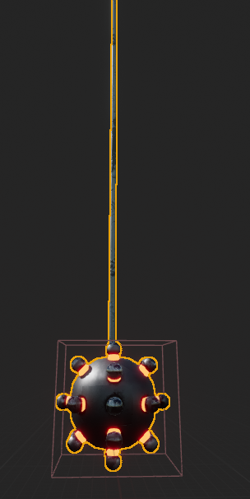
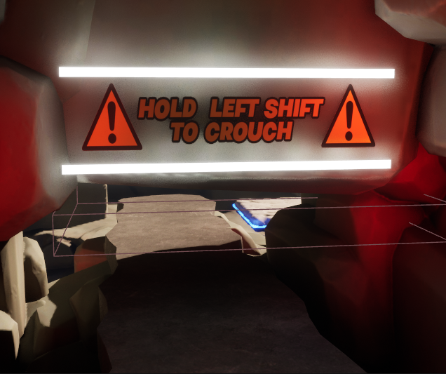
Obstacles
SWINGING SPIKE BALL
Checks for player collision using blueprints but accessing player custom function void AMainCharacter::TakeDamage
which passes a float number which can easily be customised using blueprints.
TUNNEL
Use of left shift to use crouching ability.

Slide 6
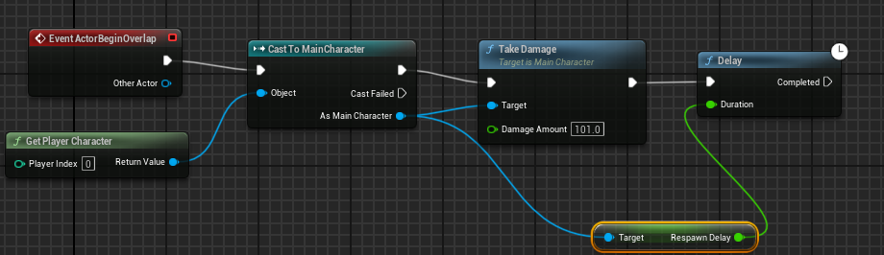
Obstacles cont.
Lava
Use of C++ function void AMainCharacter::TakeDamage
to set a custom damage amount using blueprints.
The only difference this time, is the instant damage is set to 101 with delay respawn time, to present play again menu to the player.

Slide 7
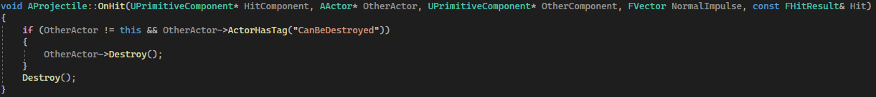
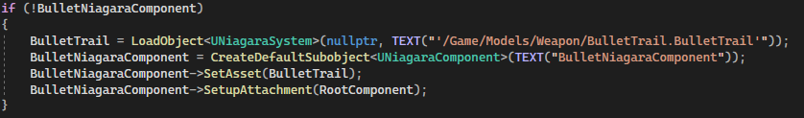

Shooting
Clicking left mouse button will fire a projectile / beam which will be destroyed on impact with anything.
If colliding with a wooden box or disappearing platform in the level, these objects will also be destroyed.
Makes use of a Niagara Particle System to have a laser beam effect following the projectile.
Gun has a max of 10 shots and ammo recharges after 3 seconds (for each shot).

Slide 8
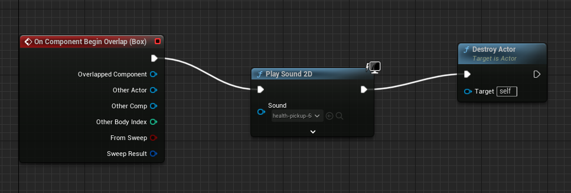
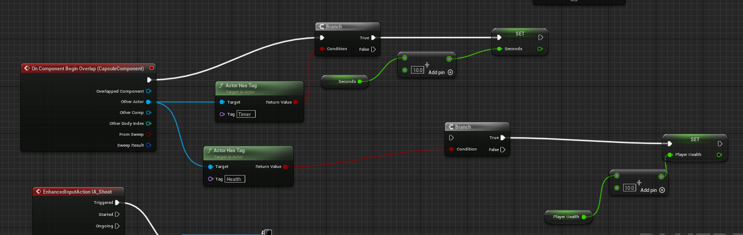
Collectibles
Collectible BP
Collectibles are placed throughout the level and hidden by a destroyable box.
Destroying the box allows the player to pick up the collectibles.
There is health and a timer that can be collected.
Values are set in player c++ script which the collectibles use to add player health and time when they are collided with
Character BP

Slide 9
Questions?

Slide 10
References:
-Maybull Studios, ND, Stylized Rock Pack, Available at: Epic Games Marketplace [Accessed 10/11/2023]
-Megascans, ND, Cobblestone_ulrlacifw, Available at: https://quixel.com/megascans/home?category=surface&search=Cobblestone_ulrlacifw&assetId=ulrlacifw [Accessed 15/11/2023]
Maybull Studios, ND, Stylized Rock Pack, Available at: Epic Games Marketplace [Accessed 10/11/2023]
Megascans, ND, Cobblestone_ulrlacifw, Available at: https://quixel.com/megascans/home?category=surface&search=Cobblestone_ulrlacifw&assetId=ulrlacifw [Accessed 15/11/2023]
CGResident at cgtrader, GameReady Stylized Wooden Crate. Available at: https://www.cgtrader.com/free-3d-models/furniture/outdoor-furniture/gameready-stylized-wooden-crate
Ovee at cgtrader, Sci-fi Gun. Available at: https://www.cgtrader.com/free-3d-models/military/gun/sci-fi-gun-db6d76d6-01d1-48fa-b796-42ba5f188421
AUDIO:
-Button-pressed | royalty-free music - pixabay. Available at: https://pixabay.com/sound-effects/button-pressed-38129/ (Accessed: 19 December 2023).
-Labyrinth of Despair | royalty-free music - pixabay. Available at: https://pixabay.com/music/build-up-scenes-labyrinth-of-despair-166594/ (Accessed: 19 December 2023).
-Blaster 2 | royalty-free music - pixabay. Available at: https://pixabay.com/sound-effects/blaster-2-81267/ (Accessed: 21 December 2023).
-(Health pickup | royalty-free music - pixabay. Available at: https://pixabay.com/sound-effects/health-pickup-6860/ (Accessed: 21 December 2023).
-Collect | royalty free music - pixabay. Available at: https://pixabay.com/sound-effects/collect-5930/ (Accessed: 21 December 2023).
-Download free copyright music (2023) Chosic. Available at: https://www.chosic.com/download-audio/45403/ (Accessed: 21 December 2023).

