Slide 1
Emotion detection Through Text: ECE 4715 Final Project
By: Willevaldo Quezada and Luis Antonio Que

Slide 2
Abstract

Slide 3
Abstract
This project presents an investigation into machine learning algorithms for emotion detection through textual analysis. It evaluates the effectiveness of an LSTM (Long Short-Term Memory) model compared to Decision Tree and Random Forest algorithms in classifying emotions. The results indicate that the LSTM model outperforms tree-based algorithms in accuracy and robustness, demonstrating its suitability for complex NLP tasks compared to the Decision Tree and Random Forest algorithms.

Slide 4
Introduction

Slide 5

Emotion Analysis
In machine learning, there are various ways to frame and categorize emotions into distinct labels. Two popular psychological theories are usually used to help categorize them:
Ekman’s Six Basic Emotions
Plutchik’s Wheel of Emotions

Slide 6
Ekman’s Six Basic Emotions:
Happiness
Sadness
Anger
Fear
Disgust
Surprise

Slide 7
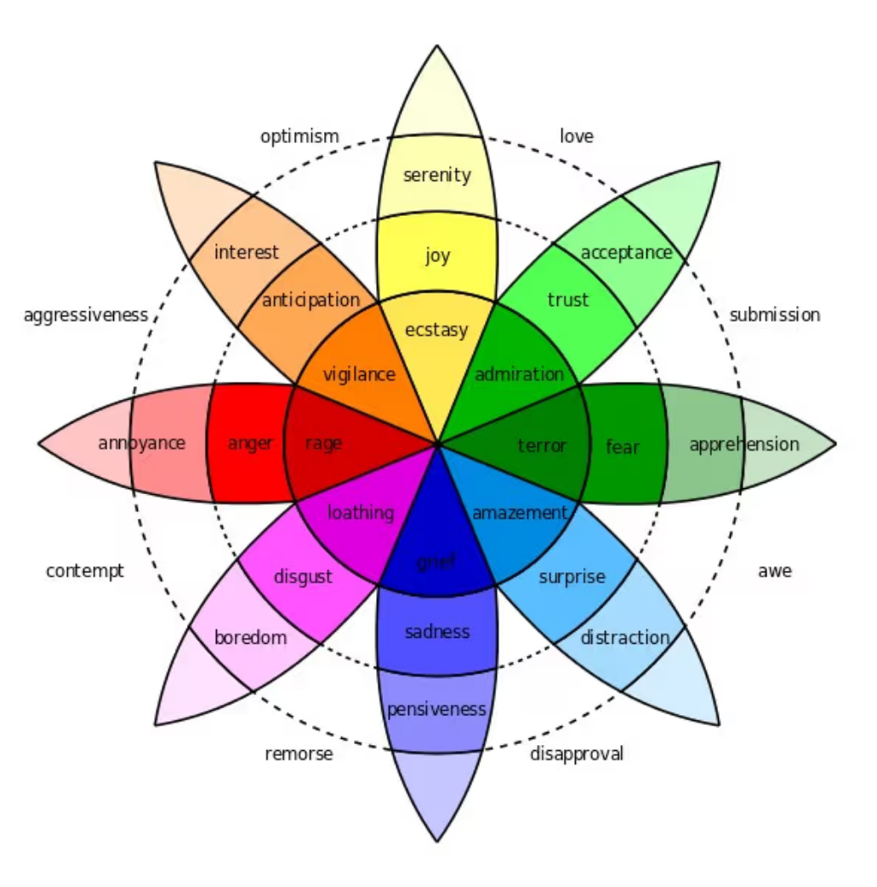
Plutchik’s Wheel of Emotions:
Expanded theory on Ekman’s model.
Uses eight primary emotions arranged in pairs of opposites:
Joy vs. Sadness
Anger vs. Fear
Trust vs. Disgust
Anticipation vs. Suprise

Slide 8
Project Overview:
Objective: to detect what emotions a line of text is saying using an LSTM algorithm. Emotions are categorized to be either: anger, fear, joy, love, sadness, surprise.
Uses code via kaggle as our baseline code.
Datasets used):
Emotion Detection from Text (tweets_emotion.csv)
Emotions dataset for NLP (test.txt, train.txt, val.txt)
GloVe: Global Vectors for Word representation (glove.6B.100d.txt, glove.6B.200d.txt, glove.6B.50d.txt)

Slide 9
Dataset Overview: Emotion Detection from Text
A collection of tweets annotated with an emotion.
Dimensions:
40,000 rows and 3 columns
Columns of tweet_id, sentiment, content
Data Types:
Tweet_id: integer
Sentiment: string (contains the emotion behind the tweet)
Content: string (contains the content of the raw tweet)

Slide 10
Dataset Overview: Emotions Dataset for NLP
Dataset that is used for emotion recognition/classification.
Text files with text an emotion flag attached at the end.
Three txt files:
test.txt
train.txt
val.txt
Useful for classification models using an NLP based approach.
Sample text:
“I feel like I am still looking at a blank canvas blank pieces of paper; sadness”

Slide 11
Dataset Overview: GloVe: Global Vectors for Word Representation
Highly popular word embedding technique used for NLP.
Represents words as dense vectors in a continuous vector space.
Uses english word vectors that are pre-trained on:
Wikipedia 2014
Gigaword 5th Edition Corpora (6B tokens, 400k vocab, tokens are in lowercase)
Contains 50,100,and 200 dimensional pre-trained word vectors.

Slide 12
Related Work

Slide 13
Paper Research:
Selected Paper:
Paper 1
Paper 2
Paper 3
Uses NN models, SVM, Naive Bayes.
Needs further research still in emotion detection
F1- score of 0.95 in detecting sadness
Uses CNN-LTSM model
Can classify fear with high accuracy
Accuracy of 98.79% and F1-score of 99.01%
Uses LTSM model
Classification in the jazz music genre is highly accurate
Accuracy of 77.5% for jazz, accuracy of >60% for other genres.

Slide 14
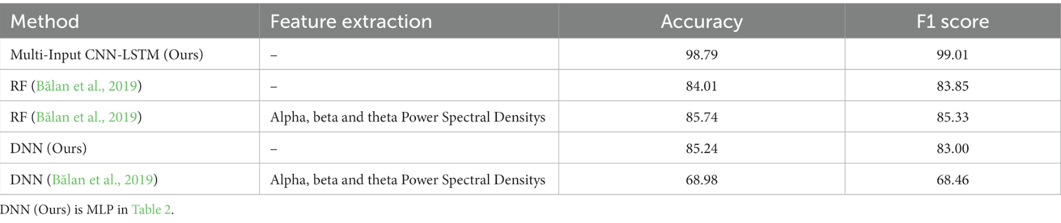
Main Paper used as inspiration:
Multi-Input CNN-LSTM deep learning model for fear level classification based on EEG and peripheral physiological signals
Key Points:
Explores the deep learning model to estimate fear levels based on multichannel EEG signals and multimodal peripheral physiological signals from the DEAP dataset.
Uses a multi-input CNN-LTSM model (Convolutional Neural Networks–Long Short-Term Memory) network for classification
Achieved an accuracy of 98.78% and an F1 score of 99.01%

Slide 15
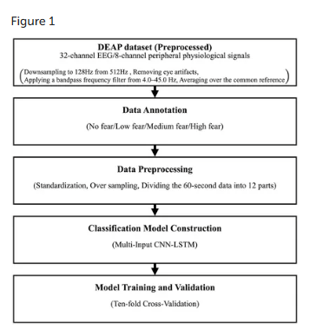
Technical Paper: Research Objectives
Develop deep learning model for fear level estimation w/ automatic feature extraction
Propose Multi-Input CNN-LSTM
Examine proposed model’s tolerance to differences in physiological signals
Notes:
-being able to treat anxiety disorders/phobias for effective exposure therapy
-stress recognition to determine factors that increase stress
-any sort of medical diagnostics linking to high emotions in PTSD, impulsive disorders

Slide 16
Model Construction
Model takes a combination of two CNNs and one LSTM layer
First CNN has EEG data with dims: 632 x 32 x 1
Second CNN takes PPS data with dims: 632 x 8 x 1
CNNs layers extract spatial features while LSTM captures time dependencies
Each CNN has a 2D conv. Layer followed by a Batch Normalization, ReLu, and 2D Average Pooling to downsample
LSTM unit is a Bidirectional LSTM reading input forwards and backwards
This model retains raw data to preserve valuable features
Notes:
-Concatenate layer for merging features from CNNs
- Flatten layer to create 1D vector
-FC layer to learn non linear features
-Output layer to produce final classifcation
-LSTM captures how brain activity changes by using input, forget, and output gates to allow the model to make decisions based on current and past data.Storing information across time steps

Slide 17
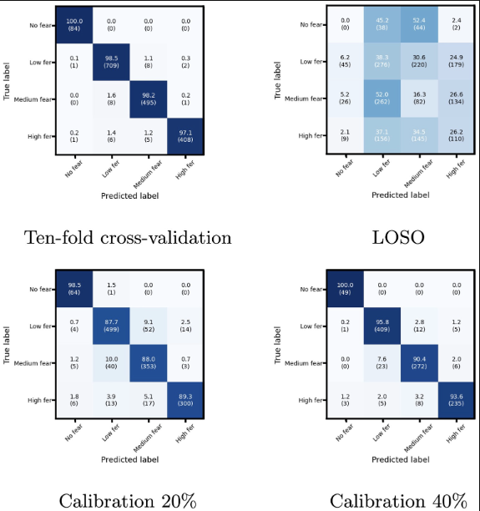
Training / Validation
90% training and 10% test
Training data split between 80% training and 20% validation
LOSO training model accuracy w/ test data: 27.77%
Training model accuracy w/ Calibration 20%: 90.89%
Training model accuracy w/ Calibration 40%: 95.07%
LOSO training model w/ input validation data: 99.34%
Low accuracy of LOSO w/ test data is due to test subjects having different characteristics from training subjects
LOSO cannot accommodate individual differences in the DEAP dataset
Notes:
-cal20 adds 20% of test data into the train data set(1371 test data used)
-cal40 adds 40% of test into train data set (1028 test data used)
-high recall on the confusion matrices indicating that the model successfully detects most positive cases) -correctly identifying a signal as a fear response
-loso uses input validation data instead of test data and is followed by calibration
-10 fold validation divides data into 10 sub groups, 1 group is used for model evaluation, while the rest are for model training

Slide 18
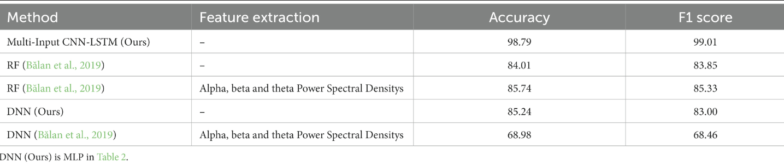
Outcomes
Achieved 98.79% accuracy and 99.01% F1 score in 10-fold cross-validation using a Multi-Input CNN-LSTM model.
Outperformed previous studies by about 13-14% in accuracy, even without additional feature extraction
Significant accuracy improvements achieved (90.89% in Cal20 and 95.07% in Cal40) when 20% and 40% of the test subject's data were included in training, showcasing potential for user adaptation.
Need for more targeted data preprocessing or individual calibration
Highlights the importance of collecting a more fear-specific dataset with diverse samples per fear level
Notes:
-LSTM has better accuracy compared to multilayer perceptron
-Multi input CNN lstm performed high using 10 fold cross validation
-Results suggest that individual calibration is crucial for user-independent accuracy, emphasizing the need for personalized data in real-world applications.
-

Slide 19
Proposed Approach

Slide 20
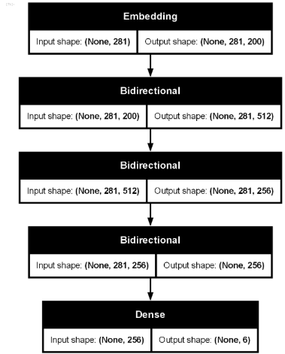
Architecture Details
Adam optimizer initialized with 0.005 learning rate combining benefits of momentum and RMSprop optimizers
Using a linear stack of layers coming from Sequential() class. Embedding layer which converts words into dense vectors of size 200 and pre-trained embedding GloVe matrices.
Input dims:
vocabSize : vocabulary size
X_train.shape[1] : input sequence length
Three bidirectional LSTM layers
Output dense layer with 6 neurons and a softmax activation

Slide 21
Loss function
Main loss function used: Categorical Cross Entropy (Softmax loss)
Standard use for multi-class classification.
Uses Adam Optimizer for optimization. - Similar to RMSprop optimizer, it is RMSprop with momentum.
Validation Loss Monitoring
Performance is monitored using validation loss during training.
Tracking Training and Validation Loss History
Training and Validation loss value are recorded during training.
Visualization of training and validation loss trends
Trends are plotted to evaluate the model performance visually

Slide 22
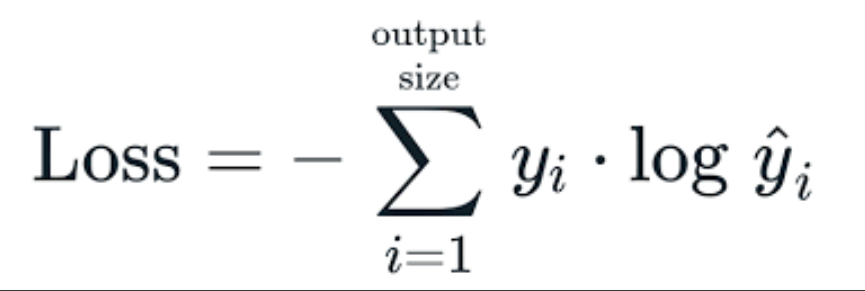
Categorical Cross Entropy
Used as a loss function for multi-class classification problems.
Measures the difference between the true labels and predicted probabilities from the model

Slide 23
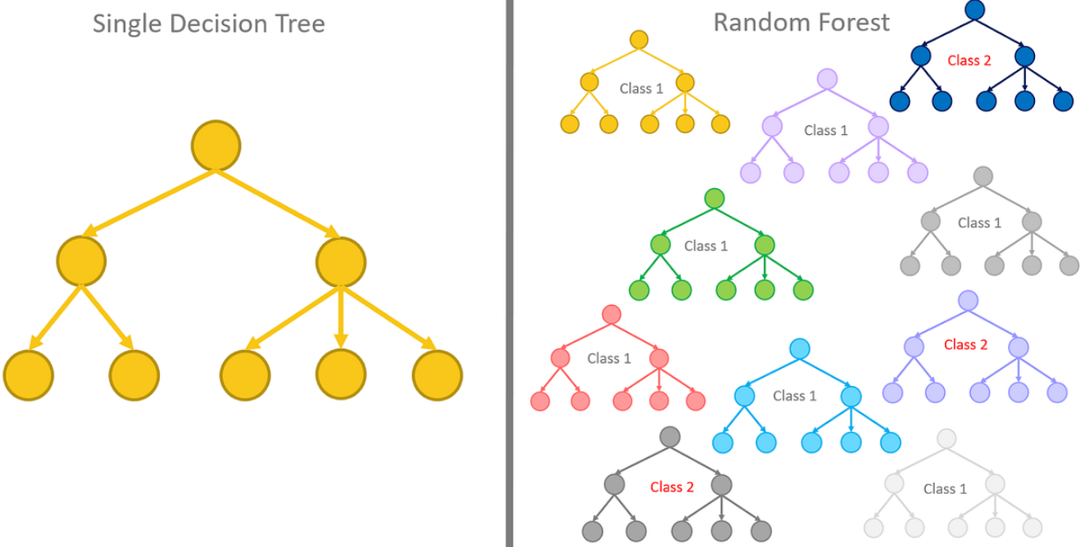
Technical explanation of main novelty
The objective:
to use the initial code from kaggle, which uses the LSTM algorithm, and modify it to use two other algorithms:
Decision Tree
Random Forest
Experiment the algorithms, compare the results and see which one can give the best and most accurate results.

Slide 24
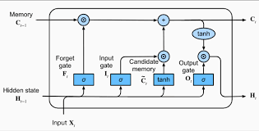
LSTM
Description:
A type of recurrent neural network (RNN) that is designed to handle sequential data and capture long-range dependencies.
How it works:
Structured of three gates:
Forget Gate
Input Gate
Output Gate

Slide 25
LSTM
Pros:
Effective at capturing both short-term and long-term dependencies in data.
Suitable for sequential tasks such as speech recognition, sentiment analysis, and machine translation.
Works well with large and complex datasets.
Cons:
Computationally more expensive than simpler RNNs due to additional parameters and operations.
Requires significant training time and resources, especially for large datasets.

Slide 26
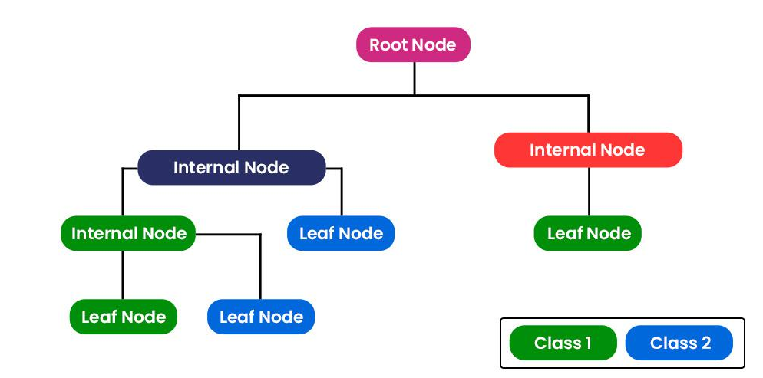
Decision Tree
Description:
A supervised learning algorithm used for both classification and regression tasks, based on a tree-like structure of decision. Usually comprised of nodes (test on features), branches (outcome of tests), and leaves (final outputs/predictions)
How it works:
Starts at the root node and splits data based on feature conditions to reduce impurity.
Splitting continues recursively until stopping criteria (like maximum depth or minimum samples per leaf) are met.

Slide 27
Decision Tree
Pros:
Simple to understand and interpret.
Handles both numerical and categorical data
Requires minimal data preprocessing
Cons:
Prone to overfitting if not pruned or restricted.
Can be unstable to small variations in data (sensitive to noise).

Slide 28
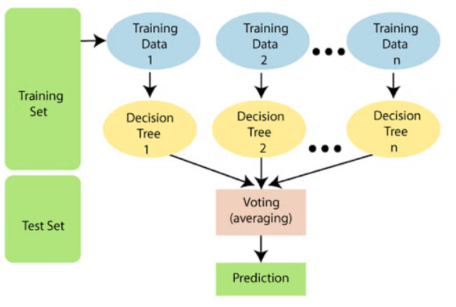
Random Forest
Description:
An ensemble learning technique that creates multiple decision trees and combines their outputs to improve accuracy and robustness.
How it works:
Builds multiple decision trees using bootstrapped samples of data, also known as bagging.
Randomly selects a subset of features for each tree split, reducing correlation between trees.
Combinees predictions, with a majority vote for classification, and average for regression.

Slide 29
Random Forest
Pros:
Reduces overfitting compares to individual decision trees.
Handles missing values and maintains accuracy with large datasets.
Provides feature importance scores for better interpretability.
Cons:
More computationally intensive than a single decision tree.
Less interpretable compared to a single tree due to complexity.

Slide 30
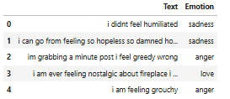
Input and Output forms
Inputs:
Outputs: ( sadness, anger, love, surprise, fear, joy)

Slide 31
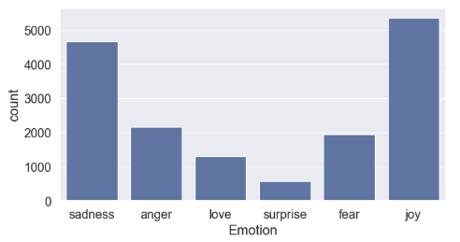
Processing the Data
Train data is counted to see how many sentences contain each emotion
df_train['Emotion'].value_counts()
plt.figure(figsize=(8, 4))
sns.countplot(x='Emotion', data=df_train)
Data contains duplicate sentences which are also removed to ensure unique dataset
Notes:
Train data is counted to see how many duplicates there are

Slide 32
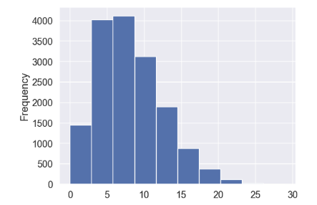
Processing the Data
In NLP, text data contains what are known as stop words
These are common words such as: the, is, as, a, etc.
temp = df_train.copy()
stop_words = set(stopwords.words('english'))
temp['stop_words'] = temp['Text'].apply(lambda x : len(set(x.split()) & set(stop_words)))
temp['stop_words'].value_counts()
temp['stop_words'].plot(kind='hist')

Slide 33
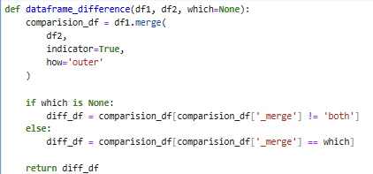
Processing the Data
Same steps are taken for the test and validation data as well.
Once all the datasets are accounted for, we pass a dataframe_difference function to remove any discrepancies among the train, test, and val datasets.

Slide 34
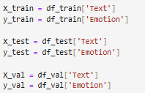

Normalizing Data
Data is “lemmatized” or reduced to its root form
Tweets contain many symbols and punctuations which must be removed while preserving the context
Text gets normalized and then given input/output labels
Sentences get tokenized, which means breaking down into individual words

Slide 35


Padding Sequences
Tokenized input sequences get padded to ensure that all the input data has the same length using a max length function
A vocabsize variable is defined to encompass all of the tokenized phrases each with an encoded index

Slide 36


Vector Representation
Using the Glove dataset, each word/character has a vector representing their semantic/syntactic meanings.
Used an embedding dimension of 200
Create an embedding matrix to be used for the LSTM network.
Adam optimizer is applied to the sequential LSTM model.
Dropout at each hidden layer to avoid overfitting data.

Slide 37
Results / Experiments

Slide 38
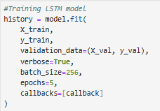
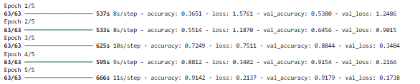
LSTM Model Training

Slide 39
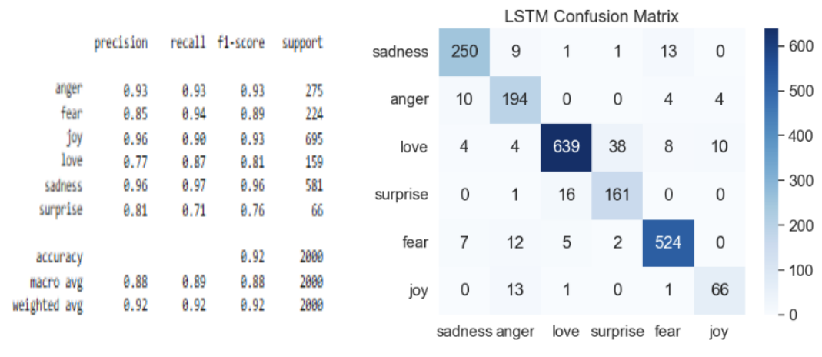
LSTM Results

Slide 40
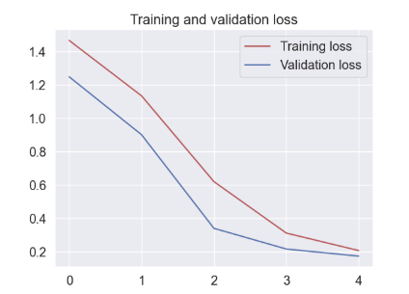
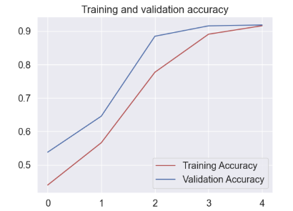
LSTM Training and Validation Curves

Slide 41
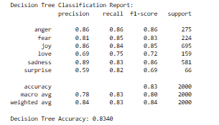
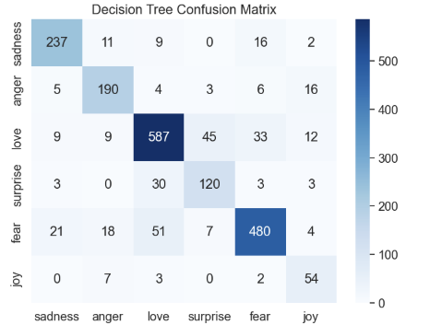
Decision Tree Results

Slide 42
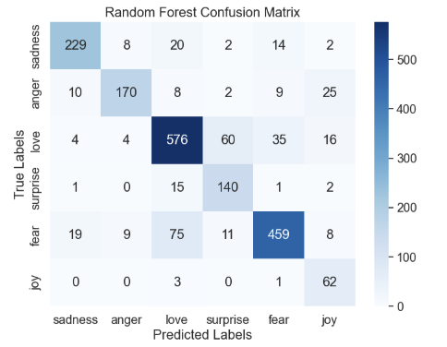
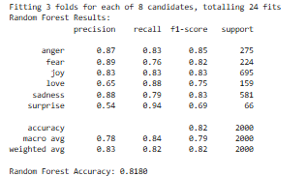
Random Forest Results
Notes:
Decision tree had higher accuracy which could be due to overfitting or poor hyper parameter tuning for the RF code

Slide 43
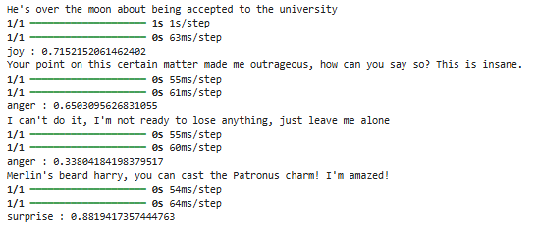
Test Example:
By using arbitrary sentences, we can determine the emotion detected as well as its probability
By looking at a Tweet, we can use the algorithm to classify a respective emotion

Slide 44
Conclusion

Slide 45
Results Comparison
LSTM
Decision Tree
Random Forest
Highest precision score: - 0.96 for joy and sadness
Lowest precision score: - 0.77 for love Accuracy: 0.92
Highest precision score: - 0.89 for sadness
Lowest precision score: - 0.59 for surprise
Accuracy: 0.83
Highest precision score: - 0.89 for fear
Lowest precision score: - 0.54 for surprise
Accuracy: 0.81

Slide 46

Conclusion:
Even after experimenting with using other algorithms, LSTM proved to be the best performing one of the three algorithms in detecting emotions and accurately doing so.
There still could be improvements to the code and hyperparameter tuning of the decision tree and random forest code to hopefully get better results.
Being able to recognize emotions through text and use an algorithm to do so is an incredible thing to learn.

Slide 47
References

Slide 48
References:
Khan. (2024, May 31). Machine Learning Classification of DEAP dataset. Kaggle. https://www.kaggle.com/code/khan1803115/machine-learning-classification-of-deap-dataset
Machová, K., Szabóova, M., Paralič, J., & Mičko, J. (2023). Detection of emotion by text analysis using machine learning. Frontiers in Psychology, 14. https://doi.org/10.3389/fpsyg.2023.1190326
Masuda, N., & Yairi, I. E. (2023). Multi-Input CNN-LSTM deep learning model for fear level classification based on EEG and peripheral physiological signals. Frontiers in Psychology, 14. https://doi.org/10.3389/fpsyg.2023.1141801
Tang, H., Zhang, Y., & Zhang, Q. (2022). The use of Deep Learning-Based Intelligent Music Signal identification and Generation Technology in national music teaching. Frontiers in Psychology, 13. https://doi.org/10.3389/fpsyg.2022.762402

Slide 49
References:
Materwelon. (2024, October 30). EMOTION_ANALYSIS_WITH_LSTM. Kaggle. https://www.kaggle.com/code/materwelon/emotion-analysis-with-lstm

Slide 50
End

