Slide 1
Attack of the Beat
Group Members: Sean McManes, Hung Nguyen Advisor: Professor Chia Han

Slide 2

Problem
Modern games create entertaining, exciting, and immersive game experiences with
Story, gameplay, game design, and more
One aspect that has been static for most games is the music
Most games typically use music to:
fill the background noise
create an atmosphere for the game
The few that do use the music to a greater extent still fall short

Slide 3
Project Description
Our project aims to bridge this disconnect and create an experience driven off the music in the game itself
Our game will use the music to manipulate several functions in the game environment
So that the player must focus on not only the game, but also the music to gain an advantage
An approach that has been missed by most modern games
Some examples:
Enemy actions being decided by the music at the time of the action
Randomized game environment layouts and objects
Unique and various encounters for the player

Slide 4
User Stories
As a programmer, I want the code to be as clean and adaptable so I can make quick and simple additions to the game.
As a player, I want to be challenged to use my skills in the game so I can feel satisfaction and get rewarded for my efforts in the game.
As a game designer, I want to make an interesting experience so that the player will be engaged and make said experience unique for them.
As an artist, I want the design and artwork in the game to work together and fit the game style, so that the experience for the player is pleasing and accurately depicts the game.

Slide 5
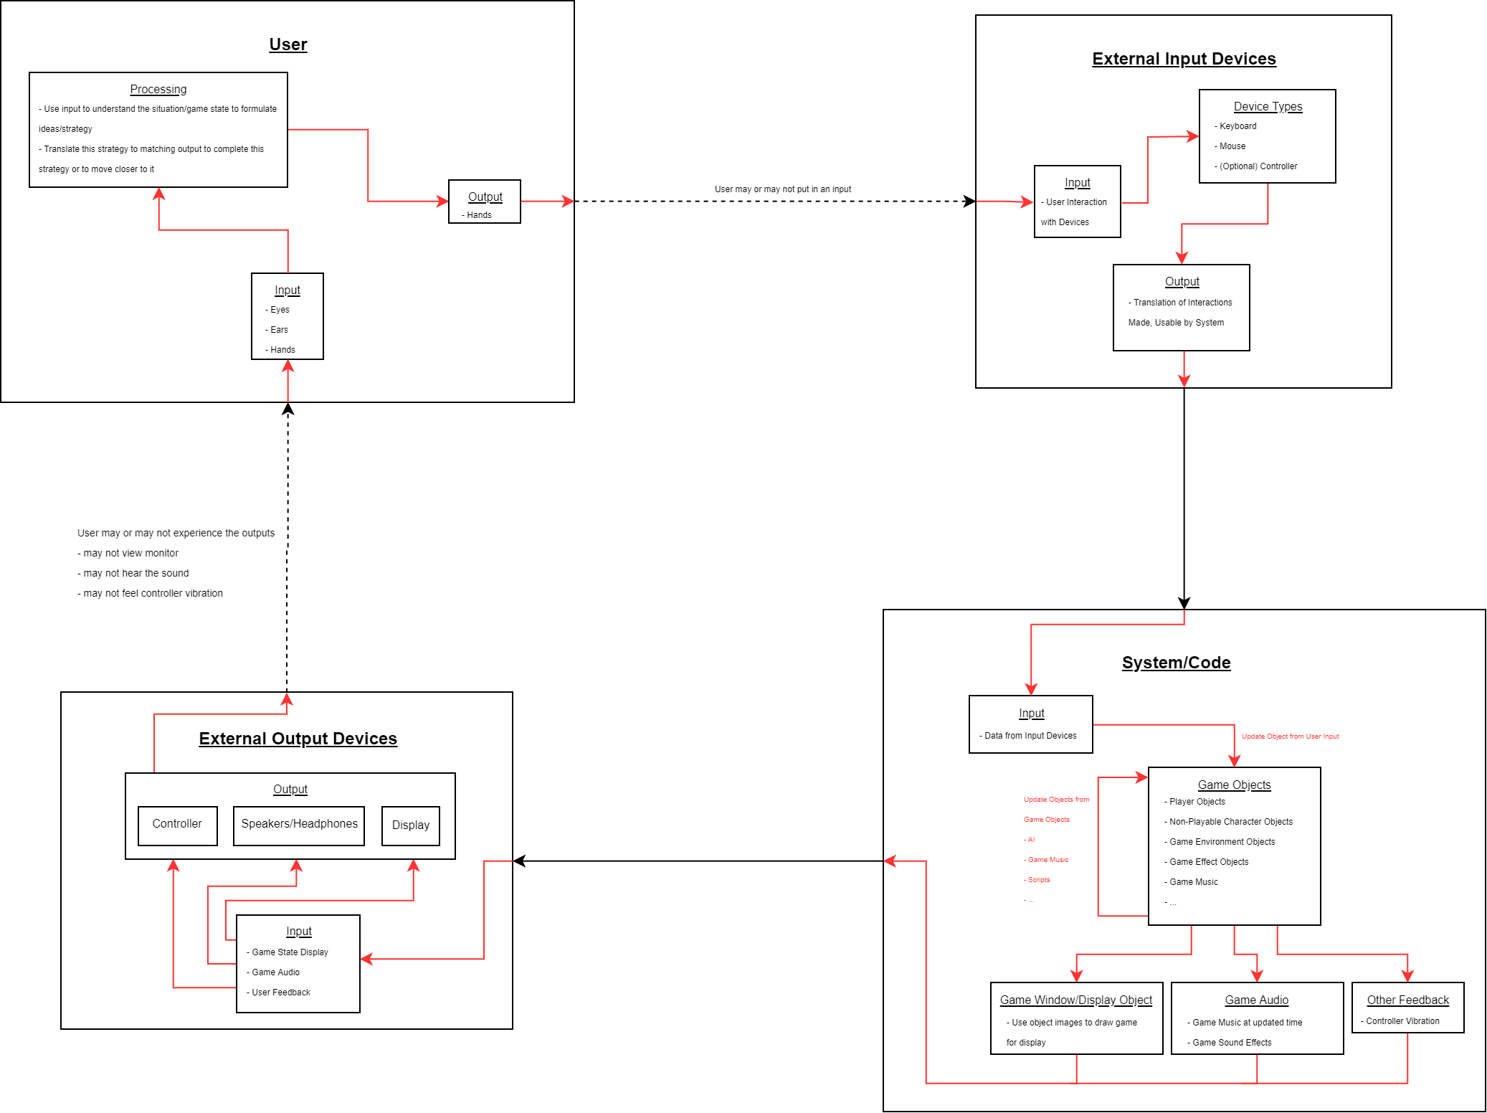
Design Diagrams

Slide 6
Project Constraints
Project designs are based on the use of free libraries (such as SDL2 and SFML) to display the game and handle game audio
No license purchases necessary and only need to credit the sources in the game
Our game will be written in C++ and is intended to run on typical computer hardware and use keyboard and mouse for the main player input
No requirement for additional input devices (such as controllers)
Copyrighted music used would need permissions to be included with the game
Our intention for this project is to keep the game open to the user’s own preference of music
Files for such music would not be included in the game, but could be added by the user

Slide 7
Current State
Currently, we are finalizing our overall rough/early design to meet the requirements set for our project
The next steps are going to be working on building the game from these designs and building off that to complete our goals
Implementing functions and game mechanics for manipulations by game music
Additional game objects and mechanics for game variety
More if there is available time

Slide 8
Timeline

Slide 9
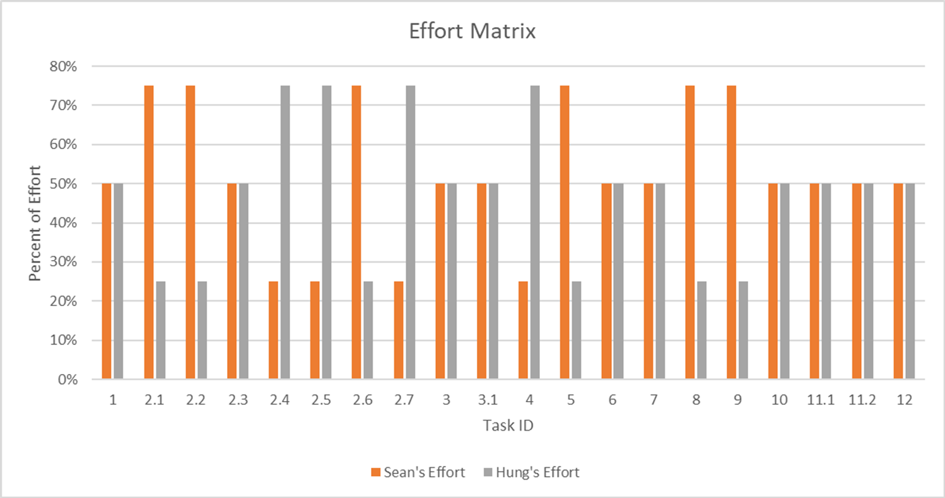
Effort Matrix

Slide 10
Expected Demo
Working base game with main components meeting the original project’s goals
Examples of game mechanics being properly manipulated by the music being played
Game enemies/non-playable characters and world objects
Game elements showcasing the ability to have unique experiences even for long-term players
Randomized game environments
Player progression and elements that allow for continual play with increasing reward for the player

Slide 11
Questions

Slide 12
Contact Information
Group Members:
Sean McManes
mcmanesw@mail.uc.edu
Nyguen Hung
nguyeh6@mail.uc.edu
Advisor
Chia Han
han@mail.uc.edu

