Slide 1
Attack of the Beat
Group Members: Sean McManes, Hung Nguyen Advisor: Professor Chia Han

Slide 2
Purpose and Goals
Create an entertaining, exciting, and immersive game experience with an emphasis on the music in the game
Most games typically use music to:
fill the background noise
create an atmosphere for the game

Slide 3
Project Description
Our project aims to bridge this disconnect and create an experience driven off the music in the game itself
Our game will use the music to manipulate several functions in the game environment
So that the player must focus on not only the game, but also the music to gain an advantage
An approach that has been missed by most modern games
Some examples:
Enemy actions being decided by the music at the time of the action
Randomized game environment layouts and objects
Unique and various encounters for the player

Slide 4
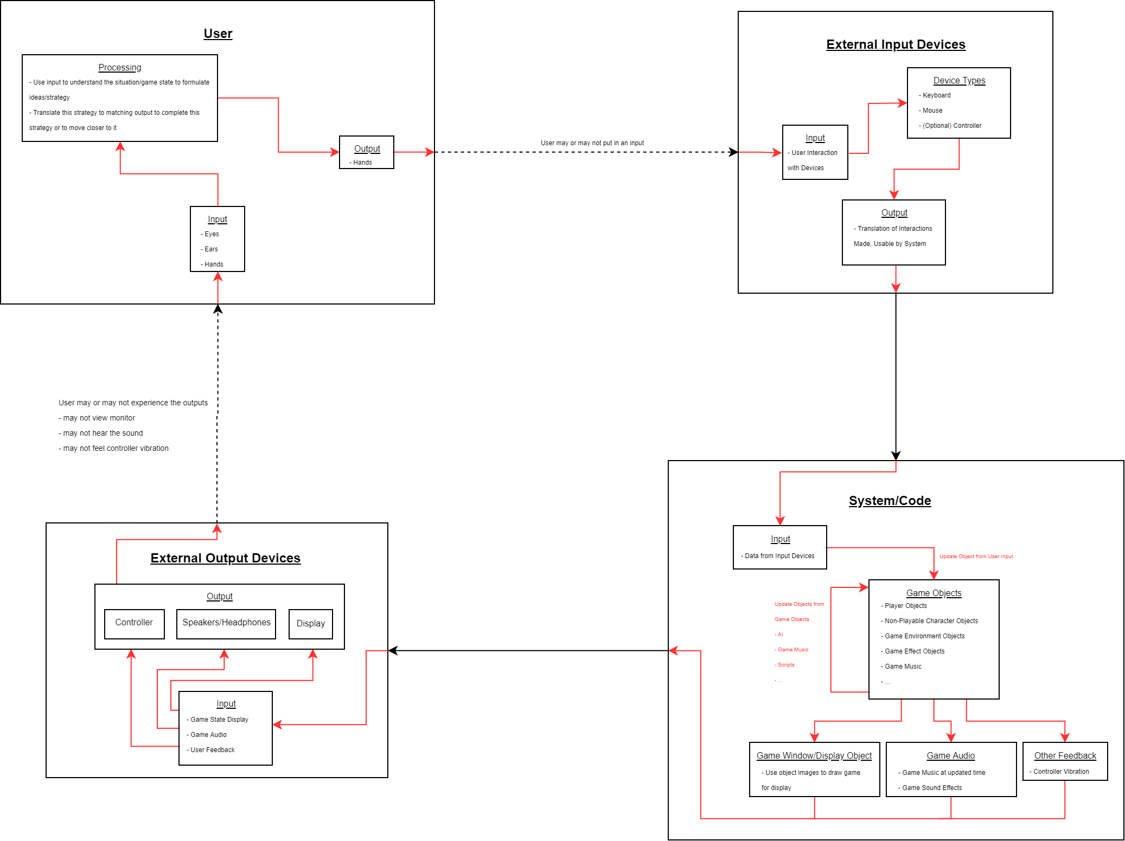
Design Diagrams

Slide 5
Current State
Currently, we are finalizing our overall rough/early design to meet the requirements set for our project
The next steps are going to be working on building the game from these designs and building off that to complete our goals
Implementing functions and game mechanics for manipulations by game music
Additional game objects and mechanics for game variety
More if there is available time

Slide 6
Timeline

Slide 7
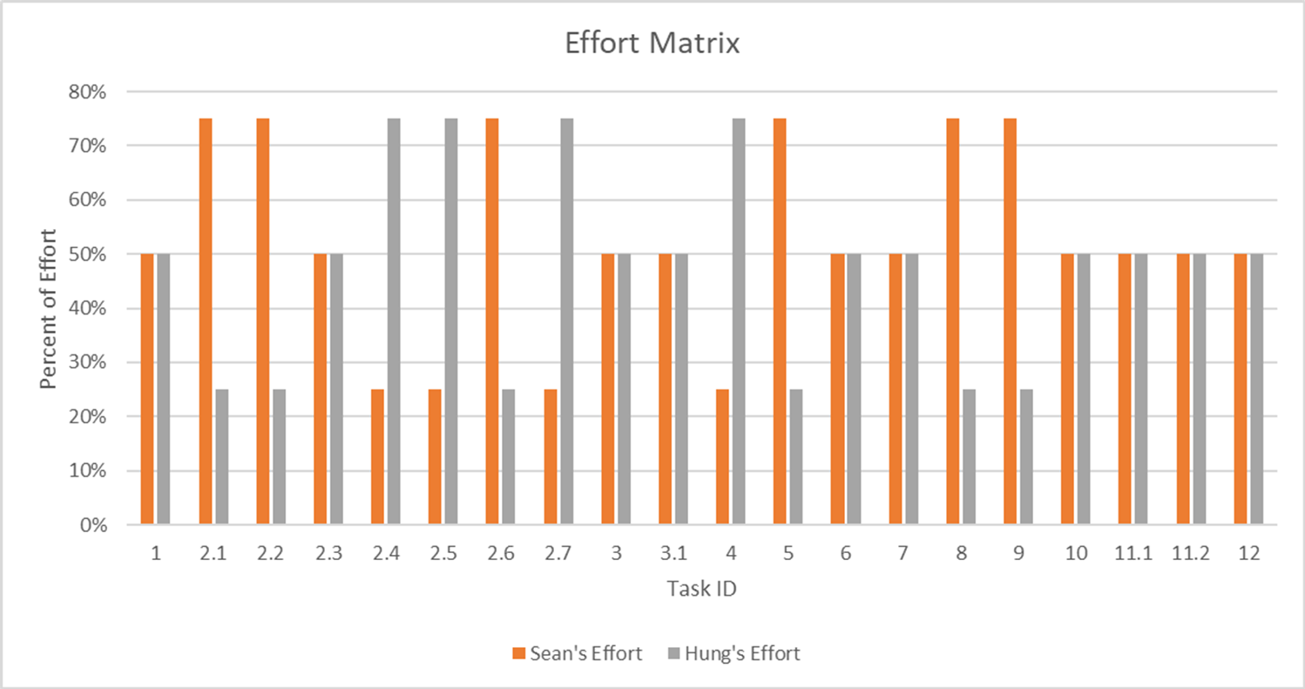
Effort Matrix

Slide 8
Expected Demo
Working base game with main components meeting the original project’s goals
Examples of game mechanics being properly manipulated by the music being played
Game enemies/non-playable characters and world objects
Game elements showcasing the ability to have unique experiences even for long-term players
Randomized game environments
Player progression and elements that allow for continual play with increasing reward for the player

Slide 9
Questions

Slide 10
Contact Information
Group Members:
Sean McManes
mcmanesw@mail.uc.edu
Nyguen Hung
nguyeh6@mail.uc.edu
Advisor
Chia Han
han@mail.uc.edu

