Slide 1
Attack of the Beat
Group Members: Sean McManes Advisor: Professor Chia Han

Slide 2

Problem
Modern games create entertaining, exciting, and immersive game experiences with
Story, gameplay, game design, and more
One aspect that has been static for most games is the music
Most games typically use music to:
fill the background noise
create an atmosphere for the game
The few that do use the music to a greater extent still fall short

Slide 3
Project Description
This project aims to bridge this disconnect and create an experience driven off the music in the game itself
This game will use the music to manipulate several functions in the game environment
So that the player must focus on not only the game, but also the music to gain an advantage
An approach that has been missed by most modern games
Some examples:
Enemy actions being decided by the music at the time of the action
Randomized game environment layouts and objects
Unique and various encounters for the player

Slide 4
Intellectual Merits
Games have used music to match the style of gameplay and themes of the game
Many have come close to the goals of this project, but fall short where we find most crucial
Dark Souls – a game with music that works perfect with the game style and gameplay
But the gameplay is not affected by the music itself
Crypt of the Necrodancer – a game that forces you to fight to the rhythm of the game
But the gameplay style is not what we desire, as it is slower and not as high-paced as envisioned for this project
Furi – a game with a great soundtrack and high-paced action
But the game has a disconnect between the game mechanics and the music
This project uses the best features in these types of games as a model to build an ideal sandbox for our game
Built on top of that, are the mechanics based on the game music to drive these features

Slide 5
Broader Impacts
Adapting game mechanics/approaches that have mostly been static and missing major innovations
As with prior innovations, new mechanics can be adopted by other developers
They could build off our developments and create alternatives and/or improvements
The user will have another way to enjoy a game, but also their music in a new way

Slide 6
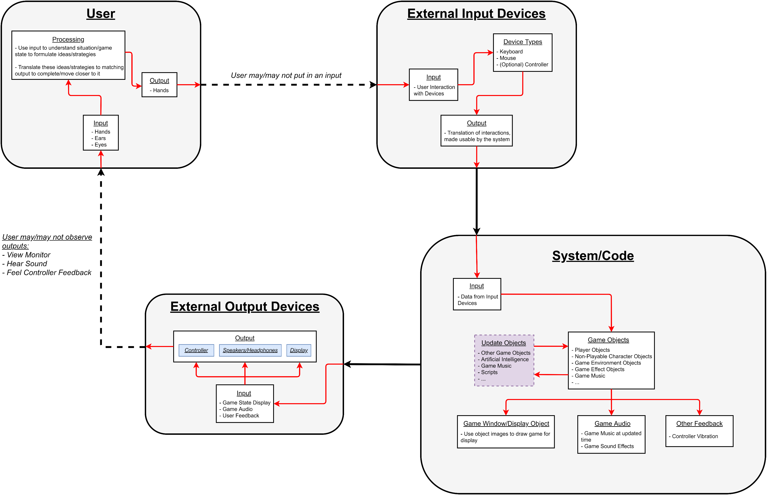
Design Diagrams

Slide 7
Design Specifications
Player/Input
Takes in game information through visual and audio cues
Outputs specific actions to manipulate controllable aspects of the game
Output Devices
Output visual, audio, and physical feedback to the player
Provide enough detail to the player to understand game situations and form a plan of action

Slide 8
Design Specifications
Game
Retrieves player input and uses it to modify available objects in the game environment
Movement, attacks, interactions with objects, …
Reads new data from game music
Frequencies at the given time
Raw data consisting of a large complex array of values pulled from the music
This data will be modified to simplify and find important parts and trends from the data
Generates updates to additional game objects based on several factors
Player input, objects in game environment, game music, …
Other effects are taken after all objects are updated
Game image(frame), game music, and feedback are sent to respective devices
This overall cycle repeats for every update/frame

Slide 9
Technologies
Originally used SDL2 to handle image displaying, object rendering, input control, and more core features of the game
Then changed to Unity Engine for smoother/updated game development
Originally using SFML to handle game music and its tools to create functions to analyze the music for the game to accept
Changed to use tools included in Unity Engine to collect music data and then custom scripts to analyze and adapt for the game

Slide 10
Timeline

Slide 11
Results and Current State
The game has working base features and object interactions necessary of the gameplay and additional developments
The game successfully analyzes the playing music during runtime to adapt components of the game environment
Now that these key components are in their final states, additions and improvements are being made with the time remaining
Mainly adding as many game mechanics that were originally desired and getting them to a working state with the game music
Improving the music analysis several test music/genres

Slide 12
Challenges
Project designs were originally based on the use of libraries (such as SDL2 and SFML) to display the game and handle game audio
Decided to change to Unity Engine, so developed code had to be converted and adapted to work with it
The change to Unity Engine made much of the development process easier, but it came with a learning curve since we had never used it
Much of the challenge was understanding the general workflow and development in Unity
Once the major pieces were created, the remaining parts quickly fell into place
Analysis and adaptation of the music created the challenge of getting an accurate “feel” of the music in the game
Any disconnect would make the game experience seem incorrect
This was an aspect that took several trials and is still getting adjusted

