Slide 1
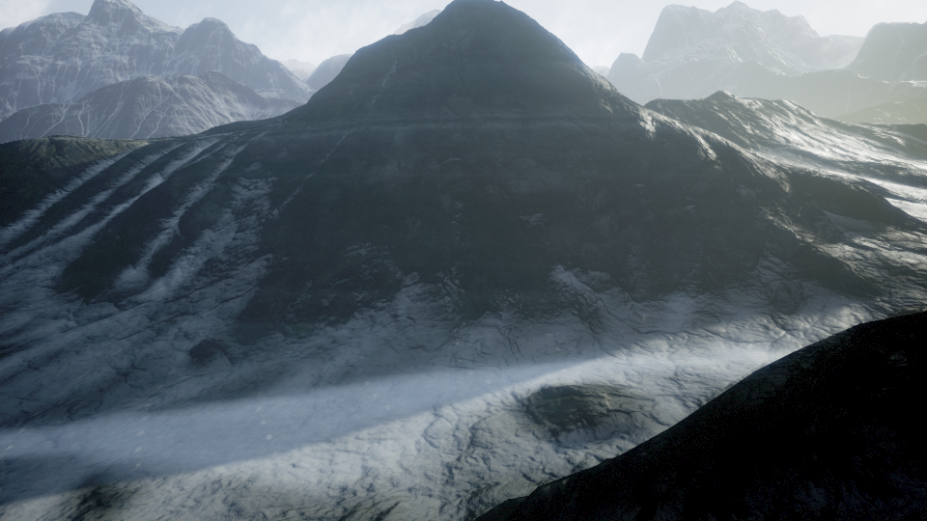
Mountain1: Trial A
MonoDepth2 Vision Module
Greedy Immediate Rewards Policy
Completed Progress | 1
Reward Term | Weight Coefficient
Depth_MonoDepth2 | 1.0
Pathing_v1 | 1.0
Smooth_v1 | 1.0
Termination: Infinite Loop
reason: repeated reverse direction

Slide 2
Mountain1: Trial B
Added smooth reward term to penalize reversing direction and reward maintaining trajectory
Completed Progress | 1
Reward Term | Weight Coefficient
Depth_MonoDepth2 | 1.0
Pathing_v1 | 1.0
Smooth_v1 | 1.0
Termination: Tangent Path
reason: rewarded to stay true

Slide 3
Mountain1: Trial C
Smooth reward terms now only penalizes reverse directions
Completed Progress | 1
Reward Term | Weight Coefficient
Depth_MonoDepth2 | 1.0
Pathing_v1 | 1.0
Smooth_v2 | 1.0
Termination: Infinite Loop
reason: overshot Points

Slide 4
Mountain1: Trial D
Slowed down drone from 10 to 5
Completed Progress | 1
Reward Term | Weight Coefficient
Depth_MonoDepth2 | 1.0
Pathing_v1 | 1.0
Smooth_v2 | 1.0
Termination: Mountain Collision
reason: depth is relative, not weighted enough when close

