Slide 1

Reverse Shell
Is it a sea shell?
Is it a crustacean?
Is it a flying saucer?
What is a reverse shell?
What will you learn?
More profound knowledge of “shells”
Difference between reverse and “bind” shells
Where can it be used
Benefits and problems of using it
The security and flaws
Techniques for creating a reverse shell
Notes:
Introduce yourself, have a joke, and start

Slide 2

What is a reverse shell?
A reverse shell allows an attacker to connect to a target machine and interact with it as if they were sitting at the keyboard. In a reverse shell, the connection is established from the target machine to the attacker's machine and not the other way around.
Once the connection is established, the attacker can interact with the target machine using a command-line interface, allowing them to run commands, upload or download files, and perform various other actions. Reverse shells can be set up on a target machine by exploiting a vulnerability in a service or application running on the target machine or by using previously installed malware or backdoors on the target machine.
https://www.imperva.com/learn/application-security/reverse-shell/
Notes:
Quick explanation at the end about how the attack is “normally” made

Slide 3


What is a “bind” shell?
A "bind" shell is a type of shell created on the target machine, allowing an attacker to connect to the shell and interact with the system as if they were sitting at the keyboard. Once the bind shell is started, it listens on a specified network port, waiting for incoming connections. When an attacker connects to the specified port on the target machine, the bind shell will allow them to interact with the system using the command line interface.
A bind shell differs from a reverse shell, as the target machine communicates back to the attacking machine. In a bind shell, the attacker establishes a connection to the target machine, which listens on a specific port. Therefore, it is often called an "incoming" connection.
https://www.101labs.net/comptia-security/lab-66-establishing-a-bind-shell-with-netcat/

Slide 4

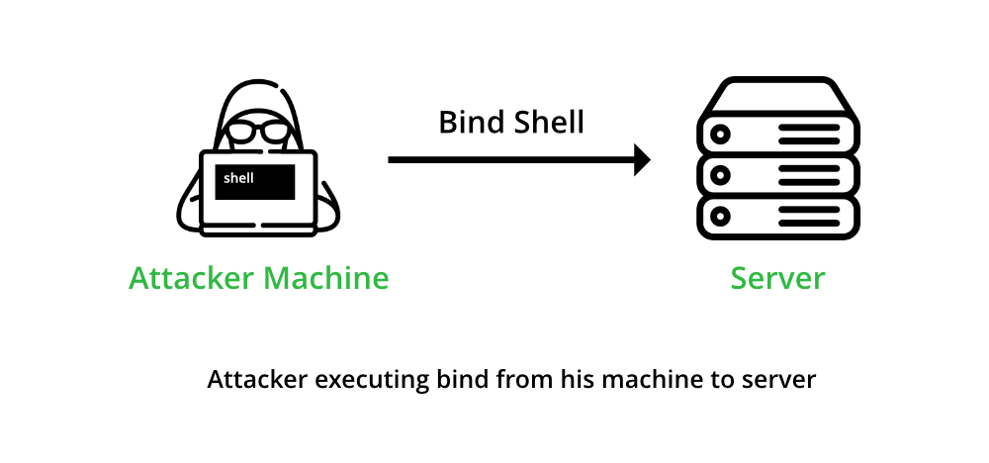
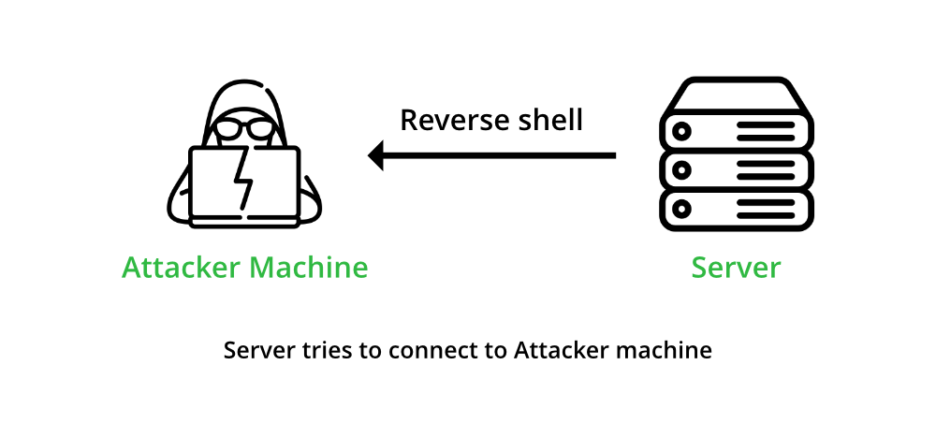
What is the difference?
The main difference between a "bind" shell and a reverse shell is the direction of the connection.
A "bind" shell is a shell created on the target machine that listens for incoming connections. Once the bind shell is started, it listens on a specified network port, waiting for an attacker to connect. When an attacker connects to the specified port on the target machine, the bind shell will allow them to interact with the system using the command line interface. A bind shell can be set up on the target machine by an attacker that already has access to the system or by exploiting a vulnerability in a service running on the target machine.
On the other hand, a reverse shell is a type of shell in which the target machine communicates back to the attacking machine. This contrasts with a traditional "bind" shell, in which the attacker connects to the target machine's listening port to gain access to the command prompt. In a reverse shell, the attacker creates a connection from the target machine back to the attacker's machine and uses this connection to gain access to the command prompt. Reverse shells can be set up on a target machine by exploiting a vulnerability or by using previously installed backdoors or malware on the target machine.
In summary, a bind shell is a type of shell that an attacker establishes a connection to, whereas a reverse shell is a type of shell that the target machine establishes a connection.
https://www.geeksforgeeks.org/difference-between-bind-shell-and-reverse-shell/
Notes:
Begin the presentation by providing an introduction to what a reverse shell is, and explain the differences between reverse shells and traditional "bind" shells.

Slide 5



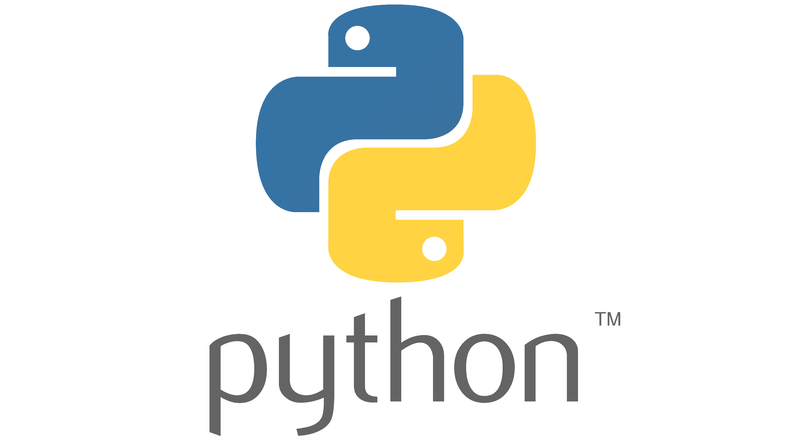


Common tools and frameworks
Netcat
Bash
Socat
Golang
PHP
Node.js
Perl
Ruby
Java
Gawk
Python
Kali …
https://highon.coffee/blog/reverse-shell-cheat-sheet/
Notes:
Explain

Slide 6
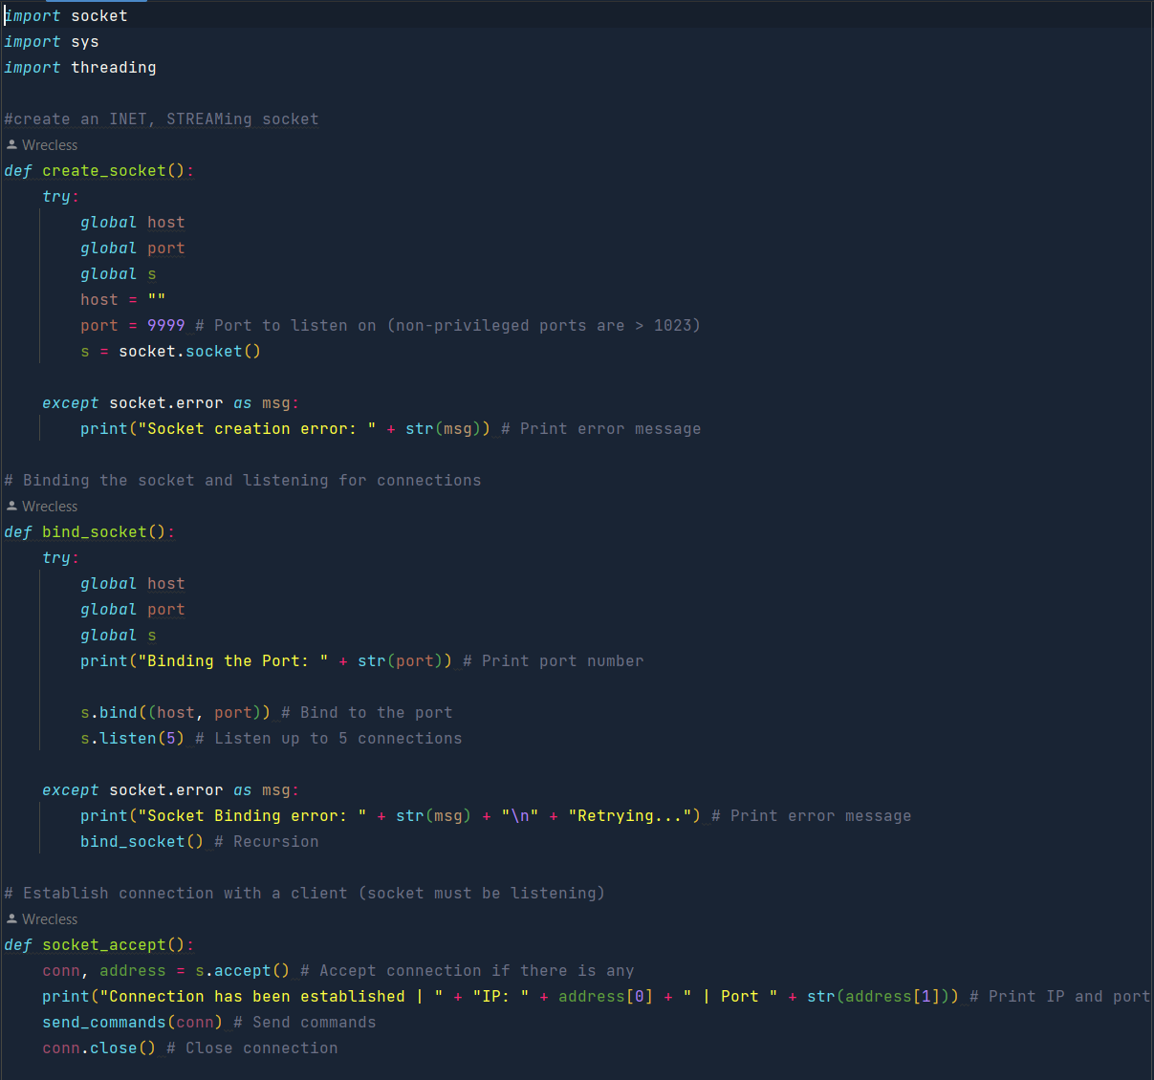
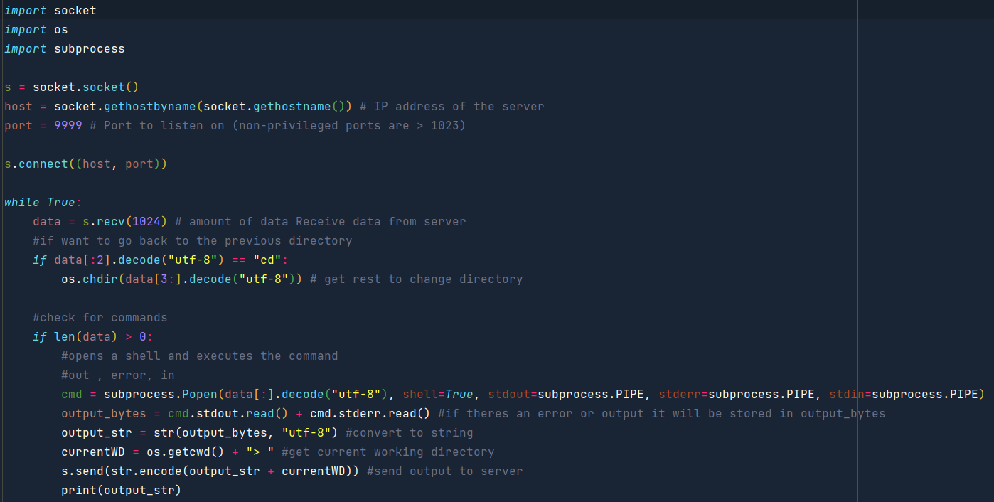
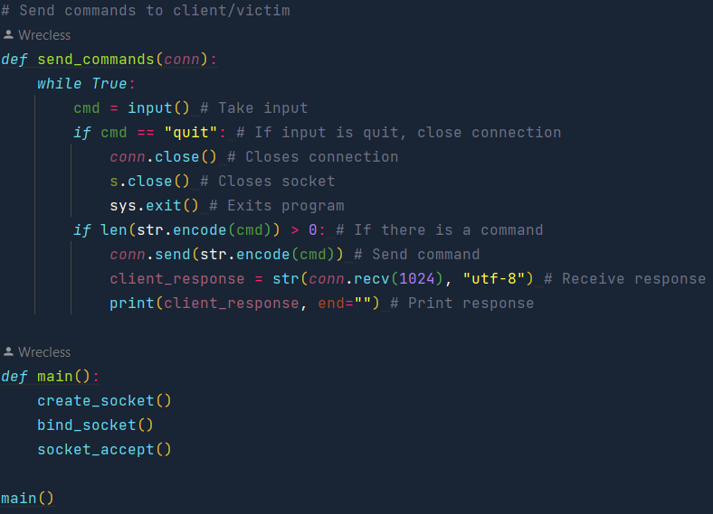
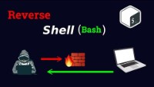
Techniques for creating reverse shells
For the client/Victim
with only a few lines of code we can access the directories of the computer
On the server side/attacker
Files can be explored
Copied
Deleted
Modified
Downloaded
etc
For more examples:

Slide 7

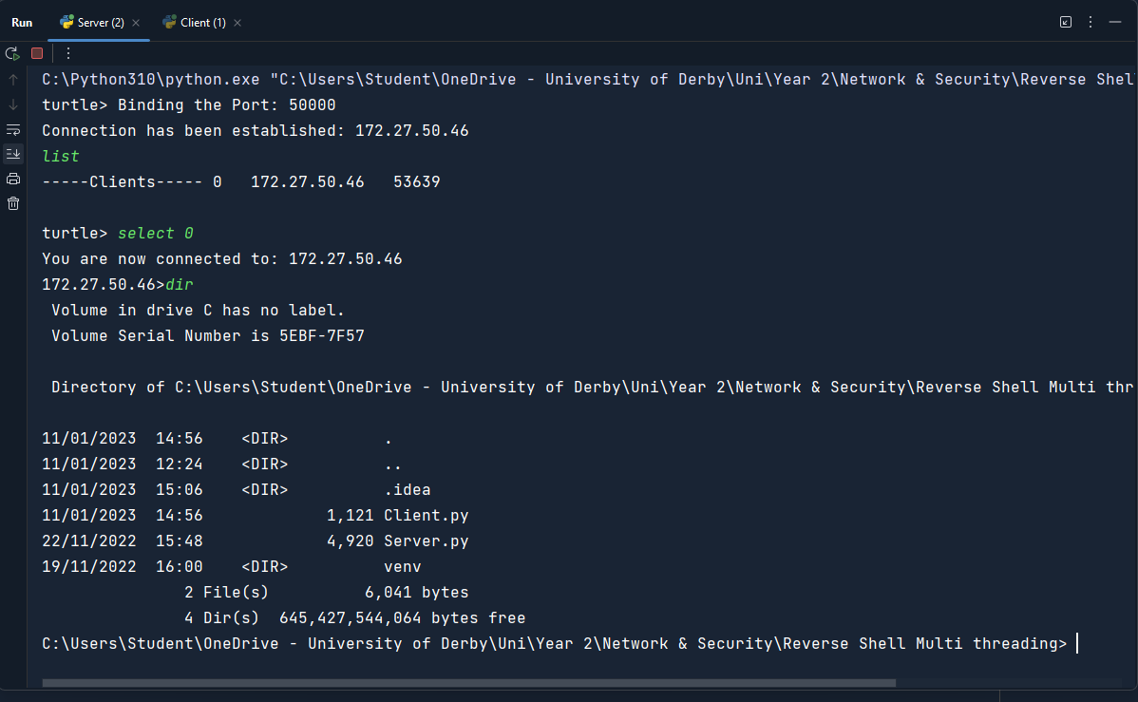
Reverse shell use
Example
A simple script can access the computer without the user knowing what’s happening.
Once the reverse shell is in the computer, the firewall doesn’t block it, as it’s an out going connection.
Notes:
Describe the different use cases for reverse shells, including both malicious and legitimate uses. Discuss how reverse shells are used in attacks such as spreading malware or stealing sensitive information, and how they can be used by Penetration Testers to test the security of a target machine.

Slide 8
Real-world security breach examples
WannaCry ransomware: The WannaCry ransomware attack in 2017 was a highly publicised example of a reverse shell attack. The attack used a vulnerability in Windows to spread malware to thousands of systems worldwide, encrypting data on the infected systems and demanding a ransom payment to restore access to the data.
NotPetya: This attack was similar to WannaCry, but was even more disruptive because it destroyed the data on the infected systems. Additionally, NotPetya was designed to move laterally in the networks, causing even more damage.
Operation Aurora: This was a cyber-espionage campaign that targeted multiple industries, with a focus on technology and defence companies. The attackers used a zero-day exploit to gain access to the targeted networks and then used reverse shells to maintain access and control over the systems.
Operation Cloud Hopper: This cyber espionage campaign targeted managed service providers (MSPs) to gain access to their client’s networks. The attackers used reverse shells to control the systems and move laterally through the networks to gain access to sensitive data.
Stuxnet: This was a sophisticated attack that targeted industrial control systems used in nuclear power plants. The attackers used multiple zero-day.
More breaches at : https://www.securitymagazine.com/articles/98716-the-top-10-data-breaches-of-2022

Slide 9







Techniques for creating reverse shells
One of the classics is embedding a reverse shell script in a “picture file”
More examples
Phishing emails
Malicious websites
Open wireless connections
Text messages with links
Installing programs from an unreliable source
Etc
Want to see my pic?
Yes, Please!!!
Sent
Opens
Pic.png
Got you!
For more examples: https://systemweakness.com/reverse-shell-exploit-demonstration-3d3641d95f8a
Notes:
Describe the methods attackers can use to create reverse shells, such as exploiting vulnerabilities, binding shells to network ports, and creating hidden tunnels.

Slide 10
Reverse shell security
Keep systems updated and patched: Regularly updating and patching software and operating systems is one of the most important steps that can be taken to protect against reverse shell attacks. Many reverse shell attacks exploit vulnerabilities in out-of-date software, so keeping software up-to-date can help to close these vulnerabilities.
Minimize exposure to the internet: Reducing the number of services that are exposed to the internet can make it more difficult for attackers to target a system. This can include disabling unnecessary services, using firewalls to block unwanted traffic, and using VPNs to encrypt communications.
Implement strong access controls: Implementing strong access controls, such as strong passwords, two-factor authentication, and logging and monitoring, can help to prevent unauthorized access to systems.
Segmenting the network: By segmenting the network, you can limit the damage caused by a successful attack and make it harder for the attackers to move laterally through the network.
Network and Endpoint security: Network and endpoint security measures like firewall, intrusion detection system, endpoint protection, can detect and prevent the attacker from entering the network
Conduct regular security assessments: Regularly conducting security assessments, including vulnerability scans and penetration testing, can help to identify potential vulnerabilities in a system and provide information on how to best remediate them.
Employee training: Employee training is key to ensure employees are aware of the dangers of reverse shells and how to avoid falling into attackers' traps. This is particularly important for employees who handle sensitive data or have access to systems that are critical to the organization
Notes:
Explain the risks associated with reverse shells, and describe the various controls that can be put in place to minimize the risk of attack. Discuss strategies for minimizing exposure to the internet, implementing strong access controls, and keeping systems updated and patched.

Slide 11
Detection and response to a reverse shell attack:
Attacks can be challenging, but several steps can be taken to detect and respond.
Monitor network traffic: One of the most effective ways to detect a reverse shell attack is to monitor network traffic for suspicious activity. This can include monitoring for unexpected outbound connections, unusual traffic on commonly used ports, and other signs of malicious activity.
Use Intrusion Detection Systems (IDS) and Intrusion Prevention Systems (IPS): IDS and IPS are security tools that are designed to detect and block malicious activity on a network. These systems can be configured to detect and alert on known indicators of compromise (IOCs) associated with reverse shell attacks.
Conduct regular security assessments: Regularly conducting security assessments, including vulnerability scans and penetration testing, can help identify a system's potential vulnerabilities and provide information on how to remediate them best.
Use endpoint security software: endpoint security software can detect and prevent the execution of malicious code on a target machine and can also detect and block reverse shell connections.
Monitor system logs: System logs can provide valuable information about the actions taken on a system and can help to identify signs of a reverse shell attack.

Slide 12
Detection and response to a reverse shell attack:
6. Isolate the affected systems: Once an attack is detected, it is crucial to isolate the affected systems from the network to prevent the attacker from spreading malware or stealing sensitive information.
7. Investigate and analyse: After the system is isolated, a detailed investigation should be conducted to understand the scope and nature of the attack. This information can be used to determine the best course of action.
8. Remediation: Once the investigation is complete, appropriate remediation steps should be taken, including patching vulnerabilities, removing malware, and restoring the system to a known good state.
9. Review and improve: After the incident, it is crucial essential what happened and identifies areas where security controls can be improved.
https://www.kiuwan.com/blog/how-to-prevent-reverse-shell-attacks/
https://github.com/EBWi11/AgentSmith-HIDS/blob/master/doc/How-to-use-AgentSmith-HIDS-to-detect-reverse-shell/How-to-detect-reverse-shell-by-AgentSmith-HIDS.md
https://sysdig.com/blog/reverse-shell-falco-sysdig-secure/
https://triagingx.com/blogs/view/txhunter-detects-reverse-shell-attacks

Slide 13


Is reverse shell evil?
Reverse shells in themselves are not inherently evil or malicious. They can be used for legitimate purposes, such as providing remote access to a system for troubleshooting or maintenance. However, because a reverse shell allows an attacker to interact with a target machine as if they were sitting at the keyboard, it can also be used for malicious purposes.
Reverse shells are often used by attackers to gain unauthorised access to a system and perform malicious actions, such as stealing sensitive information, spreading malware, or disrupting operations. Reverse shells bypass security controls, such as firewalls, intrusion detection systems, and other security measures.
It's important to note that, just like any other tool, whether it's a hammer, a car or software, it can be used for good or bad depending on the person using it and the context. A reverse shell can be a powerful tool for both attackers and defenders, so it’s essential to be aware of the potential risks and take appropriate steps to protect systems and networks from reverse shell attacks.
https://github.com/Samsar4/CEH-v10-Study-Guide/blob/master/modules/All-Modules.md
https://www.kiuwan.com/blog/how-to-prevent-reverse-shell-attacks/

Slide 14
Conclusion
In conclusion, reverse shells allow attackers to connect to a target machine and interact with it as if they were sitting at the keyboard. Reverse shells are often used by attackers to gain unauthorised access to a system and perform malicious actions, such as stealing sensitive information, spreading malware, or disrupting operations. They can bypass security controls, such as firewalls, intrusion detection systems, and other security measures.
However, it is essential to note that reverse shells can also have legitimate uses, such as providing remote access to a system for troubleshooting or maintenance. It’s essential to be aware of the potential risks associated with reverse shells and take appropriate steps to protect systems and networks from reverse shell attacks. This can include monitoring network traffic, using intrusion detection systems and endpoint security software, conducting regular security assessments, monitoring system logs, isolating affected systems, and reviewing and improving security controls.

Slide 15
Sources:
https://www.imperva.com/learn/application-security/reverse-shell/
https://www.101labs.net/comptia-security/lab-66-establishing-a-bind-shell-with-netcat/
https://www.geeksforgeeks.org/difference-between-bind-shell-and-reverse-shell/
https://highon.coffee/blog/reverse-shell-cheat-sheet/
https://www.securitymagazine.com/articles/98716-the-top-10-data-breaches-of-2022
https://systemweakness.com/reverse-shell-exploit-demonstration-3d3641d95f8a
https://github.com/EBWi11/AgentSmith-HIDS/blob/master/doc/How-to-use-AgentSmith-HIDS-to-detect-reverse-shell/How-to-detect-reverse-shell-by-AgentSmith-HIDS.md
https://sysdig.com/blog/reverse-shell-falco-sysdig-secure/
https://triagingx.com/blogs/view/txhunter-detects-reverse-shell-attacks
https://www.kiuwan.com/blog/how-to-prevent-reverse-shell-attacks/
http://www.ijiccn.com/images/files/vol-2-issue2/keshavdownload.pdf
https://ieeexplore.ieee.org/abstract/document/9401881/citations#citations

Slide 16
References
Arr0way, 2022. Reverse Shell Cheat Sheet: PHP, Python, Powershell, Bash, NC, JSP, Java, Perl ∞. [Online]
Available at: https://highon.coffee/blog/reverse-shell-cheat-sheet/
[Accessed 10 January 2023].
EBWi11, 2020. How to detect reverse shell by AgentSmith-HIDS. [Online]
Available at: https://github.com/EBWi11/AgentSmith-HIDS/blob/master/doc/How-to-use-AgentSmith-HIDS-to-detect-reverse-shell/How-to-detect-reverse-shell-by-AgentSmith-HIDS.md
[Accessed 10 January 2023].
fatman, 2022. How a Reverse Shell Works Exploit Works. [Online]
Available at: https://systemweakness.com/reverse-shell-exploit-demonstration-3d3641d95f8a
[Accessed 10 January 2023].
HUANG, K., 2020. Detect reverse shell with Falco and Sysdig Secure. [Online]
Available at: https://sysdig.com/blog/reverse-shell-falco-sysdig-secure/
[Accessed 10 January 2023].
Imperva, 2022. imperva.com. [Online]
Available at: https://www.imperva.com/learn/application-security/reverse-shell/
[Accessed 10 January 2023].
Keshav Kaushik, S. A. S. M. S. S. V. M., 2021. A novel approach to generate a reverse shell: Exploitation and Prevention. International Journal of Intelligent Communication, Computing and Networks.
kiuwan, 2022. How To Prevent Reverse Shell Attacks. [Online]
Available at: https://www.kiuwan.com/blog/how-to-prevent-reverse-shell-attacks/
[Accessed 10 January 2023].
Labs, 2020. Lab 66 – Establishing a bind shell with netcat. [Online]
Available at: https://www.101labs.net/comptia-security/lab-66-establishing-a-bind-shell-with-netcat/
[Accessed 10 January 2023].
Samsar4, 2020. CEH study guide. [Online]
Available at: https://github.com/Samsar4/CEH-v10-Study-Guide/blob/master/modules/All-Modules.md
[Accessed 10 January 2023].
SecurityStaff, 2022. The top 10 data breaches of 2022. [Online]
Available at: https://www.securitymagazine.com/articles/98716-the-top-10-data-breaches-of-2022
[Accessed 10 January 2023].
TriagingX, 2020. TXHUNTER DETECTS REVERSE SHELL ATTACKS. [Online]
Available at: https://triagingx.com/blogs/view/txhunter-detects-reverse-shell-attacks
[Accessed 10 January 2023].
Sakazi, S., Elovici, Y. and Shabtai, A., 2022. Prioritizing Antivirus Alerts on Internal Enterprise Machines. In International Conference on Detection of Intrusions and Malware, and Vulnerability Assessment (pp. 75-95). Springer, Cham.
Kaushik, K., Aggarwal, S., Mudgal, S., Saravgi, S. and Mathur, V., 2021. A novel approach to generate a reverse shell: Exploitation and Prevention. International Journal of Intelligent Communication, Computing and Networks (IJICCN), Open Access Journal, 2.

