Slide 1
A Functional Tissue Unit Segmentation Program for Histology
Wren McQueary
(she/her)

Slide 2
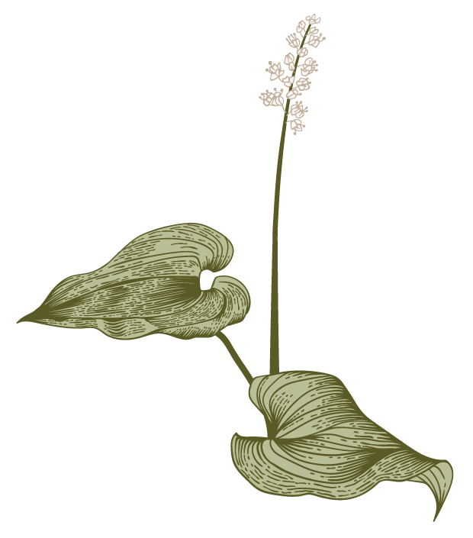
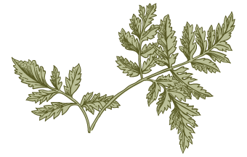
Overview
O
Problem, samples
Approach
Results

Slide 3
Problem, samples

Slide 4
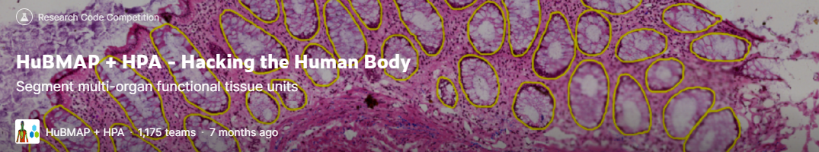
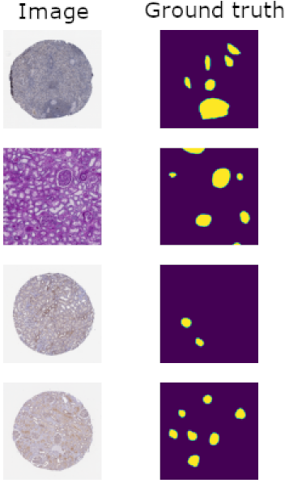
Single-class image segmentation: Recognize functional tissue units (FTUs)

Slide 5
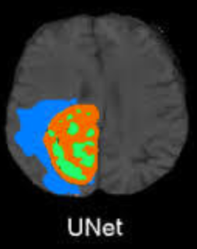
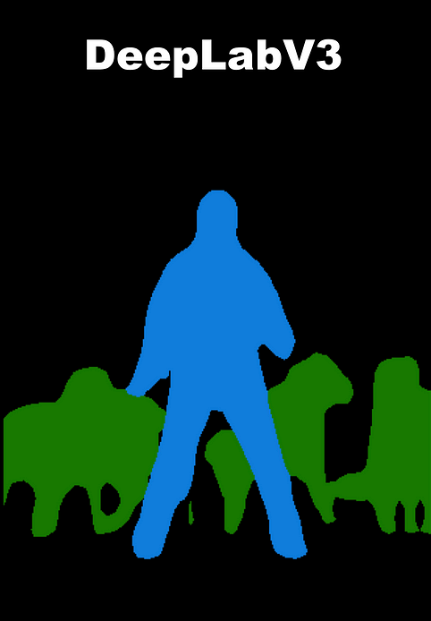
Top 5 submissions use UNet, intended for medical image segmentation
Could we get improvements by using DeepLabV3 instead?
Designed to be extremely robust to changes in image scale; uses different dilation factors in parallel
Useful trait when microscope slides are imaged at different magnifications!
But not designed with medical images in mind

Slide 6
Approach

Slide 7
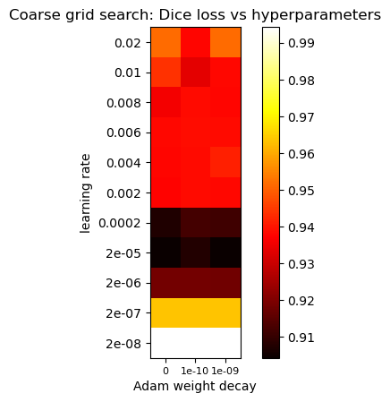
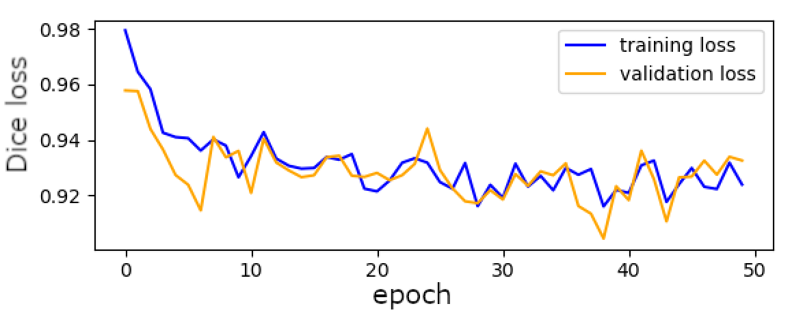
Approach – Initial attempts to make DeepLabV3 work
DeepLabV3 is multiclass, but we only need to train one of its classes
Let’s go with cat! Blobby shape that comes in a variety of poses, colors, and patterns
Loss: Dice loss (ranges from 0 to 1)
Scale all images to 512x512 and batch size to 4, to not run out of VRAM
Grid search of learning rate and weight decay, training for 50 epochs each time
Never achieved less than 0.90 Dice loss ☹
“Converged” very early

Slide 8
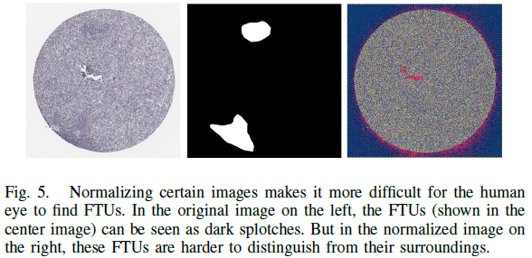
Approach – Things are getting desperate for DeepLabV3
Tweaks based on previous grid search results and loss curves:
Increased dataset from (256 train, 95 val) to (1024 train, 207 val)
Better optimizer: Ranger (combines Adam and LookAhead) – is used by one of the top Kaggle submissions
Increase epochs from 50 to 100
Change the label from cat to sofa, in case cat was near a poor local minimum
Turn off normalization and color jitter: actually works against us in this situation
Still didn’t improve Dice loss or loss curve issues
Also the exact hue of the stain is important, because different stains attach to different structures

Slide 9
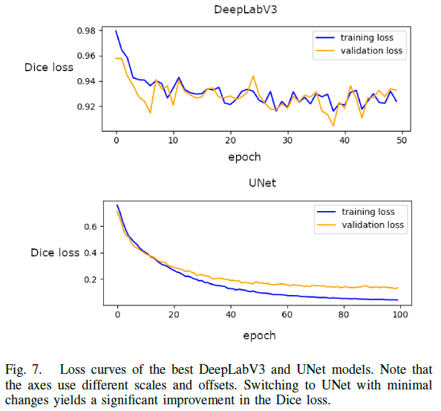
Approach – Trying UNet for comparison
Is this really DeepLabV3’s problem, or is something just wrong with my implementation?
Experiment: Switch to UNet but keep everything else the same. (Except learning rate; change it to something that’s appropriate for UNet). No grid search or tweaking.
Immediate improvement in the loss curve. Best validation loss was 0.1291, which is in the top 5 submissions for the challenge

Slide 10
Results

Slide 11
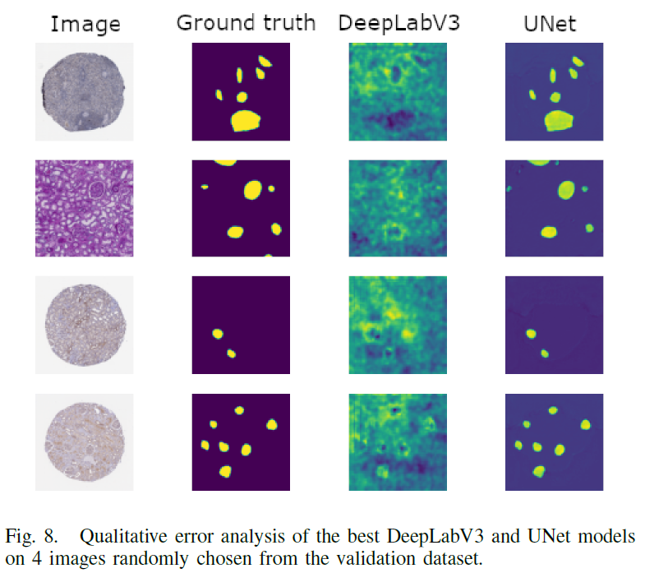
Results
DeepLabV3 is diffuse. There’s some response to the FTUs, but it’s unreliable and activates more on their edges and less inside them.
UNet is almost perfect; some tiny mistakes on second image.

Slide 12
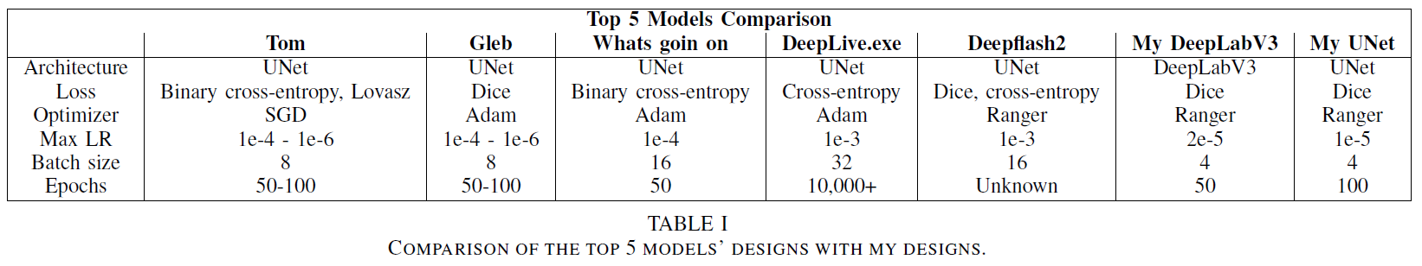
Results – Comparison to nets in top 5

Slide 13
References
Theo88, “Hubmap+hpa 1024x1024 png generation,” https://web.archive.org/web/20230408183931/https://www.kaggle.com/code/theo88/hubmap-hpa-1024x1024-png-generation, accessed: 2023-04-08.
S. Masubuchi, E. Watanabe, Y. Seo, S. Okazaki, T. Sasagawa, K. Watanabe, T. Taniguchi, and T. Machida, “Deep-learning-based image segmentation integrated with optical microscopy for automatically searching for two-dimensional materials,” npj 2D Materials and Applications, vol. 4, no. 1, p. 3, 2020.
Y. Jain, “Hubmap + hpa - hacking the human body,” https://www.kaggle.com/competitions/hubmap-organ-segmentation/overview, accessed: 2023-04-14.
L.-C. Chen, G. Papandreou, F. Schroff, and H. Adam, “Rethinking atrous convolution for semantic image segmentation,” arXiv preprint arXiv:1706.05587, 2017.
O. Ronneberger, P. Fischer, and T. Brox, “U-net: Convolutional networks for biomedical image segmentation,” in Medical Image Computing and Computer-Assisted Intervention–MICCAI 2015: 18th International Conference, Munich, Germany, October 5-9, 2015, Proceedings, Part III 18. Springer, 2015, pp. 234–241.
L. L. Godwin, Y. Ju, N. Sood, Y. Jain, E. M. Quardokus, A. Bueckle, T. Longacre, A. Horning, Y. Lin, E. D. Esplin et al., “Robust and generalizable segmentation of human functional tissue units,” bioRxiv, pp. 2021–11, 2021.
PyTorch, “Semantic segmentation,” https://pytorch.org/vision/stable/models.html#semantic-segmentation, accessed: 2023-04-14.
J. Long, E. Shelhamer, and T. Darrell, “Fully convolutional networks for semantic segmentation,” in Proceedings of the IEEE conference on computer vision and pattern recognition, 2015, pp. 3431–3440.
A. Howard, M. Sandler, G. Chu, L.-C. Chen, B. Chen, M. Tan, W. Wang, Y. Zhu, R. Pang, V. Vasudevan et al., “Searching for mobilenetv3,” in Proceedings of the IEEE/CVF international conference on computer vision, 2019, pp. 1314–1324.
Z. Joudar, “Read images tiff - organ segmentation,” https://www.kaggle.com/code/zakariajoudar/read-images-tiff-organ-segmentation, accessed: 2023-04-14.
H. Lee, “Training with thickness and staining augmentation,” https://www.kaggle.com/code/hyunwoo2/training-with-thickness-and-staining-augmentation/notebook, accessed: 2023-04-14.
L. Wright, “Ranger - a synergistic optimizer.” https://github.com/lessw2020/Ranger-Deep-Learning-Optimizer, 2019.
J. Y. Chan, A. P. Leung, and Y. Xie, “Efficient high-dimensional kernel k-means++ with random projection,” Applied Sciences, vol. 11, no. 15, p. 6963, 2021.
AlexisW, “Error: Expected more than 1 value per channel when training,” https://discuss.pytorch.org/t/error-expected-more-than-1-value-per-channel-when-training/26274/1, accessed: 2023-04-14.
PyTorch, “Semantic segmentation reference training scripts,” https://github.com/pytorch/vision/tree/main/references/segmentation, accessed: 2023-04-14.
Hasty, “Weight decay,” https://hasty.ai/docs/mp-wiki/solvers-optimizers/weight-decay, accessed: 2023-04-14.
J. Mekalanos, “Members,” https://mekalanoslab.med.harvard.edu/members/, accessed: 2023-04-14.
Y. Jain, “Data for ”segmenting functional tissue units across human organs using community-driven development of generalizable machine learning algorithms”,” https://zenodo.org/record/7545745, accessed: 2023-04-14.

Slide 14
Q&A

Slide 15
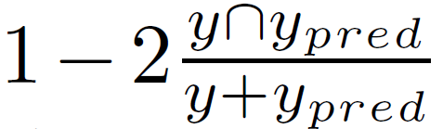
Dice Loss

Slide 16
Hidden slide: Who did what amount of the work
Wren was the only person on the team.

