Slide 1
A 3D Point Cloud Drawing Tool Using Cyclic Coordinate Descent
Presenter: Wren McQueary
(she/her)

Slide 2

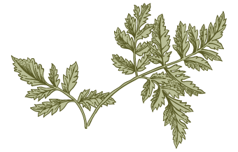
Overview
O
Problem and motivation
Relation to class material
What I built
Results and discussion

Slide 3
Problem and motivation

Slide 4
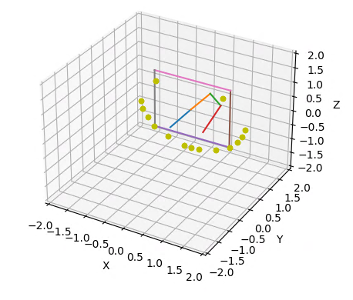
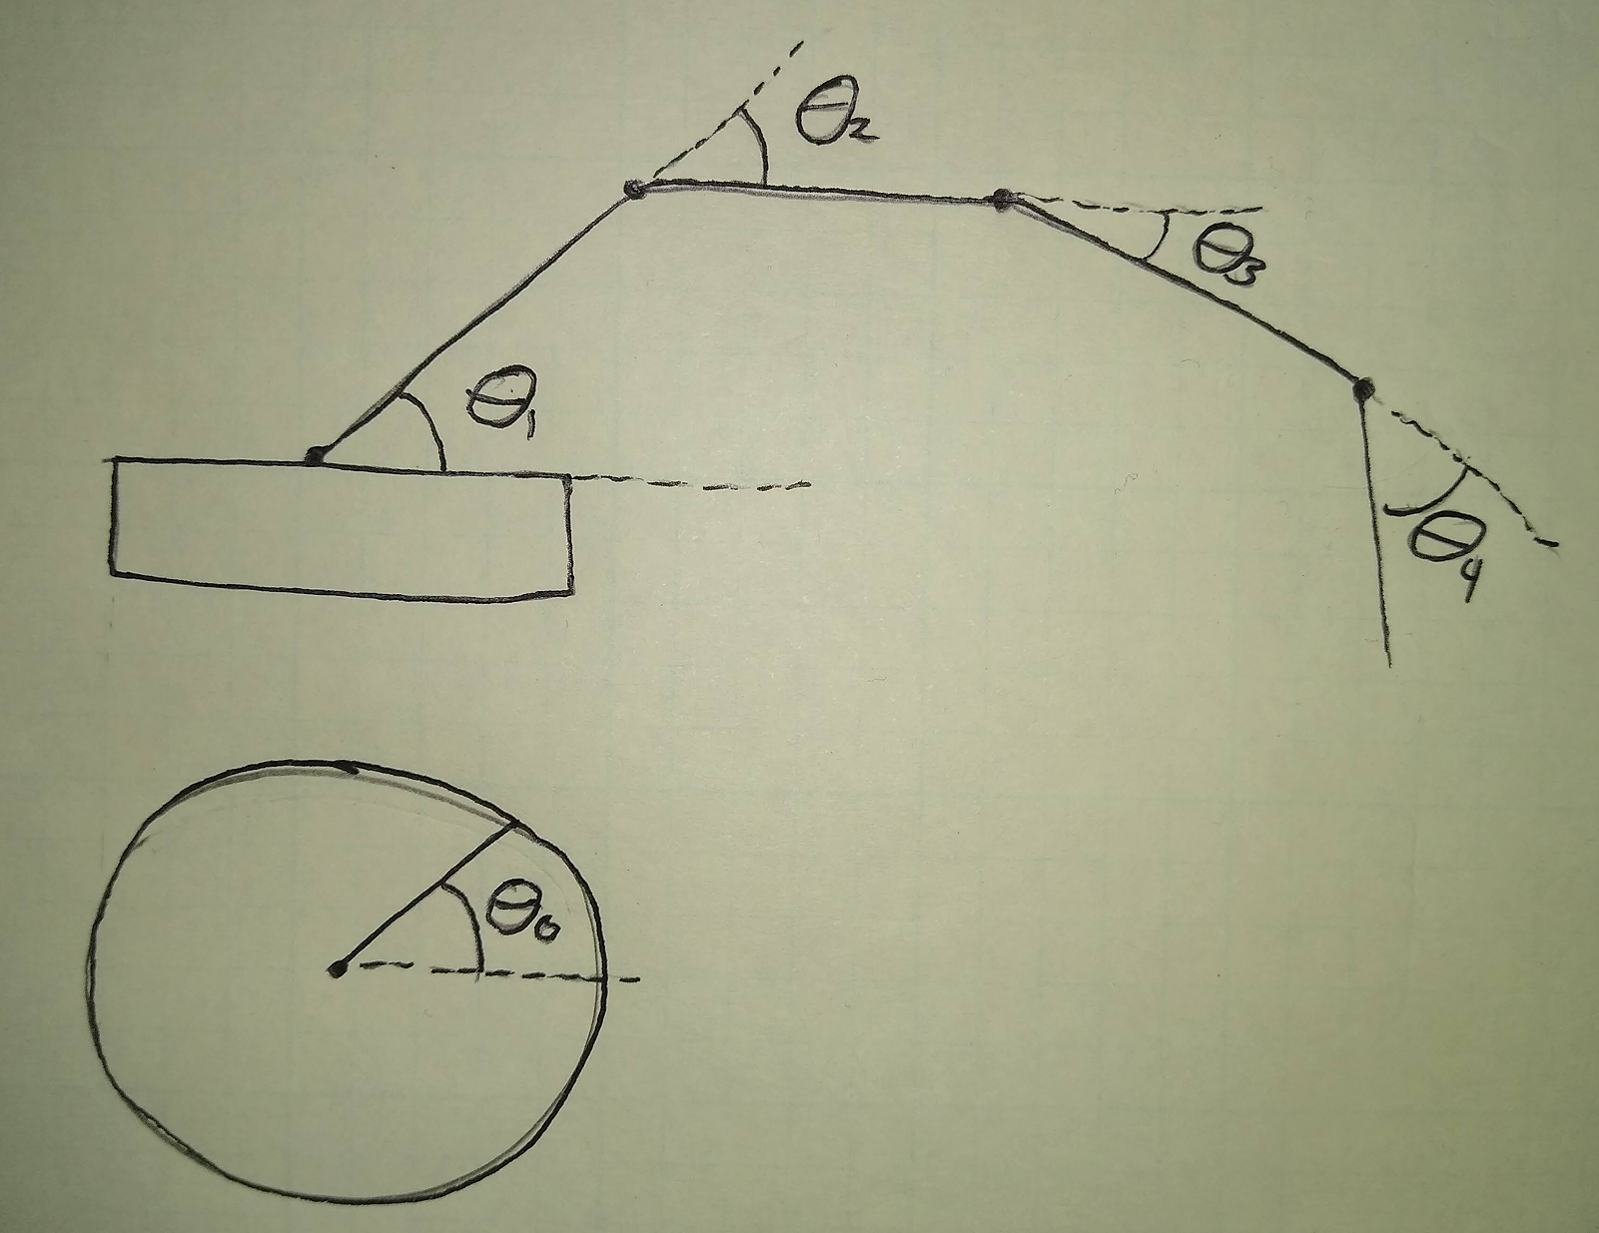
Problem and motivation
Problem: Build a simulated arm that can hang colorful points in 3D space. Use this to create point clouds of art.
Extend the IK we discussed into 3D
More arm segments
Angles are arranged similarly to a construction crane
Avoid obstacle collisions
Notes:
Specify the meaning of each angle. Intuition is it’s like a crane.

Slide 5
Personal motivation
Artistic applications of CS: Used to do museum education
MoveIt doesn’t work on my system: Wanted a workaround for IK

Slide 6
Relation to class material

Slide 7
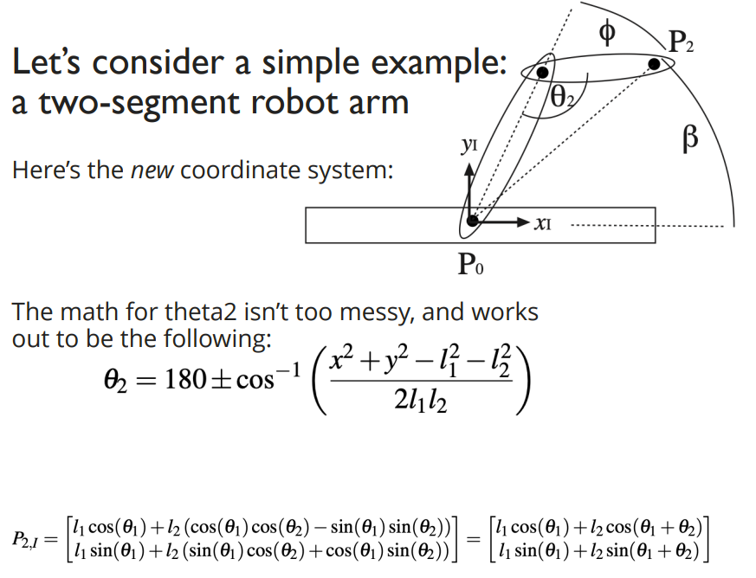
Relation to class material
Inverse kinematics that we covered in class:

Slide 8
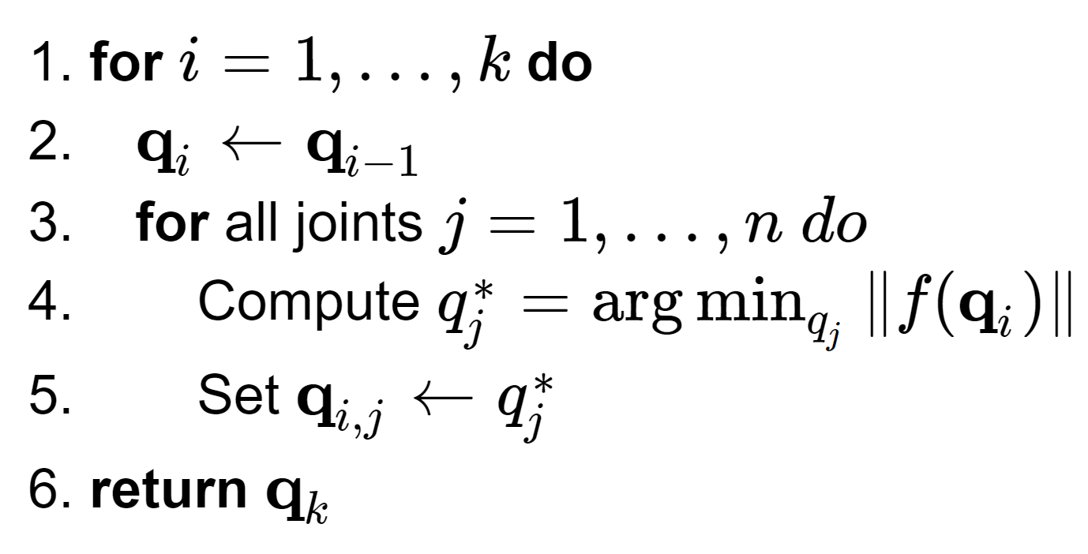
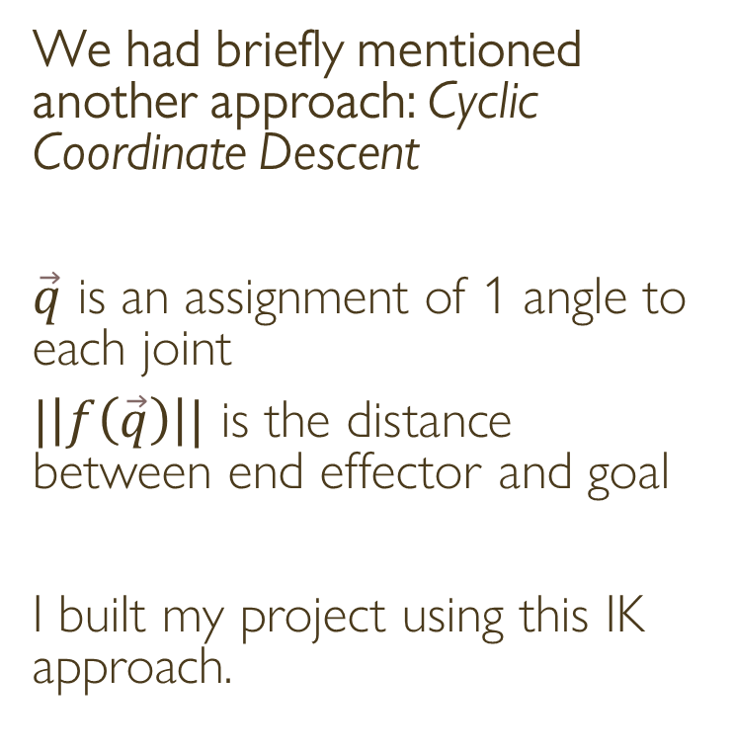
Relation to class material
We had briefly mentioned another approach: Cyclic Coordinate Descent
$\vec{q}$ is an assignment of 1 angle to each joint
$|\left|f\left(\vec{q}\right)\right||$ is the distance between end effector and goal
I built my project using this IK approach.

Slide 9
What I built

Slide 10
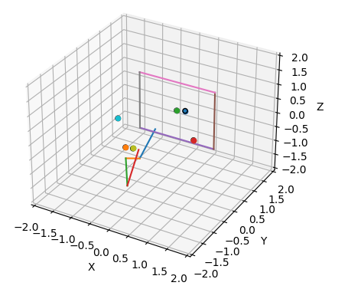
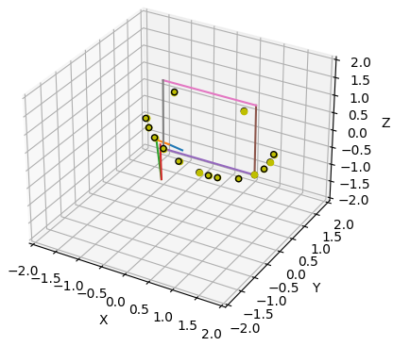
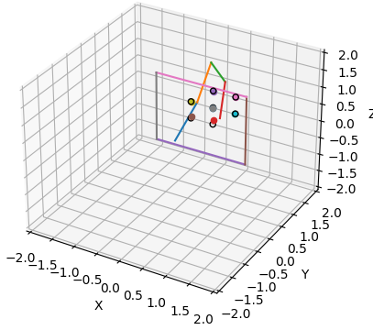
What I built
Draw points
Make art
Avoid obstacles
Notes:
Obstacle avoidance isn’t enforced for in-between frames.

Slide 11
Results and discussion

Slide 12
What I built
Performance metrics: How accurately does the robot position the end effector?
Ran the arm on these tests:
breadth_test.txt
smile.txt
smile.txt with obstacle avoidance
obstacle_avoidance_test.txt with obstacle avoidance
Gathered mean and std for each point

Slide 13
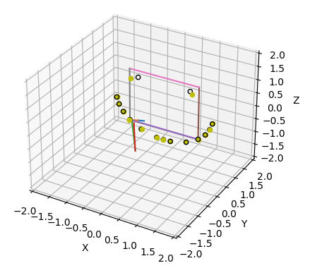
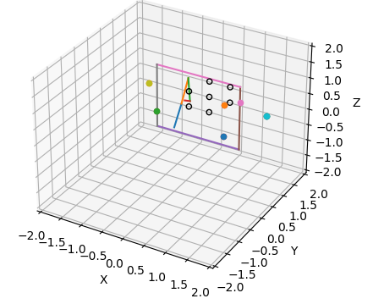
Name of test | Image | Mean distance (arm segment lengths) | Std distance (arm segment lengths) | Discussion
Breadth test |  | 0.0050 | 0.0015 | Good performance
Smile |  | 0.0057 | 0.0028 | Good performance
Smile with obstacle avoidance |  | 0.0325 | 0.0612 | Inconsistent performance; struggled for points that are near the obstacle.
Obstacle avoidance test with obstacle avoidance |  | 0.9848 | 0.0320 | CCD reaches a standstill
Obstacle avoidance test with obstacle avoidance, with assistive initialization |  | 0.0299 | 0.0320 | Good performance
Notes:
Assistive initialization entails initializing the theta values to [pi/2, 0, 0, 2*pi/3, pi/3], in that order

Slide 14
References
Chua, Yuanwei, Keng Peng Tee, and Rui Yan. "Robust optimal inverse kinematics with self-collision avoidance for a humanoid robot." 2013 IEEE RO-MAN. IEEE, 2013.
Hauser, Kris. “Robotic Systems (Draft).” Book, https://motion.cs.illinois.edu/RoboticSystems/.
Joubert, Niels, and U. Berkeley. "Numerical methods for inverse kinematics." Retrieved February 28 (2008): 2015.
Park, Sun-Oh, Min Cheol Lee, and Jaehyung Kim. "Trajectory planning with collision avoidance for redundant robots using jacobian and artificial potential field-based real-time inverse kinematics." International Journal of Control, Automation and Systems 18.8 (2020): 2095-2107.
Zhao, Liangliang, Jingdong Zhao, and Hong Liu. "Solving the Inverse Kinematics Problem of Multiple Redundant Manipulators with Collision Avoidance in Dynamic Environments." Journal of Intelligent & Robotic Systems 101.2 (2021): 1-18.

Slide 15
Q&A

