Slide 1
Finding a Well-Tuned Model for Kaggle’s Petals to the Metal Competition
Wren McQueary
(she/her)

Slide 2


Overview
O
Problem, samples
Approach
Results

Slide 3
Problem, samples

Slide 4
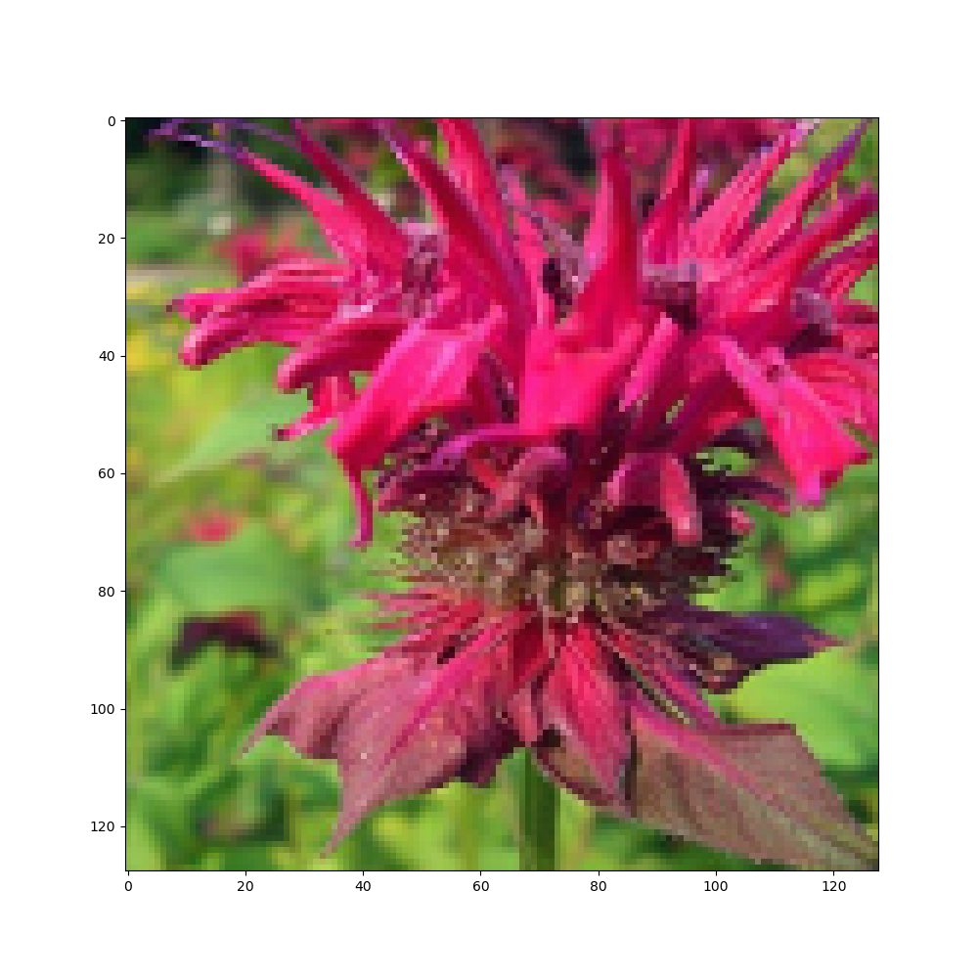
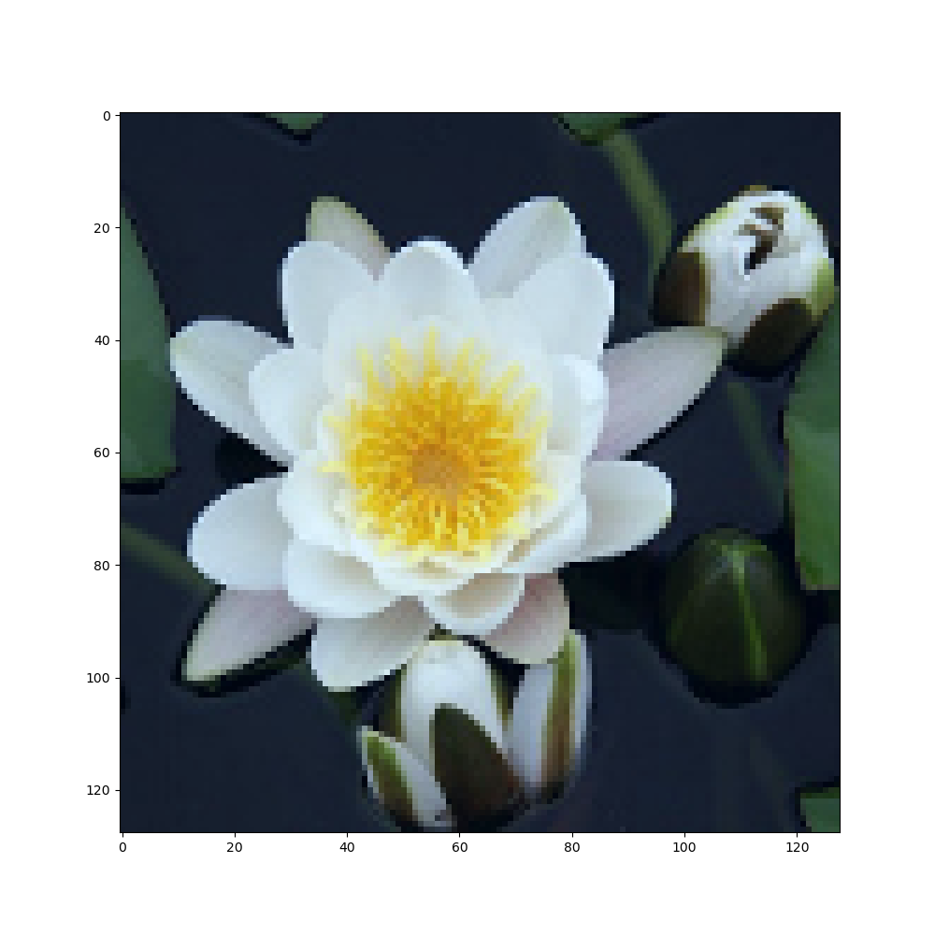

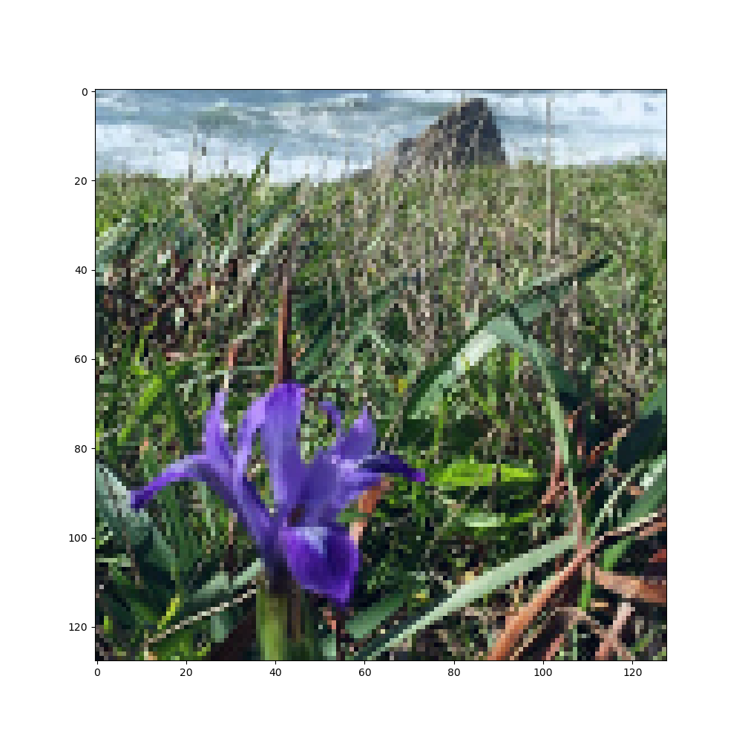
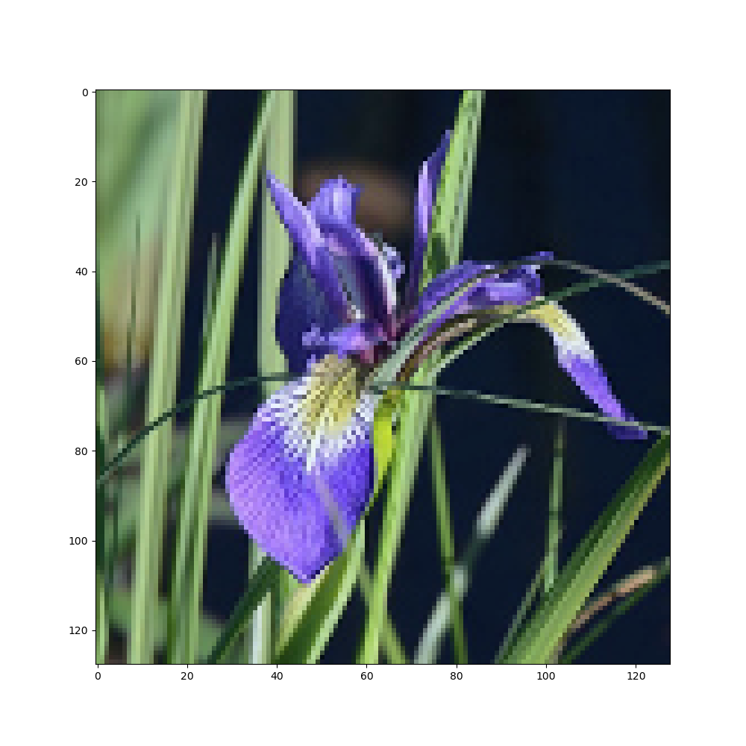
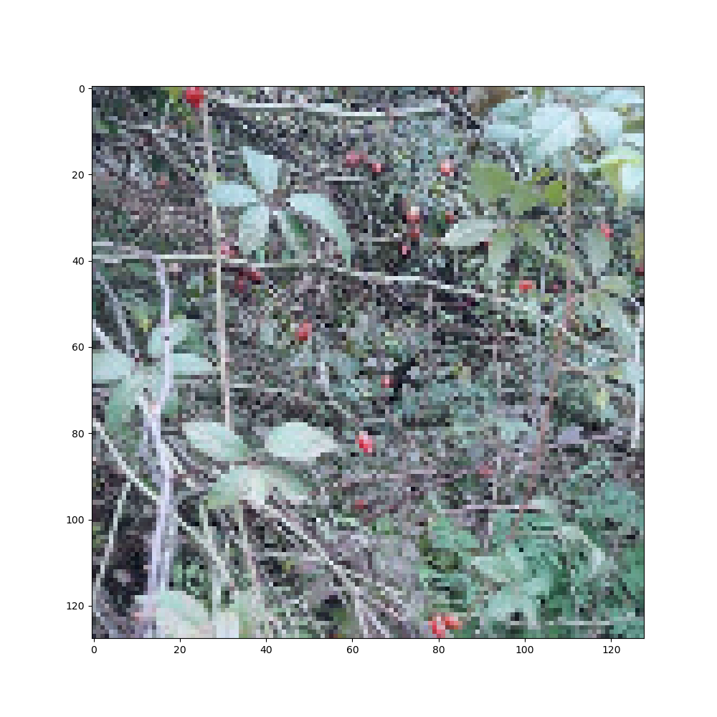
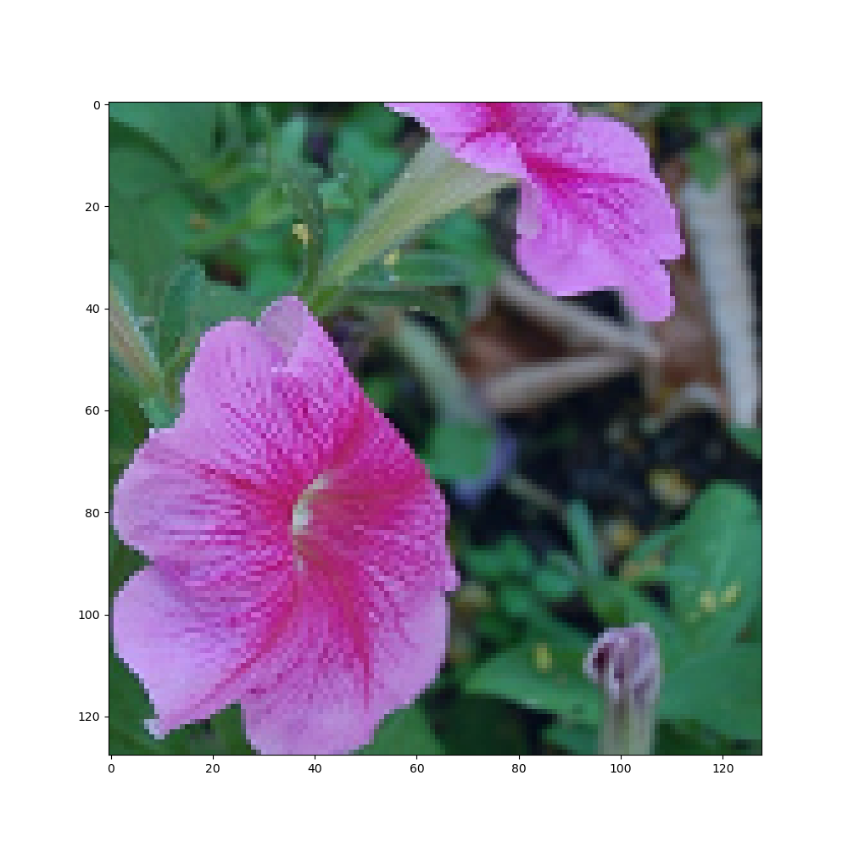
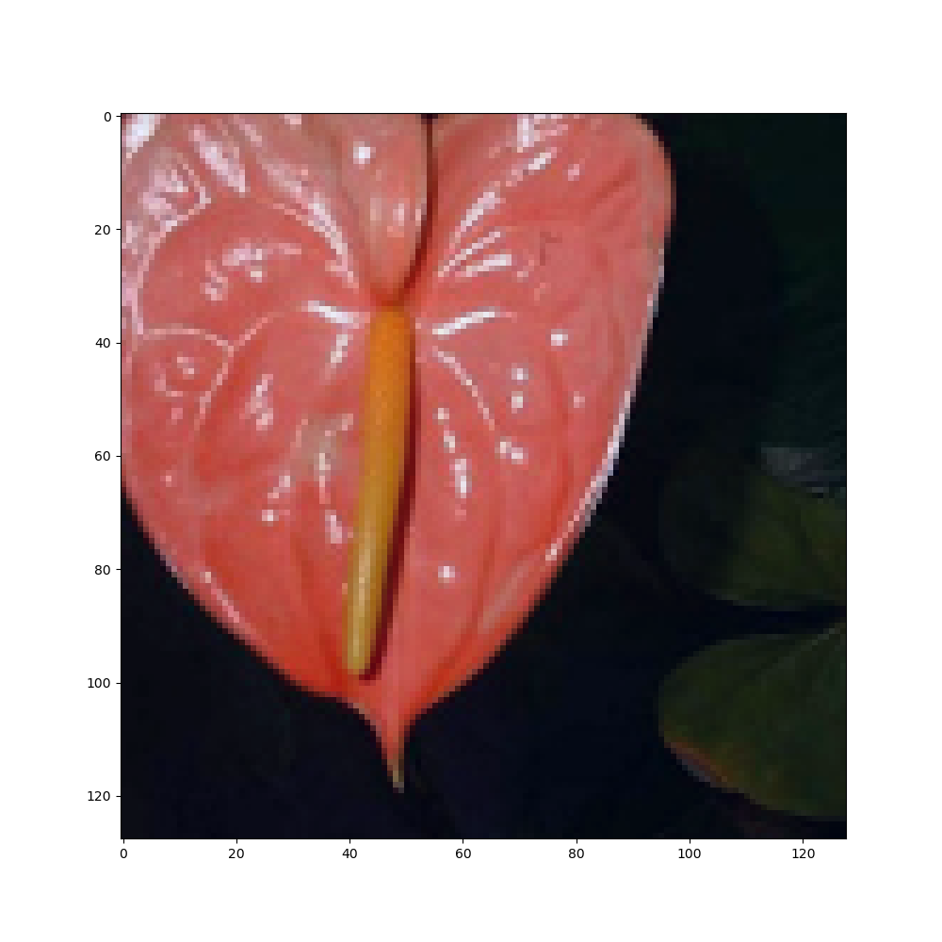
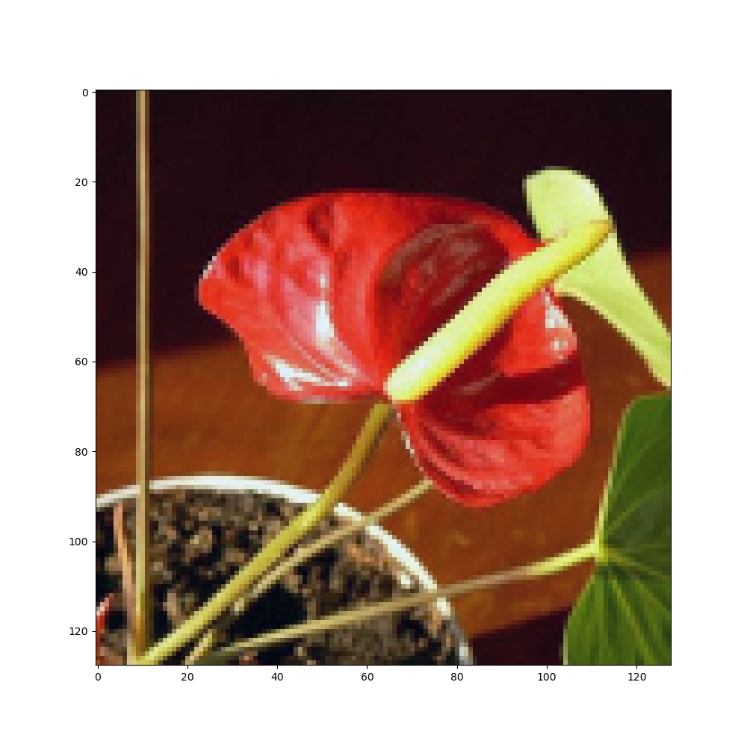
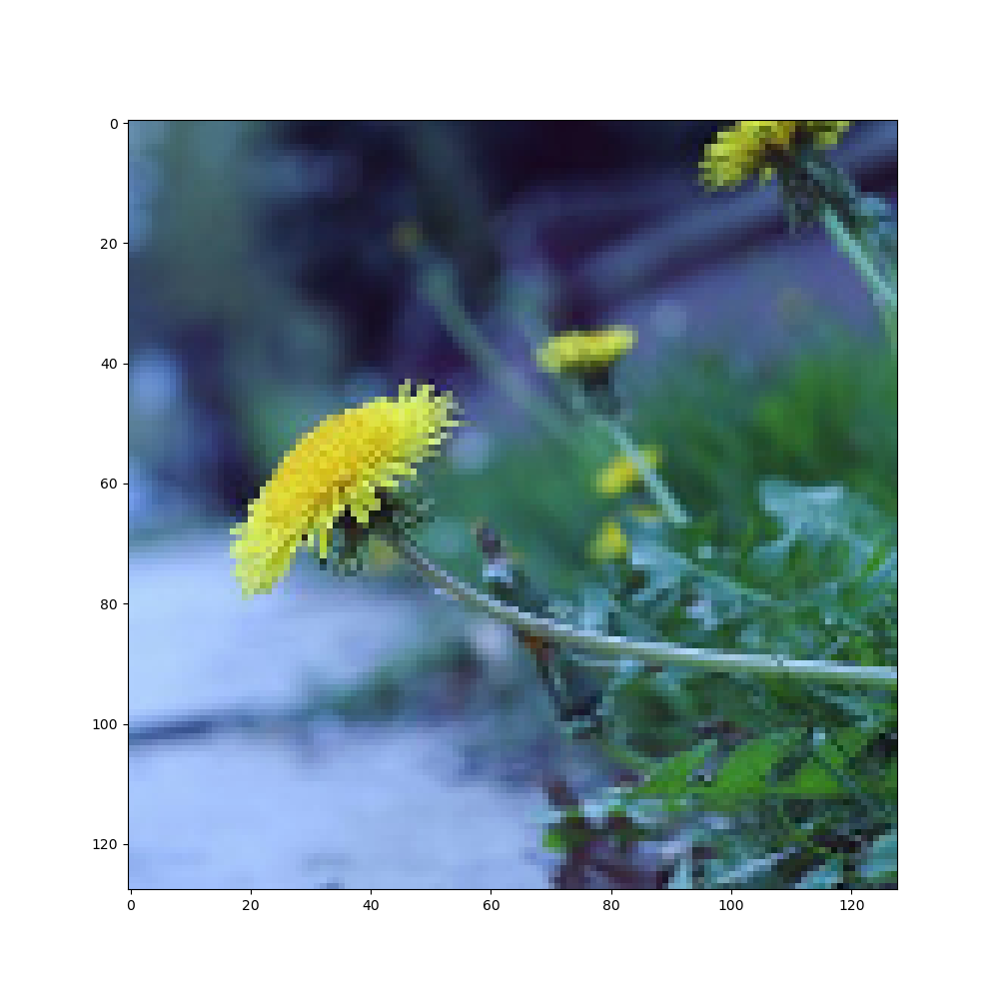
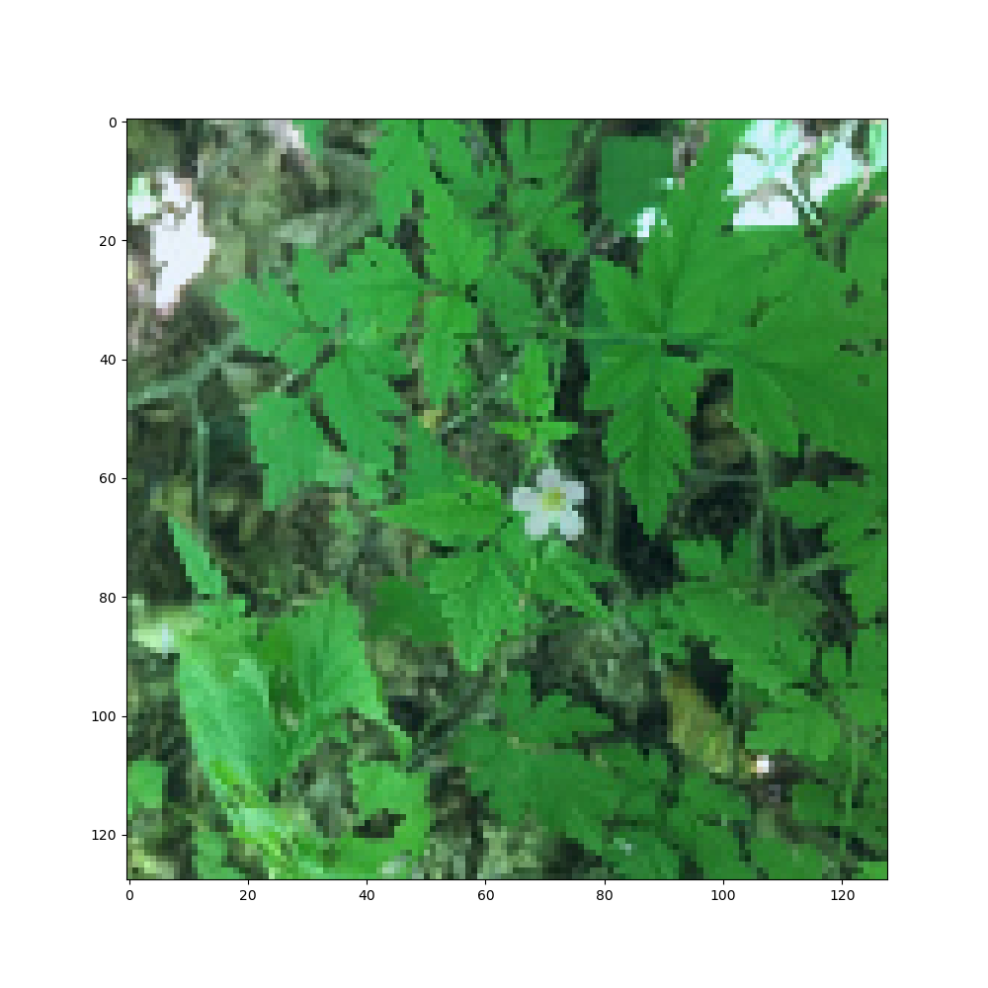
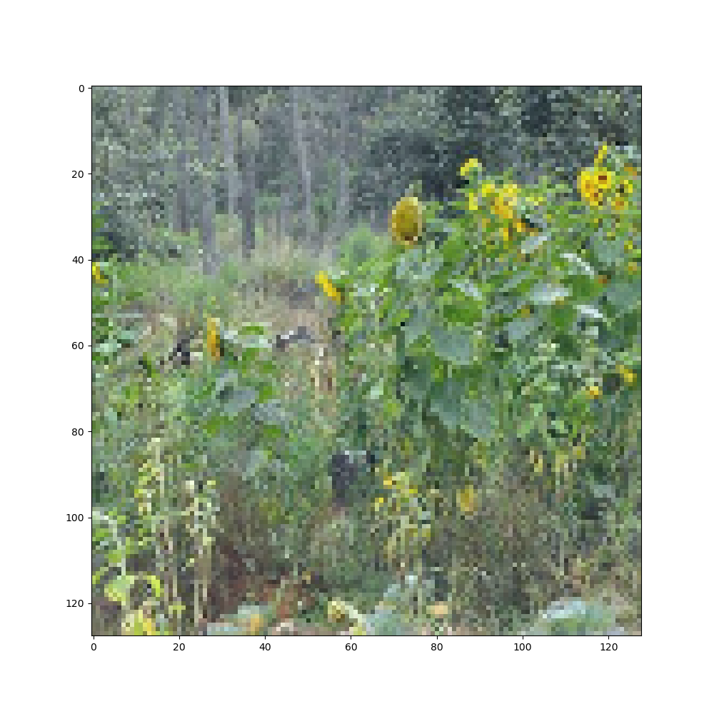
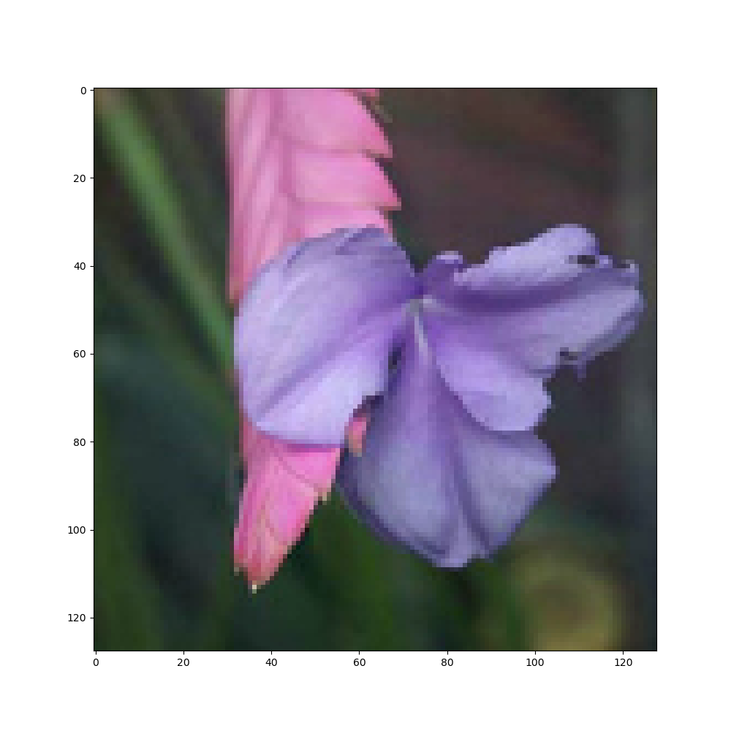
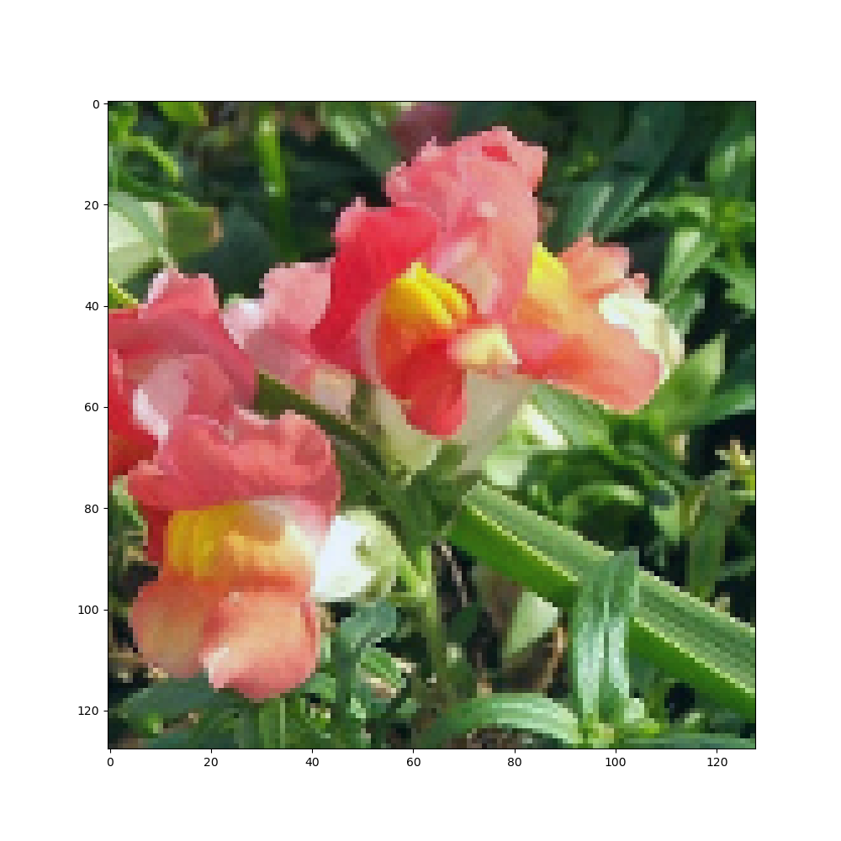
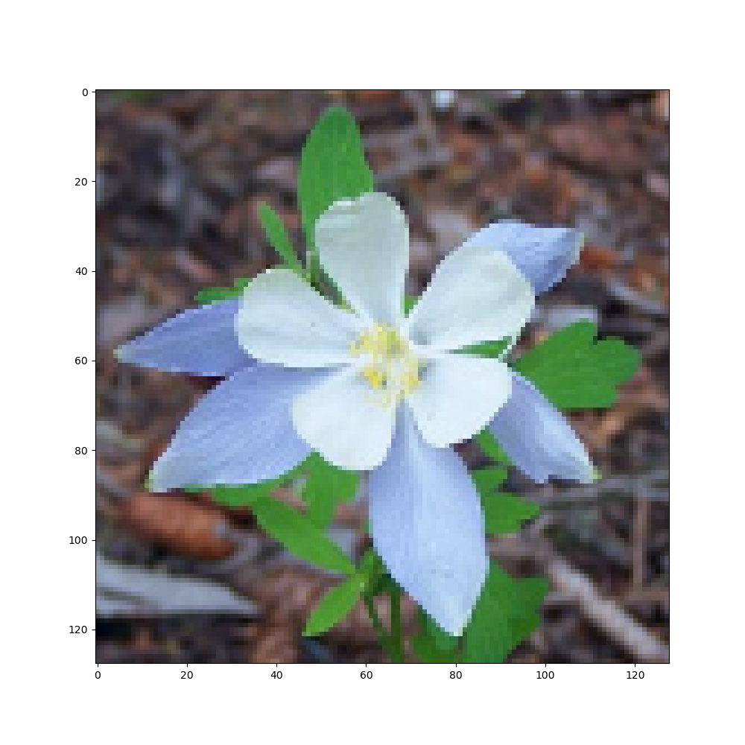
Problem, samples
Multiclass classification: Recognize 104 classes of flowers.
I chose to create my own architecture from scratch.

Slide 5
Approach

Slide 6
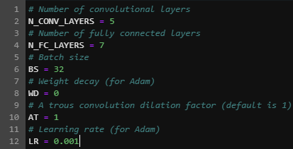

Approach – Making search easier
Finding the right architecture & hyperparameters takes many attempts.
Sped up by creating infrastructure to change layer count+size just by changing some integers at the top of the notebook
Had to rewrite Classifier class to respond to these, and adjust dimensionality so that layers would be compatible

Slide 7
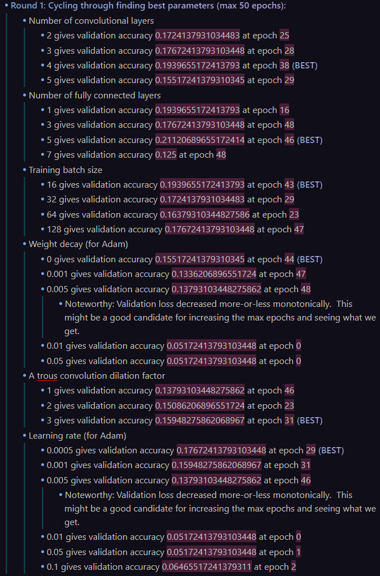
Approach – Coarse adjustment
To speed up process, used 1/64th of dataset. (Used full dataset later for fine adjustment.)
Modified grid search
Specified values under consideration
Visited one attribute at a time
Found best value holding other attributes constant

Slide 8
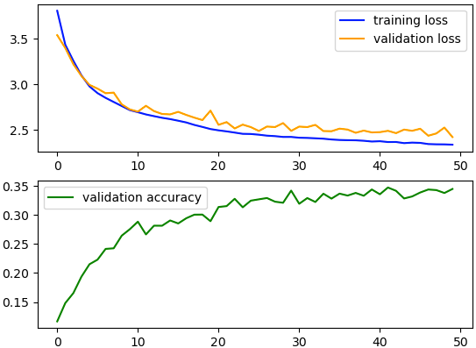
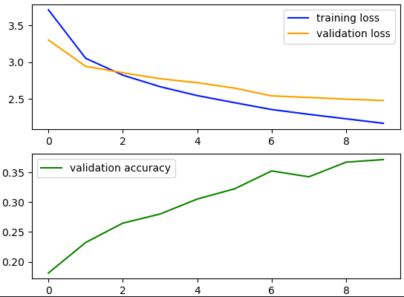
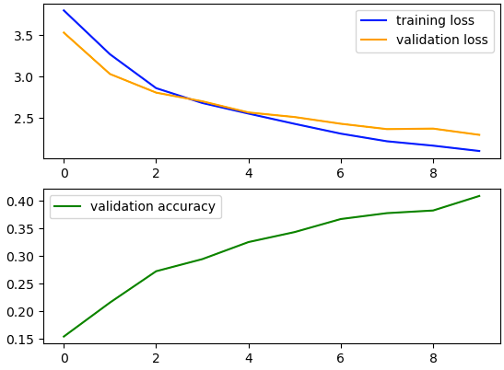
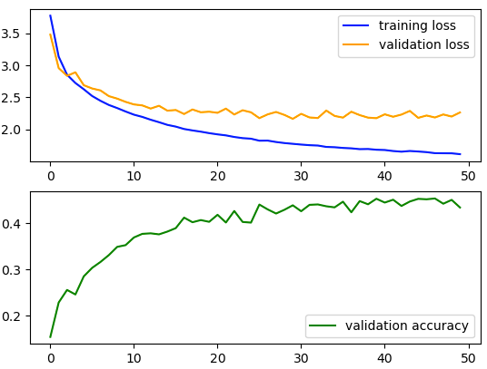
Approach – Fine adjustment with full dataset
No more grid search. Instead, nuanced tweaks guided by learning curves.
Looking better. Run for more epochs and increase weight decay to combat resulting overfitting?
Low overfitting. Make model more expressive?
Too much overfitting. Intensify data augmentation?

Slide 9
Results

Slide 10
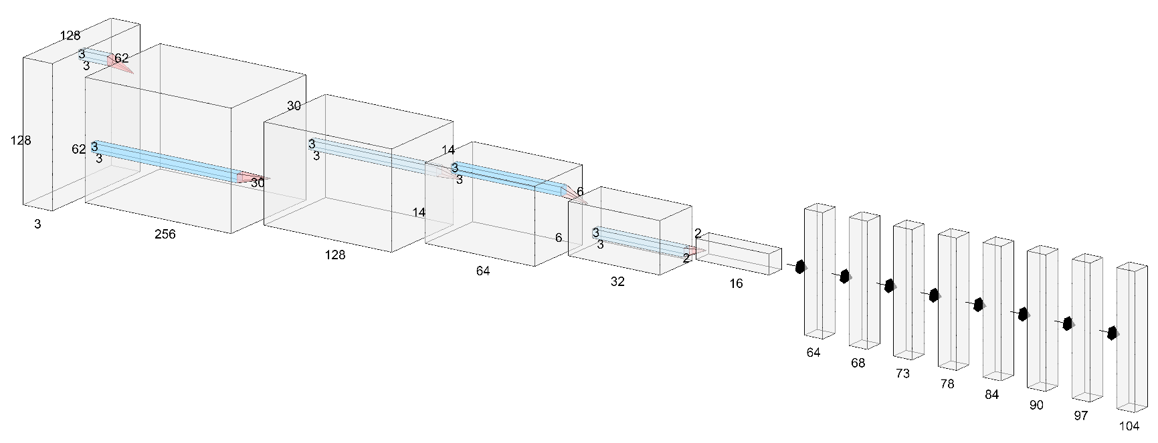
Results – Final architecture

Slide 11
Results – Comparison to pretrained nets

Slide 12
References
N. Desai, “Multiclass image classification,” https://medium.com/geekculture/multiclass-image-classification-dcf9585f2ff9, accessed: 2022-11-30.
H. Touvron, A. Vedaldi, M. Douze, and H. J´egou, “Fixing the traintest resolution discrepancy,” Advances in neural information processing systems, vol. 32, 2019.
Kaggle, “Petals to the metal - flower classification on tpu,” https://web.archive.org/web/20221103061850/https://www.kaggle.com/competitions/tpu-getting-started/overview, accessed: 2022-11-28.
J. Kosecka, “Assignment 2 part 1: Multi-label image classification,” https://web.archive.org/web/20221129161130/https://cs.gmu.edu/∼kosecka/cs747/CS747 Assignment 2.html, accessed: 2022-11-29.
S. Chatterjee, “How to read tfrecords files in pytorch!” https://web.archive.org/web/20211023181816/https://medium.com/analytics-vidhya/how-to-read-tfrecords-files-in-pytorch-72763786743f, accessed: 2022-11-28.
J. Brownlee, “How to choose loss functions when training deep learning neural networks,” https://web.archive.org/web/20221103075117/https://machinelearningmastery.com/how-to-choose-loss-functions-when-training-deep-learning-neural-networks/, accessed: 2022-11-28.
H. Saleh, Applied Deep Learning with PyTorch: Demystify neural networks with PyTorch. Packt Publishing Ltd, 2019.
J. Brownlee, “How to use learning curves to diagnose machine learning model performance,” https://web.archive.org/web/20221103075114/https://machinelearningmastery.com/learning-curves-for-diagnosing-machine-learning-model-performance/, accessed: 2022-11-28.
T. P. Foundation, “torch,” https://web.archive.org/web/20221117021831/https://pytorch.org/docs/stable/torch.html, accessed: 2022-11-28.
C. Stephenson and T. Lee, “When and how epochwise double descent happens,” arXiv preprint arXiv:2108.12006, 2021.
A. Krizhevsky, I. Sutskever, and G. E. Hinton, “Imagenet classification with deep convolutional neural networks,” Communications of the ACM, vol. 60, no. 6, pp. 84–90, 2017.
K. He, X. Zhang, S. Ren, and J. Sun, “Deep residual learning for image recognition,” in Proceedings of the IEEE conference on computer vision and pattern recognition, 2016, pp. 770-778

Slide 13
Q&A

Slide 14
Hidden slide: Who did what amount of the work
Wren was the only person on the team.

