Slide 1
PITCH · IF I AWAKEN IN LOS ANGELES
If I Awaken in Los Angeles
An immersive 100-minute theatre experience that walks 150 guests through seven built environments — Hollywood Boulevard, Boyle Heights, Asian LA, Black LA, Folk LA, The Stage, The Real LA — across a single warehouse studio in the Arts District.
One audience. One continuous journey. A live Tour Guide, two poets, five dancers, and a five-piece jazz band moving with you through each room.
"The real LA is in this room."
DIRECTION ANDREW SCOVILLE · COMPOSITION DERRICK HODGE

Slide 2
02 · THE JOURNEY
Seven neighborhoods, one continuous walk.
The audience never sits down until the finale. They start on Hollywood Boulevard — a 110-foot LED wall, dancers as tourists, the Walk of Fame underfoot. The wall pivots to street-level faces; the tour breaks open. They follow into Boyle Heights — a tianguis with stone tables and a band stage where two poets meet across a generation. Through a Chinatown gate into the arc of five Asian neighborhoods — Chinatown, Little Tokyo, Koreatown, Historic Filipinotown, Thai Town — one rapper-poet walking the line as each town's stage lights in turn. A church wall opens into Black LA across a century — gospel choir, swing dance at Dunbar, a hip-hop cypher, a Leimert Park drum circle. A knock at a door becomes Folk LA — a Laurel Canyon living room, the band joining the audience on the floor for a sing-along. Then The Stage — a classical proscenium, the only seated room, a finale that earns its formality. And finally The Real LA — a return to the opening corridor, the LED wall now a mosaic of the audience's own faces.
EVERY SPACE: ITS OWN SCENIC REGISTER · ITS OWN CAST · ITS OWN SOUND

Slide 3
03 · AT SCALE
A show built for the city it is about.
30,100 sq ft
Raw studio · Arts District, Los Angeles
EXPOSED BRICK · STEEL · CONCRETE
150
Guests per performance
WALKING · IMMERSIVE · SINGLE-DIRECTION LOOP
100 min
End-to-end
SEVEN SPACES · ONE CONTINUOUS ARC
12 / week
Performances
TUESDAY THROUGH SUNDAY
14+ month
Production run
JUNE 2026 — AUGUST 2027
7
Built environments plus a lobby that doubles as theatre
ARTS DISTRICT · LOS ANGELES

Slide 4
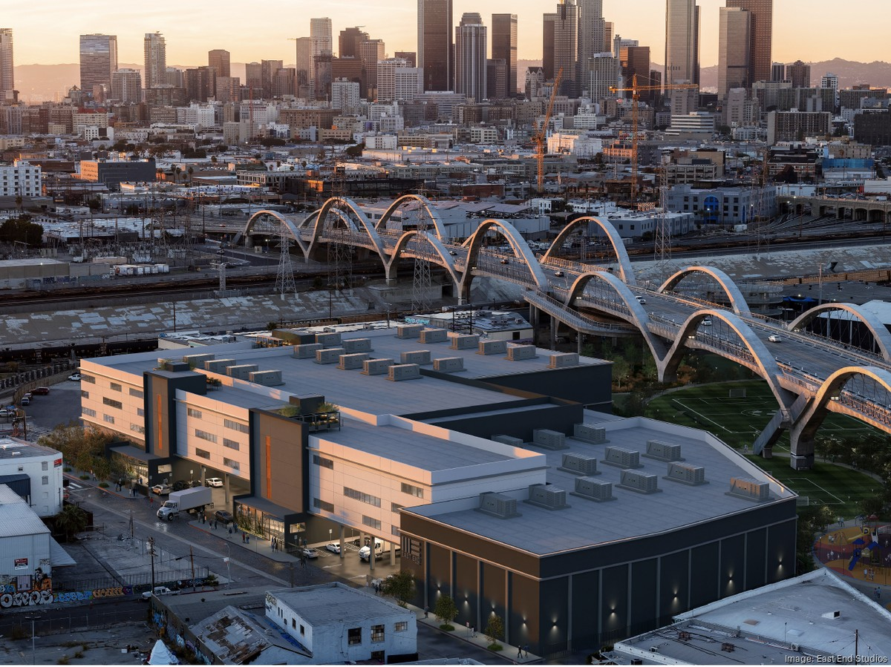
04 · THE ROOM
A studio in the Arts District.
One block from the river. Under the 6th Street Bridge. With downtown looking on. The show isn't about Los Angeles — it's inside it.

