Slide 1
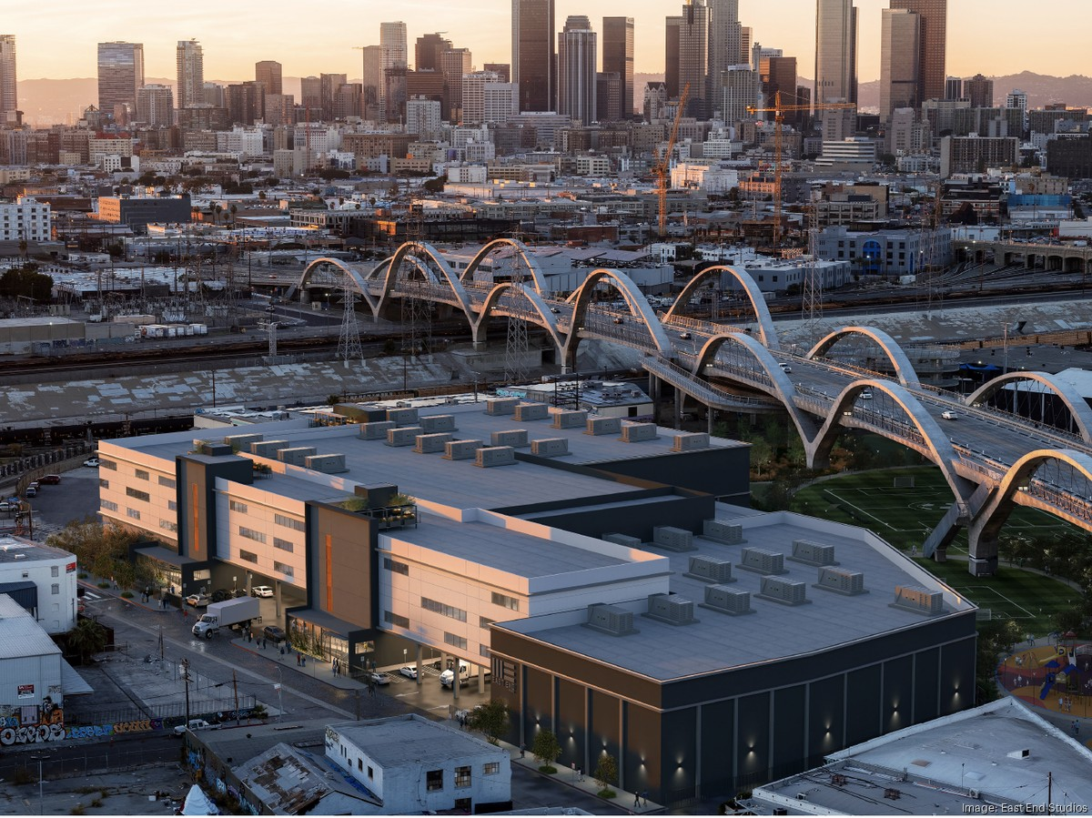
AN IMMERSIVE THEATRE EXPERIENCE · LOS ANGELES · 2026
If I Awaken in Los Angeles
ANDREW SCOVILLE · DERRICK HODGE

Slide 2
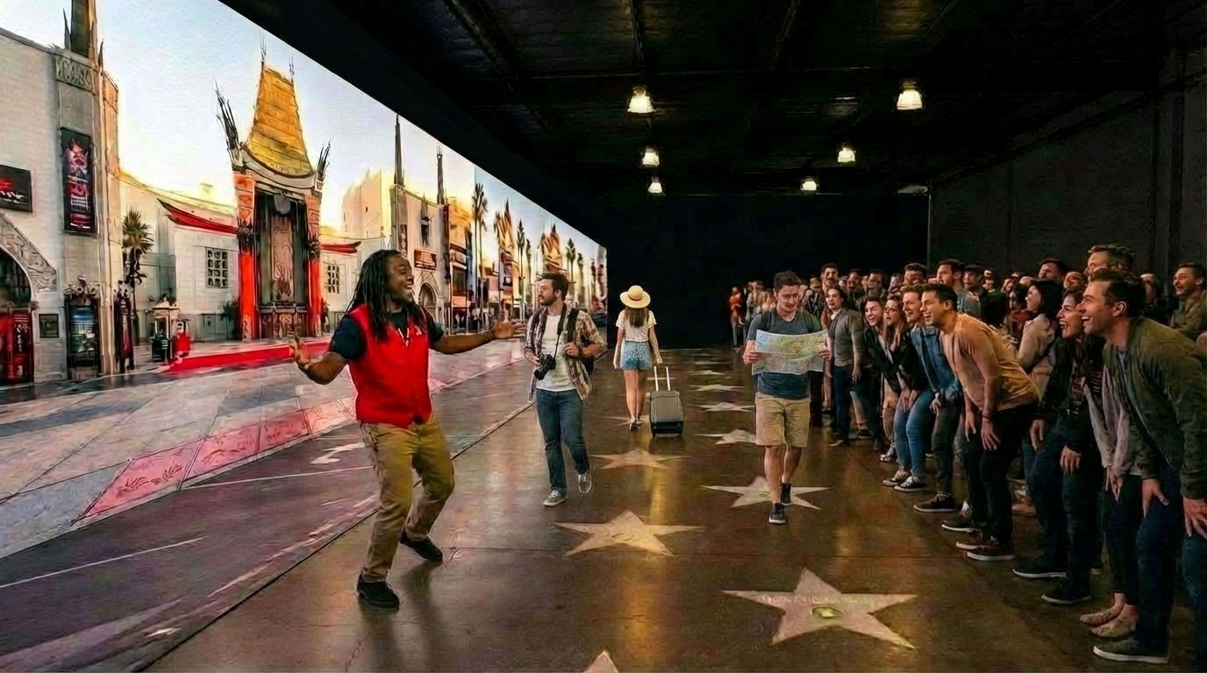
02 · THE JOURNEY
From the red carpet
to the real LA.
Starting on the red carpet — every guest photographed on entry — we walk an audience of 150 through Hollywood Boulevard, then deeper. Past the marquee, past the Walk of Fame, into Boyle Heights. Into the five Asian neighborhoods that line the freeway. Into Black LA across a century — from the gospel church to the breakdance cypher to the Leimert Park drum circle. Into a Laurel Canyon living room where the band sits down on the floor with us. Onto a single classical stage where the company arrives one by one. And finally back through the corridor we entered — but this time, the wall is made of the audience's own faces.
SEVEN NEIGHBORHOODS · ONE AUDIENCE
ONE HUNDRED MINUTES · ONE CONTINUOUS WALK

Slide 3
03 · THE THESIS
LA is more than Hollywood.
It is the people. It is the cultures. We put the audience inside both.
This isn't a show about Los Angeles. It places its audience inside the actual neighborhoods, with the actual people, with the actual music — at theatre scale.
30,100 sq ft
raw studio · Arts District, Los Angeles
150
guests per performance
100 min
end-to-end · seven spaces, one arc
12 / week
performances · Tuesday through Sunday
14+ month
production run · June 2026 — August 2027
7
built environments plus a lobby that doubles as theatre
DIRECTION ANDREW SCOVILLE · COMPOSITION DERRICK HODGE

