Slide 1
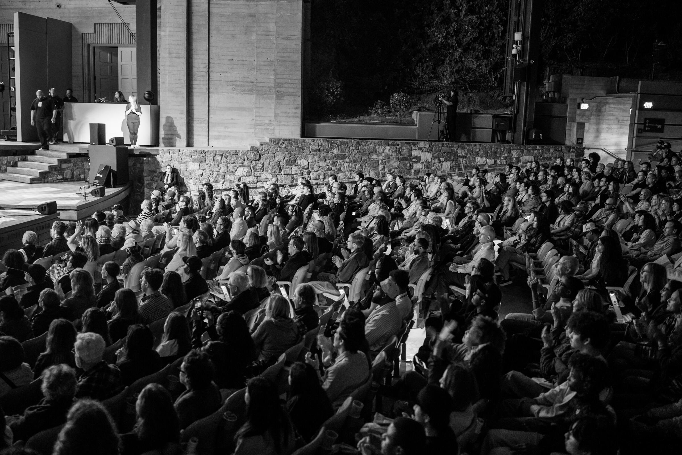
PITCH 2026
AN IMMERSIVE THEATRICAL TOUR OF THE REAL LOS ANGELES
IF I AWAKEN IN
LOS ANGELES
OPENING JUNE 2027 · ARTS DISTRICT · LOS ANGELES
SCROLL TO BEGIN ↓
01 · COVER
01 / 19

Slide 2
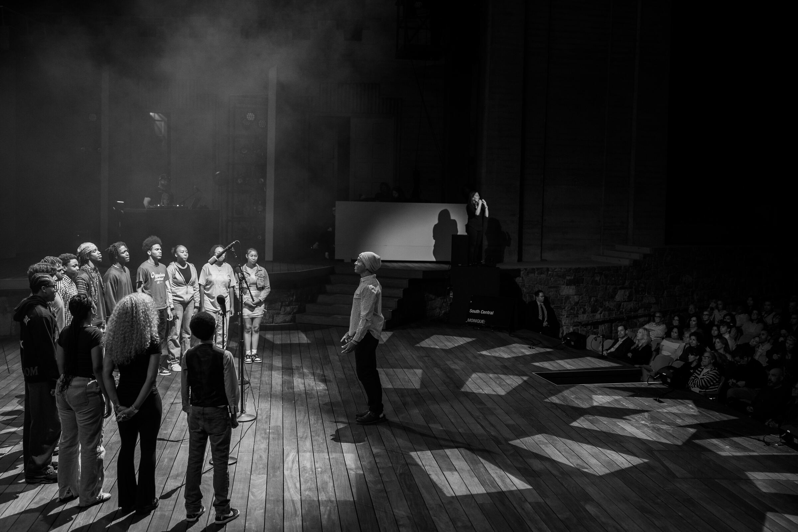
An iconic American city without an iconic show. That must-see experience you just have to see when you're in town.
This is the show
Los Angeles has been missing.
Unlike anything that's come before, and unlike anything you'll see again.
But first, let me catch you up on what If I Awaken has accomplished so far…
THE PILOT
THE ALBUM
THE AWAKENING
THE SHOW
02 · THE HOOK
02 / 19

Slide 3
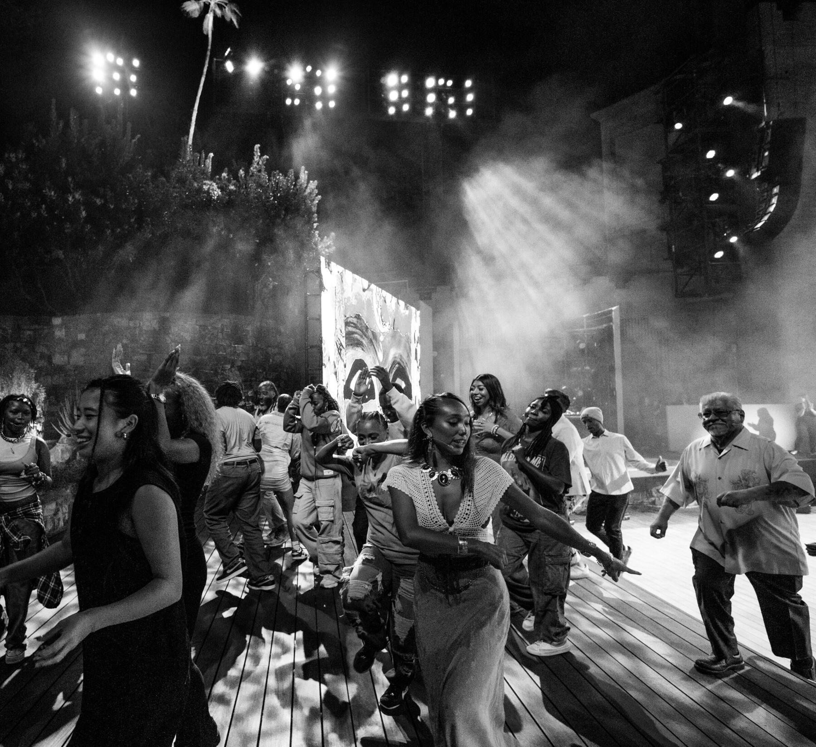
AUG 2025
OCT 2025
JAN 2026
JUN 2027
THE PILOT
THE ALBUM
THE AWAKENING
THE SHOW
1,000+ tickets · Ford
30K listens · wk one
1,400+ submissions
opens · 18-mo run
CHAPTER ONE · AUGUST 2025
THE PILOT.
If I Awaken in Los Angeles premiered at LA's iconic Ford Theatre, in partnership with the LA Philharmonic.
Directed by Gina Belafonte, with musical direction from multiple Grammy Award–winning composer Derrick Hodge. The show premiered to a sold-out house — with lines so long the show started thirty minutes late to accommodate the crowd trying to get in.
FEATURED ON STAGE
LUIS J. RODRIGUEZ
Former LA Poet Laureate
SAMANTHA RIOS
Current LA Youth Poet Laureate
DANTE BASCO
Hook · Avatar: The Last Airbender
1,000+
MENDELEYEV
NBC's The Voice
TICKETS SOLD
" They didn't just speak about Los Angeles — they spoke as Los Angeles. "
03 · THE PILOT
03 / 19

Slide 4
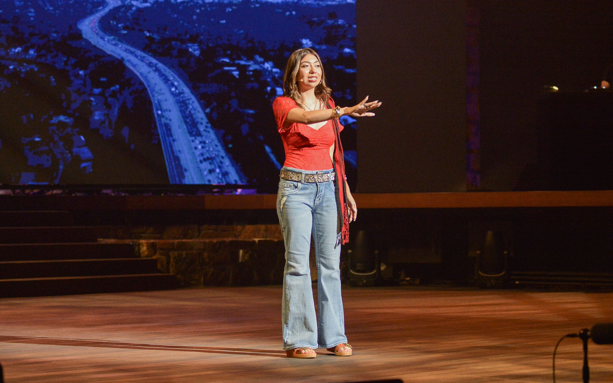
AUG 2025
OCT 2025
JAN 2026
JUN 2027
THE PILOT
THE ALBUM
THE AWAKENING
THE SHOW
1,000+ tickets · Ford
30K listens · wk one
1,400+ submissions
opens · 18-mo run
CHAPTER TWO · FIRST WEEK
ADDED ICONIC LA VOICES
IF I AWAKEN IN LOS ANGELES
THE ALBUM.
5
Grammy winning & nominated artists
3
U.S. Poet Laureates
Demand didn't stop at the stage. It surged.
2×
Library of Congress– winning team
2× Grammy-winning composer Derrick Hodge partnered with iconic LA voices — Jackson Browne, Cheech Marin, and Joy Harjo — to expand the show's impact far beyond the theater.
1
Rock & Roll Hall of Fame inductee
30K+
LISTENS · FIRST WEEK
▶ SPOTIFY
♪ APPLE MUSIC
▶ YOUTUBE MUSIC
04 · THE ALBUM
04 / 19

Slide 5
AUG 2025
OCT 2025
JAN 2026
JUN 2027
THE PILOT
THE ALBUM
THE AWAKENING
THE SHOW
1,000+ tickets · Ford
30K listens · wk one
1,400+ submissions
opens · 18-mo run
CHAPTER THREE · THE CITY ANSWERED
JUDGED BY
THE AWAKENING.
ALOE BLACC
Grammy-nominated singer-songwriter
GINA BELAFONTE
Producer · co-founder, Sankofa.org
SAFIA ELHILLO
Sudanese-American poet · Ruth Lilly Fellow
Then the entire city got involved.
JOSÉ OLIVAREZ
NYT bestselling author, Promises of Gold
We inadvertently kick-started the largest poetry competition in the country by asking one question:
CHEN CHEN
Poet
OLIVIA GATWOOD
Poet & novelist · Life of the Party
Tell us about your LA.
Partnering with the LA Unified School District and Get Lit – Words Ignite, students, teachers, classrooms, and community centers across LA added their voice.
1,400+
VIDEO SUBMISSIONS
05 · THE AWAKENING
05 / 19

Slide 6
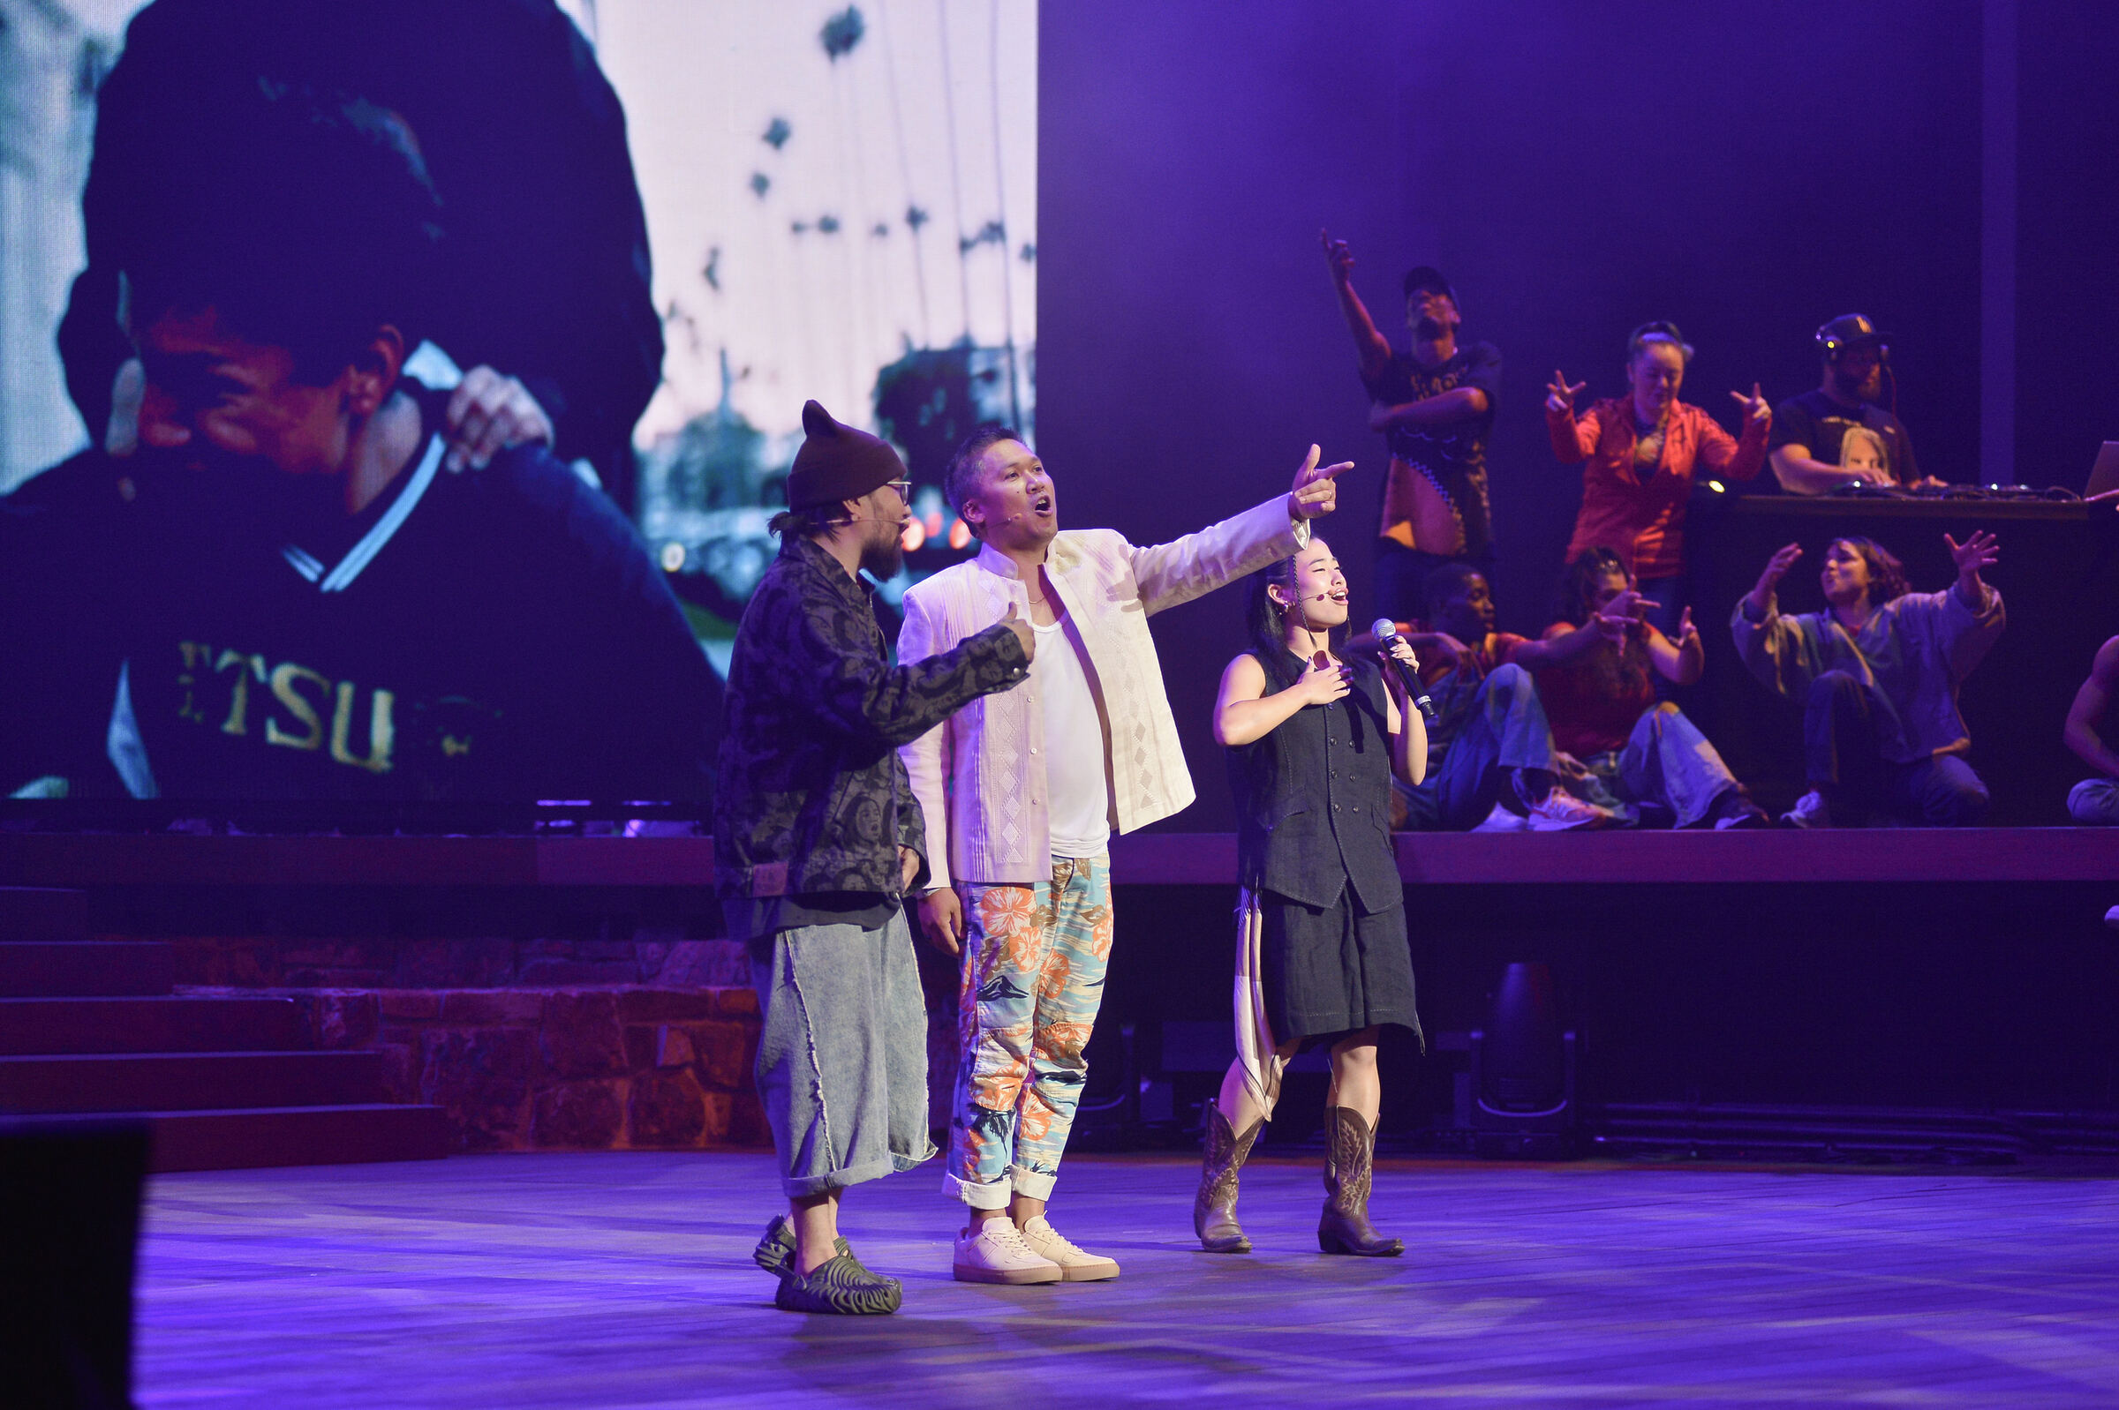
AUG 2025
OCT 2025
JAN 2026
JUN 2027
THE PILOT
THE ALBUM
THE AWAKENING
THE SHOW
1,000+ tickets · Ford
30K listens · wk one
1,400+ submissions
opens · 18-mo run
THE SIGNAL IS CLEAR. THE DEMAND IS VERIFIED.
This is the show
Los Angeles has been missing.
Three chapters in, the city's verdict was unambiguous — and the press said it back.
"A rich, moving experience. The poetry, dance, and film came together beautifully."
"A powerful celebration of LA's diversity and resilience. Unforgettable."
"Brilliant storytelling. A groundbreaking approach to history, modernity, place, and people. This show changes everything."
— Jodie Foster & Alex Hedison
— Reina Pereira
— Aloe Blacc
06 · THE SHOW
06 / 19

Slide 7
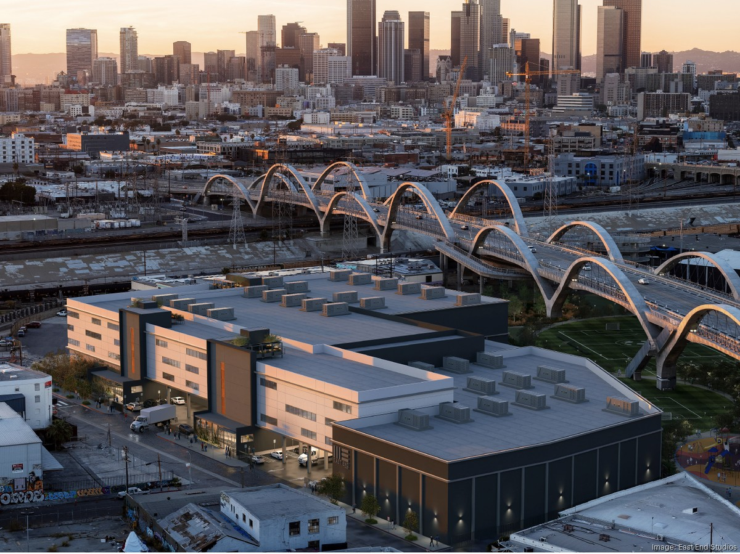
AN IMMERSIVE THEATRE EXPERIENCE · LOS ANGELES · 2027
If I Awaken in Los Angeles.
A 90-minute immersive theatrical experience that walks guests through the real Los Angeles — captured inside a 30,000-sq-ft converted studio in the Arts District, next to the iconic 6th Street Bridge.
An LA recreated and reimagined. Guests are guided through built sets and live performances spanning every neighborhood and culture that makes the city what it is.
07 · THE EXPERIENCE
07 / 19

Slide 8
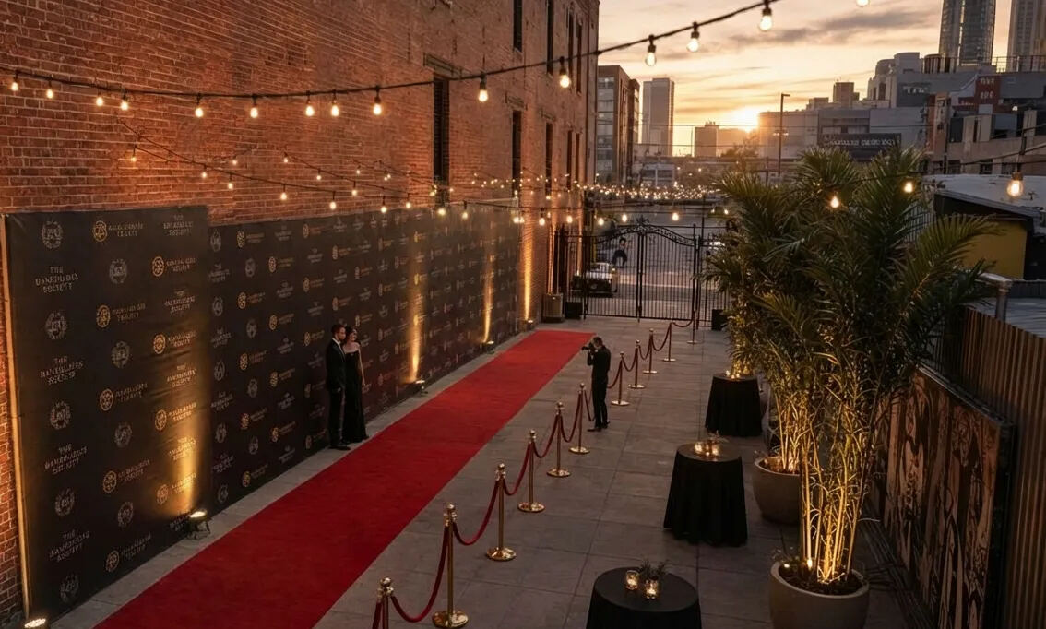
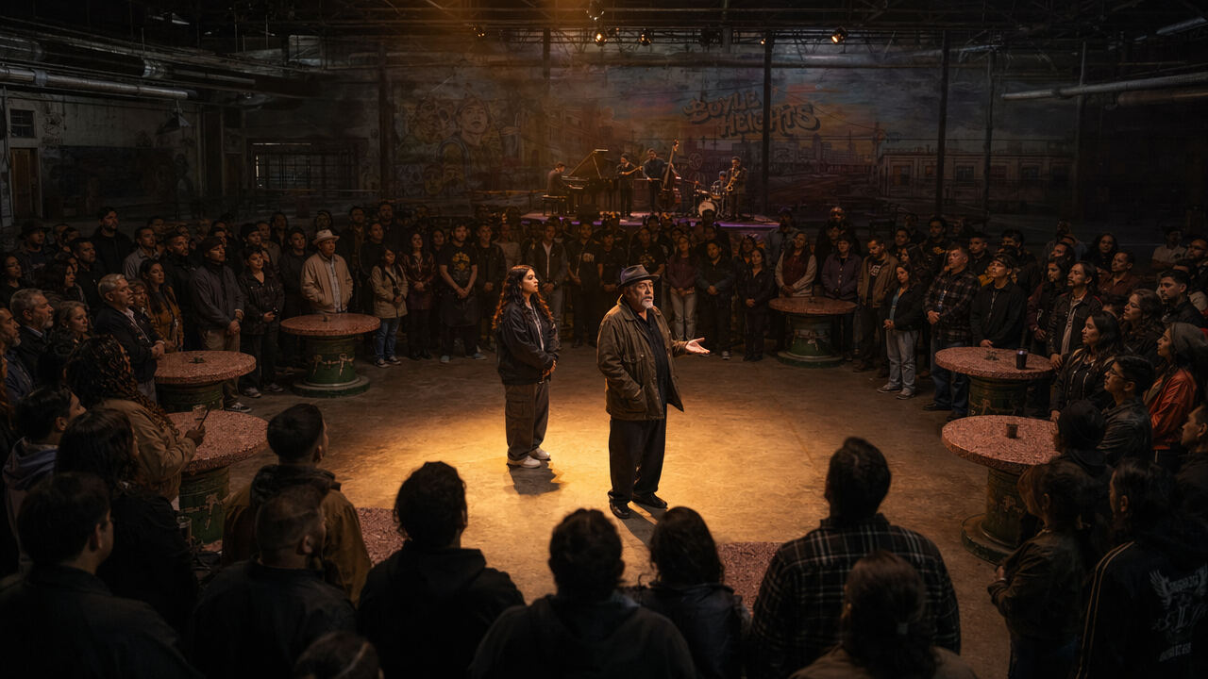
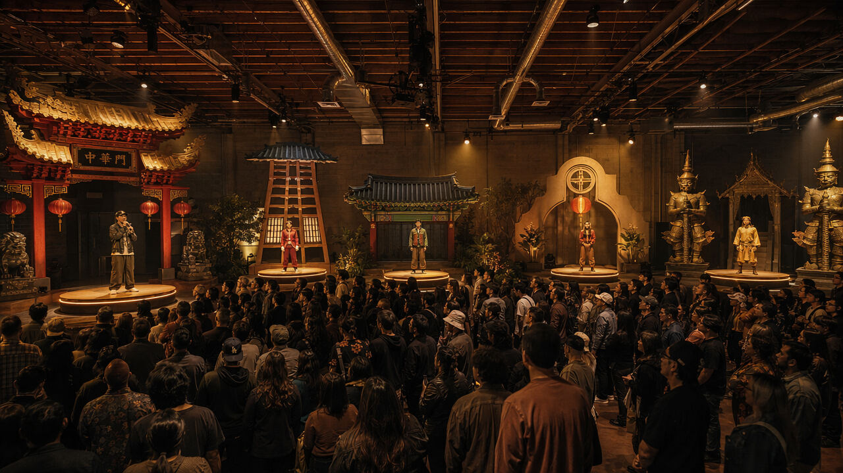
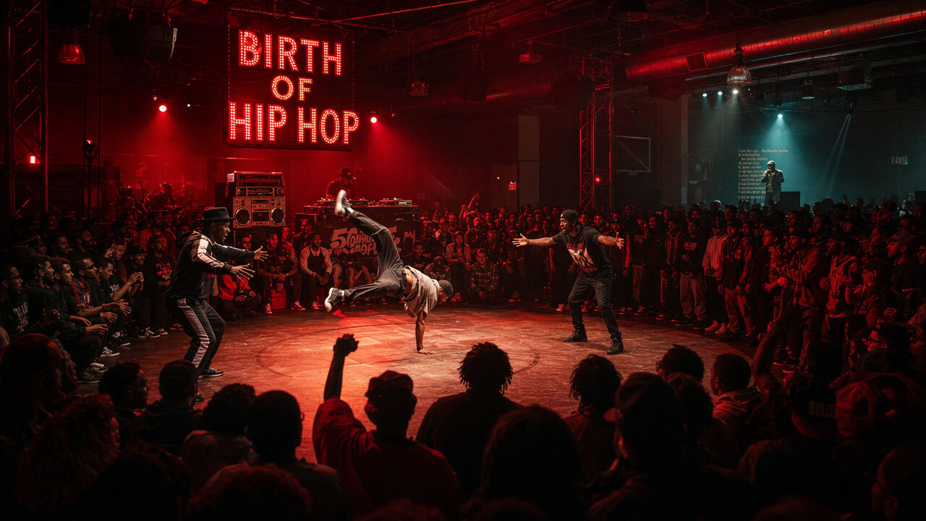
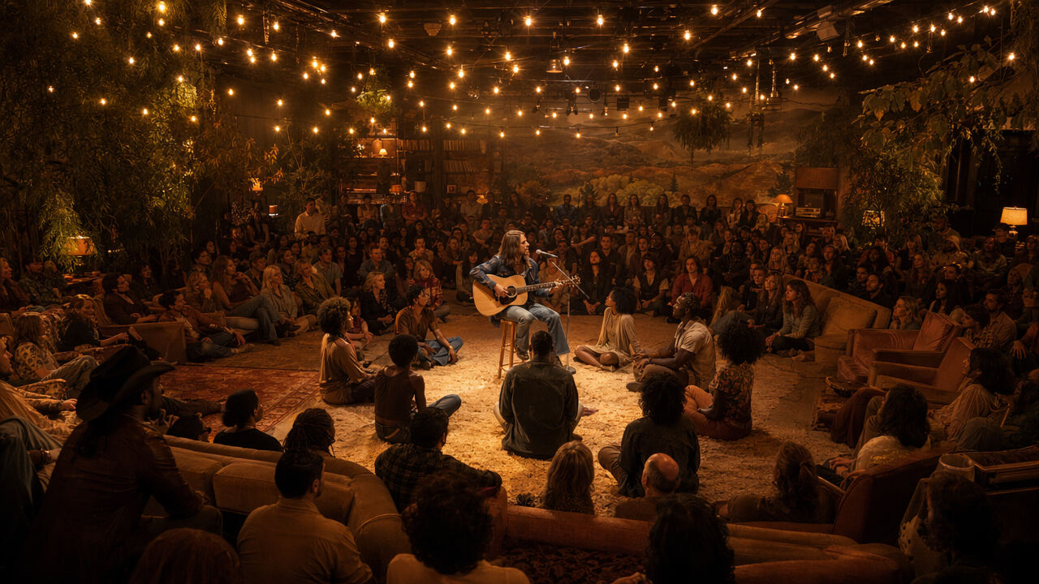
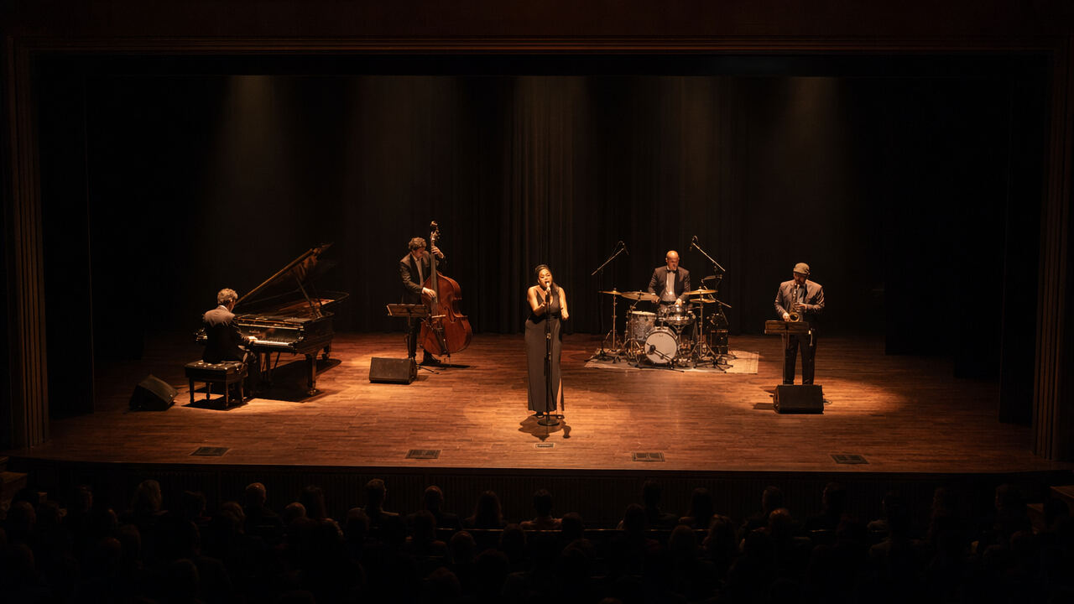
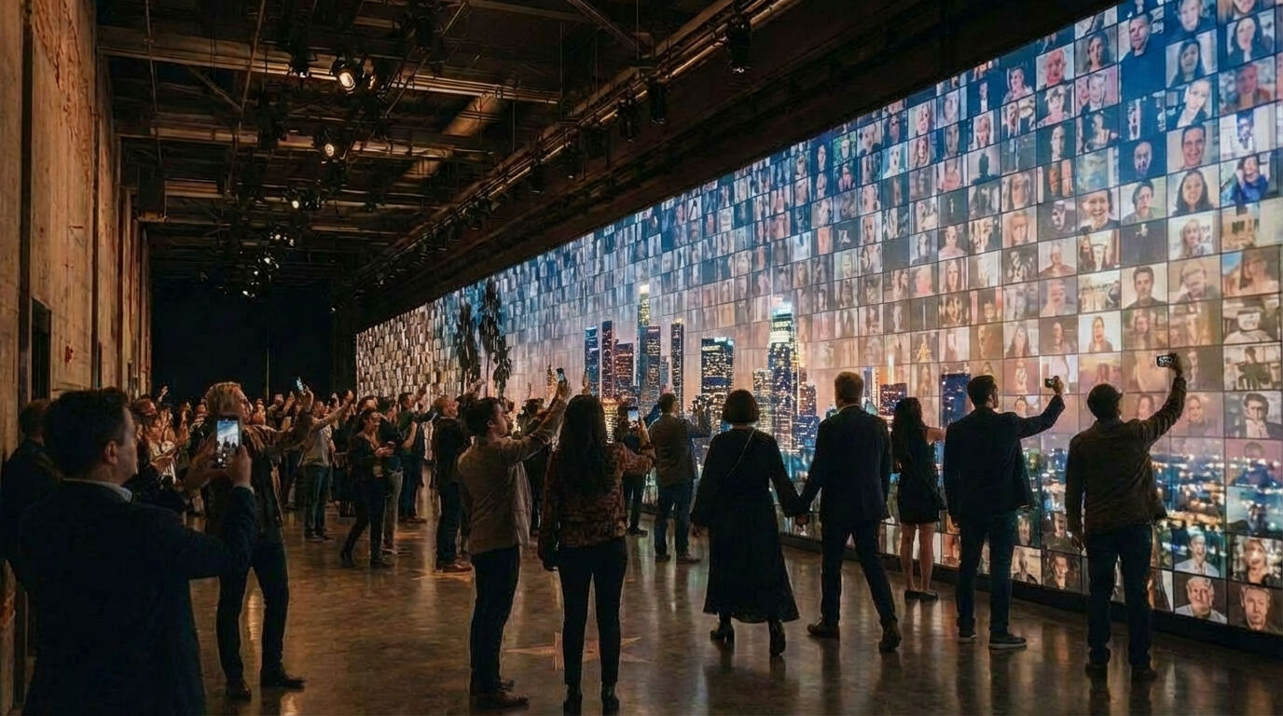
THE WALK
Seven neighborhoods, one continuous walk.
From the red carpet to the real LA. No seats until the finale.
01
02
03
04
HOLLYWOOD BOULEVARD
BOYLE HEIGHTS
THE ASIAN ARC
BLACK LA · A CENTURY
A 110-foot LED wall. Dancers as tourists. The Walk of Fame underfoot. The wall pivots — and the tour breaks open.
A tianguis with stone tables and a band stage where two poets meet across a generation.
Chinatown · Little Tokyo · Koreatown · Filipinotown · Thai Town. One rapper-poet walking the line.
A church wall opens — gospel choir, swing dance at Dunbar, hip-hop cypher, Leimert Park drum circle.
05
06
07
FOLK LA · LAUREL CANYON
THE STAGE
THE REAL LA
08 · THE JOURNEY
08 / 19
A knock at a door becomes a living room. The band joins the audience on the floor.
A classical proscenium. The only seated room. A finale that earns its formality.
Back through the corridor we entered — but this time the wall is made of the audience's own faces.

Slide 9
WHAT WE ARE BUILDING
A single, continuous, 100-minute room.
SQ FT
GUESTS
MINS
30.1K
150
100
WAREHOUSE FOOTPRINT
PER SHOW
RUN TIME
ARTS DISTRICT, LOS ANGELES
WALKING, IMMERSIVE, SINGLE-DIRECTION LOOP
SEVEN SPACES ONE CONTINUOUS ARC
SHOWS
MONTH
STAGES
12
14+
7
PER WEEK
PROD. RUN
BUILT ENVIRONMENTS
TUESDAY THROUGH SUNDAY
JUNE 2027 — AUGUST 2028
+LOBBY THAT DOUBLES AS THEATRE
09 · WHAT WE'RE BUILDING
09 / 19

Slide 10
THE TEAM
The credentials behind building the room — and representing the city.
TO BUILD AT THIS SCALE
TO REPRESENT LOS ANGELES
From Tony Award–winning producers, Grammy-winning music, Broadway immersive theatre, Coachella, Stagecoach, the Grammys, the Super Bowl, and the White House — we have the team to handle the scale.
With two decades of LA community trust, LAUSD-approved programs, the country's largest live spoken-word events, and multi-stage festival production — we have the team to represent Los Angeles.
ANDREW SCOVILLE
DERRICK HODGE
DIANE LUBY LANE
DIRECTOR
COMPOSER · 2× GRAMMY
CREATOR & LEAD PRODUCER
Director, Theater of the Mind (David Byrne). Assoc dir, Broadway's Here Lies Love. Director, Netflix's Money Heist: The Experience.
Wrote the Ford pilot. Continues to shape the show's musical language through the album and the run.
Founder & CEO of Get Lit – Words Ignite (200+ schools). Patterson Award. Presidential Lifetime Volunteer.
SHANE SNOW
ROB O'NEILL
GINA BELAFONTE
PRODUCER · TONY
PRODUCER · TONY
PRODUCER · DIRECTED PILOT
Tony Award–winning producer. Bestselling author. Pulitzer Prize entrant for journalism.
Tony winner as co-producer of The Outsiders (Broadway 2024). Co-prod, The Who's Tommy, Burlesque.
Award-winning producer, director, activist. Co-founder & E.D., Sankofa.org.
BRANDON XIV
MARK CHINAPEN
MONIQUE MITCHELL
LEAD PRODUCER
GENERAL MANAGER
PRODUCER
Co-founder of SHOWRUNNER. Award-winning across film, tech, and the seam between.
Multi-stage ops for Coachella and Stagecoach. Custom staging for the Grammys and World of Dance.
Global campaigns (Puma, Lexus, Fox), A24, NY Times. Helped pass CA SB 933 — $50M for arts ed.
10 · THE TEAM
10 / 19

Slide 11
MARKET OPPORTUNITY · COMPARABLES
This is the show Los Angeles has been missing.
Every great cultural capital has its iconic live experience — the must-see, the staple, the show built for that city. Here's what those shows are worth in their markets:
NEW YORK CITY
LAS VEGAS
NASHVILLE
Sleep No More
Meow Wolf
Grand Ole Opry
2M+
3M
250K+
total visitors
annual visitors
annual visitors
$200M+
$300M+
$15M
lifetime ticket gross
raised · scaled from $9.2M single location to a national platform
annual revenue
LONDON
PARIS
LOS ANGELES
Secret Cinema
Moulin Rouge
If I Awaken in Los Angeles
1M+
600K
—
tickets sold
annual guests
opens June 2027
$100M+
$68M
$9.5M
acquisition
annual revenue
raise · chapter one
11 · MARKET · COMPARABLES
11 / 19

Slide 12
MARKET OPPORTUNITY · LOS ANGELES
The entertainment capital of the world — about to enter its global spotlight.
Greater Los Angeles is home to 18M+ people, nearly 50M annual visitors, with LA tourism generating $40.4B annually in business sales — and currently has no defining live experience of its own.
CITY | RESIDENT MARKET | ANNUAL VISITORS
New York City | 20M–22M | 64M
Los Angeles | 18M+ | 49M / nearly 50M
Paris | 12M–15M metro | 48.7M
Las Vegas | 2.3M+ | 40M+
London | 9M / 15M metro | ~30M / 21M intl
Nashville | 2.2M+ | 16.9M
AND LA IS ABOUT TO BE ON THE BIGGEST STAGE
15M
additional visitors / spectators · 2028 Olympics
5B
global viewers
$18B
estimated economic impact
We have a show built for an Olympic moment.
In a once-in-a-generation window of opportunity.
12 · MARKET · LA + OLYMPICS
12 / 19

Slide 13
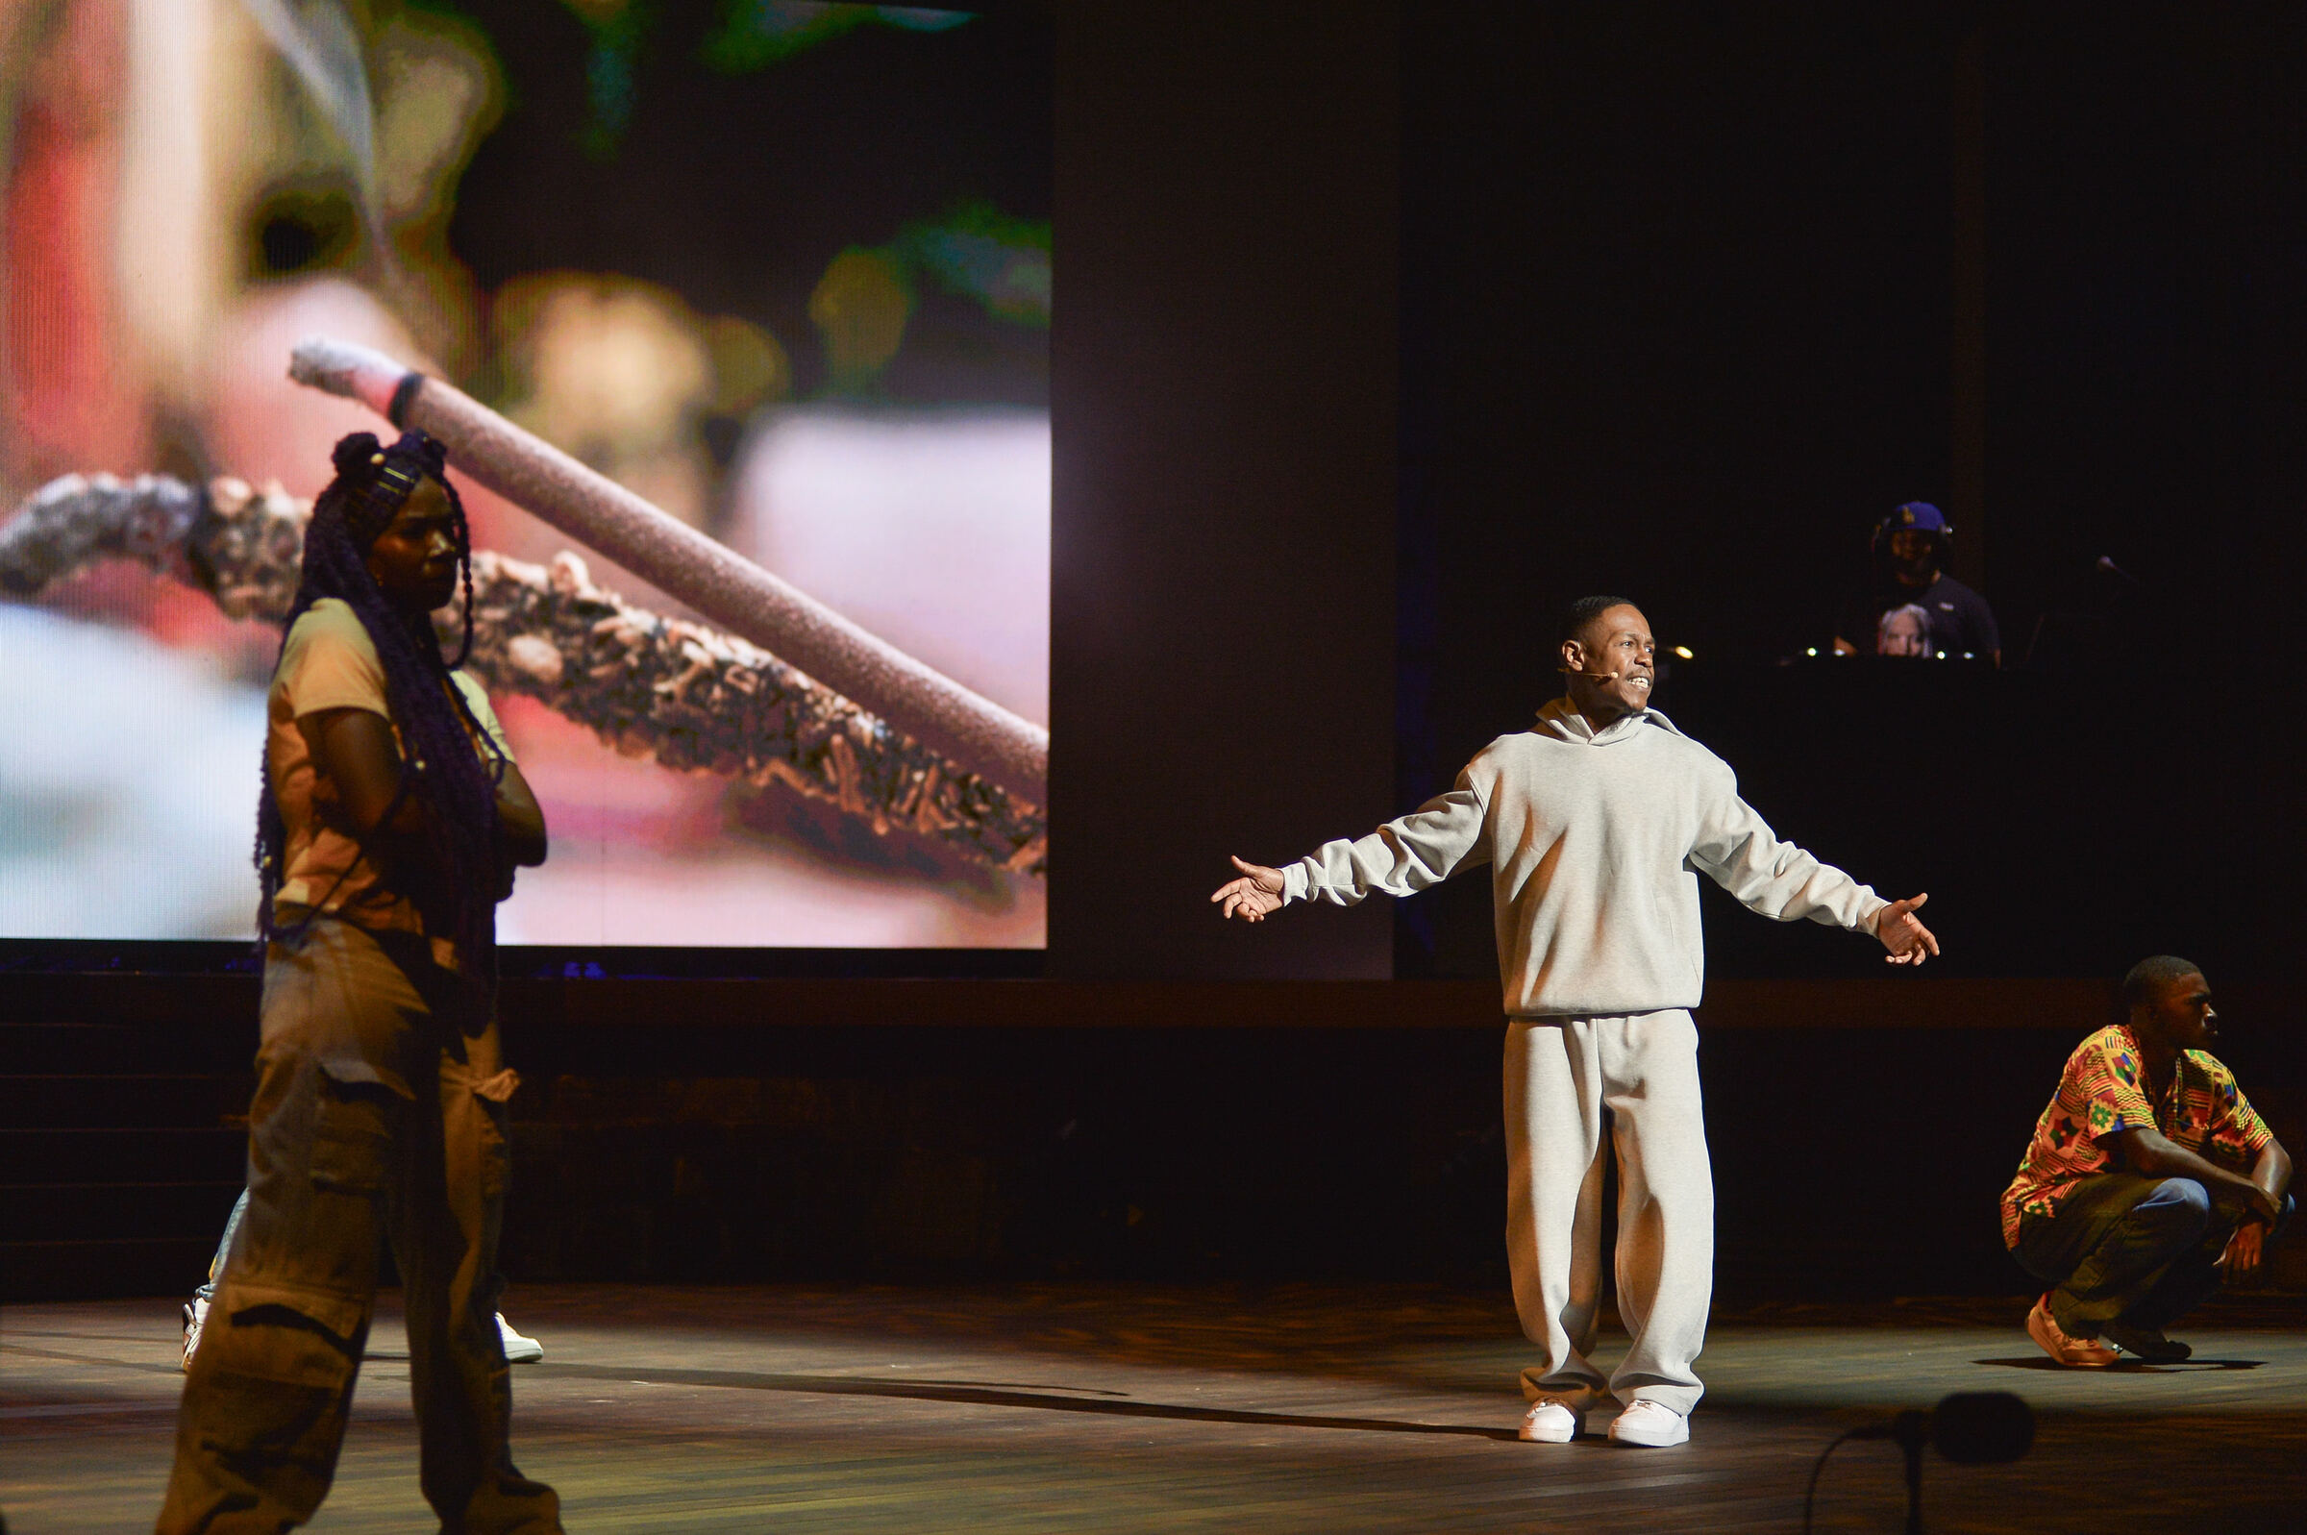
IF I AWAKEN… IN EVERY CITY
LA is chapter one of a replicable franchise.
The form travels because the form is honest: tell the truth about a place through the people who live there. Same architecture, new local cast, new revenue line — every city is a new chapter.
CITY | RESIDENT MARKET | ANNUAL VISITORS
New York City | 20M–22M | 64M
Los Angeles | 18M+ | 49M / nearly 50M
Paris | 12M–15M metro | 48.7M
Las Vegas | 2.3M+ | 40M+
London | 9M / 15M metro | ~30M / 21M intl
Nashville | 2.2M+ | 16.9M
CHAPTERS TO COME
If I Awaken in
If I Awaken in
If I Awaken in
NEW YORK
CHICAGO
LONDON
13 · THE FRANCHISE
13 / 19

Slide 14
THE ASK · 3 ROUNDS OF INVESTMENT
We are seeking $9.5M total, split across three rounds.
01
ROUND ONE · PREPRODUCTION
02
ROUND TWO · PRODUCTION
03
ROUND THREE · LAUNCH
$1M
$7M
$1.5M
opens June 1, 2026 · closes Q3 2026
opens January 1, 2027 · closes Q2 2027
opens June 1, 2027 · closes Q4 2027
STRUCTURE
STRUCTURE
STRUCTURE
Equity + profit-sharing
Profit-sharing only · no equity
Profit-sharing only · no equity
EQUITY OFFERED
MINIMUM
MINIMUM
$1M for 10% equity
$50K · Class A LP units
$50K · Class A LP units
USE
USE
USE
Design dev · venue lease · advance marketing
Venue build · production · cast · install · marketing · reserve
Launch marketing · operating reserve · contingency
UPSIDE
RECOUPMENT
RECOUPMENT
Equity participates in acquisition / licensing / expansion
First-position 110% recoupment · 50/50 net profit
First-position 110% recoupment · 50/50 net profit
14 · INVESTMENT ROUNDS
14 / 19

Slide 15
ROUND ONE · EQUITY INVESTMENT
Only Round One investors get equity in the show.
$1M
10%
for
EQUITY UP FOR GRABS
Round One investors hold equity through the LA run, the events business, the franchise, and any liquidity event that follows. They also participate in the profit-share. Rounds Two and Three are profit-share only.
HOW EQUITY MAKES MONEY · ACQUISITION COMPARABLES
EXPANSION & LICENSING
COMPANY | BUYER | AMOUNT
Cirque du Soleil | TPG / Fosun / CDPQ | ~$1.5B
Secret Cinema | TodayTix Group | $100M+ / ~£88M
Blue Man Group | Cirque du Soleil | ~$65.5M
→
Sleep No More
— expanded to Shanghai and Seoul
→
Meow Wolf
— six immersive installations across the U.S.
→
Secret Cinema
— 50+ productions; Disney, Marvel, Netflix
Round One investors also participate in the profit-share alongside Rounds Two and Three.
15 · ROUND 1 · EQUITY MODEL
15 / 19

Slide 16
FINANCIAL PROJECTIONS · TICKET SALES
Two thresholds. One investor return curve.
TO KEEP THE SHOW RUNNING
FOR INVESTORS TO RECOUP
PILOT-LEVEL DEMAND
61%
75%
100%+
capacity · ~92 of 150 avg seats / show · breakeven
capacity · the threshold at which investors recoup 110% within the 18-mo run
capacity · what the Ford pilot actually did · oversold
RETURN PROJECTIONS — AFTER 14 MONTHS
If we sell 80% of tickets
~$3.2M net contribution
If we sell 90% of tickets
~$4.4M net contribution
If we sell 100% of tickets
~$5.5M net contribution
Net contribution after operating costs & recoupment. Pilot at the Ford oversold at 100%+. Projections assume the run begins June 2027; numbers expand further with events business (next slide).
TIER | SEATS / WK | AVG $ | WEEKLY $
Community | 520 | $50 | $26,400
Standard | 720 | $83 | $58,800
Premium | 480 | $132 | $63,000
VIP · Saturday only | 80 | $185 | $14,800
16 · FINANCIALS · TICKETS
16 / 19

Slide 17
FINANCIAL PROJECTIONS · CORPORATE EVENTS
210 dark day-equivalents. All six differentiators.
The show occupies the venue Thursday–Sunday evenings and weekend afternoons. Monday through Wednesday — and weekday daytime — sit dark. Roughly 3.5 fully rentable days/week × 60 weeks = ~210 day-equivalents of unused premium real estate.
WHAT WE HAVE
RUN-PERIOD REVENUE
110-ft permanent LED wall
$5K–$20K / day
SCENARIO | GROSS | NET
Conservative ~30% | $540K | +$405K
Moderate ~50% | $1.13M | +$847K
Aggressive ~65% | $1.82M | +$1.37M
Real bar program
$8K–$15K / day
150-seat proscenium theater
$5K–$10K / day
Outdoor red-carpet courtyard
Premiere-tier
30,000 sq ft of versatile space
$10K+ / day comp
Arts District location
Premium tier
WHAT WE SELL
MOST LA VENUES OFFER ONE OR TWO. WE HAVE ALL SIX.
Full venue buyout · premieres
$25K–$45K
Single-space rental · launches
$6K–$12K
Production / filming
$8K–$18K / day
Recurring programs · comedy
$2K–$5K
17 · FINANCIALS · EVENTS
17 / 19

Slide 18
A NOTE FROM THE CREATOR · DIANE LUBY LANE
In Los Angeles, things take root.
People from all over the world feel this — and so they flock here, the dreamers, the wanderers, the immigrants, in search of a chance, a rebirth, a fresh start. And the city receives them.
Los Angeles has loved us.
With this show, we offer that love back.
— Diane Luby Lane · Creator
18 · NOTE FROM THE CREATOR
18 / 19

Slide 19
RESERVE YOUR PLACE IN ROUND ONE
Be part of
the awakening.
TO RESERVE OR LEARN MORE
ROUND ONE CLOSES
press@ifiawaken.la
Q3 2026
ifiawaken.la · @ifiawaken
Doors open · June 2027
IF I AWAKEN IN LOS ANGELES · PITCH 2026
AN IMMERSIVE THEATRICAL TOUR OF THE REAL LOS ANGELES

