Slide 1
Writing at scale
Content management with structured content, topic-based writing, and single-source publishing
Write the Docs SLC | January 2019
Notes:
Tonight, we’ll talk about structured content, topic-based writing, and single-source publishing.

Slide 2
What are we doing here?
What this discussion is
What this discussion isn’t
An overview of structured content, topic-based writing, and single-source publishing and how they can benefit you
Includes some rudimentary examples
A thorough exploration of structured content, topic-based writing, and single-source publishing
An examination of tools
An implementation guide
Notes:
But first, let’s level.

Slide 3

Content management
Notes:
Really, we’re talking about content management. How do you feel when looking at your collection of documents? If it’s anything like me, this image is eerily reminiscent of my day-to-day.
What works with a simple blog or small-scale help library quickly becomes unsustainable at larger scales. The way you think about content needs to change. The tools and structures you use will also likely need to change.
There are three ideas or methodologies that prove particularly helpful at scale.

Slide 4
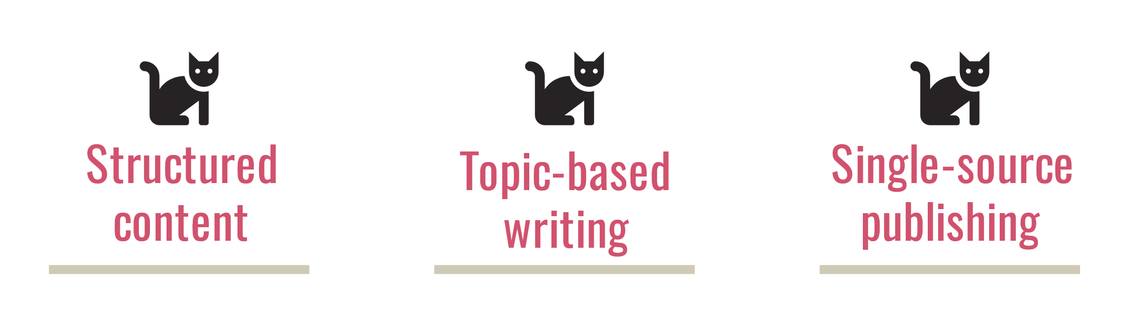
Better together
Often XML
Separates words from look and feel
Content reuse (single source)
Better quality
Produces multiple outputs from one project (html, PDF)
Notes:
Each of these could be a presentation on their own. You’ll need to do your own research to get the most out of these, because we’re mostly looking at the high-level stuff today.
Let me be clear: these things often don’t make much sense in regards to cost/benefit unless you’re writing at a larger scale. Tools and training for these are often expensive and unnecessary for small projects.

Slide 5

Structured content
“Content, whether in a textual, visual, or playable format, that conforms to structural and semantic rules that allow machine processing to meet specific business requirements.” .
Rahel Bailie – The Language of Content Strategy
So… what?
Basically, you build content in chunks that machines can understand and do cool things with.
Notes:
In a nutshell, structured content’s goal is to separate content from presentation.
Structured content basically means putting virtual boundaries around discrete chunks of information. Then, you define how those chunks of information are supposed to behave.
Many content management tools handle all of this automatically behind the scenes.
It can be as simple as Word styles or as complicated as XML and databases.
---Word sample---
Let’s start with what simple structured content looks like. Word Styles could be considered a form of structured content. They’re visual rules that can be applied to discrete chunks of content.
Let’s now look at what structured content is not.
---XML sample, no styles---
XML is the most common tool in the structured content world. XML is a markup language (like HTML) designed to store and transport data. XML serves as a framework that allows you to semantically define data elements.
---XML sample, with styles---
Element attributes add another layer to structured content. They allow you to be more specific about what kind of information each element contains. In turn, that let’s whatever tools you’re using know which content should be included and which should be excluded.
Benefits
Portable, reusable content
Reduce translation cost/complexity
Enforce style and branding guidelines
References
https://gathercontent.com/blog/whats-deal-structured-content

Slide 6
Topic-based writing
“Everyone agrees that we should be writing in topics. (Okay, not everyone, probably, but everyone who is likely to read this blog.) Everyone agrees we should write in topics. But no one agrees on what a topic is.” .
Mark Baker – “What is a topic? What does standalone mean?”
So… what is a topic?
A discrete, complete, piece of information that can stand on its own.
Notes:
Instead of writing linearly, like a complete chapter, approach content as discrete chunks. Each chunk, or topic, can be added, removed, or ordered as necessary.
You can create chapters and larger documents by adding a topics in a container.
Benefits
Content reuse (single source)
Standardization
Modularity and maintenance

Slide 7
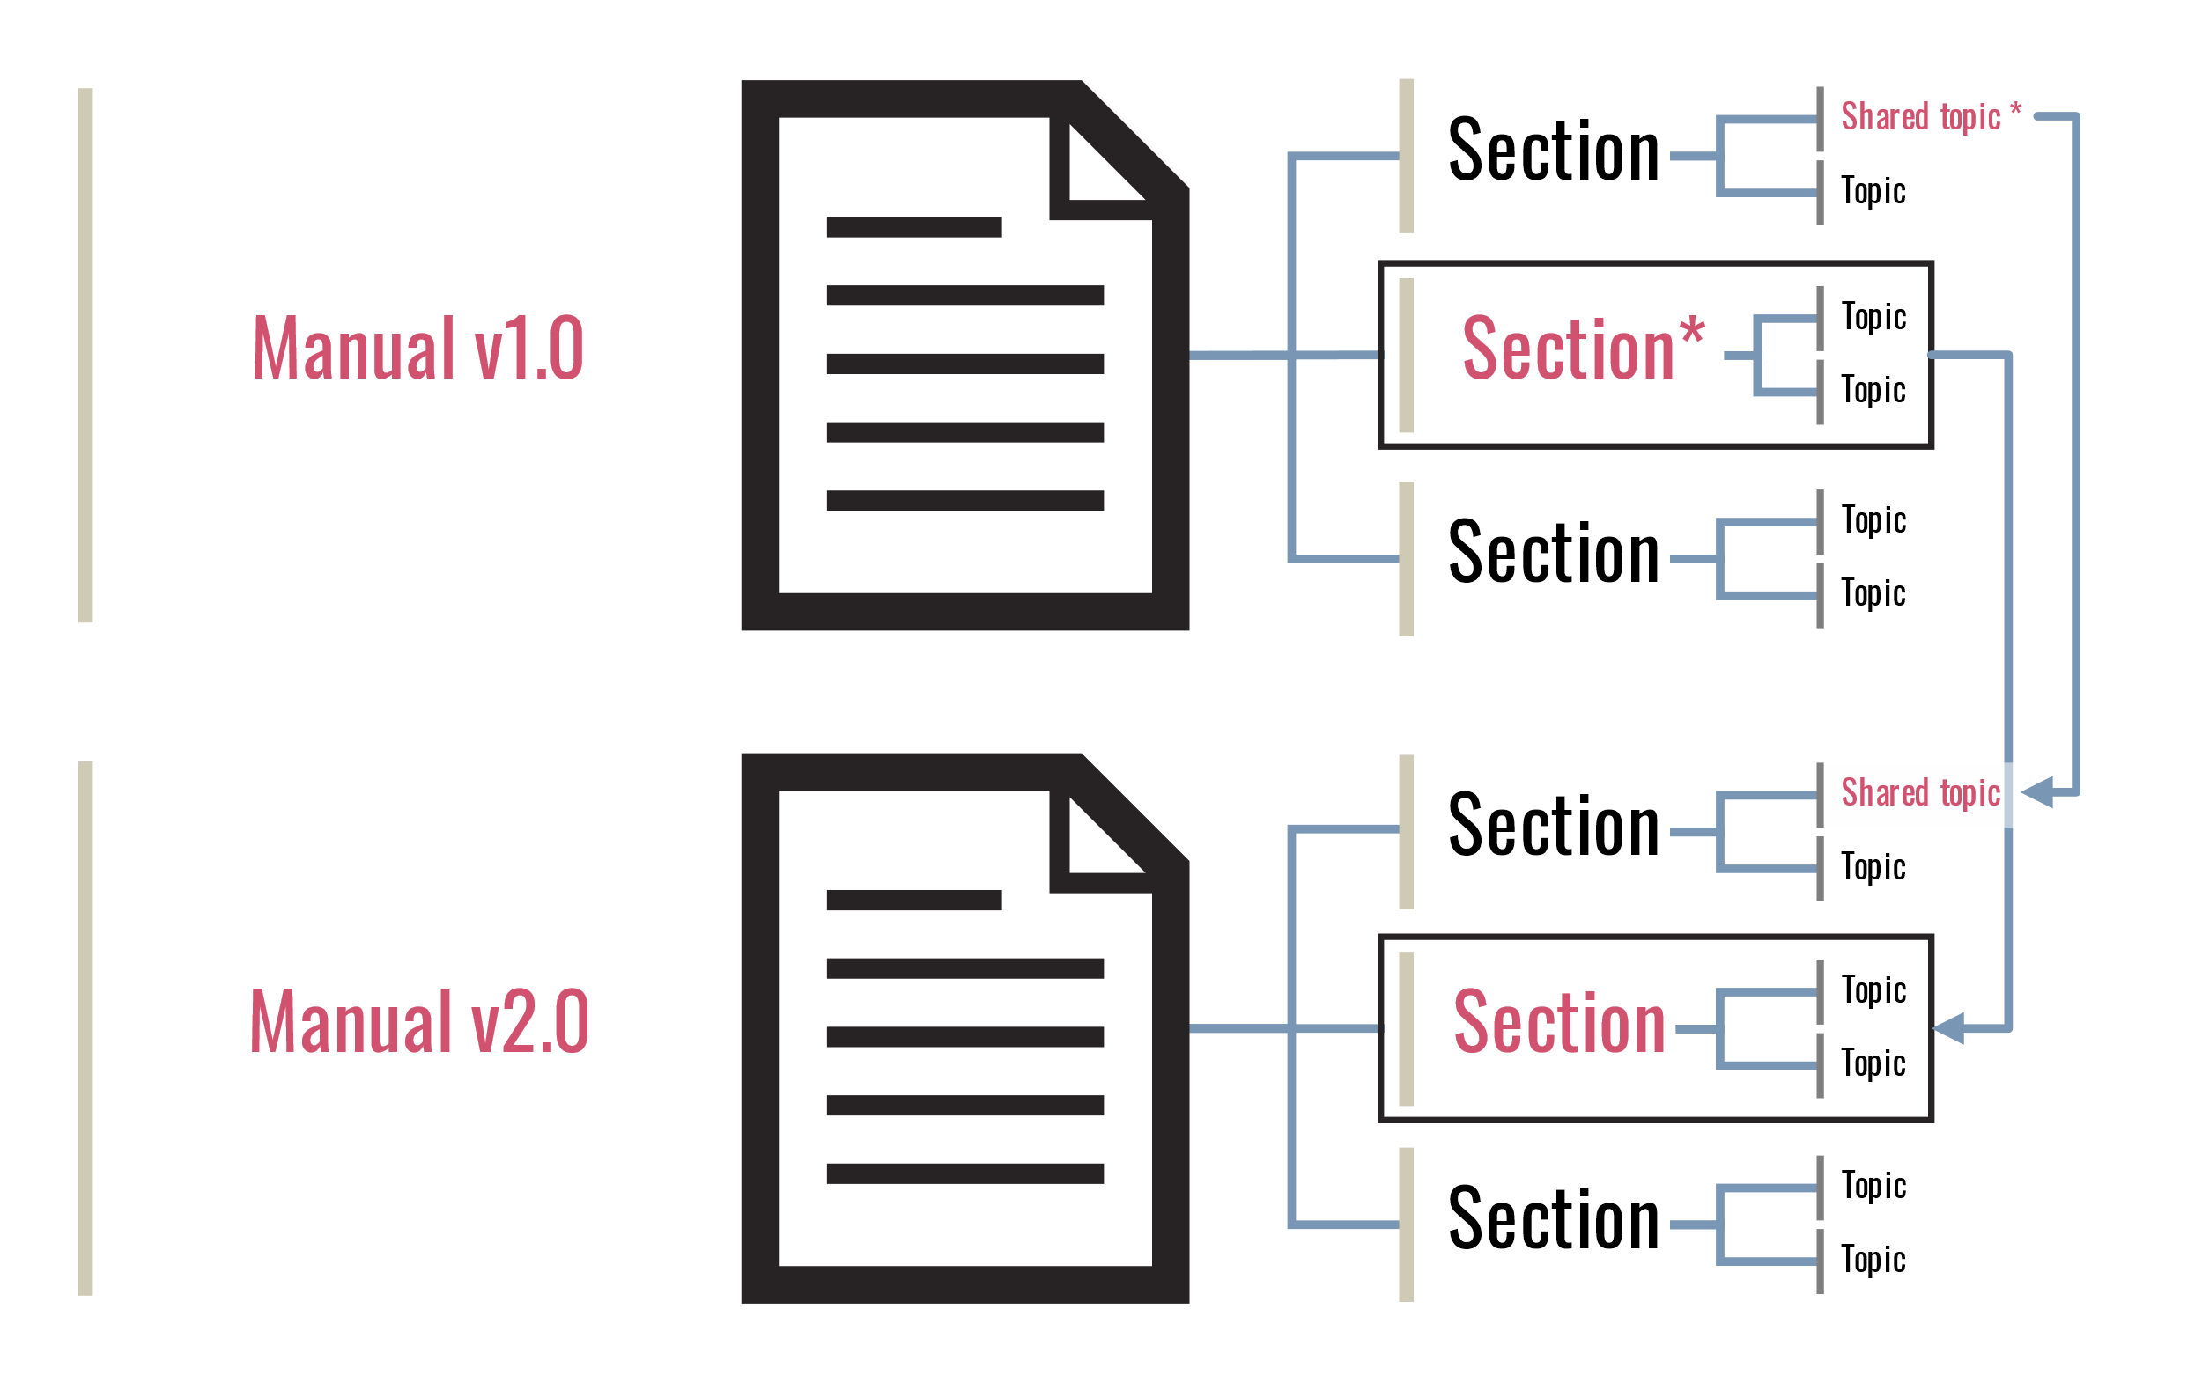
Notes:
Content reuse

Slide 8
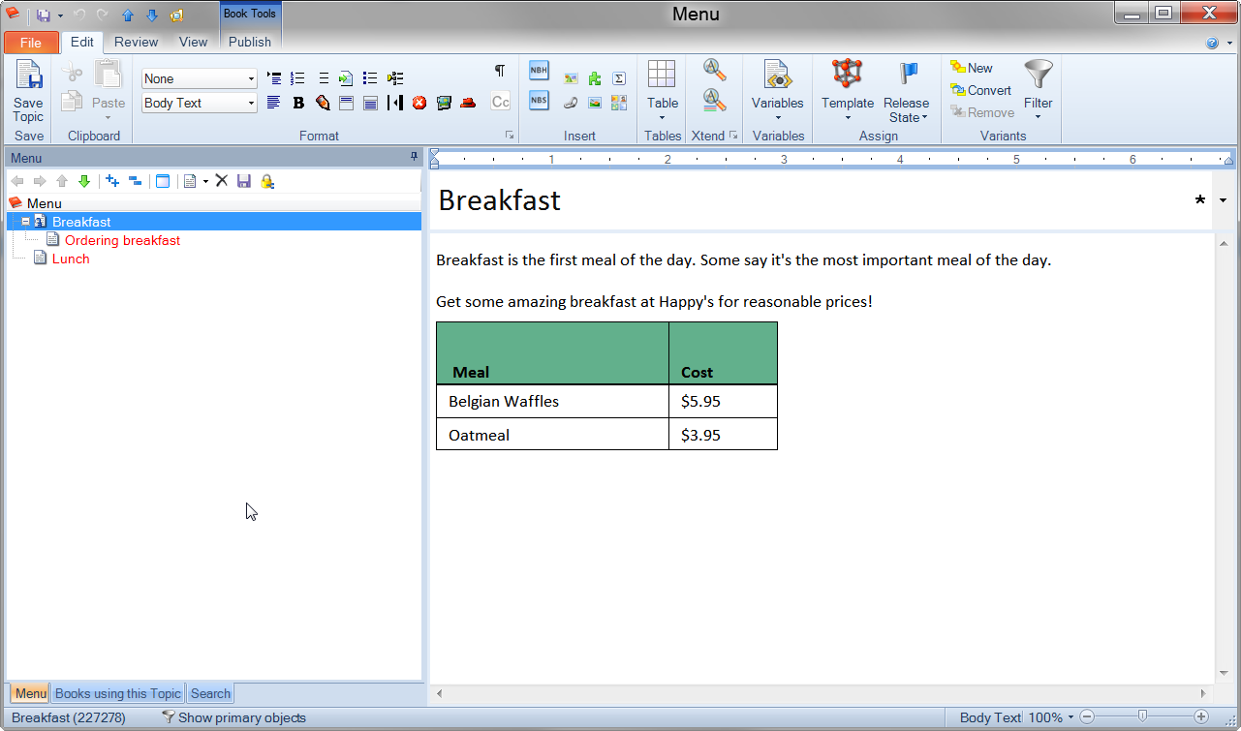
Notes:
How you organize topics is a matter of information architecture.

Slide 9
Single-source publishing
“The term “single sourcing” is used to mean a number of different things in tech comm and content strategy. Among them:
Producing PDF and Web pages (or help) from the same source file or files.
Content reuse (in other words, storing a single source for a piece of information and publishing it in various places).
Using a single repository/file format for all content.” .
Mark Baker – “Is Single-Sourcing Dead?”
So… which is it?
We’ll look at single-source publishing in the sense of content reuse (second bullet).
Notes:
Single source publishing ties everything together.

Slide 10
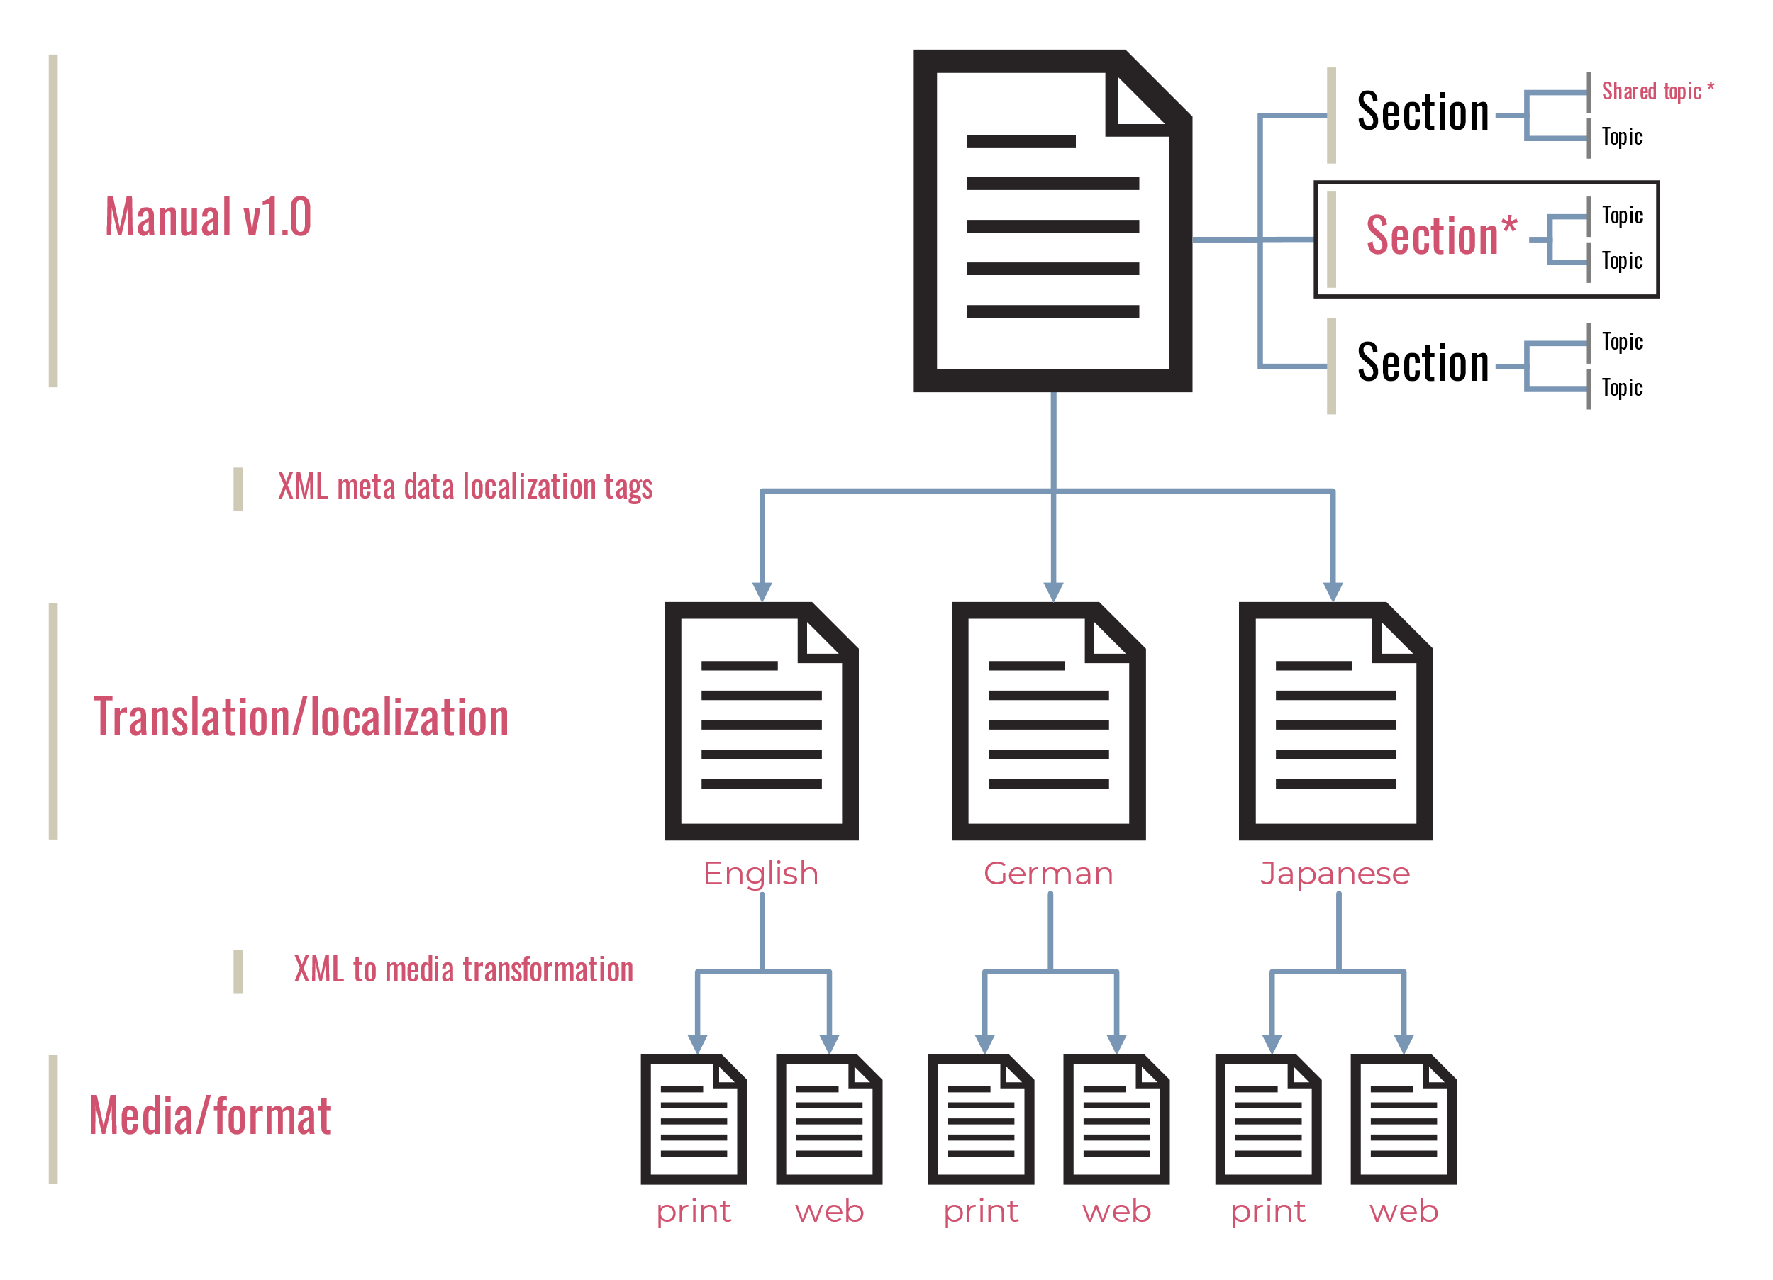

Slide 11
Tools
Help Authoring Tools (HATs)
Static site generators
MadCap Flare
Author-it
Robohelp + Framemaker
ArborText
Oxygen XML Author/Editor
List: https://www.g2crowd.com/categories/help-authoring-tool-hat
Jekyll
Hugo
Sphinx
A million others
List: https://www.staticgen.com/

Slide 12
Learn more…
Structured content
Structured content: https://www.dnnsoftware.com/blog/what-is-structured-content-definition-benefits-and-how-to-get-started
Structured writing: https://www.goodreads.com/book/show/41885955-structured-writing
XML: https://www.w3schools.com/xml/default.asp
Topic-based writing
Reuse: http://www.rockley.com/articles/MEC_Chapter_2.pdf
Topic types: https://everypageispageone.com/2012/07/28/the-tyranny-of-the-terrible-troika-rethinking-concept-task-and-reference/
DITA: https://learningdita.com/about/
Single-source publishing
Single-source publishing models: https://idratherbewriting.com/2016/02/11/the-problem-with-single-source-publishing/

Slide 13
Thank you!
General references
Contact
https://en.wikipedia.org/wiki/Semi-structured_data
http://neostc.org/cmswp/wp-content/uploads/2016/12/LnL_2004_IntroStructuredXML_SAbel.pdf
https://techwhirl.com/three-musketeers-of-technical-content-structure-writing-publishing/
Kyle Rollins
LinkedIn https://www.linkedin.com/in/kyle-blank-rollins/
WTD Slack krollins

