Slide 1


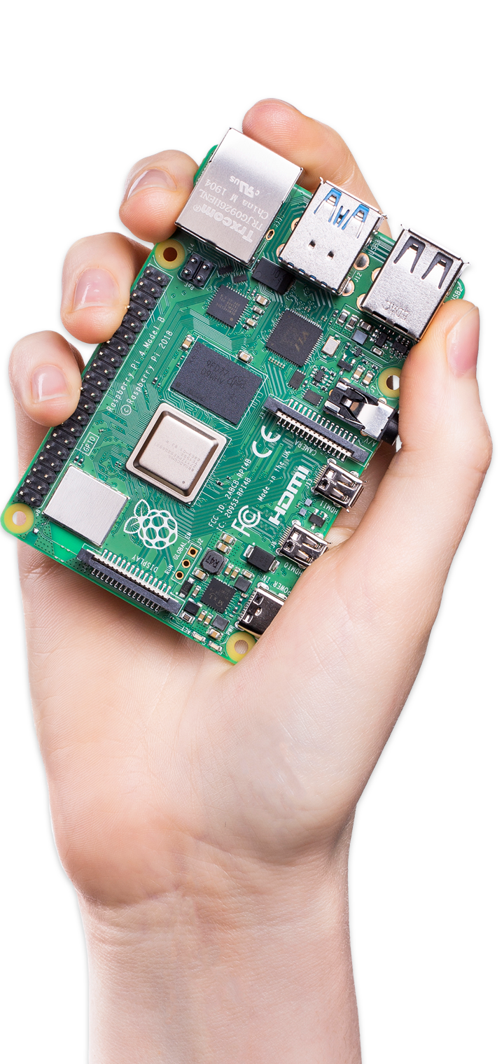



Raspberry Pi 4
计算机与信息安全学院21级小学期暨
第二届“智慧机器，以芯起航”
树莓派培训
Your tiny, dual-display, desktop computer
…and robot brains, smart home hub, media centre, networked AI core, factory controller, and much more

Slide 2
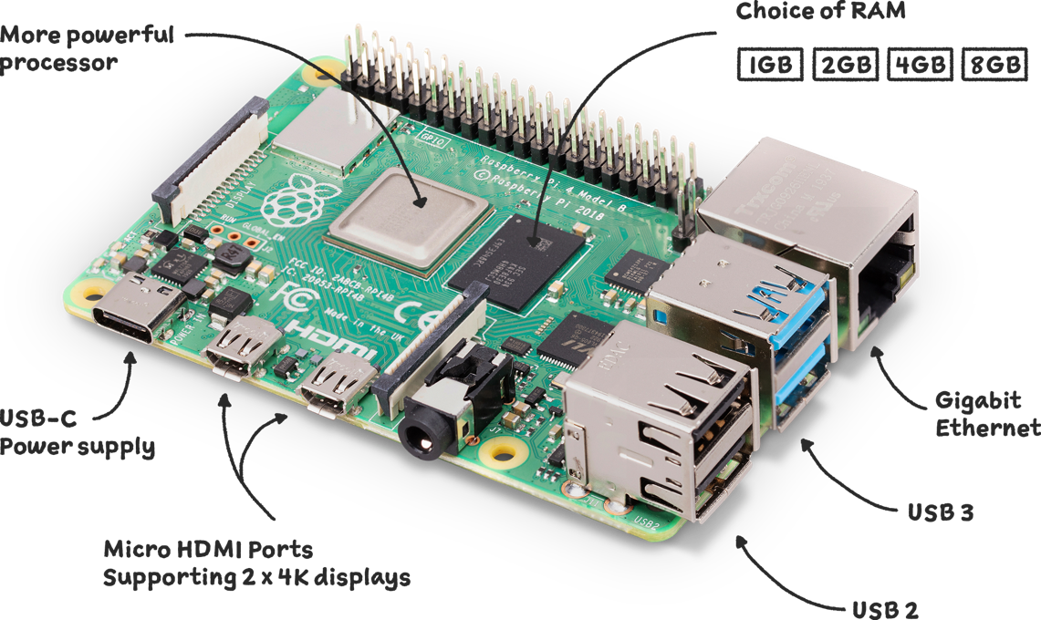

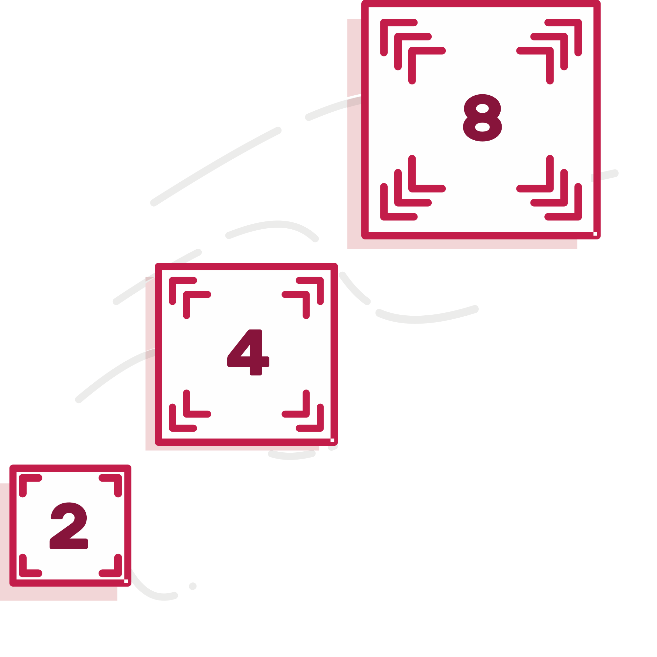
Raspberry Pi 4 Faster, more powerful
Raspberry Pi 4 comes with Gigabit Ethernet, along with onboard wireless networking and Bluetooth.
We're making different variants of the Raspberry Pi 4 available, depending on how much RAM you need — 1GB, 2GB, 4GB, or 8GB.

