Slide 1

AGROWNEX-AI System for Next-Gen Weather Insurance Pricing
(Minor project presentation)
Presented By:
Shakti Prosad Dey (Roll No. 23124100)
Mohammad Aslam(Roll no: 23124065)
Under the supervision of
Dr. Vijay Kumar
Associate Professor & Head
Department of Information Technology
Dr. BR Ambedkar National Institute Of Technology , Jalandhar

Slide 2
Table of contents
1. Project Objective
2.Why Agrownex matters?
3. Tools and Technologies
4. Core Modules
5.User workflow
6. Challenges and Next Steps
7.Initial implementation of Agrownex
8. Market analysis
9. Conclusion

Slide 3
Project Objective
01
02
Weather-Based Risk Analytics
AI-Assisted Guidance
Deliver real-time weather forecasts, geolocation-based climate data, and comprehensive climatology charts to assess agricultural risk accurately.
Provide an intelligent chat assistant with voice and text support, offering instant answers to insurance queries with fallback resilience.
03
04
Dynamic Quote Generation
Scalable Deployment
Streamline insurance quote calculation by integrating weather data and risk models into an automated, user-friendly process.
Build a production-ready, serverless that scales seamlessly and maintains high availability across platforms.

Slide 4
Why Agrownex matters?
Climate Uncertainty
AI Innovation
Unpredictable weather patterns increasingly threaten crop yields and farmer livelihoods, making traditional insurance inadequate.
Advanced AI can now provide instant, personalized insurance guidance, democratizing access to expert advice.
Real-Time Data
Modern APIs deliver hyperlocal weather forecasts and climate analytics, enabling precise risk assessment.

Slide 5
Tools and Technologies
Backend & Integration:
Scikit-learn
X-Gboost library(Boosting)
Random Forest Library(Bagging)
Matplotlib
Ensemble(Stacking and Voting)
Datasets(CSV format)
Frontend Technologies
React 18 – Modern component architecture
TypeScript – Type-safe development
Vite – Fast build tooling
TailwindCSS – Utility-first styling
TanStack Query – Powerful data fetching
Recharts – Interactive visualizations

Slide 6
Core Modules
1.Weather Analytics Module
2.AI Assistant Module
3.Insurance Quote Module
Provides geolocation-based forecasts, 6-month climatology averages, and interactive charts. Users can search locations or use GPS for hyperlocal weather insights.
Intelligent chat interface with voice and text input modes, powered by Gemini AI. Includes model fallback logic and streaming responses for seamless interaction.
Calculates dynamic insurance quotes by integrating weather risk data with agricultural parameters, providing instant, transparent pricing for farmers.

Slide 7
Challenges and Next Steps
Traditional insurance models fail to account for real-time weather patterns and climate variability. Farmers need intelligent, data-driven solutions that understand their unique risk profiles and provide instant guidance when they need it most.
Limited weather-aware insurance products.
Delayed risk assessment and quote generation.
Lack of accessible expert guidance.
Poor integration of climate data in underwriting.
At last Agrownex can be an onestop solution for the farmers or the agents who are associated with weather insurance.

Slide 8
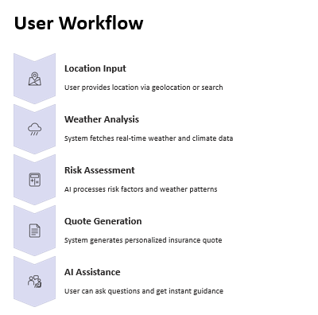
Workflow

Slide 9
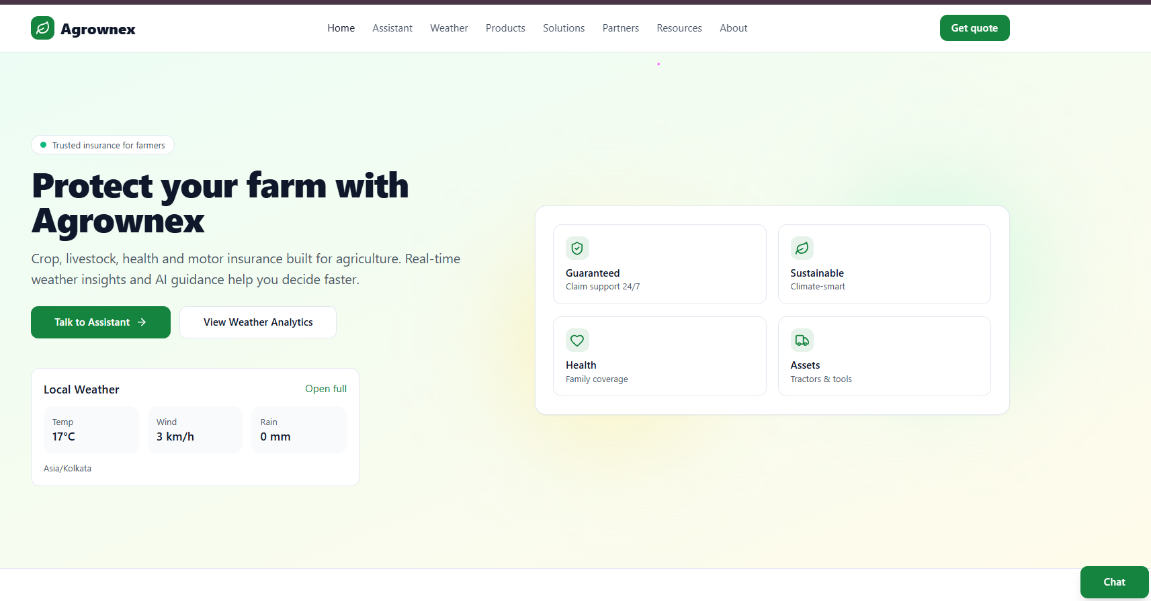
Implementations of Agrownex(Initial Phase)
Homepage

Slide 10
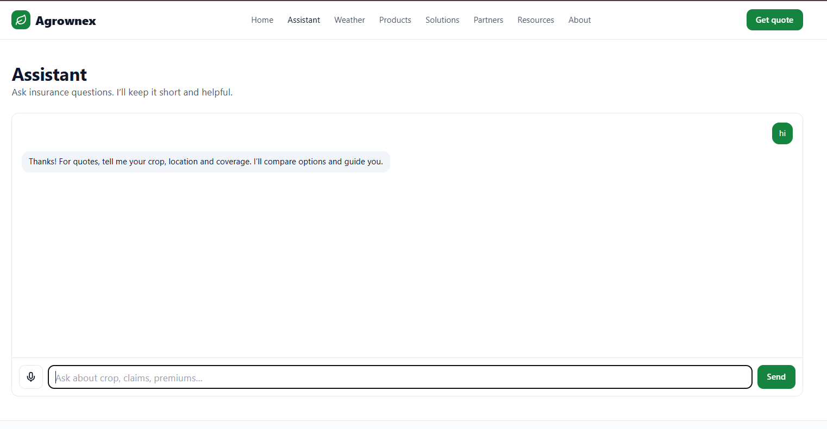
Ai Assistant page

Slide 11
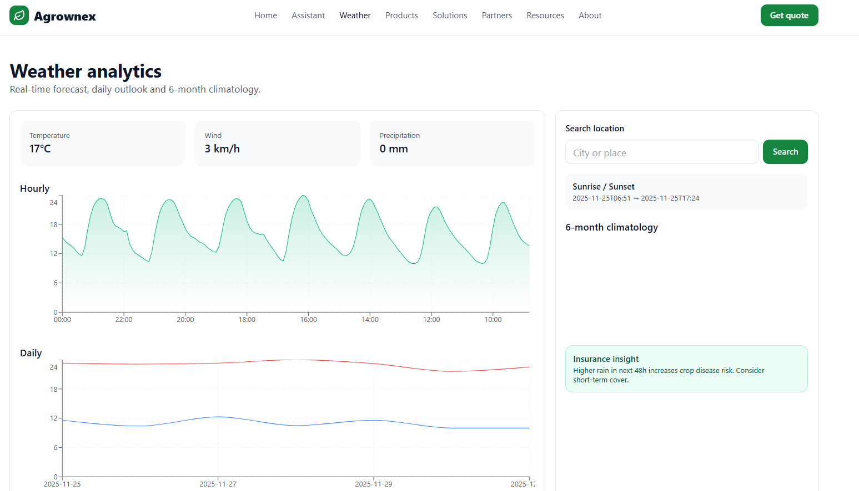
Weather Analytics Dashboard

Slide 12
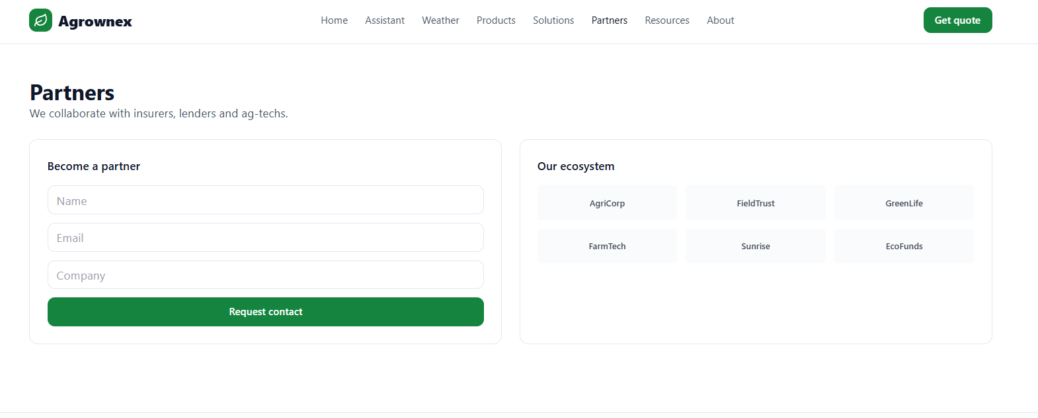
Become an Agent

Slide 13
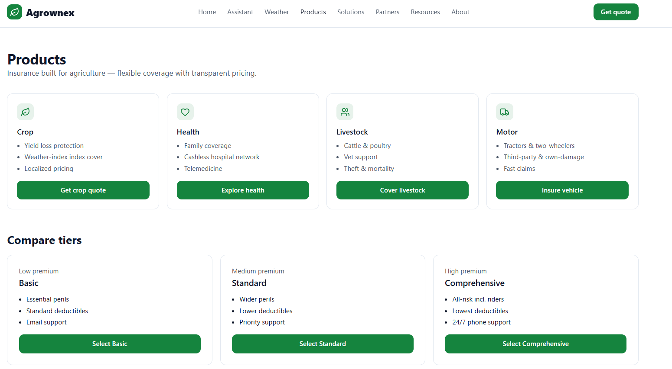
Products(Insurance)

Slide 14
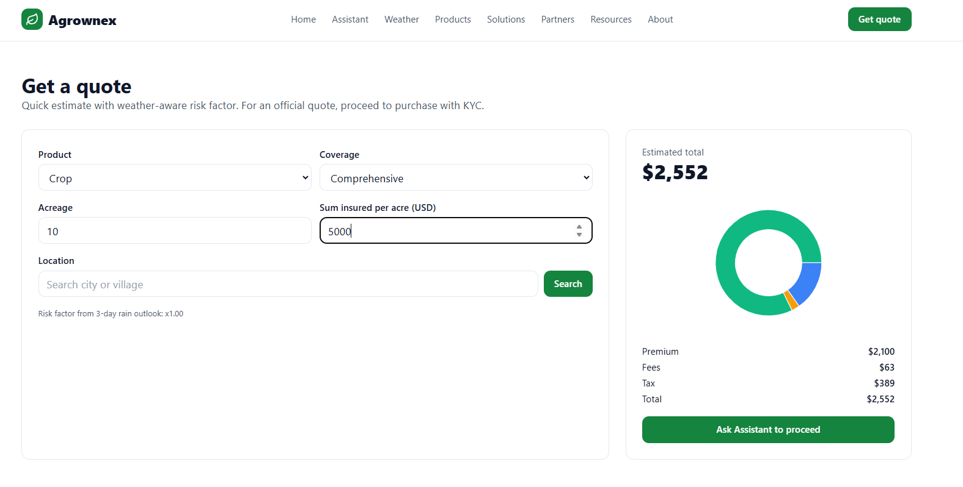
Quote Feature

Slide 15
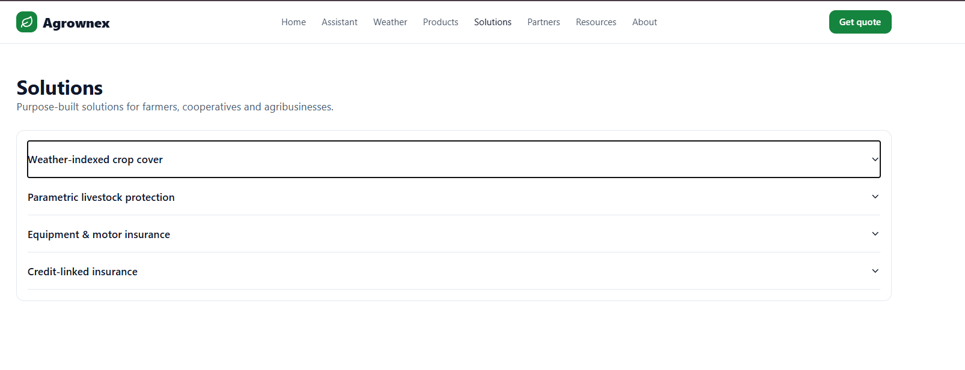
Solutions(Market Situations)

Slide 16
Datasets:
PMFBY (Pradhan Mantri Fasal Bima Yojana) datasets, trends, charts, and insights using three datasets:
Dataset 1: Coverage-level crop data
Year & Season (Kharif/Rabi)
Scheme (PMFBY)
State & District
Crop Name
Sum Insured
Premium Rate
Farmer Share
State Share & GOI Share
Insurance Company details
What this dataset is used for:
Understanding crop insurance coverage
Risk levels
Insurance premium subsidies
Crop-wise and state-wise analysis

Slide 17
Datasets:
Dataset 2: District-level statistics
Number of farmers
Loanee vs Non-Loanee farmers
Area insured
Sum insured
Farmer/government share
Gender-wise breakdown
Category (SC/ST/OBC/GEN)
Farmer types (small/marginal/etc.)
What this dataset is used for:
To understand farmers’ participation
To compare districts
To analyze gender and caste distribution
To calculate premium shares

Slide 18
Datasets:
Dataset 3: Time-series crop production table
What this dataset is used for:
Study production trends
Compare crops across years
Forecast risks
Ministry of Agriculture table
Crop
Season
Production (in lakh tonnes)
Year-wise production estimation

Slide 19
Models:(Why Random Forest & XGBoost?)
Random Forest
Handles tabular data well
Good baseline model
Reduces variance via bagging
Easy to interpret
XGBoost
Boosting technique is strong learning
Handles missing data
Built-in regularization
Usually gives state-of-the-art performance

Slide 20
Evaluation of the model and comparison:

Slide 21
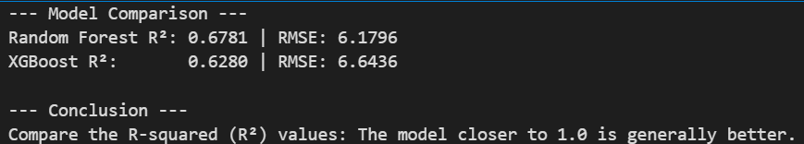
Accuracy of the model

Slide 22
Market analysis
Government-led insurance (PMFBY etc.)
Bajaj Allians
ICICI Lombard
HDFC Ergo
Private MNC’s
Nurture.farm
Gramcover

Slide 23
Conclusion
Where Agrownex Can Position Well
Offering real-time weather analytics + forecasts + risk scoring (e.g. for drought, flood, pests) so farmers can anticipate risk, not just recover after loss.
Integrating a user-friendly AI assistant (voice + text) that helps farmers understand risks, quote insurance options, possibly claim guidance.
Using parametric triggers (weather thresholds) to speed up payouts or at least alerts.
Ensuring hyperlocal data (weather stations / local inputs) so quotes / risk estimates are precise.
Providing transparent risk & quote breakdown (why premium is what it is, how weather contributes, etc).
Faster / simpler UX / lower friction compared to government schemes & big insurers.

Slide 24
Thank You
--------------

