Slide 1
笔记

Slide 2
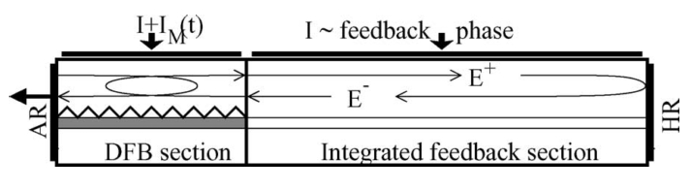
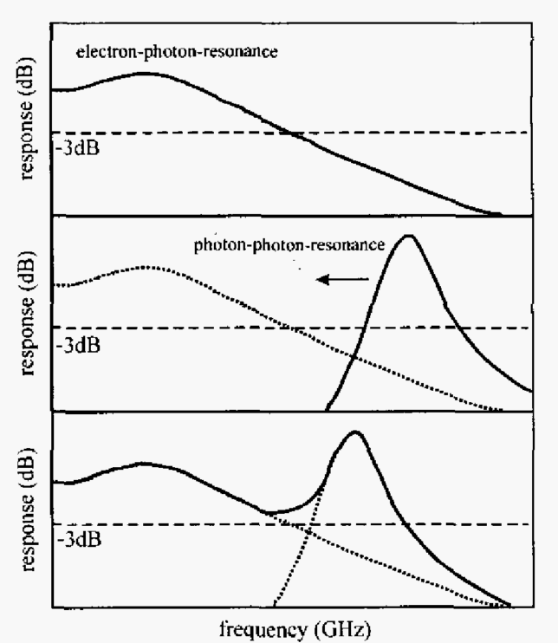
DFB
反馈区+高反层 → 为DFB区提高强的高反馈
This PPR is related to the round-trip frequency of the photons in a laser cavity. For short-cavity high-speed lasers, the PPR is too far away (> 100 GHz) to have an impact on the high-frequency response characteristics. However, by increasing the cavity length, the PPR can he pushed nearer to the ER and a strong enhancement of the 3-dB bandwidth can be expected if the dip between the two resonances can be kept moderate

Slide 3
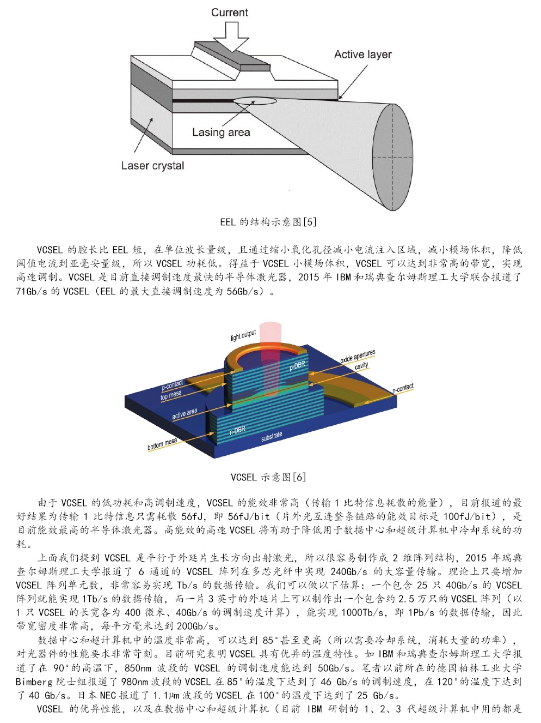

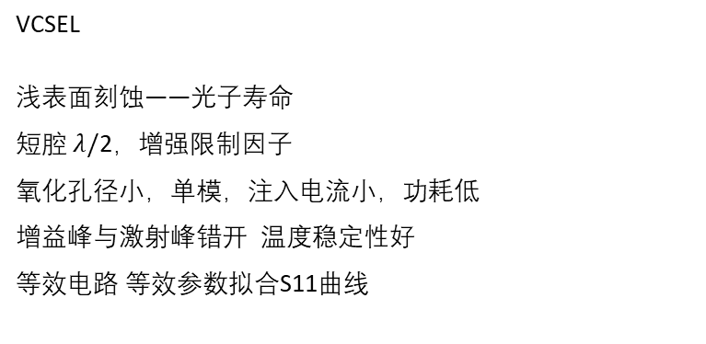
VCSEL
浅表面刻蚀——光子寿命
短腔 $λ/$2，增强限制因子
氧化孔径小，单模，注入电流小，功耗低
增益峰与激射峰错开 温度稳定性好
等效电路 等效参数拟合S11曲线
VCSEL,模场体积小,0.07${μm}^{3}$
VCSEL, 6mW
Microdisk ,40uW

