Slide 1

PROG6212
POE PART 3
ST10313401 CINDY GUAN-YING WU

Slide 2
THIS PRESENTATION SHOWS THE IMPROVEMENTS MADE TO PART 2, FOR THE COMPLETION OF PART 3.
Contract Monthly Claim System: A comprehensive ASP.NET Core web application for managing monthly claims submission, approval, and payroll processing for contract lecturers in educational institutions.

Slide 3
IMPROVEMENTS MADE
- HR:
  HR adds/create all users and adds all information like name, surname, email, hourly rate etc.
  HR can update all user information.
  HR can generate reports or invoices (using LINQ) and is downloadable as PDF.
  -Lecturer:
  Login function added
  When logged in and submitting a claim, name, surname and hourly rate should be pulled from what the HR has added.
  Should have an auto-calculation
  Validation (maximum working hours should not exceed 180 hours).
  EF with a database (integrated with SSMS).

Slide 4
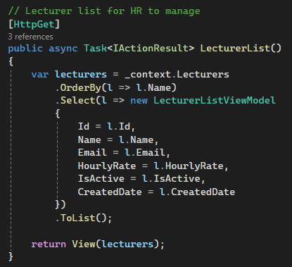
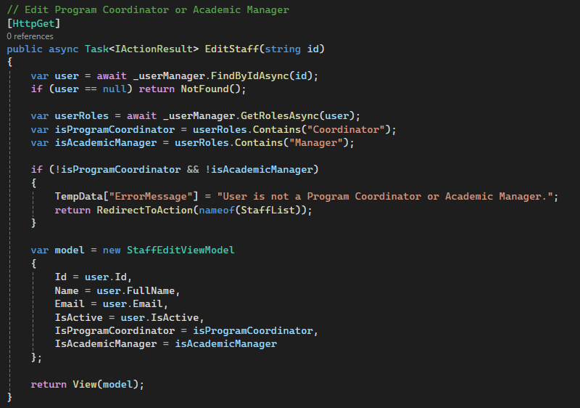
HR: HRController
The HR can:
- Manage lecturer profiles and rates
- Create and manage staff (program coordinators and academic managers) accounts

Slide 5
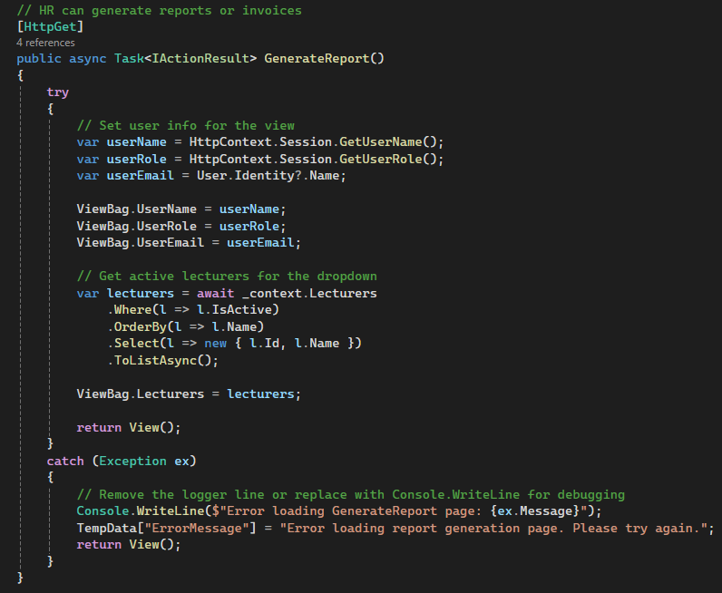
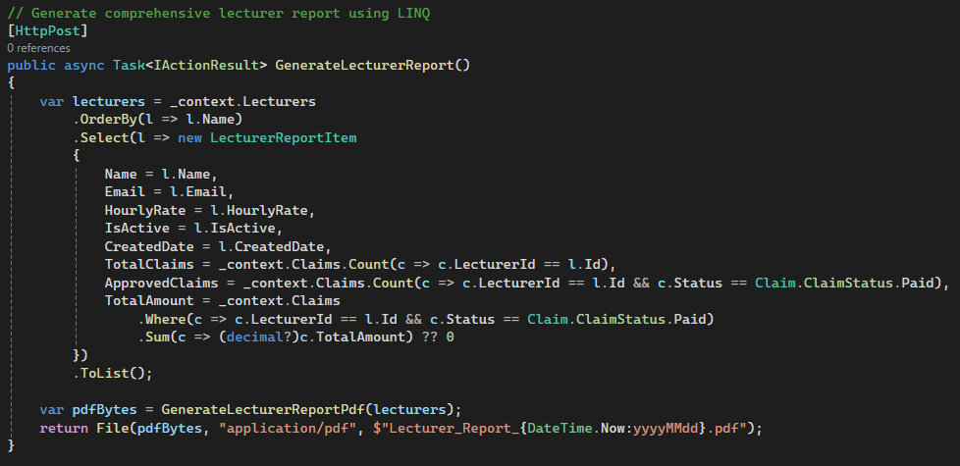
HR: HRController
- Generate comprehensive reports
- Process payroll and generate invoices
- System-wide analytics and monitoring

Slide 6
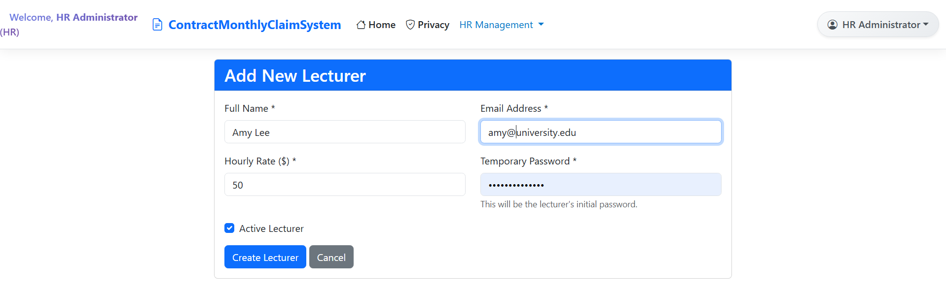
HR: Create lecturer
The HR can add a new lecturer and set an initial login password for the lecturer. Moreover, it can set the lecturer to either be active or inactive.

Slide 7
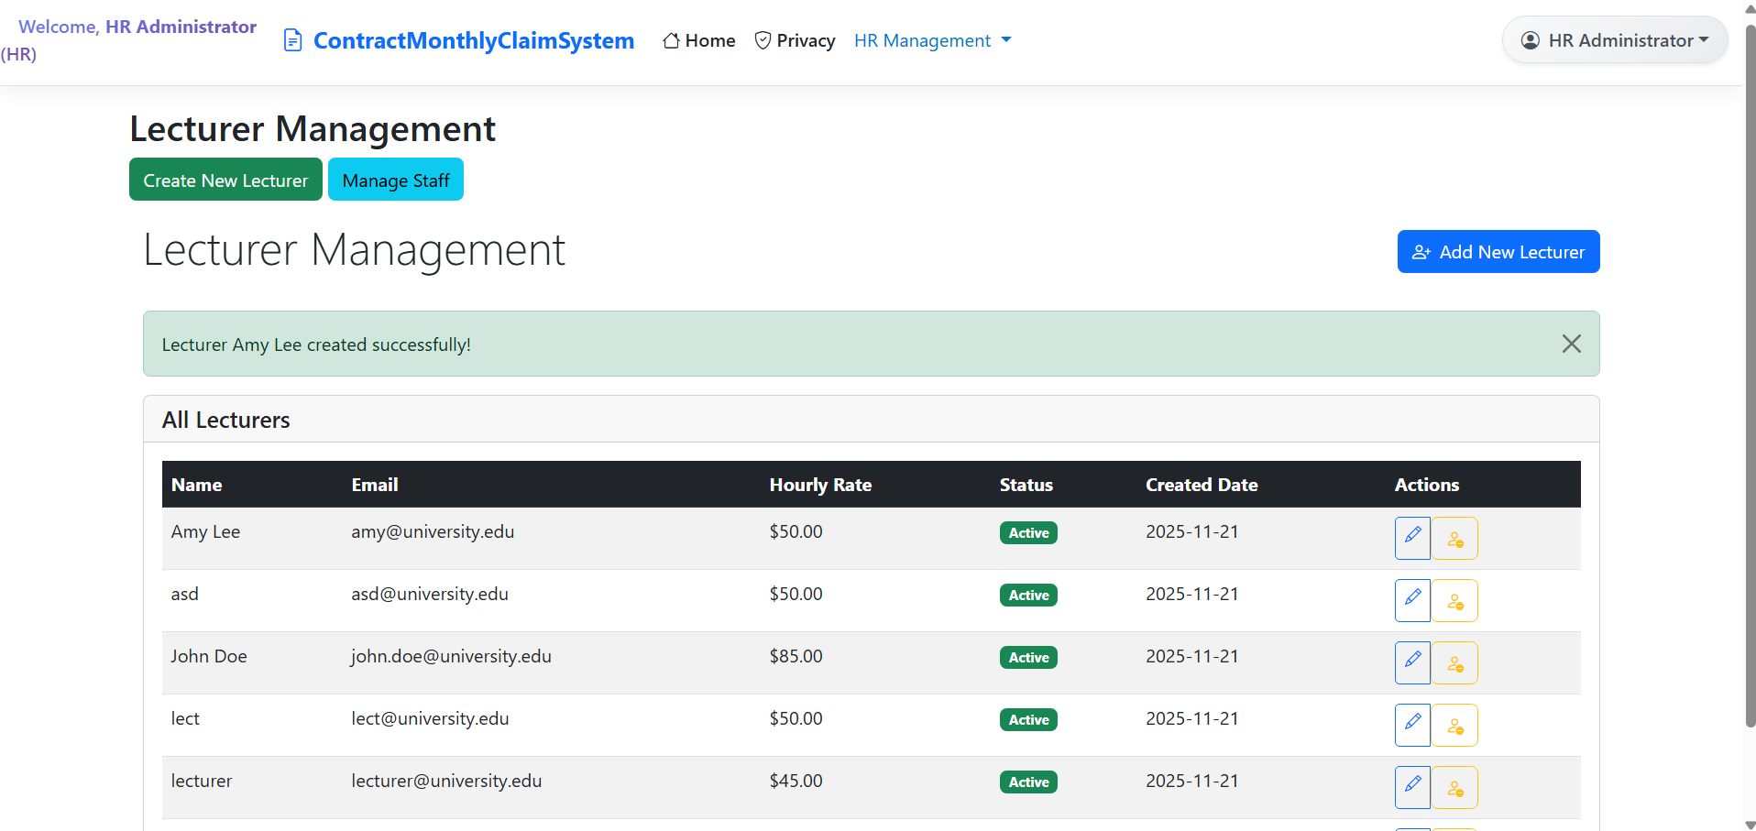
HR: Manage/Edit lecturer
HR can also manage all the lecturers: Edit their details and to activate/deactivate them

Slide 8
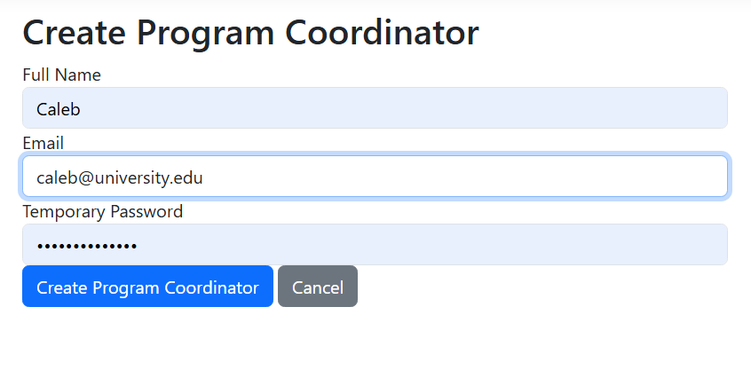
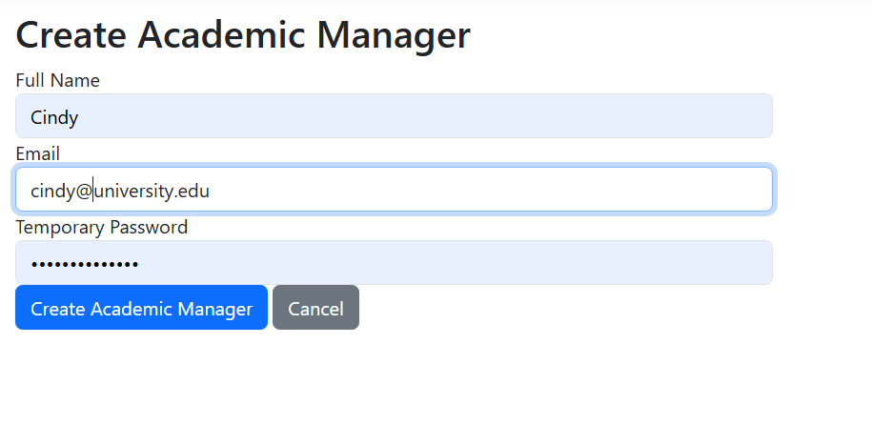
HR: Create coordinator/manager

Slide 9
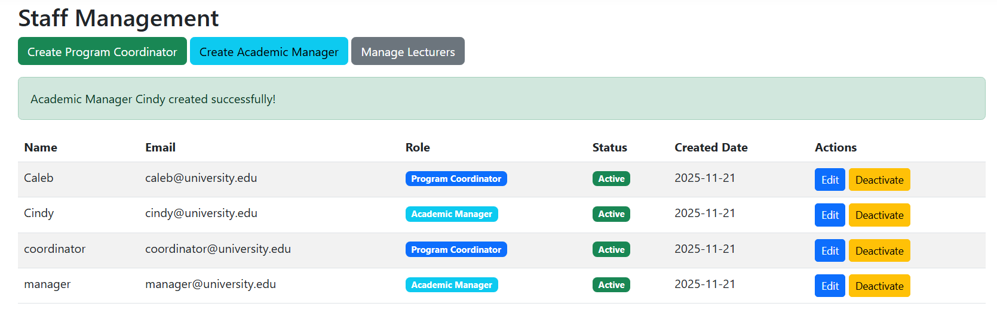
HR: Manage coordinator/manager
HR can also edit activate/deactivate Program Coordinator and Academic Managers.

Slide 10
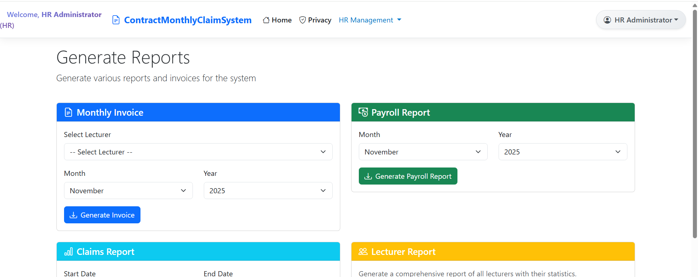
HR: Generate Reports
HR can generate relevant reports including: Monthly invoice, Payroll, Claims report, Lecturers report and Staff report.

Slide 11
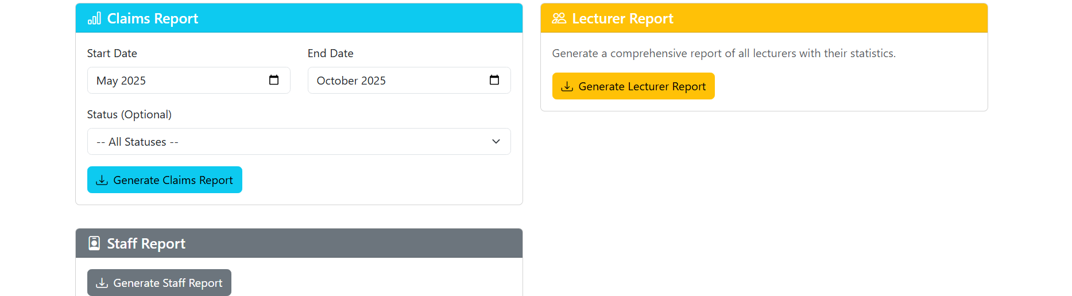
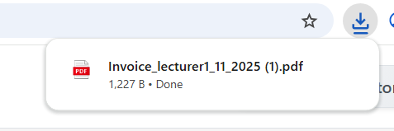
HR: Generate Reports
The reports generated are also downloadable as PDF. This is achieved using LINQ

Slide 12
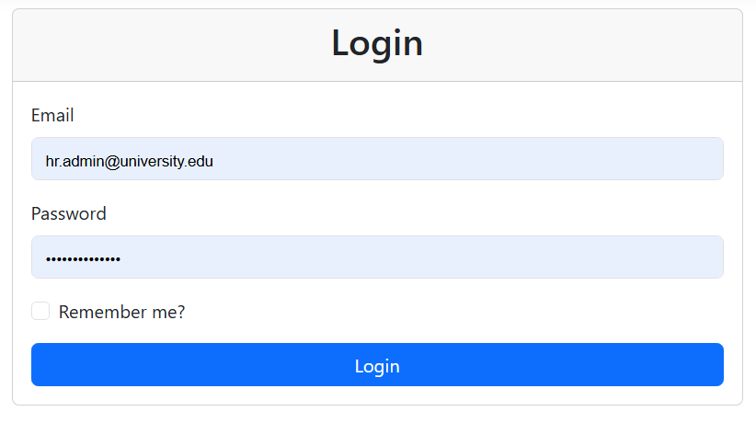
Login
Added login functionality:
To allow certain levels of access of information based on login role.
E.g. HR have full access/ Lecturers have no access to approval page

Slide 13
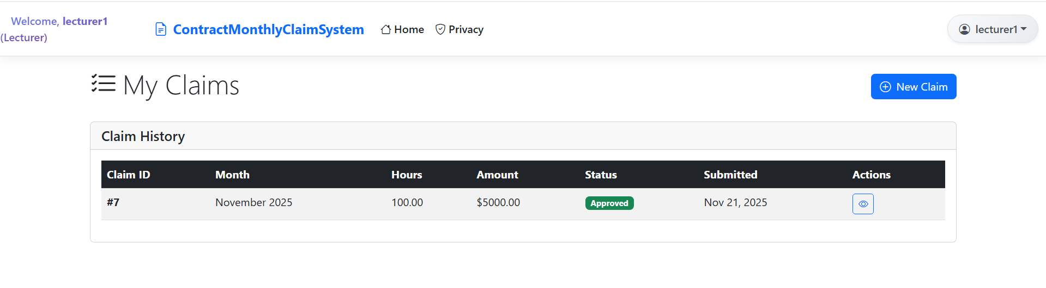
Login: Lecturer
Lecturer logs in but ONLY has access to the page where they can create and view their own claims, but not to approve or edit.

Slide 14
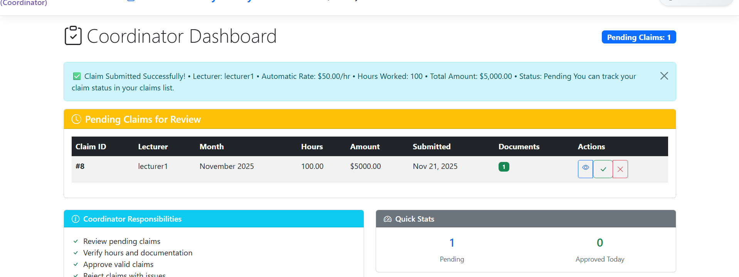
Login: Program Coordinator
- Coordinator logs in and has access to the approval page and approve or reject the claim made by the lecturer.

Slide 15
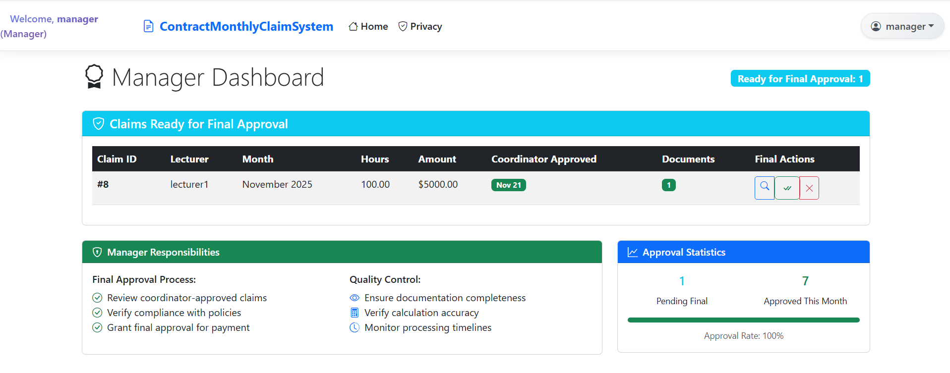
Login: Academic Manager
- The manager logs in and has access to the Final Approval page where he/she can make the final approval or rejection.

Slide 16
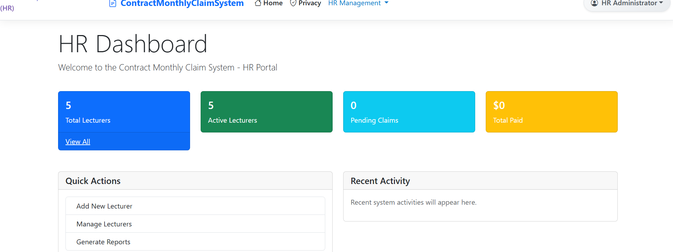
Login: HR
- HR logs in and has access to all manage functions, including add, edit and generate all relevant reports. The HR has full access.

Slide 17
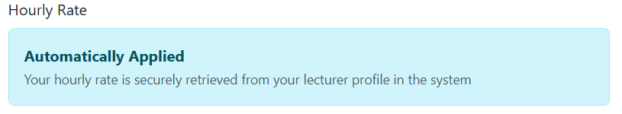

Automatic calculation
- The web app automatically pulls the hourly rate set for each lecturer and automatically calculates the total amount.

Slide 18
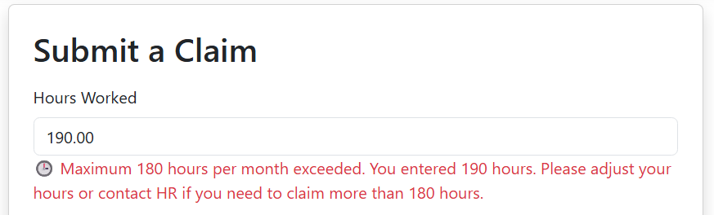
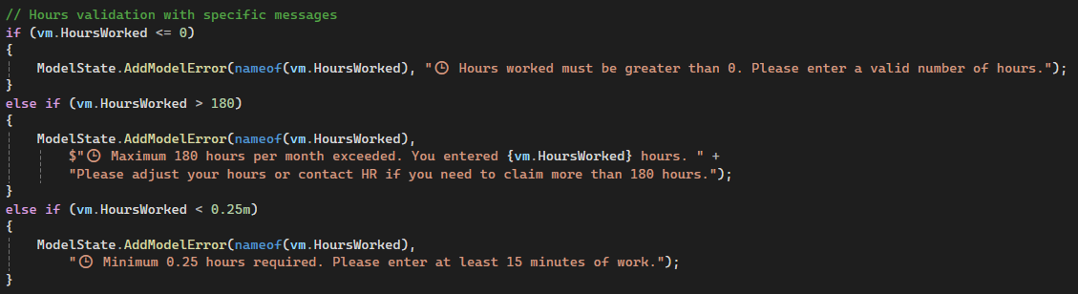
Validation:
The web app validates the working hours.
The maximum working hours is 180 hours.
Thus, the claim cannot be created if the working hours exceeds 180 hours.

Slide 19
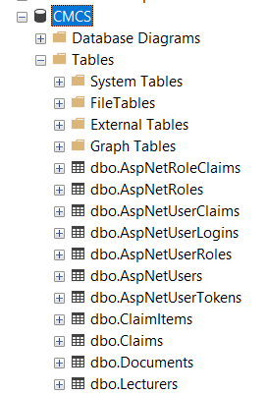
SSMS database integration
The web app has been integrated with the SSMS (SQL Server Management Studio) database.
The connection to the database was formed using the connection string.
Relevant DB (named “CMCS” in this case) and necessary tables are created in the SSMS to store information for each user.

Slide 20


